Slide 1
Student Performance Analysis
Algebra I
Standards of Learning
Notes:
Statewide results for the spring 2014 mathematics SOL tests have been analyzed to determine specific content that may have challenged students. In order to support preparation of students for the Algebra I test, this PowerPoint presentation has been developed to provide examples of SOL content identified by this analysis. It should be noted that these items are not SOL test questions and are not meant to mimic SOL test questions. Instead, they are intended to provide mathematics educators with further insight into the concepts that challenged students statewide.
It is important to keep the content of this statewide analysis in perspective. The information provided here should be used as supplemental information. Instructional focus should remain on the standards as a whole, with school or division level data being used as the focal guiding resource to help improve instruction.

Slide 2
Practice for SOL A.1
Select each phrase that verbally translates this algebraic expression:
One fourth times the cube root of x less five.
One fourth times the cube root of x less than five.
Five subtract one fourth times the cube root of x.
Five less than one fourth times the cube root of x.
Notes:
For SOL A.1 students need additional practice translating expressions. This example asks students to select each phrase that represents a verbal translation of the expression shown. Two of the answer options translate this expression and are boxed in red on the screen. If students are presented with two options similar to the options highlighted in yellow, they have difficulty recognizing how these options differ and do not recognize the last option as a correct translation.

Slide 3
Practice for SOL A.1
Evaluate the following expressions:
a.
b.
c.
4
Notes:
For SOL A.1 students also need additional practice evaluating expressions with cube roots, square roots, and the square of a number, particularly when the replacement variable has a negative value.
The answers to the examples are shown on the screen. For example a, a common student error is to add negative thirty six rather than thirty six. Similarly, a common error for example b is to subtract negative nine rather than nine. For example c, a common error would be to calculate the value under the radicand as negative thirty six plus sixty four rather than thirty six plus sixty four. It is important that students recognize the difference between squaring a negative number and squaring a number and taking its opposite.

Slide 4
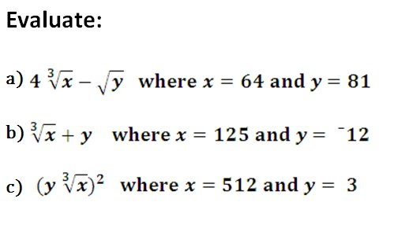
Practice for SOL A.1

Slide 5
Practice for SOL A.1
Translate into an algebraic expression:
The quotient of the square root of x and five
The cube root of the product of x and y, less twelve
The sum of the square root of sixteen and the product of four and the cube root of eight
Translate into a verbal expression:
d)
e)

Slide 6
Practice for SOL A.1
Evaluate the following expressions:
a.
b.
5
Notes:
For SOL A.1 students need additional practice evaluating expressions that contain an absolute value.
A common student error is not taking the absolute value of the quantity inside the absolute value sign when that value is negative. For example, in problem a, this error would result in multiplying negative two times negative five to get a value of ten, rather than multiplying negative two times five to get a value of negative ten.
The answers to the examples are shown on the screen.

Slide 7
Suggested Practice for SOL A.2
Find the quotient:
a)
b)
Simplify:
c) d) e)

Slide 8
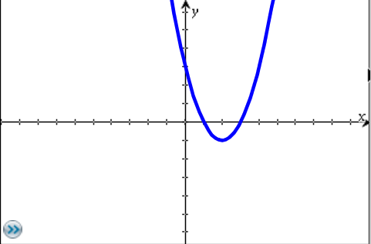
Practice for SOL A.2
What are the apparent factors of the function f(x)?
f(x)
Related questions:
Identify all x- and y-intercepts of the function f(x). (SOL A7.d)
Identify the domain and range of the function f(x). (SOL A7.b)

Slide 9
Practice for SOL A.2a
Simplify: (6x³)² (2x²)²
48x¹³
144x¹⁰
12x⁹
16x⁹
Notes:
For SOL A.2a, students need additional practice applying the laws of exponents when multiplying expressions. The answer to the question is shown on the screen.
For items similar to this example, the most common error is shown on the screen. The most common error students make when determining the coefficient of this product is to multiply the coefficients in the expression, without applying the exponent. This error results in a coefficient of 8. The most common error students make when determining the exponent of the product is to add all of the exponential numbers in the expression. Therefore, in this item, this error would result in an exponent of nine.

Slide 10
Practice for SOL A.2a
Simplify:
a. b.
c. d.
7
Notes:
For SOL A.2a students need additional practice applying the laws of exponents to simplify expressions.
The examples on the screen show some areas of student weakness. For example a, many students will calculate the power of the variable correctly, but will incorrectly calculate the coefficient by not raising the two to the fourth power. Similarly in example b, many students will incorrectly solve this by dividing thirty by six to get five, and then not square the five. Example c is shown because students need more practice recognizing any value raised to the zero power is one. And finally, example d is shown because students need additional practice simplifying expressions with negative exponents.
Students did well on items that required applying the basic rules, such as addition or subtraction of exponents only. For example, students would perform well on example b if the question only asked students to simplify what is inside the parenthesis.
The answers to the four examples are shown on the screen.

Slide 11
Practice for SOL A.2b
1. If , find the quotient of and .
Simplify, if :
Which polynomial is equivalent to this expression if
a. b. c. d.
4
Notes:
For SOL A.2b, students need additional practice dividing polynomials. It would benefit students to practice this skill in both open-response and multiple choice formats.
The answers to the questions are shown on the screen.

Slide 12
Practice for SOL A.2b
a. Find the quotient of and .
b. Simplify the following expression. Assume the denominator does not equal zero.
c. Simplify :
8
Notes:
For SOL A.2b students need additional practice dividing polynomials. Students perform better on simplifying polynomial expressions that involve addition, subtraction and multiplication, but do need additional practice with dividing polynomials. It would be helpful for students to practice this skill in a non-multiple choice format.
The answers to the questions are shown on the screen.

Slide 13
Practice for SOL A.2c
Identify one of the factors of when it is
completely factored.
a. b. c. d.
Identify one of the factors of when it is
completely factored.
a. b. c. d.
5
Notes:
For SOL A.2c, students need additional practice identifying one of the factors of the completely factored form of a polynomial. Students typically perform better on a multiple choice item that asks for the factored form of a polynomial, rather than an item which asks for one of the factors. When an item asks for the factored form of a polynomial, students could work backwards from each answer option by multiplying the factors to determine if the product is the given polynomial. When an item only asks for one factor, it requires students to be able to perform the skill of factoring on the given polynomial.
The answers to the examples are shown on the screen.

Slide 14
Practice for SOL A.2c
Identify all of the factors of when it is completely factored.
9
Notes:
For SOL A.2c students need additional practice completely factoring polynomials, particularly when there is a greatest common factor.
For the example shown, many students would not recognize that the greatest common factor of two is indeed a factor. It is also important to note that four x squared minus nine can be factored into the quantity two x plus three times the quantity two x minus three, and is therefore not a factor of eight x squared minus eighteen when it is completely factored.
The answer to the example is shown on the screen.

Slide 15
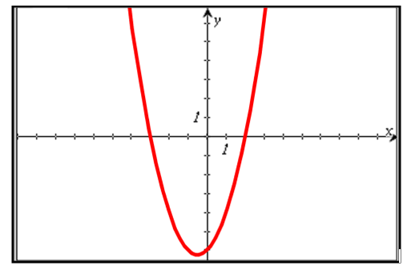
Practice for SOL A.2c
Using two of the factors shown, create a possible equation for the graphed relation.
Notes:
Here is another example for SOL A.2c. Students need additional practice using the x-intercepts from the graphical representation of the polynomial to determine and confirm its factors.
Most students can answer questions that require selection of a factored equation from a list of answer options to match the given graph. However, it is more difficult for them to create the equation from a list of factors.
The answer to the question is shown on the screen.

Slide 16
Practice for SOL A.2c
A polynomial function has zeros at and . Which function could be this polynomial function?
6
Notes:
For SOL A.2c, students need additional practice identifying a factored form of a polynomial function given the zeros. The answer to the example is shown on the screen. The most common error is to use the zero and its sign (positive or negative) in the factored form. For the example shown, the zeros are positive two and positive six, so this common error would result in choosing option C rather than the correct answer, which is option D.

Slide 17
Suggested Practice for SOL A.3
Identify each expression that is in simplest radical form.
8
Notes:
For SOL A.3, students need additional practice identifying expressions that are in simplest radical form, when given a list of expressions. When presented an expression, students should focus on the radicand to make sure that it cannot be further simplified rather than focusing on the term that precedes the radical expression.
The answer to the example is shown on the screen.

Slide 18
Practice for SOL A.3
Completely simplify:
a)
b)
c)
d)

Slide 19
Practice for SOL A.3
Write each expression in simplest radical form.
a.
b.
c.
Notes:
For SOL A.3 students need additional practice simplifying the square root of a monomial algebraic expression.
Students would benefit from experiences that require them to simplify monomial expressions that do not have perfect square coefficients.
The answers to the examples are shown on the screen.

Slide 20
Practice for SOL A.3
Completely simplify:
a)
b)
c)
d)

Slide 21
Practice for SOL A.4
Solve each equation:
a)
b)

Slide 22
Practice for SOL A.4
Solve each equation:
a)
b)

Slide 23
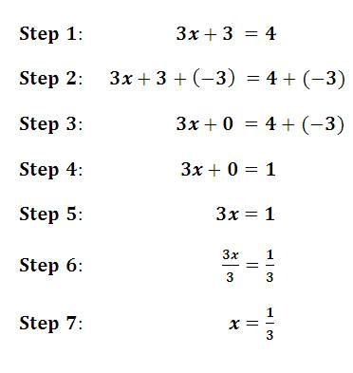
Practice for SOL A.4
Solve for x:
What property justifies the work between each step?

Slide 24
Practice for SOL A.4
Find the solutions or roots of the function.
a)
b)

Slide 25
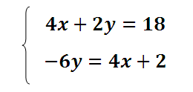
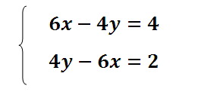
Practice for SOL A.4
Find the x-value of the solution to this equation:
Identify whether this system of equations has one real solution,
no real solution or infinitely many solutions:

Slide 26
Practice for SOL A.4
Solve for x:
What property justifies the work between each step?

Slide 27
Practice for SOL A.4a
The formula for the surface area (S) of a triangular prism is
where h is the height of the prism, p is the perimeter of the base, and B is the area of the base. Solve the equation for the given variable:
a. Solve for h:
b. Solve for B:
14
Notes:
For SOL A.4a students need additional practice solving literal equations.
The answers to the two questions are shown on the screen.

Slide 28
Practice for SOL A.4b
Students need additional practice justifying steps used to solve an equation using the axioms of equality.
What property justifies the work between step 1 and step 2?
Commutative property of addition
Inverse property of addition
Addition property of equality
Associative property of addition
Notes:
For SOL A.4b, students need additional practice justifying steps used to solve an equation using the axioms of equality.
The answer to the question shown on the screen is the Addition Property of Equality because between step 1 and step 2 “2x” is added to both sides of the equation. A common error is to label this as the Inverse Property of Addition, presumably because step 2 shows 2x + -2x. However, the Inverse Property of Addition states that a number a plus its opposite equals 0. That property would be applied in a later step when 2x plus -2x is shown to equal zero.

Slide 29
Practice for SOL A.4c
Identify the solutions to the equation:
a.
b.
c.
d.
Notes:
For SOL A.4c, students need additional practice finding solutions to quadratic equations presented algebraically.
Students would benefit from practice with quadratic equations that are not in standard form, such as in the example provided.
The answer is shown on the screen.

Slide 30
Practice for SOL A.4c
Identify the solutions to the equation:
a.
b.
c.
d.
15
Notes:
For SOL A.4c students need additional practice finding solutions to quadratic equations presented algebraically and graphically.
The answer to the question is shown on the screen.

Slide 31
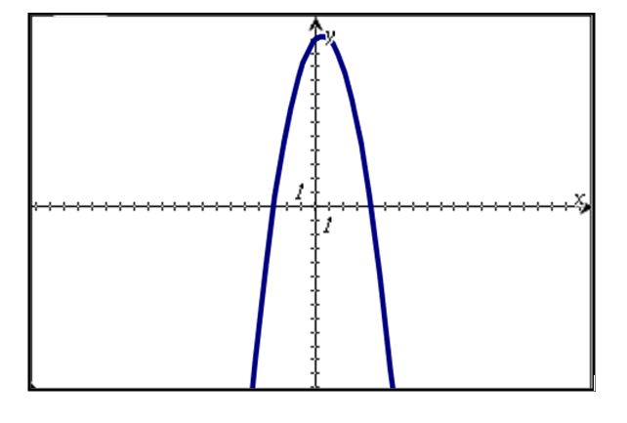
Practice for SOL A.4c
The graph of is shown.
Plot the solutions to .
16
Notes:
Here is another example for SOL A.4c. Students don’t seem to understand that the word “solution” is where the graph of the quadratic equation crosses the x-axis. Students will erroneously plot the y-intercept as a solution, and many times, they will also plot the maximum or minimum as the solution.
The answer to this question in shown on the screen.

Slide 32
Practice for SOL A.4d
1. What is the solution to ?
2. What describes the solution to ?
a. There is an infinite number of real solutions.
b. There are no real solutions.
c. The only solution is 0.
d. The only solution is 5.
12
Notes:
For SOL A.4d, students need additional practice determining solutions to equations that have the following solutions: x =0, an infinite number of real solutions, and no real solutions.
The answers to the examples are shown on the screen.

Slide 33
Suggested Practice for SOL A.4d
Describe the solution to each equation.
a.
b.
c.
Notes:
For SOL A.4d students need additional practice describing solutions to equations that have the following solutions: x =0, an infinite number of real solutions, and no real solutions.
The answers to the examples are shown on the screen.

Slide 34
Practice for SOL A.4d
Find the solution to the equation shown:
a.
b.
c.
d.
Notes:
For SOL A.4d, students need additional practice finding solutions to equations that contain rational expressions, such as the example shown.
The answer to the example is shown on the screen.

Slide 35
Practice for SOL A.4d
Find the solution to the equation shown.
14
Notes:
Students also need additional practice finding solutions to equations that require computation with positive and negative rational numbers.
The answer to the example is shown on the screen.

Slide 36
Practice for SOL A.4e
What is the x-value of the solution to this system of equations?
Notes:
For SOL A.4e, students need additional practice finding the x-value of the solution of a system of equations presented both algebraically and graphically.
The example on the screen presents a system algebraically and asks for the x-value of the solution to the system. The example on the next screen presents a system graphically and asks the same question.
The answer to this example is shown on the screen.

Slide 37
Practice for SOL A.4e
1. Which system of equations has no real solution?
a. b.
c. d.
2. What is x-value of the solution to this system of equations?
18
Notes:
For SOL A.4e students need additional practice finding solutions to systems of equations presented algebraically.
Students are better at identifying the solution to a system of equations when the system is presented graphically. However, when the system is presented algebraically, students have more difficulty. In the first example, students are asked to identify a system of equations with no real solution. Students should be able to compare the slopes of the lines in each system to determine whether the lines are parallel. The second question asks students to find the x-value of the solution to the system of equations.
The answers to both questions are shown on the screen.

Slide 38
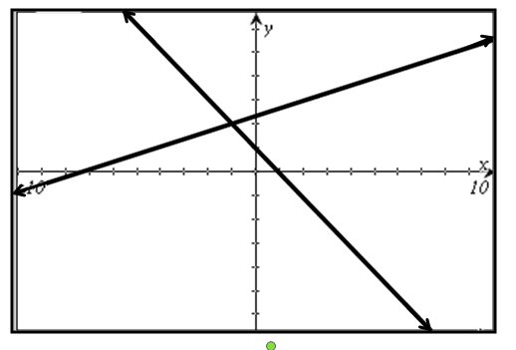
Practice for SOL A.4e
What appears to be closest to the x-value of the solution to this system of equations?
a. c.
b. d.
Notes:
When a system of equations is presented graphically, as in this example, students tend to choose the x-value of an x-intercept of one of the lines as the answer, rather than the x-value of the intersection.
The correct answer is shown on the screen.

Slide 39
Practice for SOL A.4f
James bought a total of 15 bottles of drinks for his team.
Each drink was either a bottle of water or a bottle of juice.
He spent $1.50 on each bottle of water.
He spent $3.00 on each bottle of juice.
James spent a total of $28.50.
How many bottles of juice did James buy?
17
Notes:
For SOL A.4f, students need additional practice finding solutions to systems of equations presented in a real-world situation. Students had a difficult time finding solutions when they had to write the system from given information and then find the solution.
The answer to the example is shown on the screen.

Slide 40
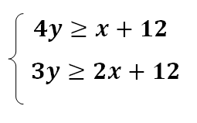
Practice for SOL A.5
Graph the solution to the system of inequalities:
a) Name two points that are in the solution set.
b) Select the point(s) that are part of the solution set:
(-7,-2) (-6,0) (-6,1) (-4,2) (-4,4) (-3,0) (2,3) (4,4)

Slide 41
Practice for SOL A.5
Solve and graph on a number line:

Slide 42
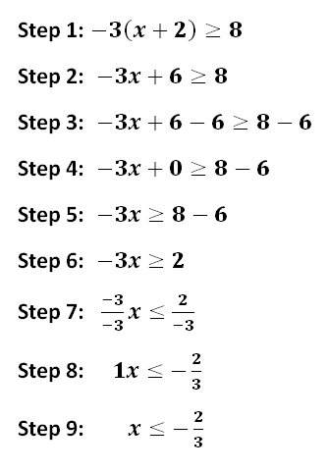
Practice for SOL A.5a
An inequality is solved as shown.
Between which two steps is an
error made? Explain the error.
Notes:
For SOL A.5a students need additional practice solving multistep inequalities.
One way in which this standard is assessed is identifying where a mistake has been made in the steps shown for solving. The answer to this example is shown on the screen. An extension could be to incorporate practice for SOL A.5b by asking students which property justifies the work between two consecutive steps.

Slide 43
Practice for SOL A.5b
Given:
Using the given inequality, select all that illustrate the application of the subtraction property of inequality.
Notes:
For SOL A.5b students need additional practice identifying properties of inequality.
This question asks students to identify all inequalities that illustrate the subtraction property of inequality. The answers are shown on the screen.
As an extension ask students to identify the property illustrated by each of the answer options not selected.

Slide 44
Practice for SOL A.5d
1. Which ordered pairs are solutions to this system of inequalities?
Which ordered pair is a solution to this system of inequalities?
a. b. c. d.
Notes:
For SOL A.5d, students need additional practice identifying ordered pairs that are solutions to a system of inequalities.
When providing practice, students should be given the opportunity to work with inequalities that are presented in multiple formats, including standard form.
The answers to the examples are shown on the screen.

Slide 45
Practice for SOL A.5d
Which ordered pairs are solutions to this system of inequalities?
$$\left(−4,−3\right) \left(0,−4\right) \left(1,1\right) \left(1,3\right) \left(3,−1\right) \left(4,3\right) (6,0)$$
Notes:
For SOL A.5d students need additional practice identifying ordered pairs that are solutions to a system of inequalities.
Students do well when selecting solutions from a graph, or when asked to shade the region of the graph that is the solution to the system of inequalities. They do not do as well when they have no visual representation of the system.
The answers to the example are shown on the screen.

Slide 46
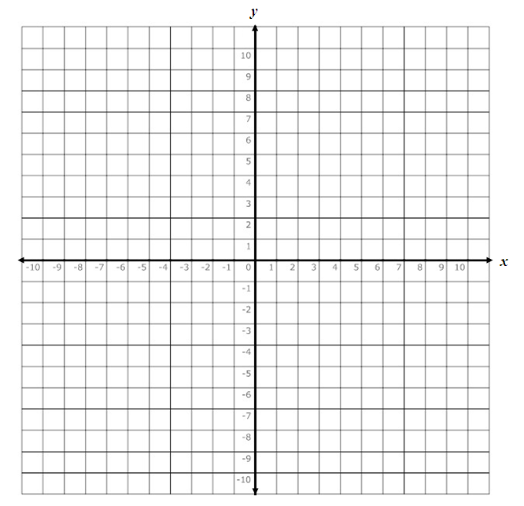
Practice for SOL A.6
Plot two points that lie on the line:
a)
b)
*A related question would be to ask students to name the slope
of these two lines.

Slide 47
Practice for SOL A.6
Write the equation of a line that:
Passes through the point (4,-2) and has an x-intercept of 3
Passes through the point (5,1) and has a y-intercept of -3
Graph the lines represented in a and b above.

Slide 48
Practice for SOL A.6a
Find the slope of the line passing through the points (8,1) and
(6,9).
Line p line has an x-intercept of 5 and a y-intercept of 3.
Find the slope of line p.
Extension: What is an equation for line p?
Notes:
For SOL A.6a, students need additional practice finding slope. As an extension to example #2, ask students to determine an equation for line p.
The answers are shown on the screen.

Slide 49
Practice for SOL A.6a
Find the slope, m, of the line represented by the given equation.
a.
b.
c.
24
Notes:
For SOL A.6a students need additional practice finding slope. Equations should be presented to students in different formats.
The answers to the questions are shown on the screen.

Slide 50
Practice for SOL A.6a
Find the slope of the line passing through the points (6,3) and
(4,2).
Find the slope of the line passing through the point (5,1) with an
x-intercept of 4.
25
Notes:
Here are two more examples for SOL A.6a. In the second example, students will need to think about the x-intercept as a point in order to find the slope of the line.
The answers are shown on the screen.

Slide 51
Practice for SOL A.6
Given:
a. What is the slope of the line represented by this equation?
b. What is the y-intercept of the line represented by this equation?
c. Graph the line represented by this equation.
26
Notes:
Here is another example that contains questions that are correlated to standards A.6 and A.7.
The answers are shown on the screen.

Slide 52
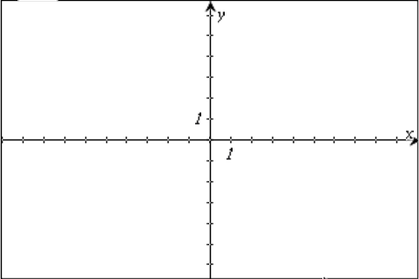
Practice for SOL A.6b
Graph the inequality .
27
Notes:
Here is another example for SOL A.6b. Students would benefit from experiences graphing an inequality presented in varied formats.
The answer is shown on the screen.

Slide 53
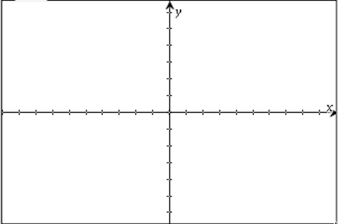
Practice for SOL A.7
Graph these functions on a coordinate plane and identify the zeros of
the function:
a)
b)
c)

Slide 54
Practice for SOL A.7b
What appears to be the range of the relation shown?
a.
b.
c.
d.
29
Notes:
For SOL A.7b students need additional practice identifying the domain and range from a graph.
It is important for students to recognize that the range for this set of points consists of discrete values, as indicated on the screen, and is not a range of values, as indicated in option b.

Slide 55
Practice for SOL A.7b
What appears to be the domain of the relation shown?
All real numbers greater than -1
All real numbers greater than 2
All real numbers less than 10
All real numbers
30
Notes:
Here is another example for SOL A.7b.
The answer is shown on the screen.

Slide 56
Practice for SOL A.7c
Which function appears to have two distinct zeros?
a.
b.
c.
d.
2. What are all the zeros of the function ?
23
Notes:
For SOL A.7c, students need additional practice identifying the zeros of a function presented algebraically.
The answers to the two examples are shown on the screen.

Slide 57
Practice for SOL A.7c
Graph each function and then plot a point at the location of the zero.
a.
b.
c.
31
Notes:
For SOL A.7c students need additional practice finding zeros of linear functions. A common error is for students to substitute zero into the equation for the variable x, erroneously selecting the y-intercept as the location of the zero.
The answers to the questions are shown on the screen.

Slide 58
Practice for SOL A.7c
a. What are the zeros of the function ?
b. What are the zeros of the function ?
Notes:
For SOL A.7c students also need additional practice finding zeros of quadratic functions presented algebraically.
The answers to the two examples are shown on the screen.

Slide 59
Practice for SOL A.7d
What are the x- and y- intercepts of the function ?
a. x- intercept of $\left(0,\frac{8}{3} \right)$ and y- intercept of $\left(−8,0\right)$
b. x- intercept of $\left(0,−\frac{8}{3} \right)$ and y- intercept of $\left(8,0\right)$
c. x- intercept of $\left( \frac{8}{3} ,0\right)$ and y- intercept of $\left(0,−8\right)$
d. x- intercept of $\left( −\frac{8}{3} ,0\right)$ and y- intercept of $\left(0, 8\right)$
Notes:
For SOL A.7d students need additional practice identifying the x- and y-intercepts of a function.
For this example, students are asked to find both the x- and y-intercepts of a linear function.
The answer is shown on the screen.

Slide 60
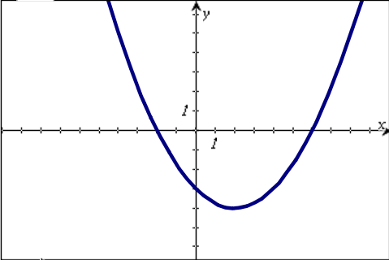
Practice for SOL A.7d
Plot the x- and y-intercepts of the relation shown on the graph.
34
Notes:
Here is another example for SOL A.7d. This example asks students to plot the x- and y- intercepts of a relation presented graphically.
The answers are shown on the screen.

Slide 61
Practice for SOL A.7e
Find the values of for the domain values of .
24
Notes:
For SOL A.7e, students need additional practice identifying the values of a function for given domain values. For this standard, students would benefit from varied presentations of this concept.
Using the example on the screen, students would typically perform very well on an alternate version of this item such as: “Evaluate f(-3) for the function f(x)=9x^2+1,” or “Evaluate f(6) for the function f(x)=9x^2+1.” Presenting the domain in set notation and/or specifically using the word “domain” in the question helps students make the connection that the values they are calculating using -3 and 6, respectively, are the corresponding range values for the specific domain values. Examples such as this help make the connection that the ordered pairs (-3,82) and (6,325) lie on the function.
The answers to this question are shown on the screen.

Slide 62
Practice for SOL A.8
The number of calories, c, burned while walking is directly proportional to the distance, d, a person walks. Tom burned 180 calories walking a distance of 2 miles. Which equation represents this relationship?
a.
b.
c.
d.
26
Notes:
For SOL A.8, students need additional practice identifying a direct variation equation algebraically and graphically. Students did well when they had to identify a direct variation from a table of values. However, they had a more difficult time identifying the equation that represented a direct variation described in a practical application.
The answer to the example is shown on the screen.

Slide 63
Practice for SOL A.8
Select three of these points that will create a relation that is a
direct variation.

Slide 64
Practice for SOL A.8
Point A (-3,3) lies on a line that represents a direct variation
equation. Plot three other points on that line.
A

Slide 65
Practice for SOL A.8
This chart shows how the cost per person to rent a vacation home varies with the
number of people in a group.
Cost Per Person to Rent a Vacation Home
Which statement is true about the relationship?
It is a direct variation relationship because .
It is a direct variation relationship because .
It is an inverse variation relationship because .
It is an inverse variation relationship because .
Number of People in Group | Cost Per Person ($)
5 | 530.00
8 | 331.25
10 | 265.00
20 | 132.50

Slide 66
Practice for SOL A.8
Given this set of ordered pairs:
a. Select three points that will create a direct variation relation.
b. Select three points that will create an inverse variation relation.
Notes:
For SOL A.8 students need additional practice selecting ordered pairs from a list to make a relation that is a direct or inverse variation.
The answers to the examples are shown on the screen. In addition, students need to be able to identify which set of ordered pairs, when presented as answer options, represent a direct or inverse variation.

Slide 67
Practice for SOL A.8
Identify the equations that represent a direct variation.
37
Notes:
For SOL A.8 students also need additional practice identifying a direct variation equation algebraically and graphically.
The answers to the example are shown on the screen.

Slide 68
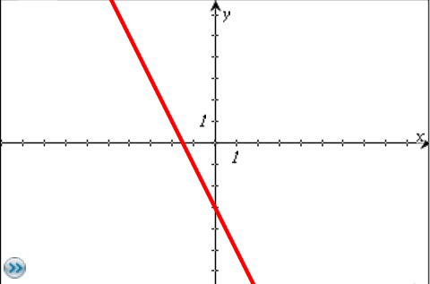
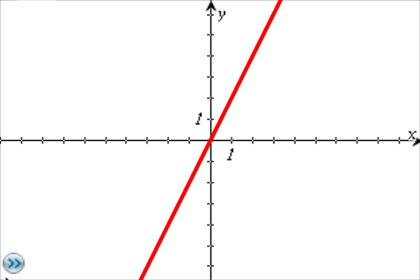
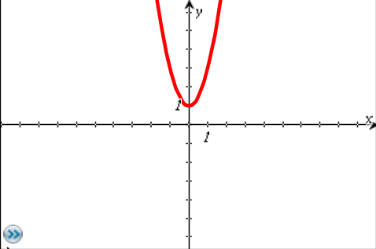
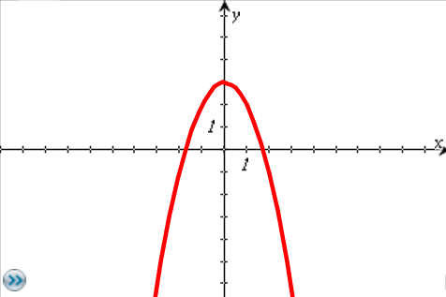
Practice for SOL A.8
Identify the graph of a direct variation.
38
Notes:
Here is an example that requires identification of a graph of a direct variation. The answer is shown on the screen.

Slide 69
Practice for SOL A.8
Create a direct variation using two of the ordered pairs from those shown.
27
Notes:
For SOL A.8, students need additional practice creating a direct variation from a set of ordered pairs. Students should realize that every direct variation passes through the origin. Using the origin and the given point (-5,-2), students should be able to determine the equation of the direct variation, which in this example, is y=(2/5)x. Once they have the equation of the direct variation, they should be able to select the points from the list that lie on the line. There are other strategies which can be used to solve this problem and a discussion with your students of various strategies is encouraged.
The answers to the example are shown on the screen.

Slide 70
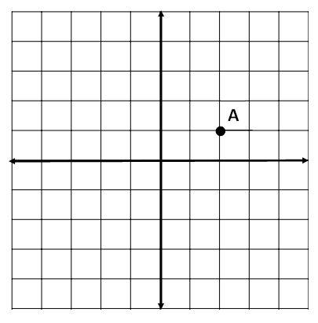
Practice for SOL A.8
Point A lies on the graph of a direct variation. Identify two other points with integral coordinates that lie on the graph of the direct variation.
y
x
28
Notes:
For SOL A.8, students also need additional practice identifying a direct variation graphically.
Using their knowledge of slope and that every direct variation passes through the origin, students should be able to identify additional points that lie on the graph of the direct variation.
The answers to the example are shown on the screen.

Slide 71
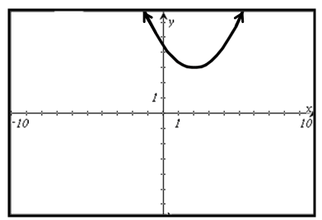
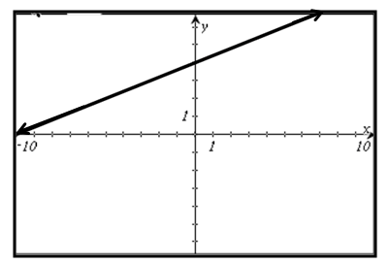
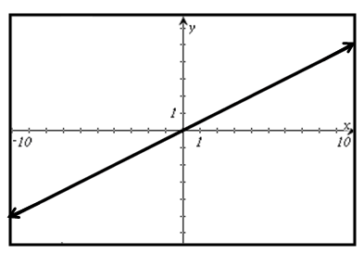
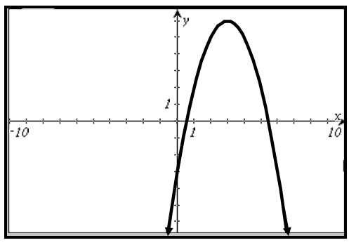
Practice for SOL A.8
Identify the graph that represents a direct variation.
Notes:
When presented a variety of graphs, students had difficulty identifying the graph that represents a direct variation. The answer is shown on the screen.

Slide 72
Practice for SOL A.8
The number of days, d, it takes workers to set-up for the Summer Music Festival varies inversely as the number of workers, w. The Summer Music Festival was set-up in 2 days by 50 workers. Which equation represents this situation?
a.
b.
c.
d.
Extension: How many days would it take 60 workers to set up for the Summer Music Festival?
30
Notes:
For SOL A.8, students also need additional practice identifying an inverse variation equation that represents a real-world situation.
The answer to the example is shown on the screen.
As an extension, ask students how many days it would take 60 workers to set-up for the Summer Music Festival. The answer is shown on the screen.

Slide 73
Practice for SOL A.9
A data set is shown.
If the standard deviation of the data set is approximately 1.25, how many of these elements are within one standard deviation of the mean?
32
Notes:
For SOL A.9, students need additional practice performing calculations with statistical information.
For the data set shown, the mean is 4.2. In order to determine how many elements are within one standard deviation of the mean, subtract the standard deviation from the mean, and add the standard deviation to the mean to find the interval in which values within one standard deviation lie. For the example on the screen, any data elements that are greater than or equal to 2.95 and less than or equal to 5.45 are within one standard deviation of the mean. The answer is shown on the screen.

Slide 74
Practice for SOL A.9
a. A data set has a mean of 55 and a standard deviation of 3.5. The z-score for a data point is -1.2. What is the data point?
b. A data set has a standard deviation of 3. The element 16 is an element of a data set, with a z-score of 2.4. What is the mean of the data set?
Notes:
For SOL A.9 students need additional practice performing calculations with statistical information.
The answers to the two examples are shown on the screen.

Slide 75
Practice for SOL A.9
A teacher gave a quiz. The following stem-and-leaf plot shows the
scores of the students in her class.
Quiz Scores
STEM | LEAF
4 | 0
5 | 0 0
6 | 0 0 0
7 | 0 0 0 0
8 | 0 0 0
9 | 0 0
10 | 0
The mean score of this data set is 70 and the standard deviation (rounded to the nearest tenth) is 15.8.
Which scores are within one standard deviation of the mean?
Key: 6|0 equals 60

Slide 76
Practice for SOL A.9
A data set has a mean of 16.5 and a standard deviation of 3.
The element x has a z-score of 1.5. In which interval does the
element lie?
10.5 ≤ x < 13.5
13.5 ≤ x < 16.5
16.5 ≤ x < 19.5
19.5 ≤ x < 22.5
22.5≤ x < 25.5

Slide 77
Practice for SOL A.9
The number of minutes book club students read on Monday night is displayed by the graph. The mean number of minutes for this data set is 21.18, and the standard deviation of the data set is 6.5. The z-score for the data point representing the number of minutes Tim read is 1.25. In which interval does this data point lie?
Notes:
Here is another example for SOL A.9. This example asks students to identify an interval in which a data point lies. Intervals can be presented graphically, as in this example, or algebraically.
The answer to this question is shown on the screen.

Slide 78
Practice for SOL A.9
A data set has a mean of 45. An element of this data set
has a value of 50 and a z-score of 0.75. What is the
standard deviation for this data set, rounded to the nearest
hundredth?
Use two of the three numbers shown in the list to complete this sentence.
A data set could have a variance of and a standard
deviation of .
9 40.5 81
Notes:
For SOL A.9, students need additional practice performing calculations with statistical information and understanding the relationship between variance and standard deviation.
The answers to the two examples are shown on the screen.
As an extension to example #2, ask students to give other numbers that would accurately complete the sentence. Students should realize that the standard deviation of a data set is the square root of the variance.

Slide 79
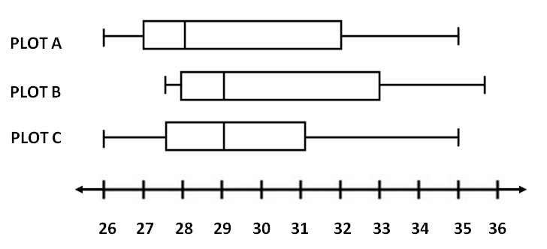
Practice for SOL A.10
Which two plots appear to have the same value for the range?
Which two plots appear to have the same value for the interquartile range?
Which two plots appear to have the same value for the median?
Notes:
For this standard, students need additional practice identifying and comparing basic values associated with box-and-whisker plots: the range, interquartile range, and median. The range is the difference between the upper and lower extremes. The interquartile range is the difference between the upper quartile (Q3) and the lower quartile (Q1). The median value (Q2) can be found by locating the vertical line in the box, between Q1 and Q3.
The answers to the questions are shown on the screen. The next slide shows these same box-and-whisker plots with a different question format.

Slide 80
Practice for SOL A.10
Each of these box-and-whisker plots contain 15 unique elements.
Write a statement comparing the range of both plots.
2. Which box-and-whisker plot has the greater interquartile range?
3. Which data set has more elements with a value of 11 or greater?
Notes:
For SOL A.10 students need additional practice interpreting data plotted in box-and-whisker plots.
Students struggle with vocabulary, such as range and interquartile range. They have difficulty calculating and comparing the range and interquartile range of two or more plots. Students also need practice comparing plots that have a specified number of elements. For instance, the third question requires students to sketch out Plots A and B and determine how many elements of each plot meet a given criteria.
The answers to the questions are shown on the screen.

Slide 81
Practice for SOL A.10
This box-and-whisker plot represents nine pieces of data. No number is repeated.
The number 23 is removed from the data set and a new box-and-
whisker plot is drawn. Compared to the values in the original box-and-
whisker plot, describe the changes to each of these values (increases,
decreases or stays the same):
the lower extreme
the lower quartile
the median
the upper quartile
the upper extreme

Slide 82
Practice for SOL A.10
Each of these box-and-whisker plots represents a data set with 10 distinct elements.
Which statements about these plots appear to be true?
There are more elements in the lower quartile of plot B than plot A, because the left whisker of plot B is longer than the left whisker of plot A.
Since both data sets have 10 distinct elements, the box of plot A and the box of plot B contain the same number of elements.
There are fewer elements in the upper quartile of plot B than plot A, because the right whisker of plot B is shorter than the right whisker of plot A.
The interquartile range of plot A is greater than the interquartile range of plot B.
The range of both plots are equal.

Slide 83
Practice for SOL A.10
Plot A represents the total number of songs downloaded by each of 15 students in Mr. Archer’s class during October. Each student in Mr. Archer’s class downloaded a different number of songs from the others.
Plot B represents the total number of songs downloaded by each of 20 students in Mrs. Baker’s class during October. Each student In Mrs. Baker’s class downloaded a different number of songs from the others.
During the month of October, what is the difference between the number of students who downloaded more than 6 songs in Mrs. Baker’s class and the number of students who downloaded more than 6 songs in Mr. Archer’s class?
Notes:
Here is another example for SOL A.10. This question requires students to determine how many data points in each plot meet a certain criterion.
The answer is shown on the screen.

Slide 84
Practice for SOL A.10
This box-and-whisker plot summarizes the number of pieces of pizza each of ten volunteers served at a concession stand one night.
Another volunteer served 16 pieces of pizza that night, and 16 is added to the original data set. A new box-and-whisker plot is drawn. Which two statements comparing the new box-and-whisker plot to the original box-and-whisker plot must be true?
The interquartile range of the box-and-whisker plot increases.
The range of the box-and-whisker plot increases.
The value of the upper extreme increases.
The value of the median increases.
Notes:
Here is an example that requires students to determine the affect on a box and whisker plot when an element is added to the data set. Paying attention to the location of the new element within the original data set helps students determine whether or not certain conclusions can be drawn. It is very important for students to realize that some statements cannot be proven true using the box and whisker plot, since the elements themselves are not given. Students must draw conclusions based only on the information that is given.
For instance, the statement, “The interquartile range of the box-and-whisker plot increases,” may be true or false, depending on the data set. Likewise the location of the median of the data set will change, but the value of the median may or may not increase. The only two statements that will always be true are the ones indicated on the screen.

Slide 85
Practice for SOL A.10
Which statement appears to be true regarding the box-and-whisker plots shown?
The interquartile range of the data for plot A is greater than the interquartile range of the data for plot B.
The upper extreme of the data for plot A is greater than the upper extreme of the data for plot C.
The range of the data in plot A is the same as the range of the data in plot C.
The median of the data in plot A is greater than the median of the data in plot B.
36
Notes:
This question asks students to identify the true statement about these box-and-whisker plots. Again, students are comparing the basic values associated with the plots: range, interquartile range, and median. This item also has a statement about the upper extreme that needs to be evaluated.
The answer to the question is shown on the screen.

Slide 86
Practice for SOL A.11
This set of ordered pairs shows a relationship between x and y.
Which equation best represents this relationship?
a.
b.
c.
d.
Extension: Using the curve of best fit, what is the value of y, rounded to the nearest whole number, when the value of x is 8?
38
Notes:
For SOL A.11, students need additional practice determining the linear or quadratic curve of best fit for a set of data. Students should be able to determine whether the curve of best fit is linear or quadratic, and then choose the equation which best models the data.
The answer to the question is shown on the screen.
As an extension, have students predict the value of y, rounded to the nearest whole number, when the value of x is 8.
The answer is shown on the screen.

Slide 87
Practice for SOL A.11
This set of ordered pairs shows a relationship between x and y.
What is the equation for the quadratic curve of best fit for this
set of data?
b. Predict the value of y when x = 8.
Notes:
For SOL A.11 students need additional practice making predictions using the linear or quadratic curve of best fit.
Students performed better when they had to predict from a graph or find the equation of a line of best fit when the data points were presented on a graph. When data was presented in set form or in a table, students had more difficulty finding the curve of best fit and making a predication.
The answers to the questions are shown on the screen.

Slide 88
Practice for SOL A.11
Determine the quadratic curve of best fit for the data. Then
estimate what the value of y will be when x = -4.

Slide 89
Practice for SOL A.11
This table shows the value, v, of an account at the end of m months. There was an initial deposit of $50 and no other deposits were made.
If the value of the account continues to increase in the same way, predict the value of the account at the end of 13 months. Use the quadratic curve of best fit to make the prediction.
m, time in months | v, value in dollars
0 | 50
1 | 129
3 | 299
5 | 485
7 | 687
9 | 905
Notes:
Here is another example that asks students to predict a value using the quadratic curve of best fit. Similar to the last example, students should determine the quadratic curve of best fit using the graphing calculator, and then use that curve to predict the value of the account at the end of thirteen months.
The answer to the question is shown on the screen.

Slide 90
Practice for SOL A.11
This set of ordered pairs shows a relationship between x and y.
Using the line of best fit, which is closest to the output when the input is 5?
a.
b.
c.
d.
39
Notes:
For SOL A.11, students need additional practice making predictions using the curve of best fit.
Students should be familiar with different ways to describe the x- and y-values, including input, output, independent variable, and dependent variable.
The answer to the question is shown on the screen.

Slide 91
Practice for SOL A.11
The data in the table shows the average United States farm size, in acres, for the years 2000-2007.
Average Farm Size
Using the line of best fit for the data shown in the table, what is the best prediction of the average farm size in the year 2014?
a. 437 acres b. 441 acres c. 447 acres d. 463 acres
Year | Average Acres Per Farm
2000 | 434
2001 | 437
2002 | 436
2003 | 441
2004 | 443
2005 | 444
2006 | 446
2007 | 449
Notes:
Here is one last example for SOL A.11. The answer is shown on the screen.

Slide 92
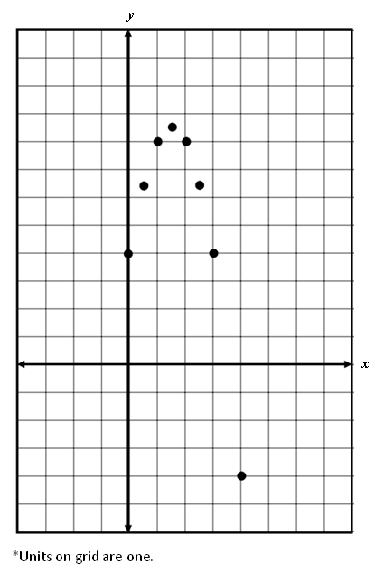
Practice for SOL A.11
Which equation best models the relationship shown on the grid?
a.
b.
c.
d.
40
Notes:
Here is another example that asks students to select the curve of best fit given data on a grid. Students should recognize the shape as quadratic and be able to eliminate choices a and b. They should also recognize that since the curve opens downward, the coefficient on the first term will be negative. This eliminates option c and leaves the student with the correct answer, which is option d. Alternately, a less efficient strategy for this particular example is to enter the points into the graphing calculator, and then find the quadratic curve of best fit.

