Slide 1



JAMES MONROE HIGH SCHOOL
Strategies to Empower Scholars to go Above and Beyond their Potential
What learning strategies will produce our best results?
How will we respond if they already know it?
What do we expect our students to learn?
How will we respond when they don’t learn?
How will we know they are learning??
Reflect
Knowledge
https://www.flexiblecreativity.com/james-monroe-hs-august-2025
Skills
Vocabulary
Prepared especially for the
James Monroe Professional Learning Community
by Dan Mulligan, drdanmulligan@gmail.com
August 2025

Slide 2
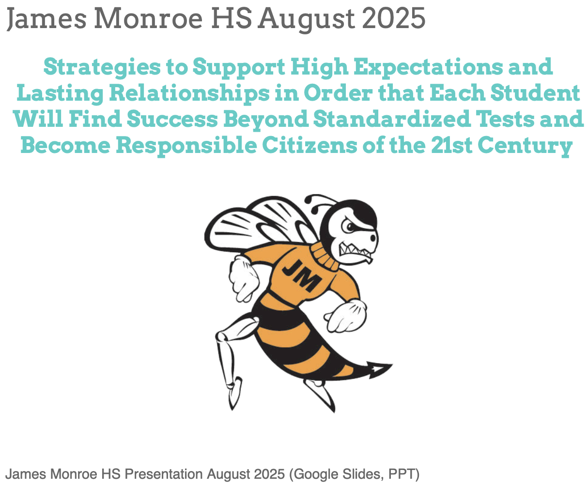
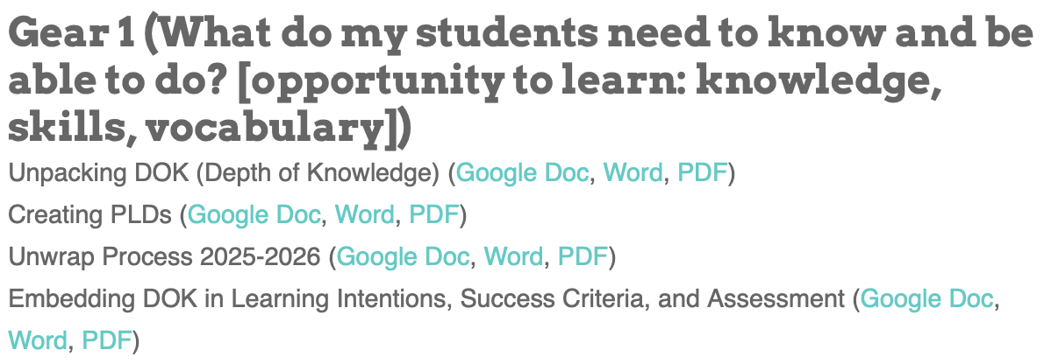
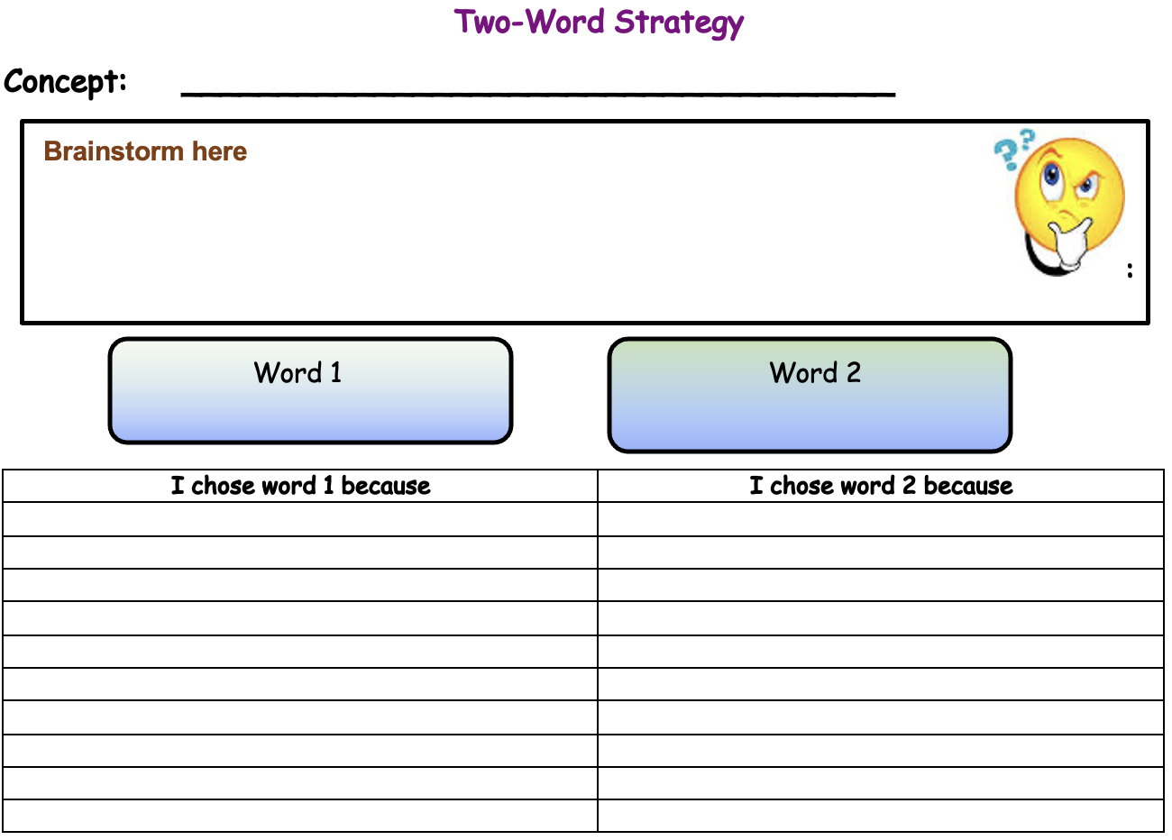
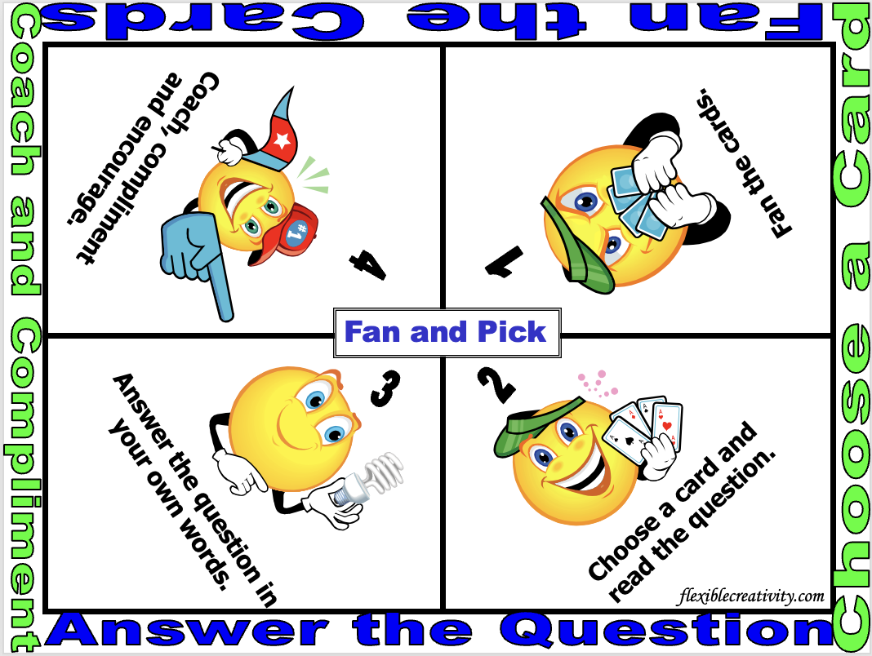
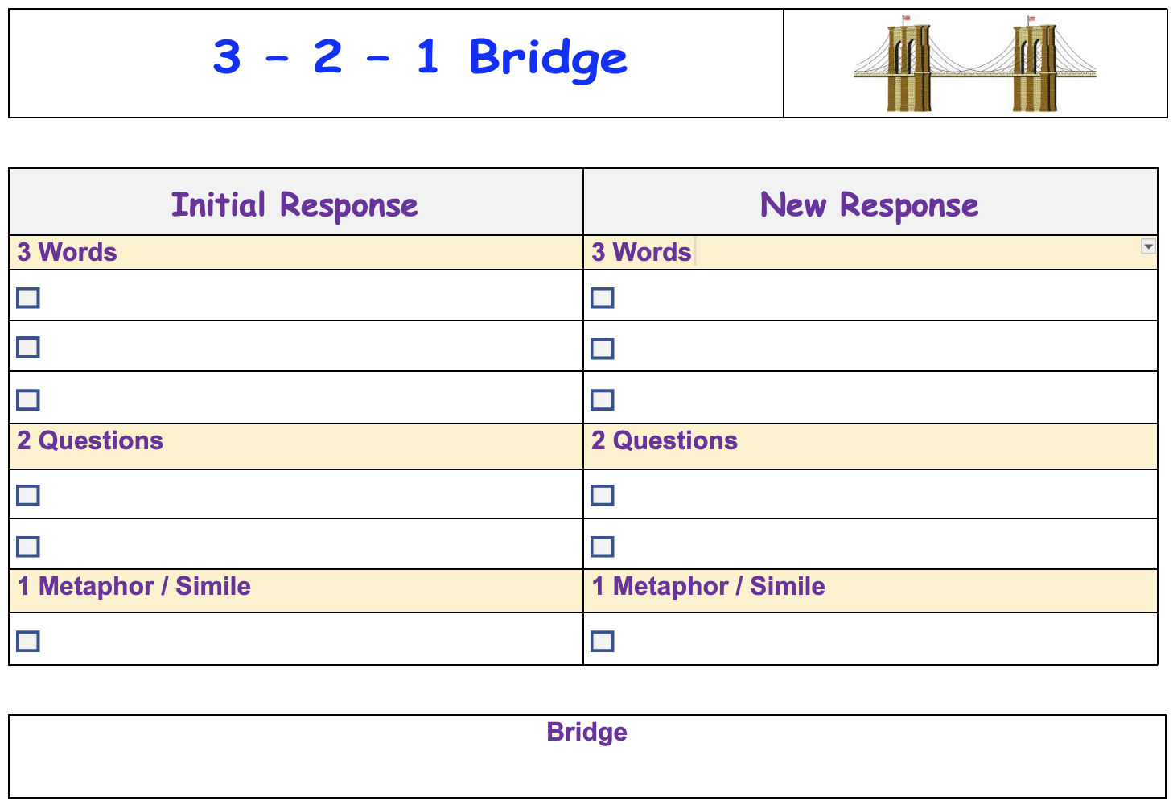
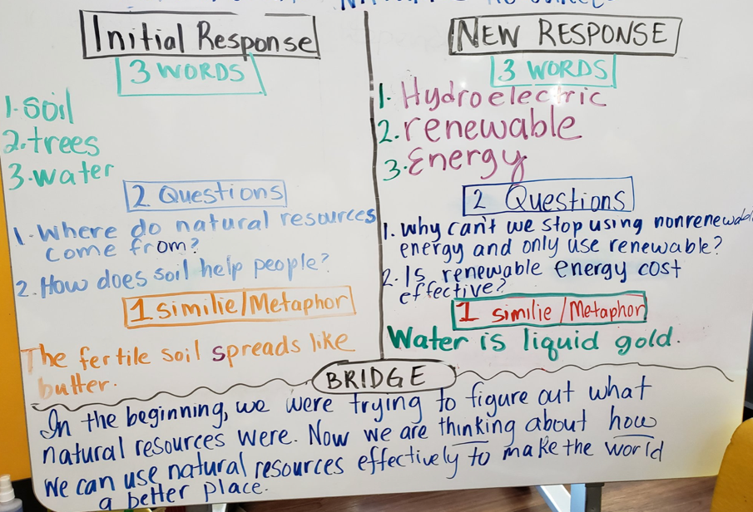
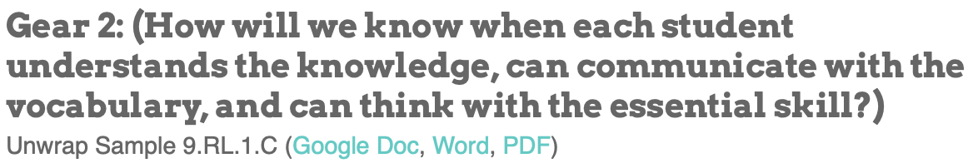
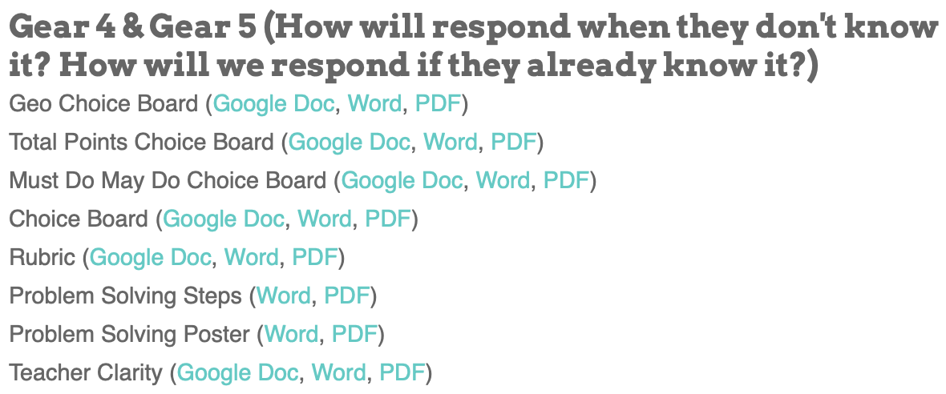
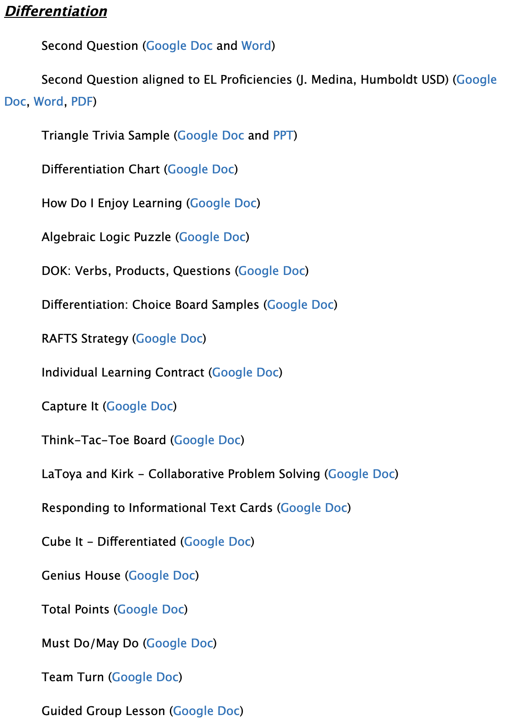
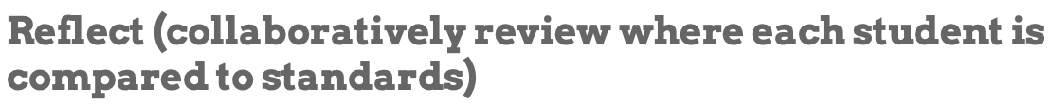
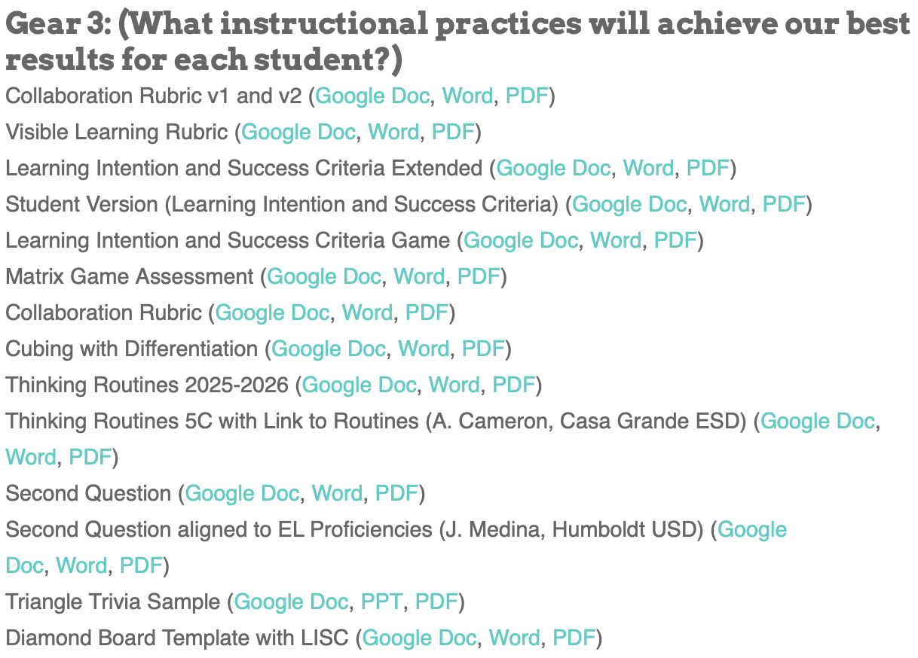

Thinking
Routines
Resources to Share

Slide 3

When I die…I hope it occurs during an after-school professional development…
…because the transition from life to death will be so slight, that I will hardly notice it.
Possible thoughts from a James Monroe teacher

Slide 4

Guaranteed and Viable Curriculum
Knowledge
Skills
Focus for
Assessment
and
Learning
Vocabulary
Vocabulary

Slide 5




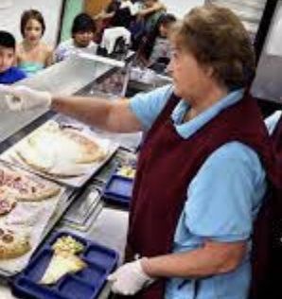

Team
Monroe
Members
Clues should be things they would say.
Parent
200 POINTS
Custodian
Teacher
100 POINTS 100 POINTS
Coach
Cafeteria Worker
Librarian
50 POINTS 50 POINTS 50 POINTS

Slide 6


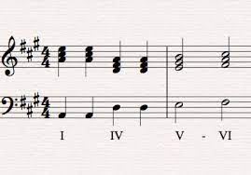
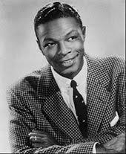
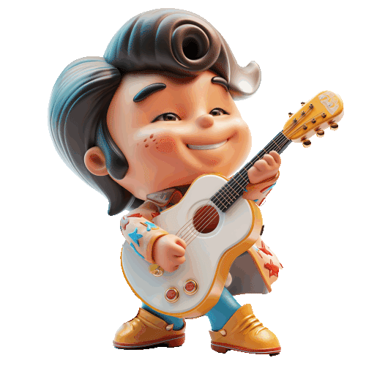

Music
Choir
200 POINTS
Harmony
Chord
100 POINTS 100 POINTS
Baritone
Guitar
Beat
50 POINTS 50 POINTS 50 POINTS

Slide 7
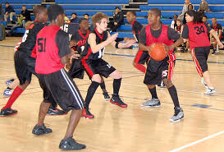





Physical Education
Participate
200 POINTS
Balance
Movement
100 POINTS 100 POINTS
Endurance
Nutrition
Fitness
50 POINTS 50 POINTS 50 POINTS

Slide 8
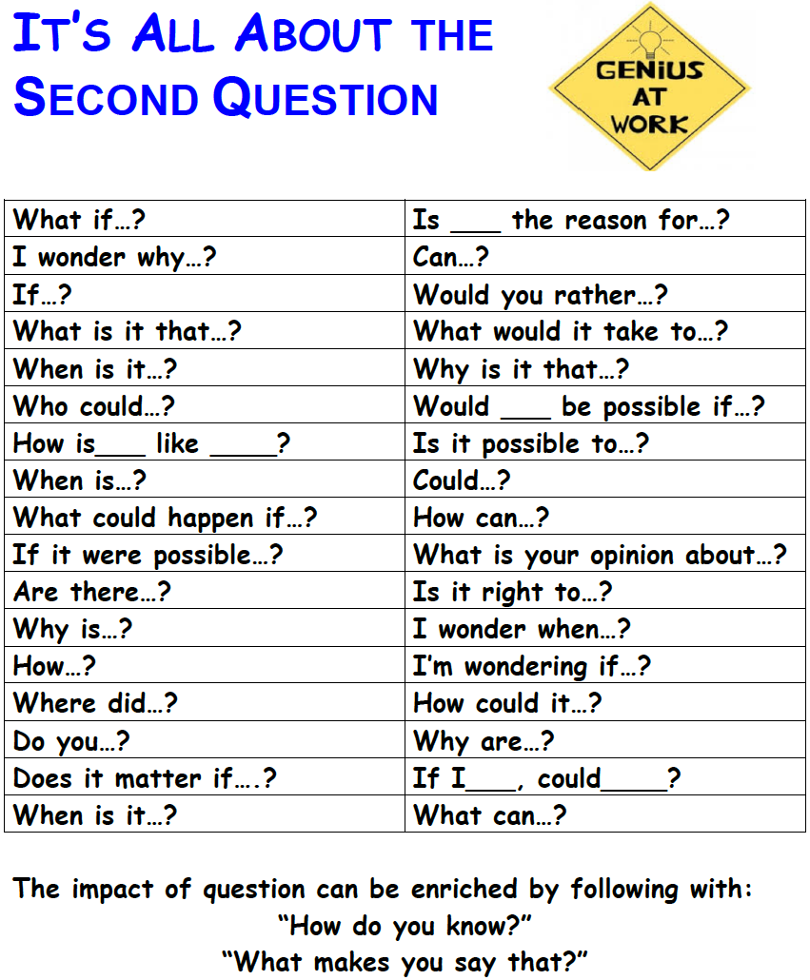
Don’t
Steal
Their
Thinking!

Slide 9
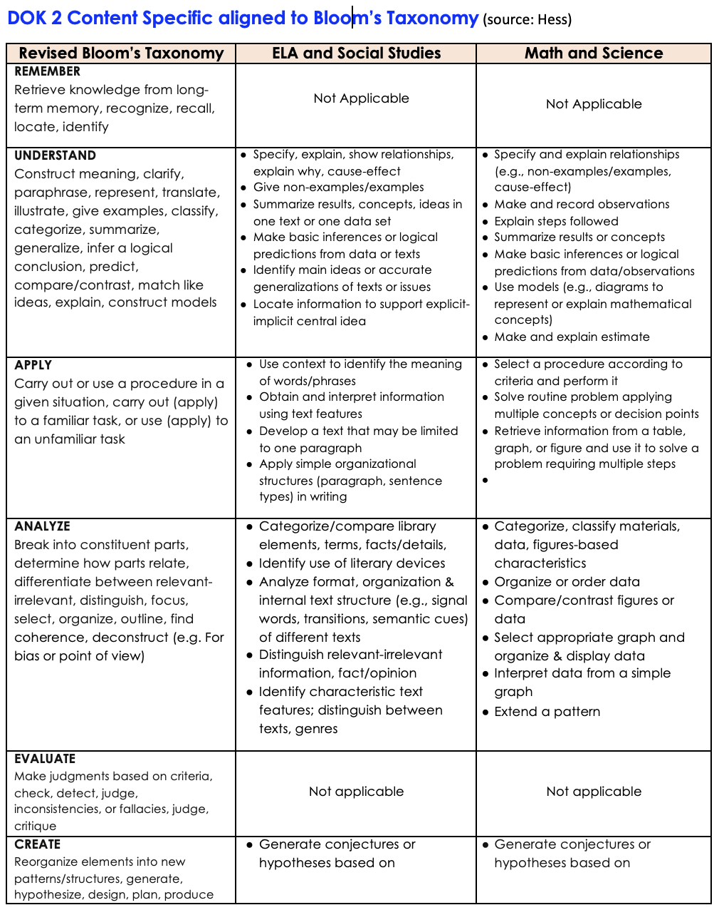
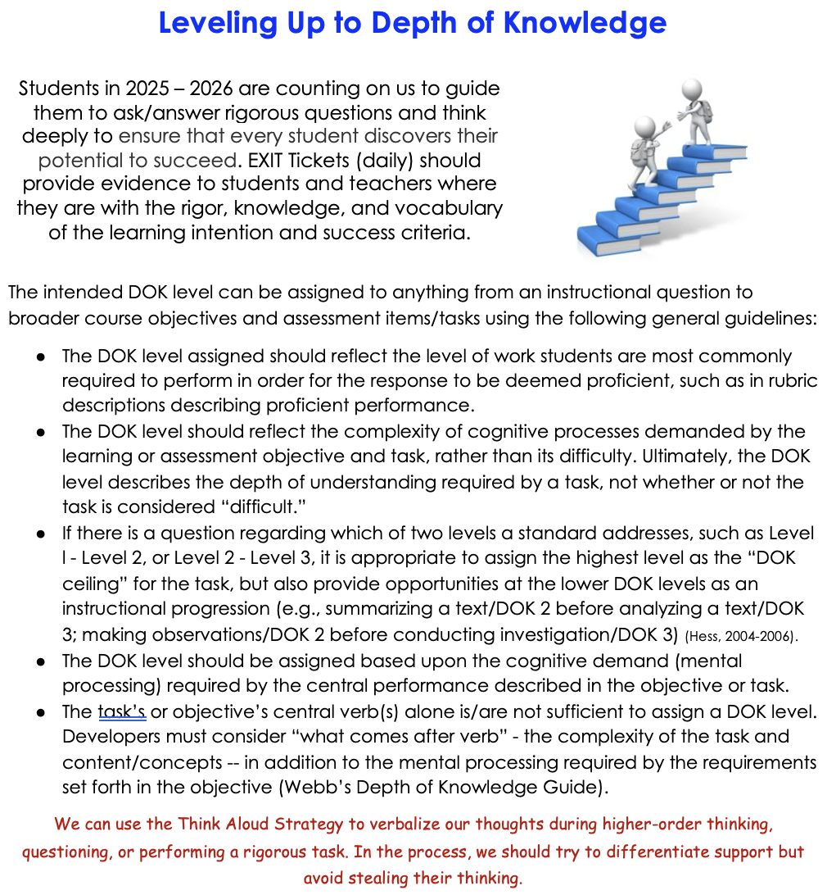
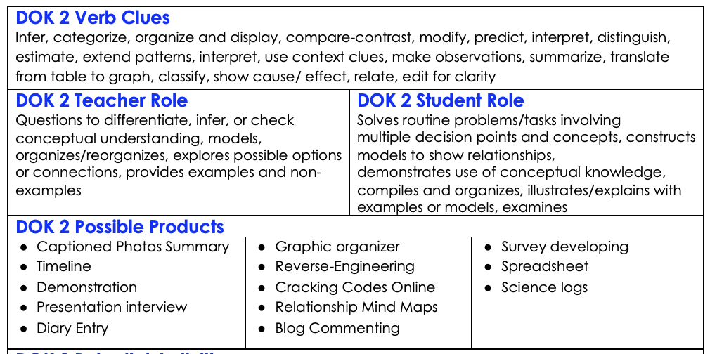
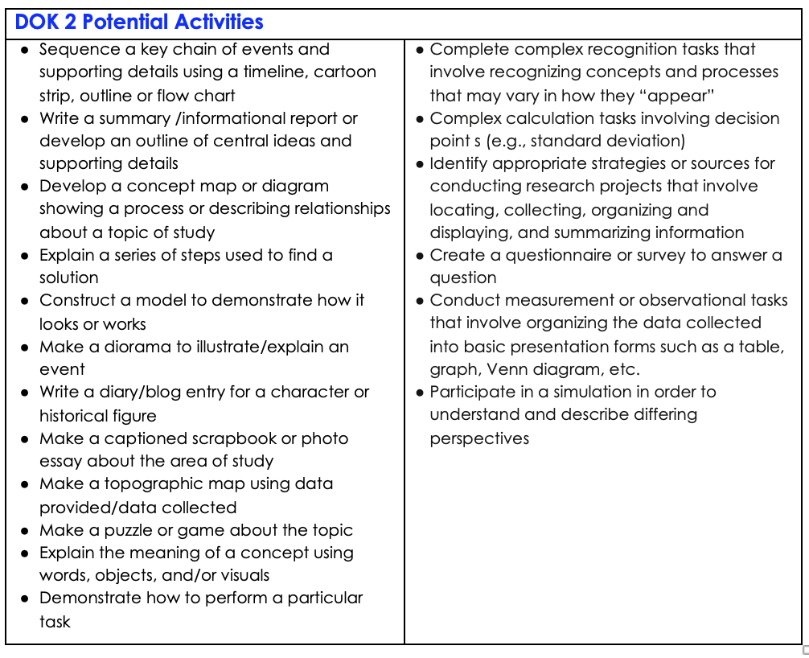
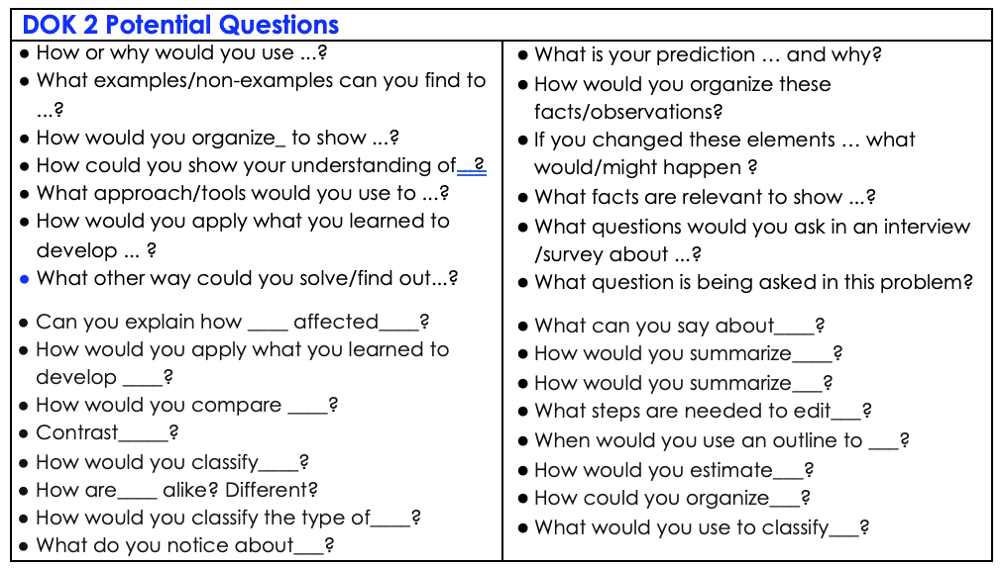
What does the
standard ask
each student to do?

Slide 10
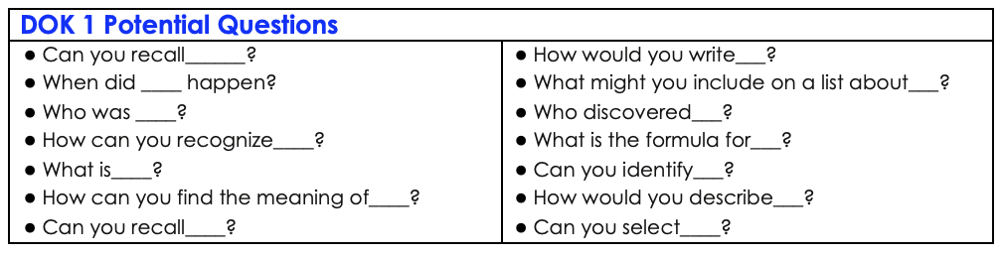

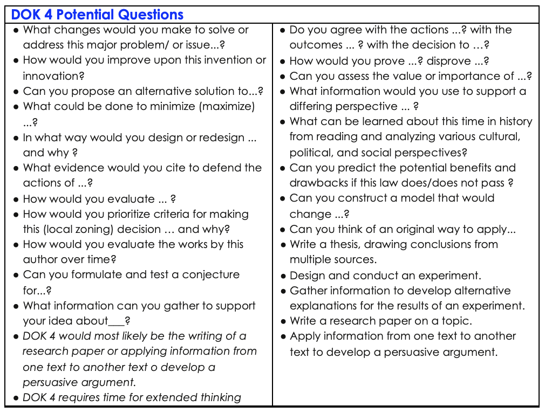
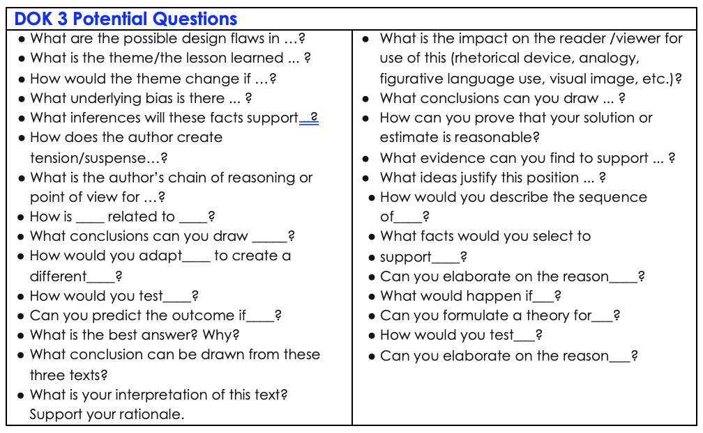
What does the
standard ask
each student to do?

Slide 11

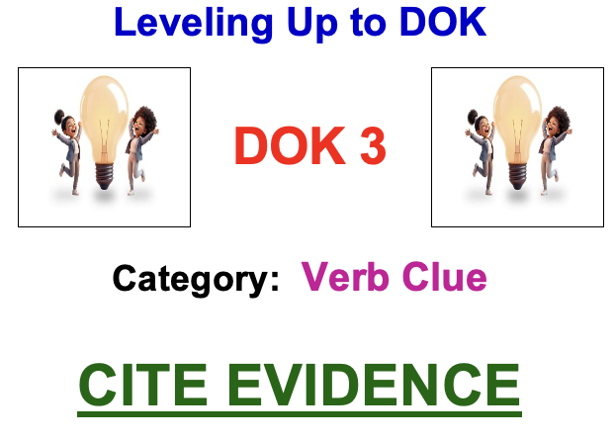
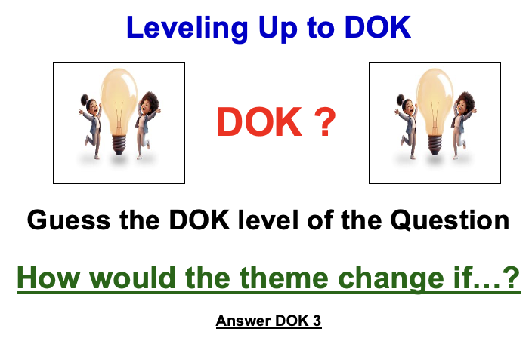
Instructional Strategy:
Motor Mouth
Purpose: To build and ‘check for’ background knowledge
One partner draws a card
Read their partner the DOK level and the Category
The partner with the card has one minute to give clues that will help their partner say the key word on the card.

Slide 12
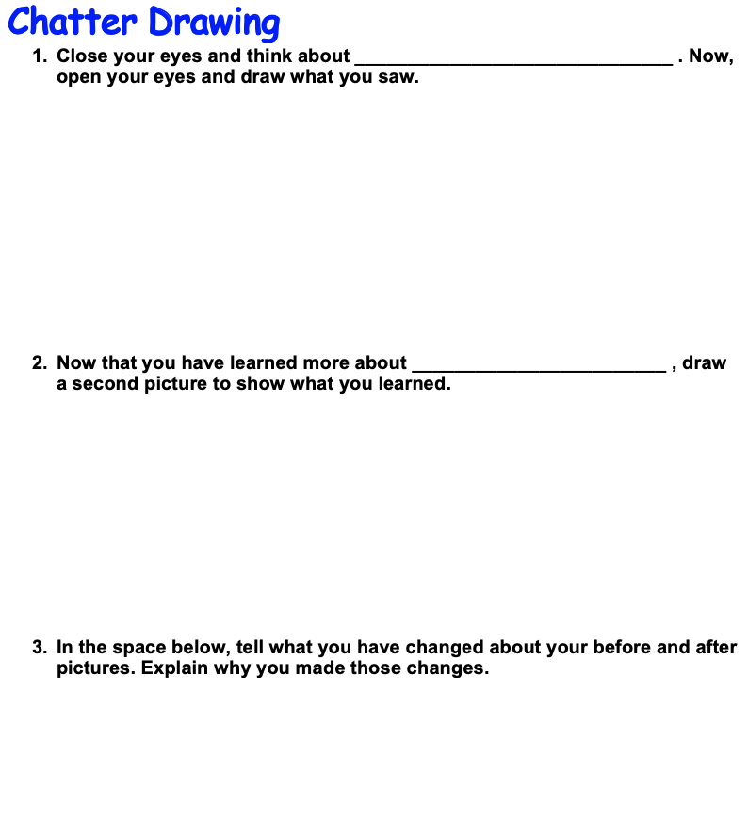
The Power of Connecting Student Learning preassessment revisited as a part of closure
Don’t
Steal
Their
Thinking

Slide 13

Capturing Each Student’s
WONDER…
Suggestion: Place the rigor at the beginning of a lesson or unit to capture each student’s wonder.
Strategy:
ZOOM IN

Slide 14
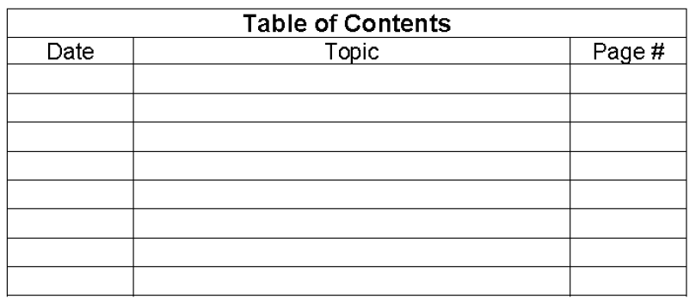
ORGANIZATION
Helping Students Develop Understanding
Purposefully facilitate students collaborating to create interactive notes to archive essential understandings based on unpacked standards (and PLD).

Slide 15
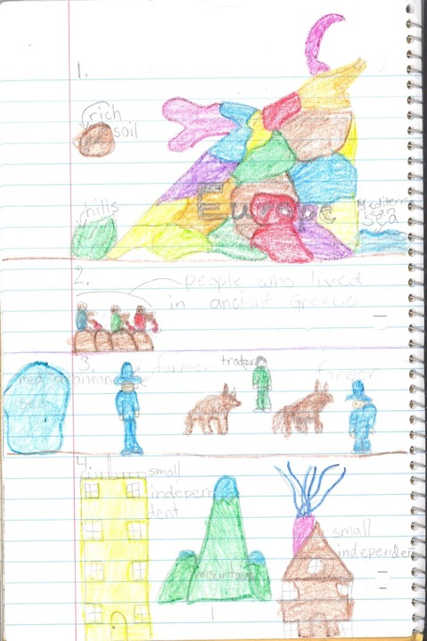
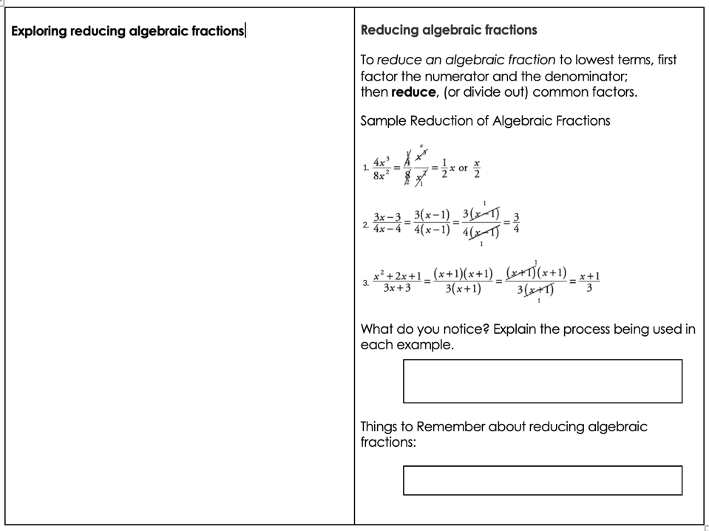
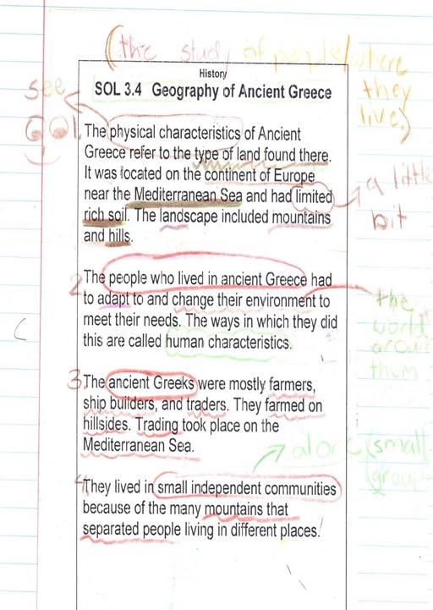

Slide 16
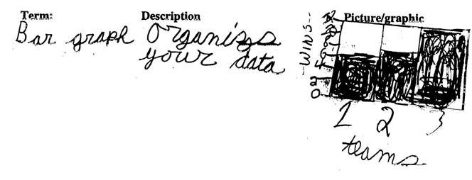
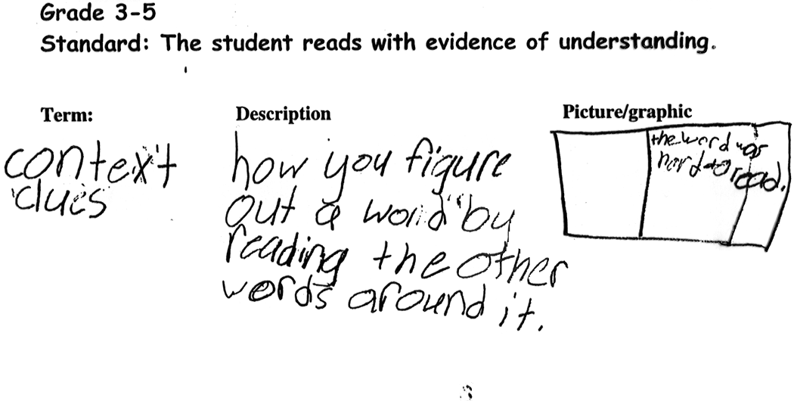
Student-Generated
Glossary

Slide 17
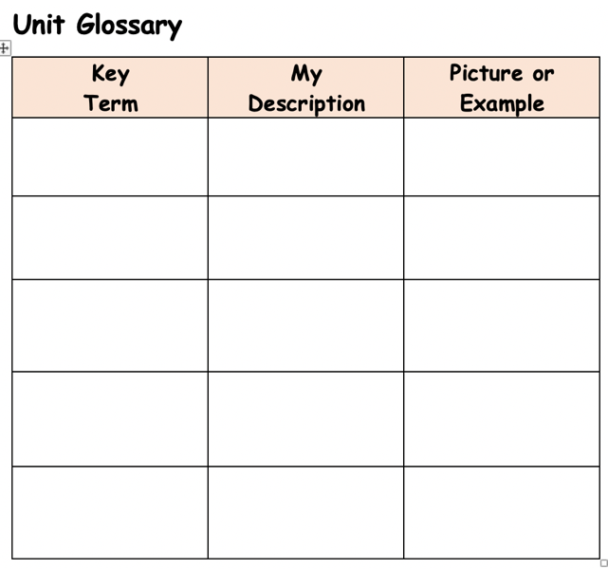
Unit Glossary Template

