Slide 1



ALBEMARLE COUNTY PUBLIC SCHOOLS
Effective Strategies To Ensure Every Student Succeeds
What learning strategies will produce our best results?
What do we expect our students to learn?
How will we respond if they already know it?
How will we respond when they don’t learn??
How will we know they are learning??
Reflect
https://www.flexiblecreativity.com/albemarle-august-2023
Prepared especially for the New Members of the
Albemarle Professional Learning Network
by Dan Mulligan, drdanmulligan@gmail.com
August 2023
Secondary
Edition

Slide 2

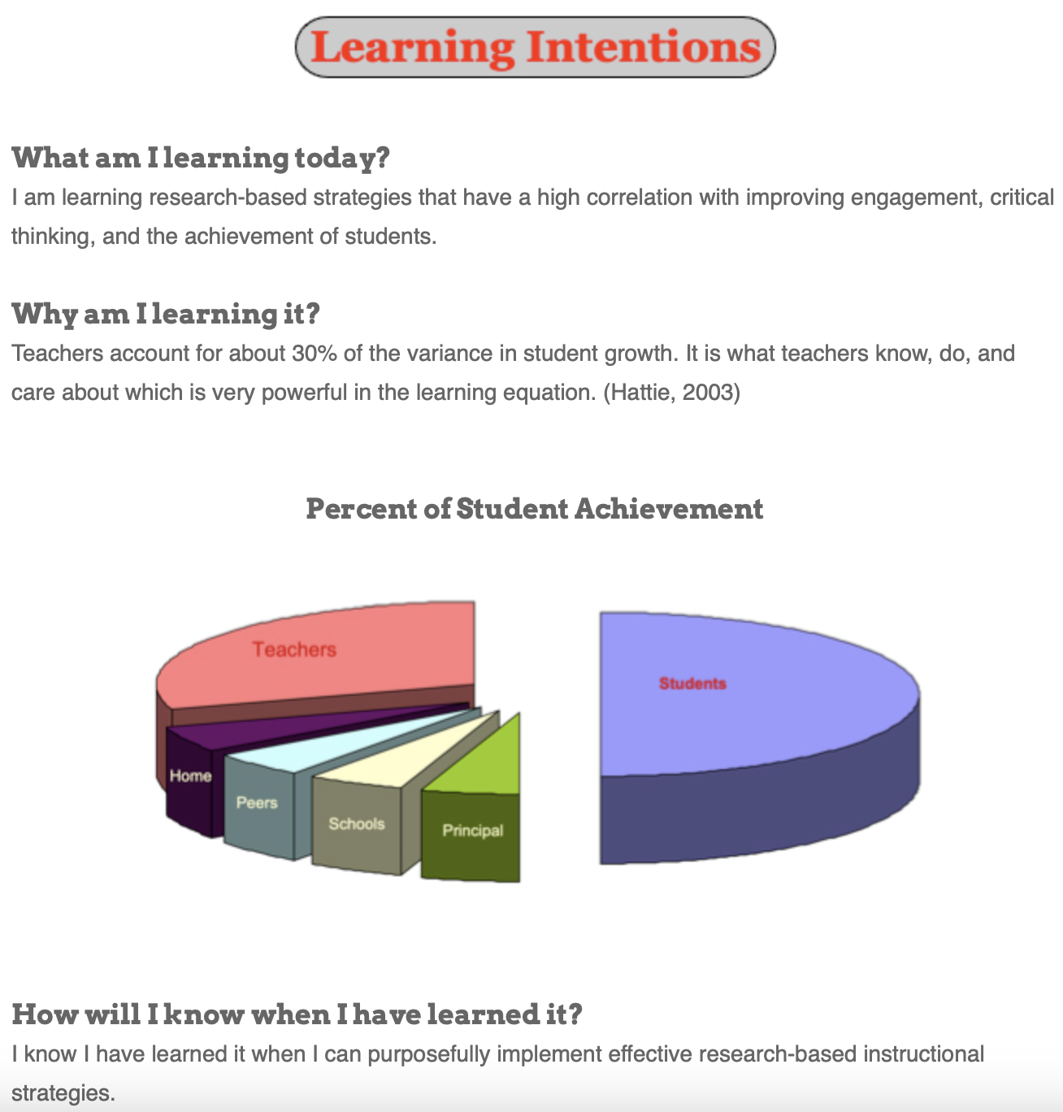

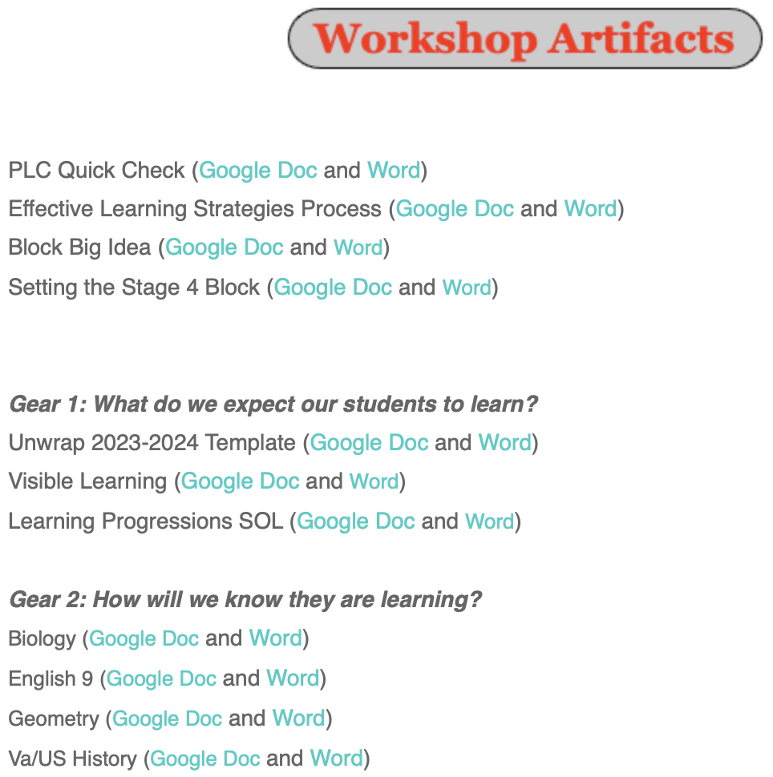

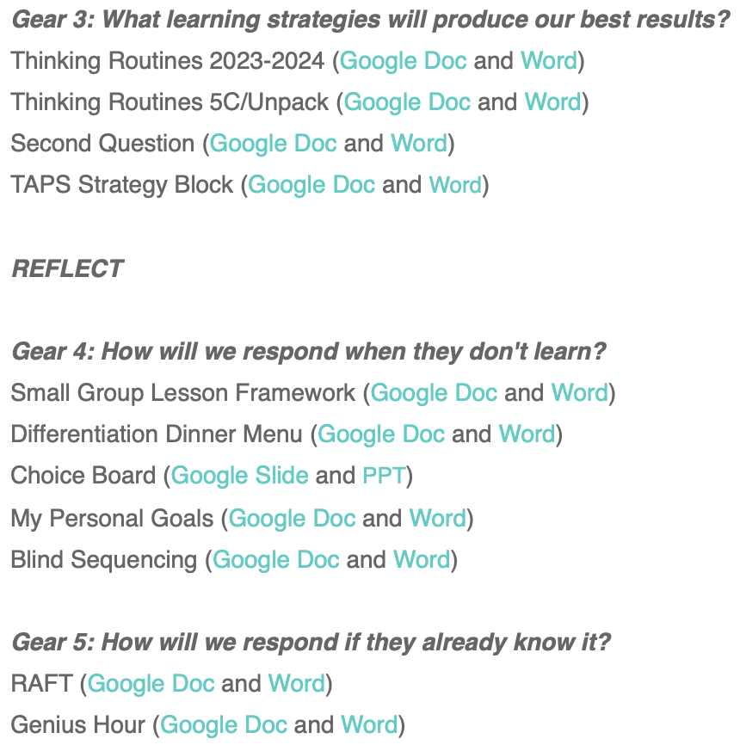
Resources to Share
Don’t Steal
Their Thinking!

Slide 3
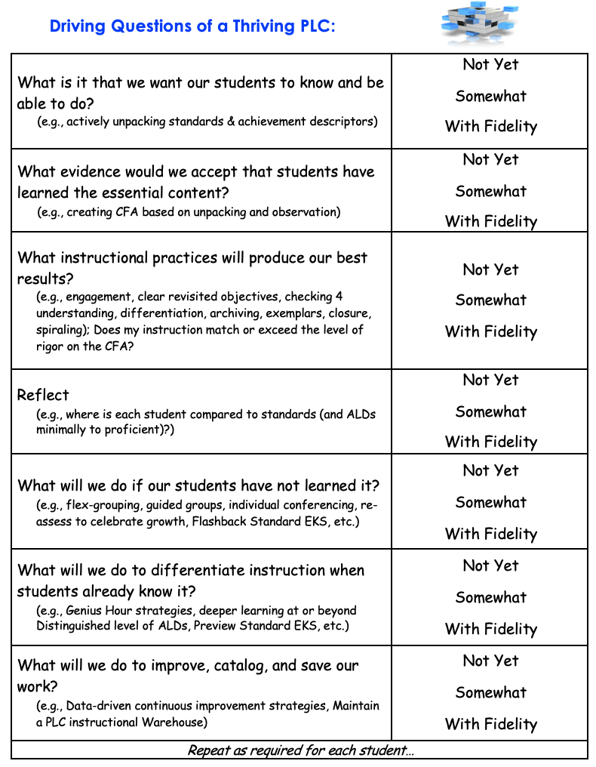
Providing
a
Guaranteed
and
Viable
Curriculum
First Page
White Cardstock Sheet
WHITE
Cardstock

Slide 4
What are some effective strategies to engage students?
Creating an Environment for Learning
Celebrating You!
Work collaboratively (e.g., construct viable arguments, critique, agree) to describe effective strategies.
Why are they effective?
WHITE
Cardstock

Slide 5

Bring your documents and meet someone new.
Find two seats, sit together, and say hello!
Four Second Partner

Slide 6
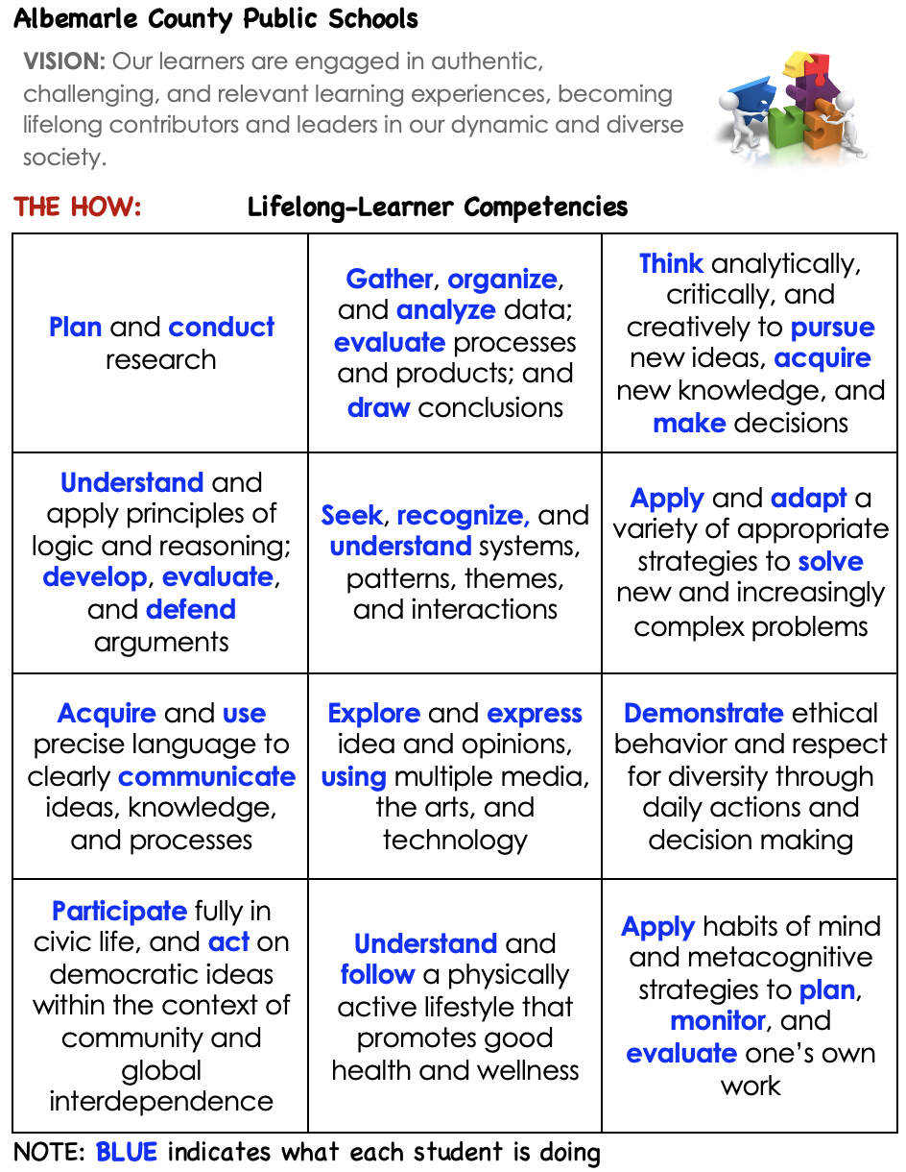
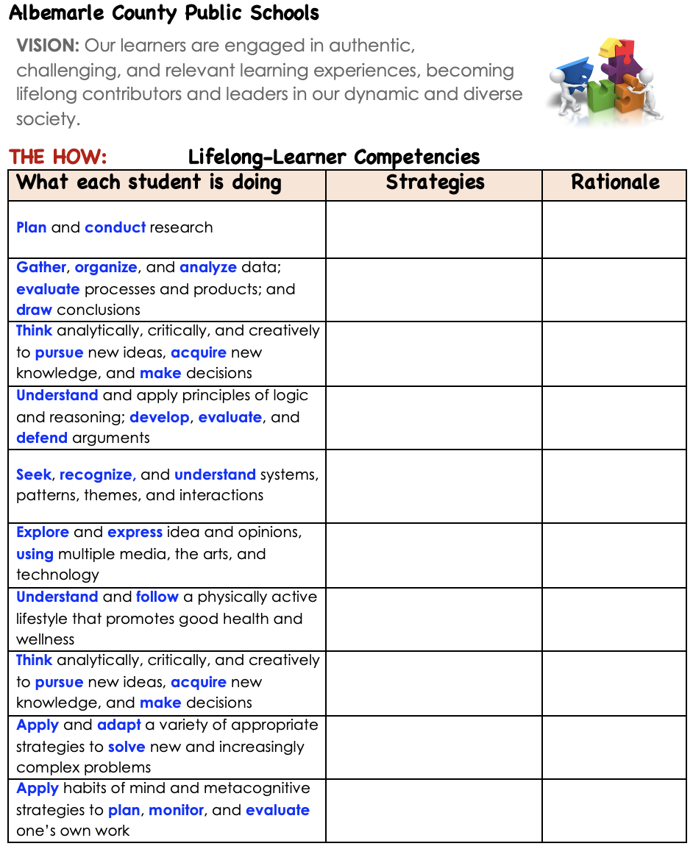
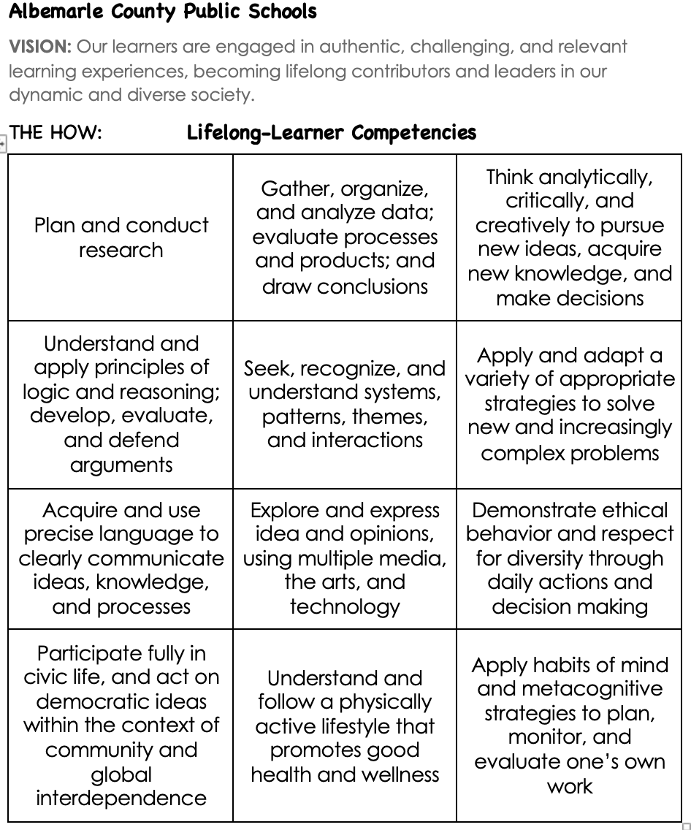
Albemarle County
Life-long Learners Competencies
‘No one rises to low expectations.
~Carl Boyd

Slide 7

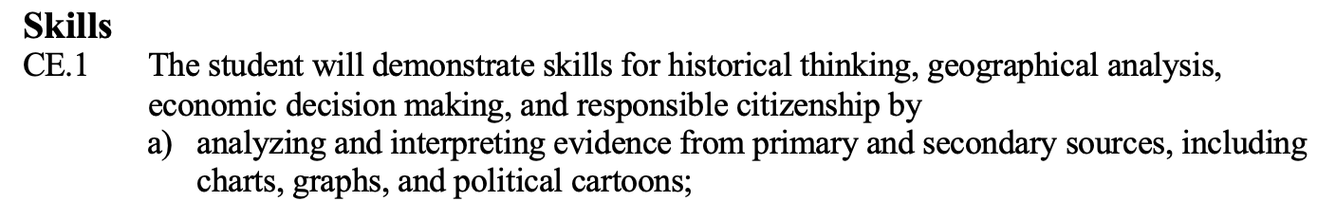
What do I want my students to know and be able to do?

Slide 8
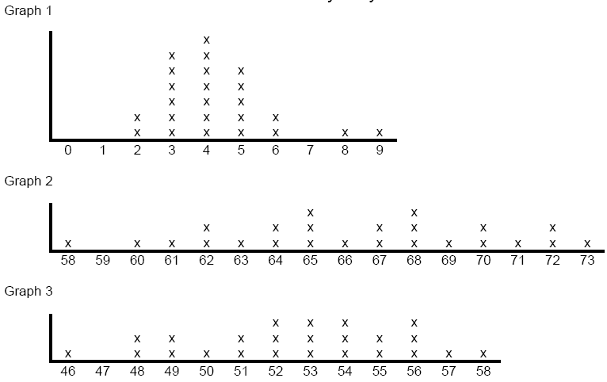
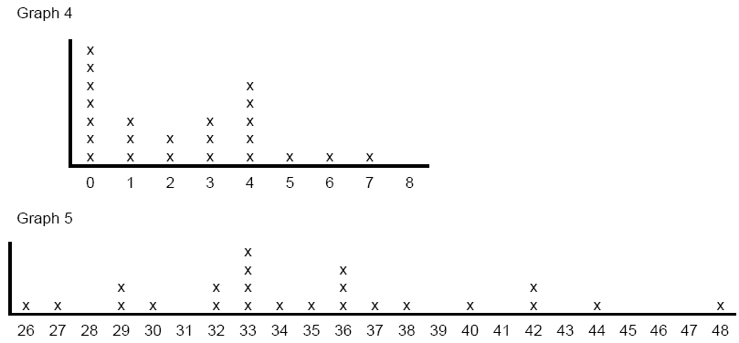
a. The number of cavities the sixth graders have?
b. The number of people in the sixth graders’ families?
c. The ages of the sixth graders’ mothers?
d. The heights of the sixth graders in inches?

Slide 9
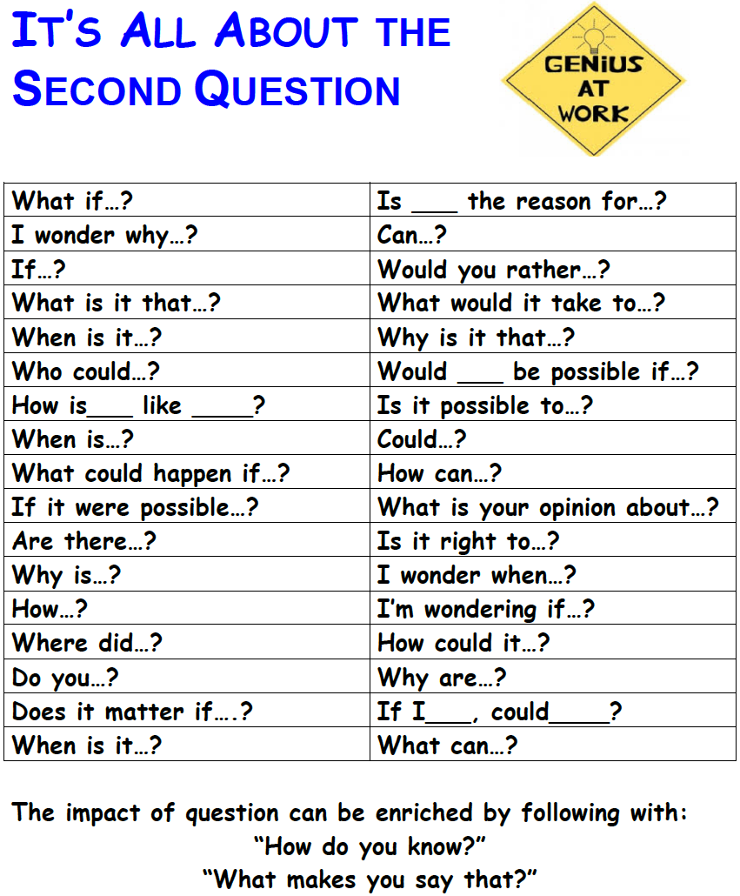
Don’t
Steal
Their
Thinking!

Slide 10
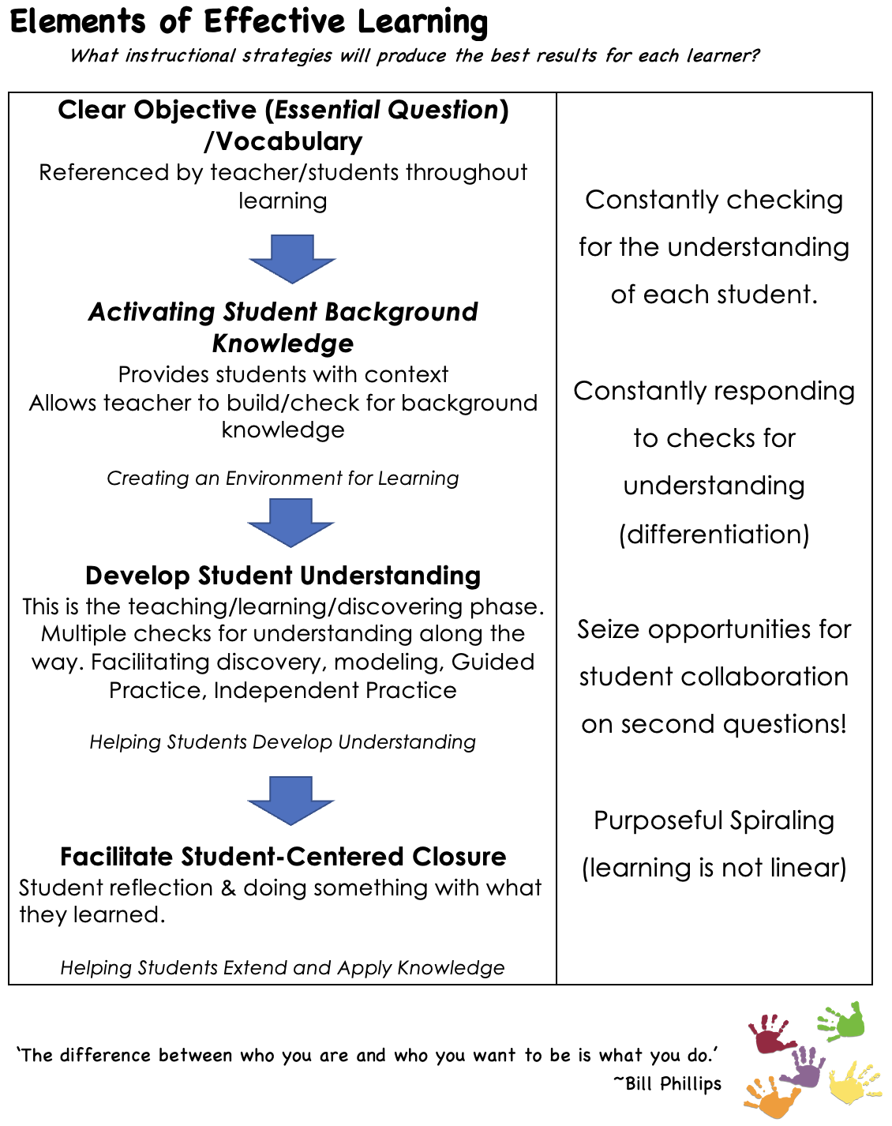
GEAR 3: What instructional practices will produce our best results for each learner?
page
1

Slide 11
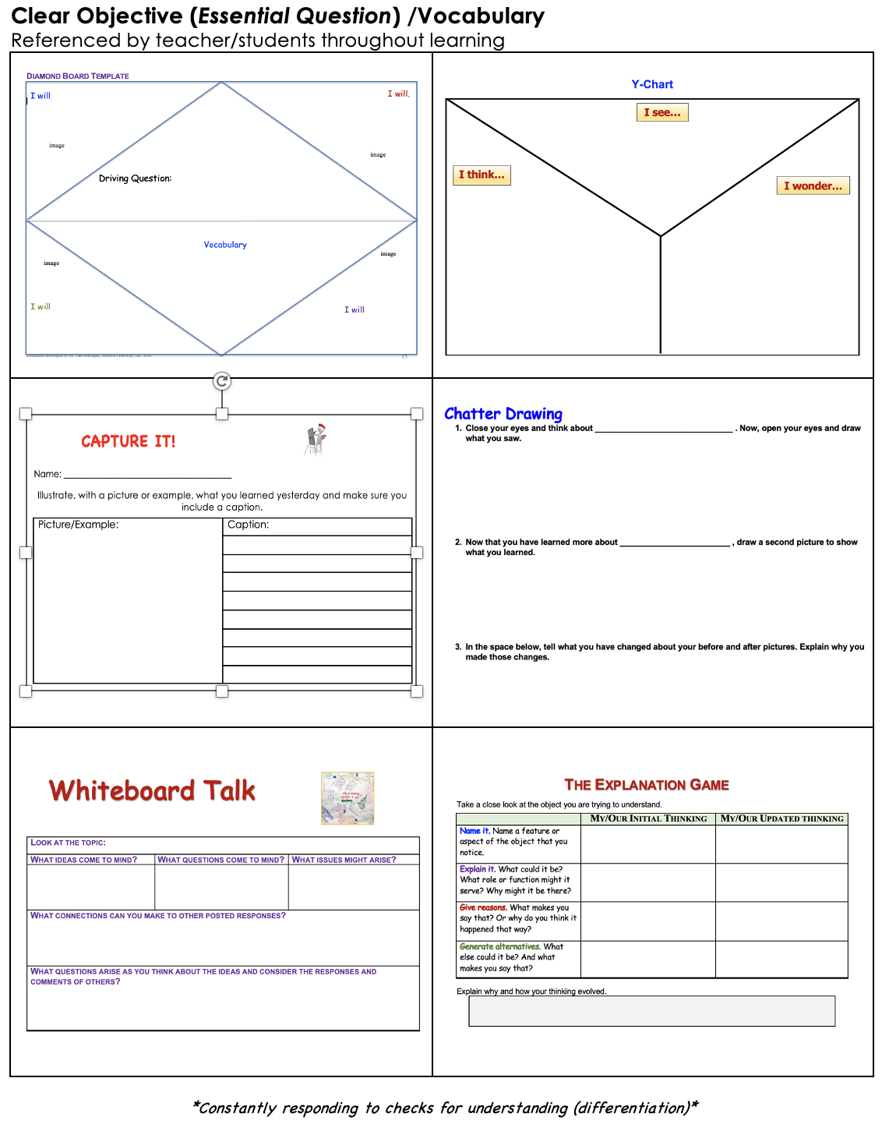
Checks for Understanding Along the Way
(Chunking and Checking)
page
2

Slide 12
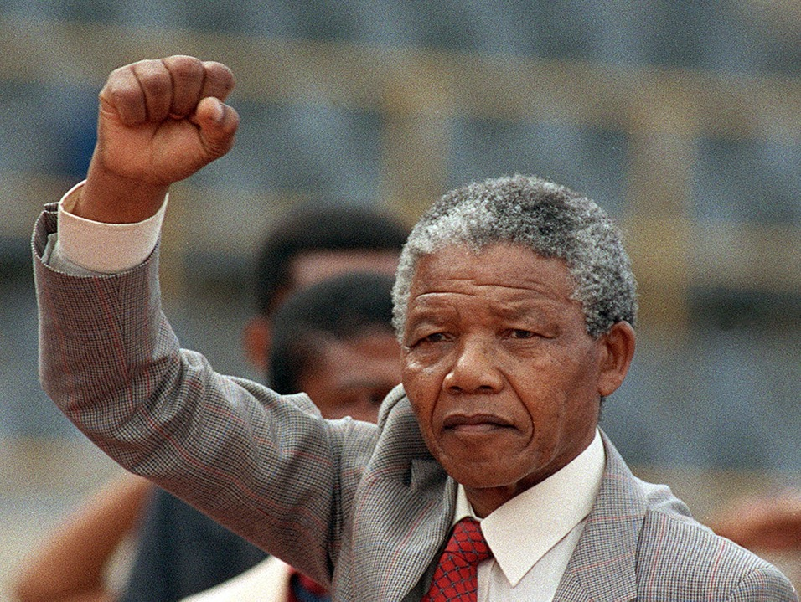

HOOK: Recruiting Interest
WHO AM I?
Thinking Routine: Zoom In

Slide 13

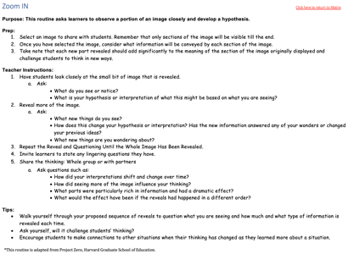
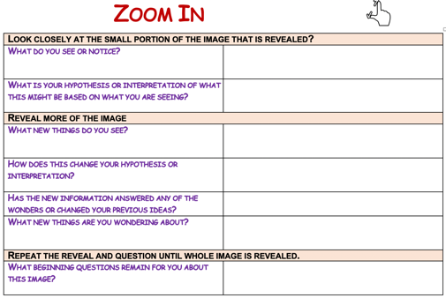
Zoom-in
Thinking Routine
Purpose: This routine asks learners to observe a portion of an image, video, article, graph, or book closely and develop a hypothesis.
Ask questions such as:
How did your interpretations shift and change over time?
How did seeing more of the image influence your thinking?
What parts were particularly rich in information and had a dramatic effect?
What would the effect have been if the reveals had happened in a different order?

Slide 14
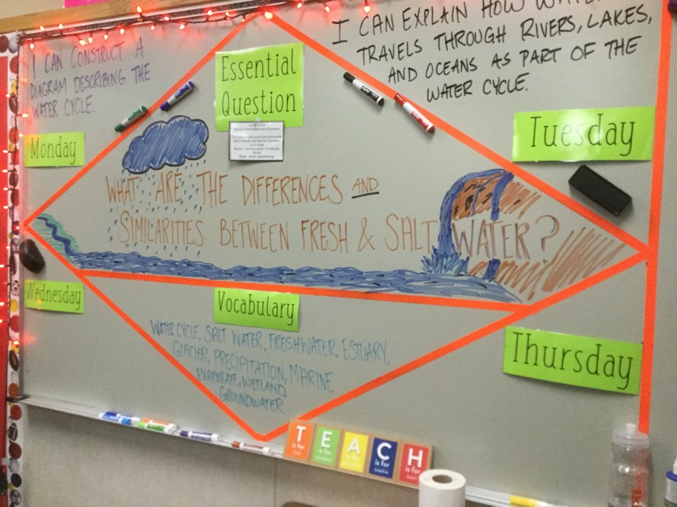
Setting the Objective
and
Providing Feedback

Slide 15
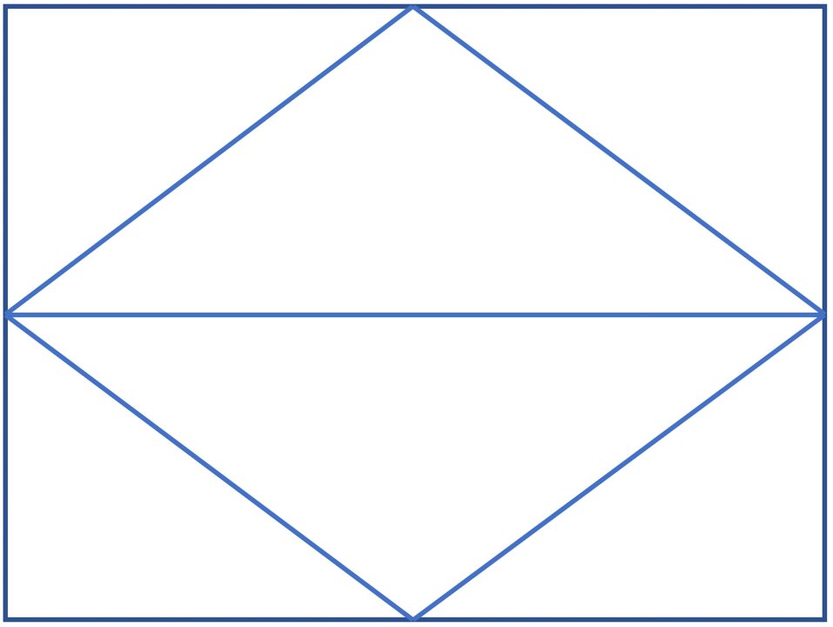
I can identify and describe two-dimensional and three-dimensional shapes.
I use identify properties of squares.
Driving Questions:
How do we know when a shape is a quadrilateral?
How can we sort and explain types of quadrilaterals?
Shape Side Angle Square
Quadrilateral Rhombus Rectangle
Three-dimensional Two-dimensional
Example Nonexample
Sort
I can sort and draw examples and nonexamples of types of quadrilaterals.
I recognize types of quadrilaterals.

Slide 16
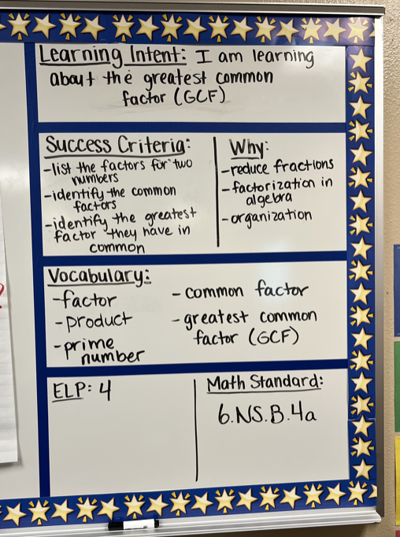
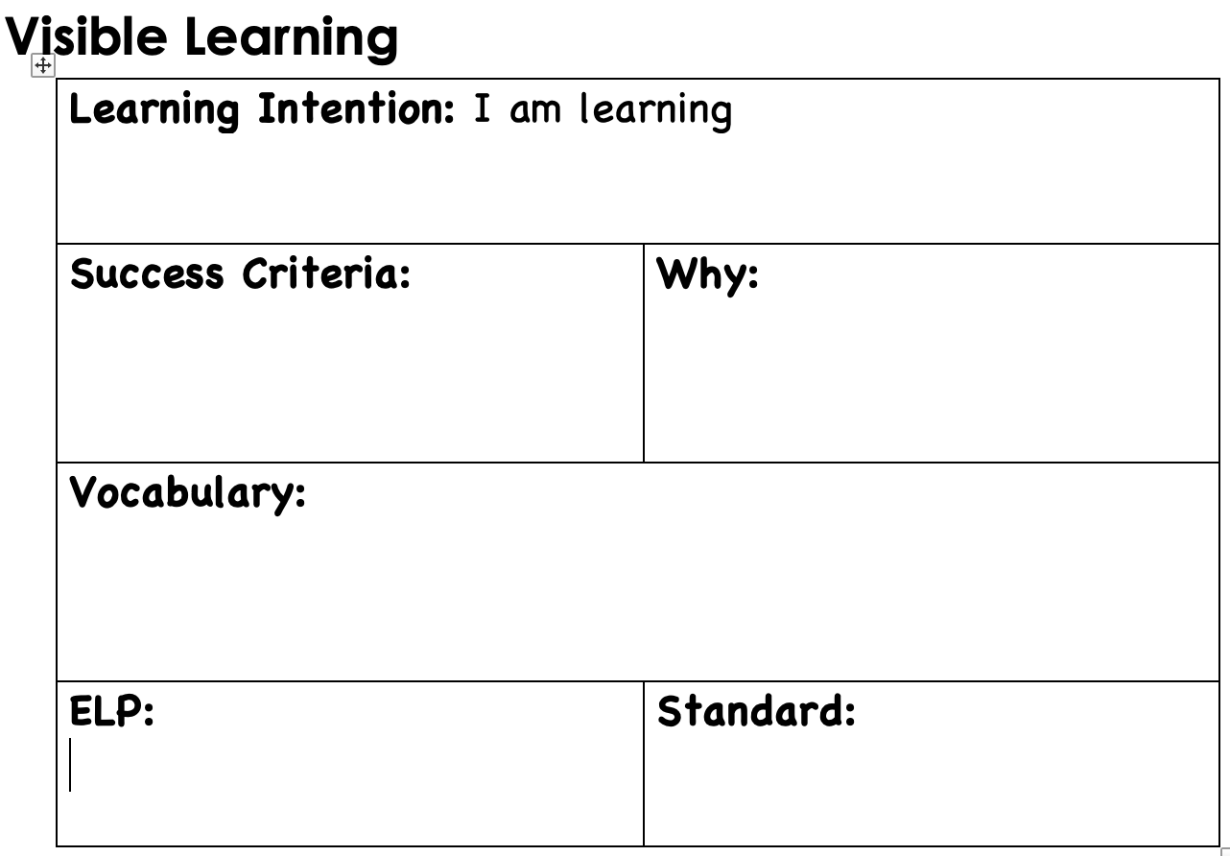
Visible Learning

Slide 17
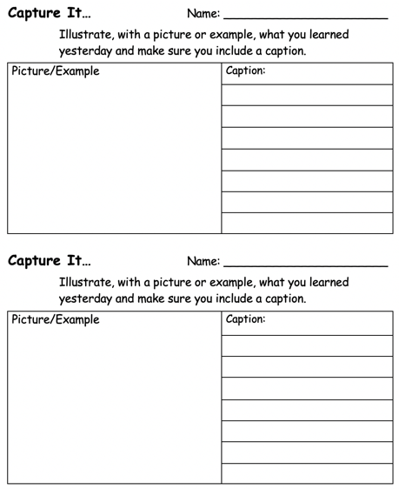
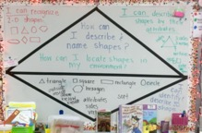
Setting Objectives & Providing Feedback
Misconception:
Posting an objective raises student achievement.
Truth:
Students and the teacher USING the objective is what raises student understanding and achievement.
Spiraling to Previous Day’s Essential Understandings

Slide 18
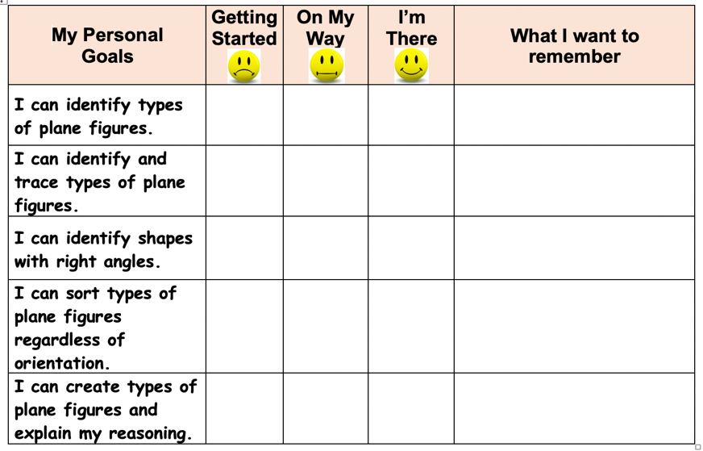
There are two reasons why we assess:
To inform instructional decisions (targeted learning stations)
To encourage each student to try

Slide 19
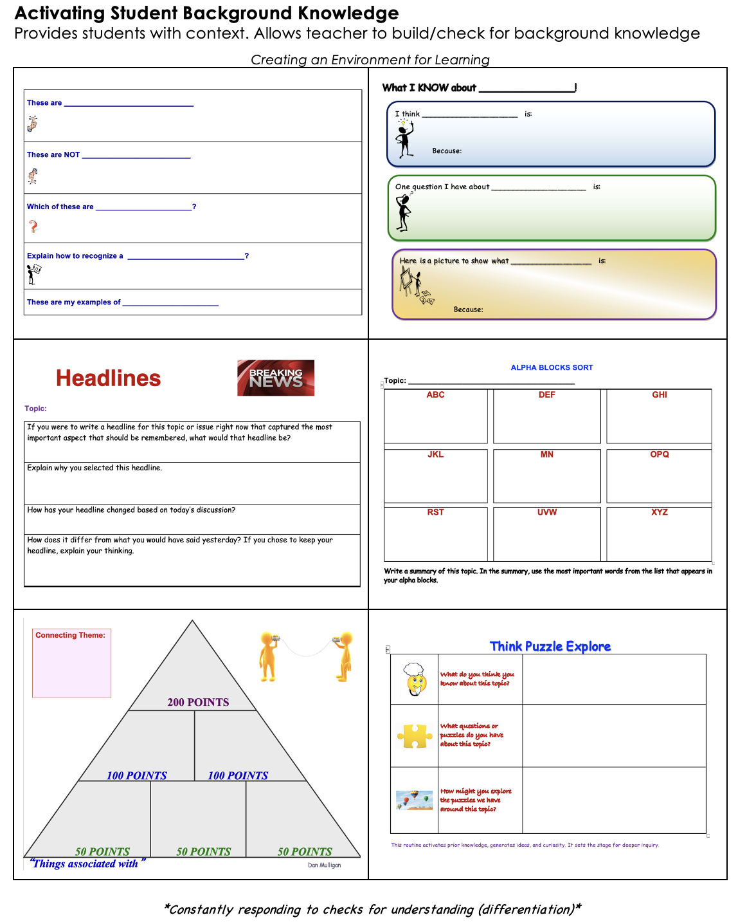
Checks for Understanding Along the Way
(Chunking and Checking)
page
3

Slide 20




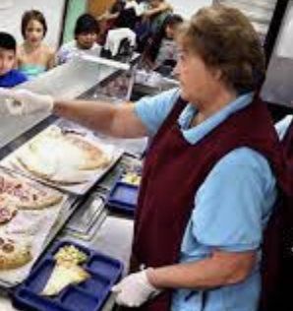

Team
Albemarle
Members
Clues should be things they would say.
Parent
200 POINTS
Principal
Teacher
100 POINTS 100 POINTS
Superintendent
Cafeteria Worker
Librarian
50 POINTS 50 POINTS 50 POINTS

Slide 21
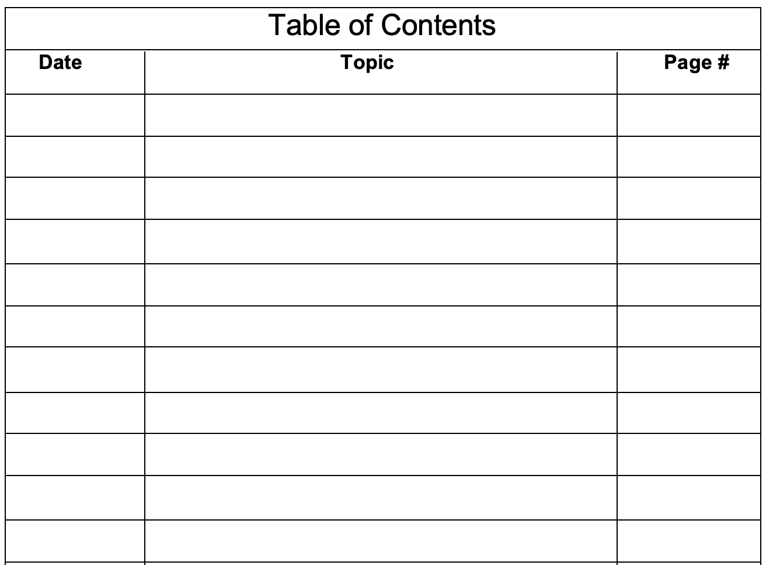



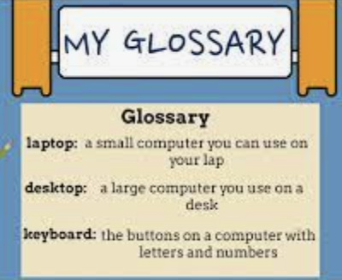

Grade 1
Informational
Text
Table of Contents
200 POINTS
Illustrations
Details
100 POINTS 100 POINTS
Main Topic
Glossary
Ask Questions
50 POINTS 50 POINTS 50 POINTS

Slide 22




Science
Energy
200 POINTS
Mixture
Electron
100 POINTS 100 POINTS
Atmosphere
Experiment
Dissolve
50 POINTS 50 POINTS 50 POINTS

Slide 23
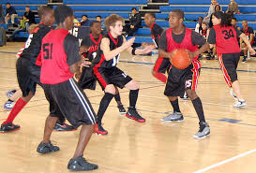
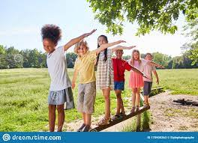


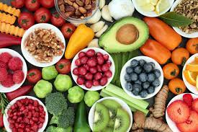

Physical Education
Participate
200 POINTS
Balance
Movement
100 POINTS 100 POINTS
Endurance
Nutrition
Fitness
50 POINTS 50 POINTS 50 POINTS

Slide 24
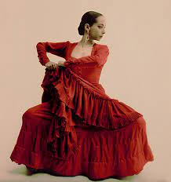
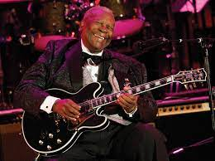
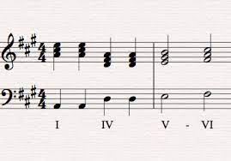
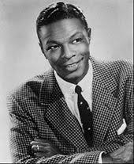
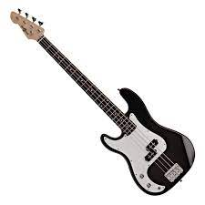

Music/ Dance
Flamenco
200 POINTS
Blues
Chord
100 POINTS 100 POINTS
Baritone
Bass Guitar
Beat
50 POINTS 50 POINTS 50 POINTS

Slide 25
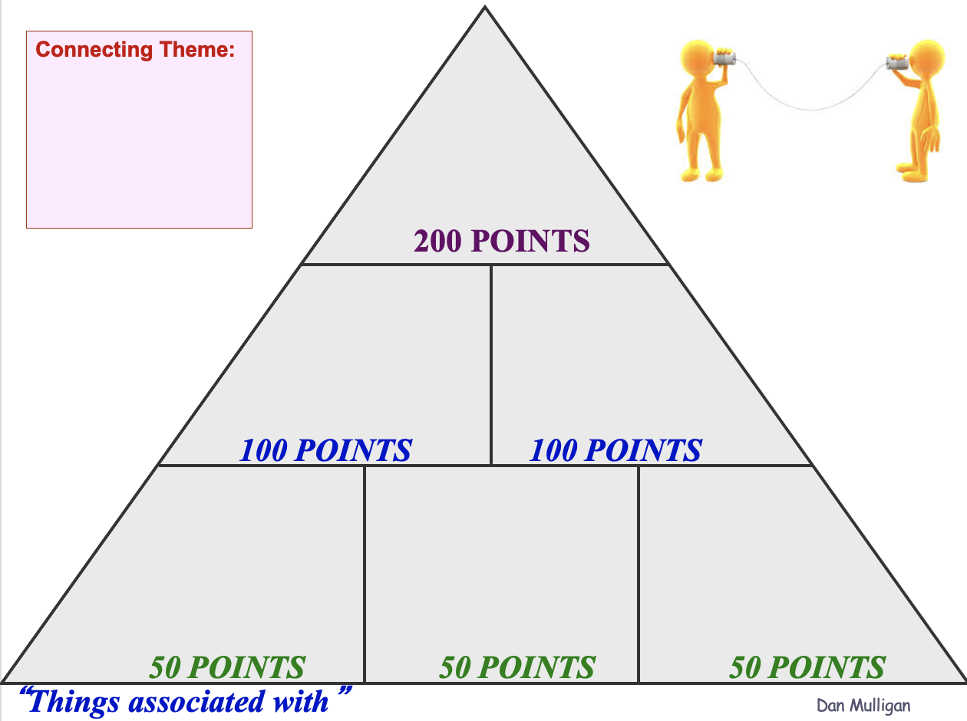

Slide 26

Commitment
“If you don’t make a total commitment to whatever you’re doing then you start looking to bail out the first time the boat starts leaking. It’s tough enough getting that boat to shore with everyone rowing, let alone when a guy stands up and starts putting his life jacket on.”
~Lou Holts Jr.

Slide 27
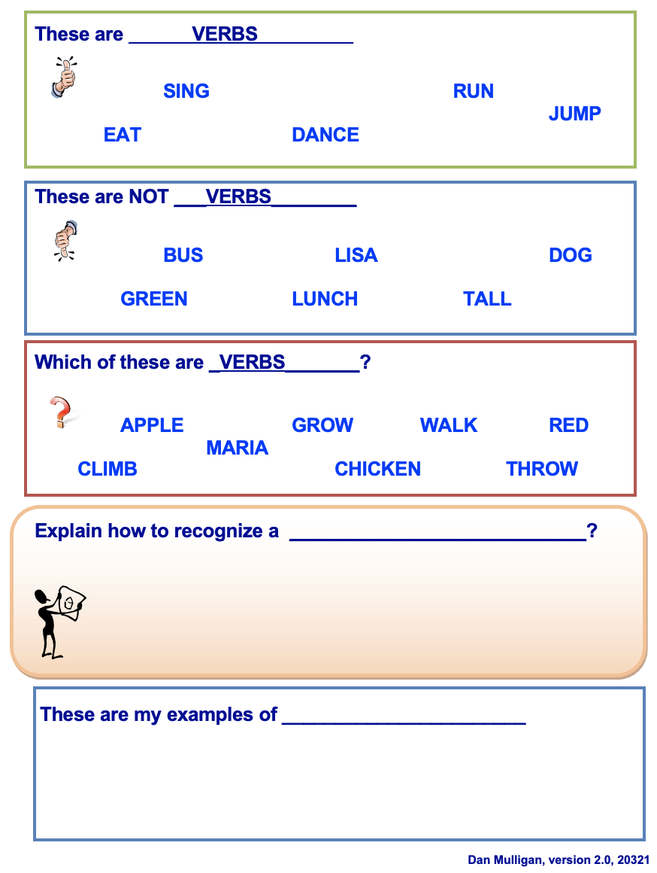
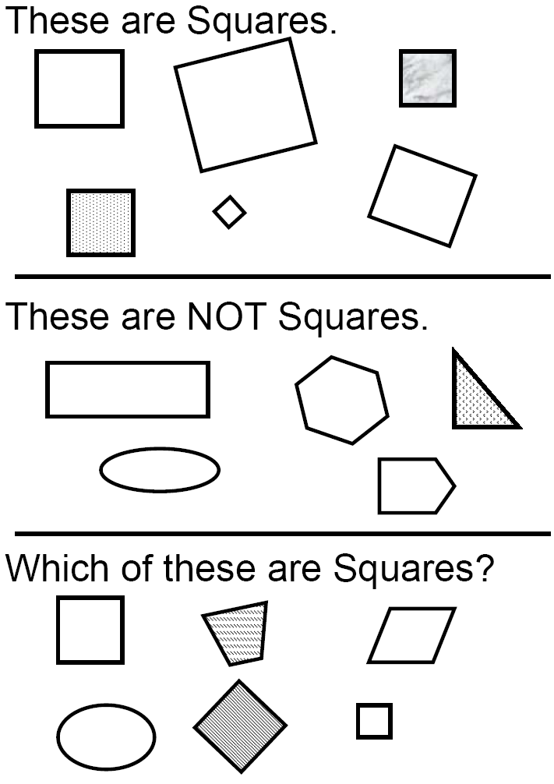

Don’t
Steal Their
Thinking!

Slide 28
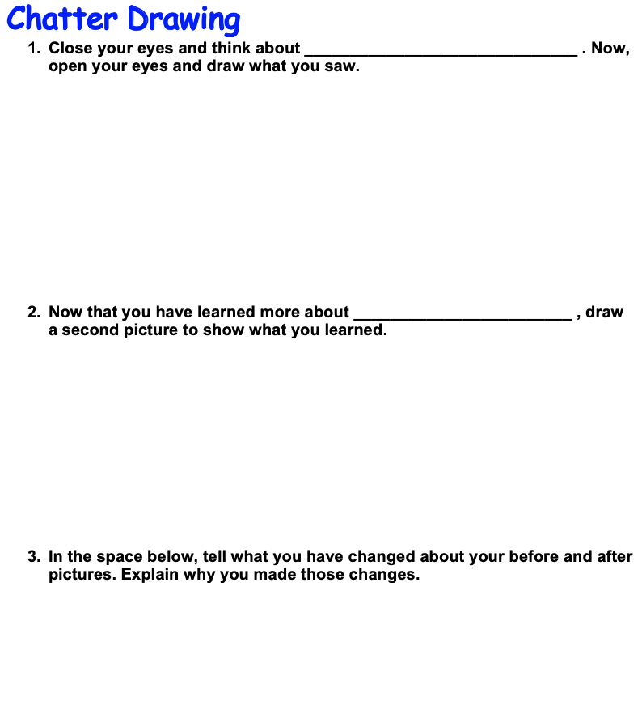
The Power of Connecting Student Learning preassessment revisited as a part of closure
Don’t Steal
Their Thinking

Slide 29
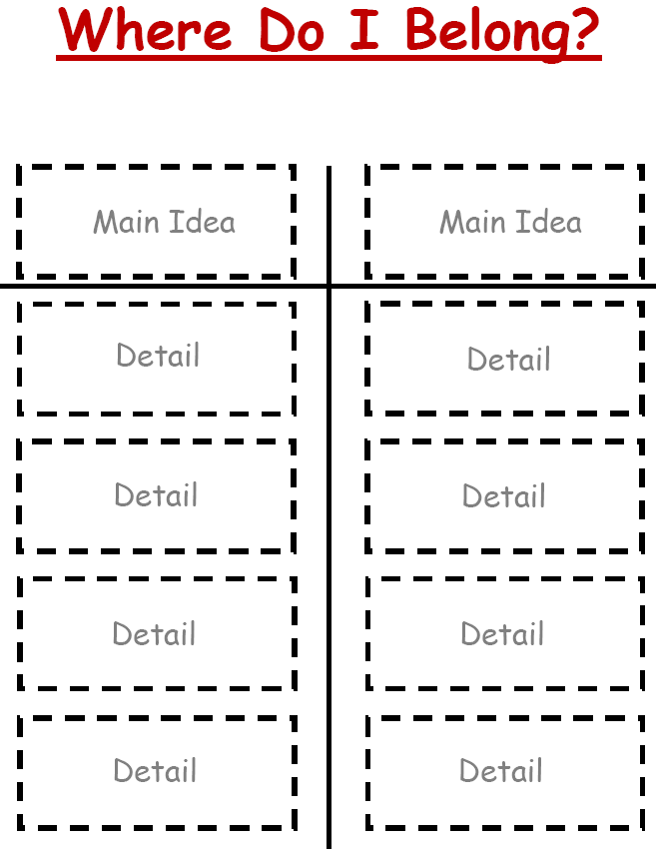

Classifying
Rectangle
Shape
Circle
Square Corner
Side
Attribute
Round
Triangle
Corner
Square

Slide 30

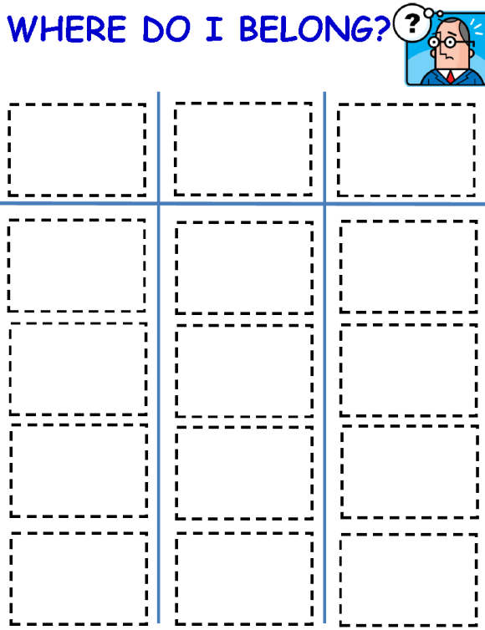
Parts of Speech
Tree
Fluffy
Sharp
Lion
Noun
Adjective
Talk
Run
Verb
Sing
House
Climb
Ashanti
Long
Sweet

Slide 31
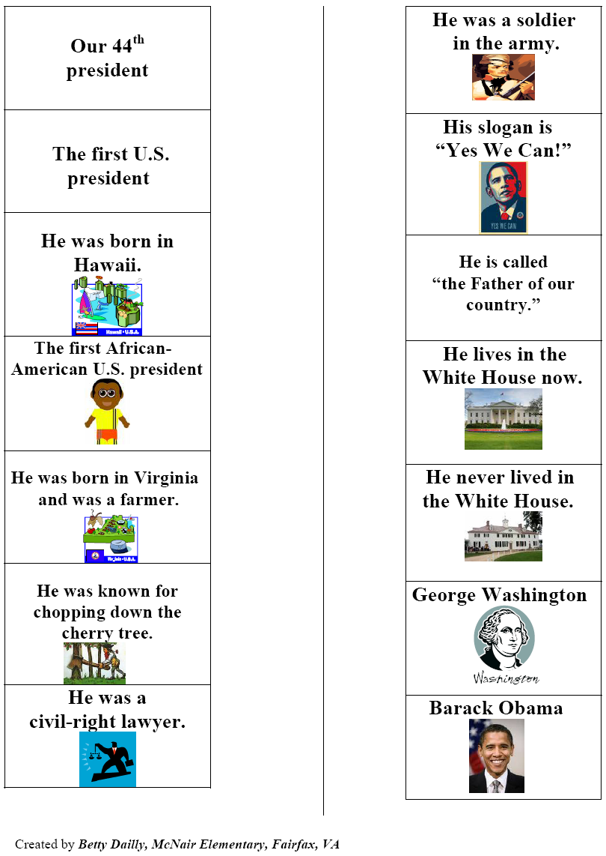

Slide 32
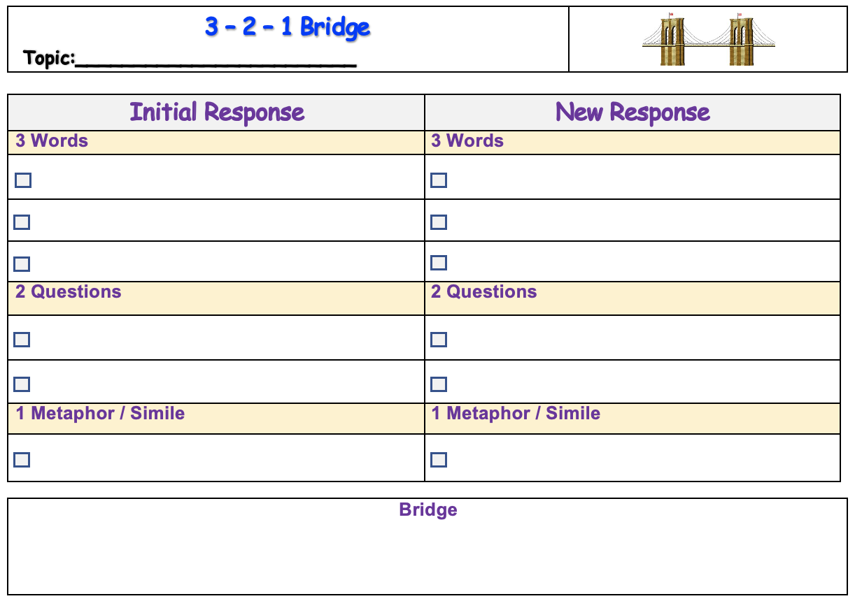
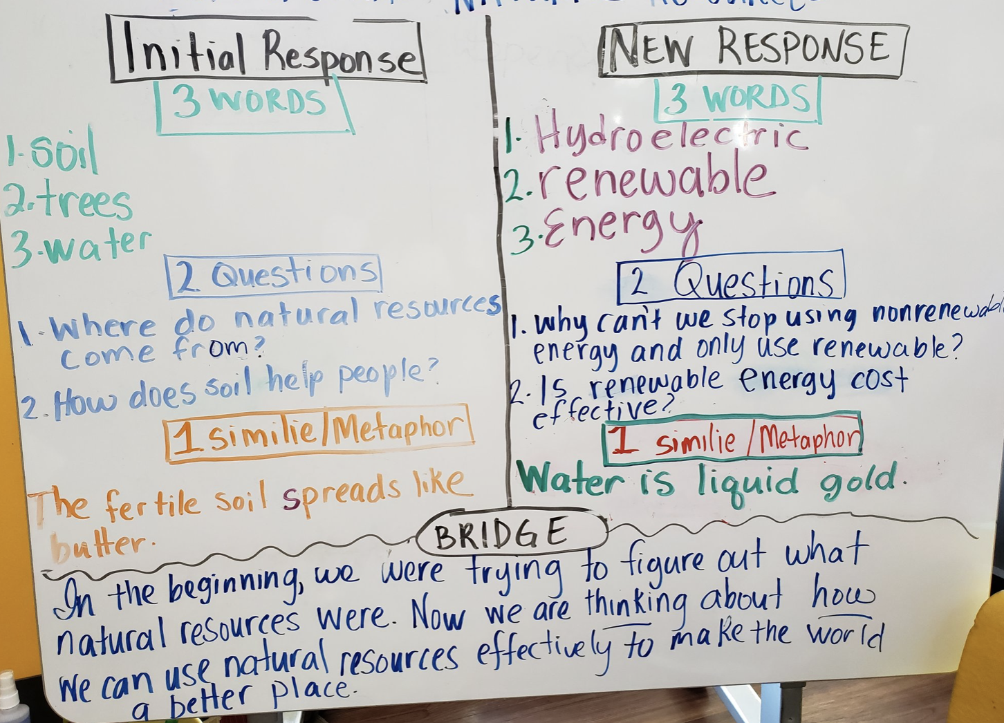
Summarizing
And
Note-taking

Slide 33
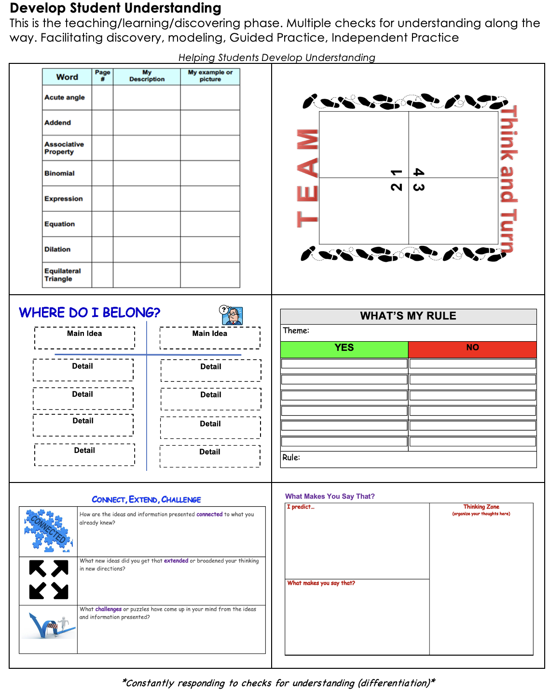
Checks for Understanding Along the Way
(Chunking and Checking)
page
4

Slide 34
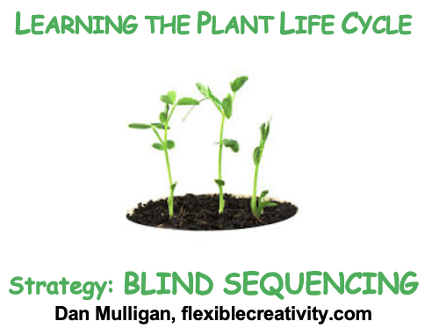

Content Neutral Structure:
BLIND SEQUENCING
Please leave the cards in the Ziplock with this side (cover) face-up.
Directions:
Shuffle cards.
Deal all cards with same side (cover) face-up.
Clockwise one person describes a

Slide 35
Musical/Rhythmic Sing it Create a beat Rap it Make a cheer Create a jingle Hum it Identify sounds React to sounds Listen to sounds Connect to music Write a poem | Verbal/Linguistic Read it Spell it Write it Listen to it Tell it Recall it Use “you” words Apply it Chunk information Say it Use mnemonics | Logical/Mathematical Make a pattern Chart it Sequence it Create a mnemonic Analyze it Think abstractly Think critically Use numbers Prove it Interpret the data Use the statistics | Visual/Spatial Mind maps Graphic organizers Video Color code Highlight Shape a word Interpret a graphic Read a chart Study illustrations Visualize it Make a chart Create a poster
Body/Kinesthetic Role play Walkabout Dance Lip sync Skits/charades/mimes Construction Math manipulatives Sign language Sports Activity centers Body language | Intrapersonal Metacognition Use self-talk Work independently Solve in your own way Understand self Journal it Rehearse it Use prior knowledge Connect it Have ownership | Interpersonal Think-Pair-Share Jigsaw Cooperative grouping Drama Debates Class meetings Role play Meeting of minds Peer counseling Tutors/buddies Giving feedback Shared Journals | Naturalist Label it Categorize it Identify it Form a hypothesis Do an experiment Adapt it Construct it Classify it Investigate it Discern patterns

Slide 36

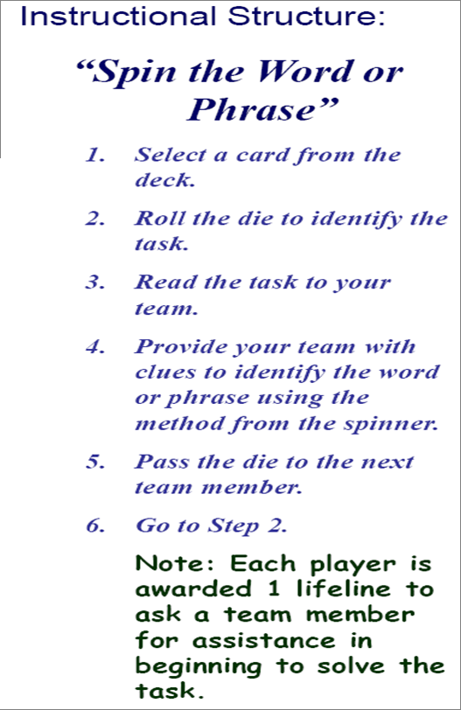
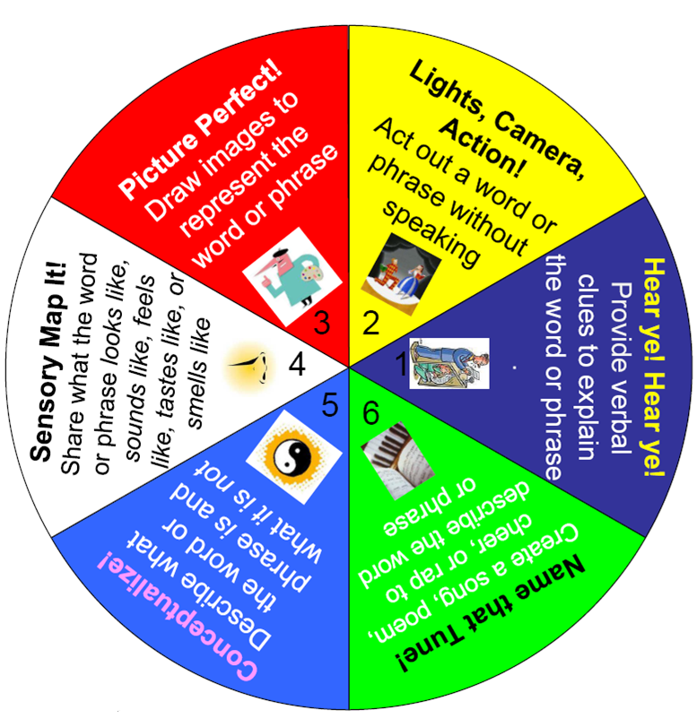
Click on the arrow to start and stop spinner.

Slide 37

High Expectations for Each Student
“No one rises to low expectations.”
~Carl Boyd

Slide 38
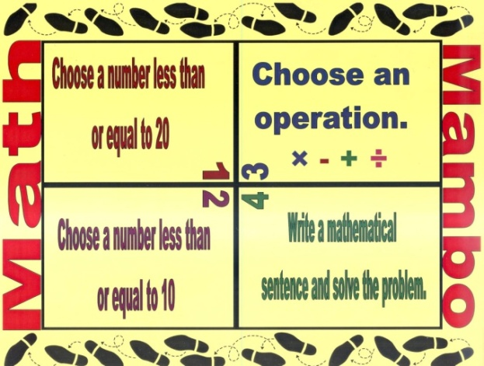
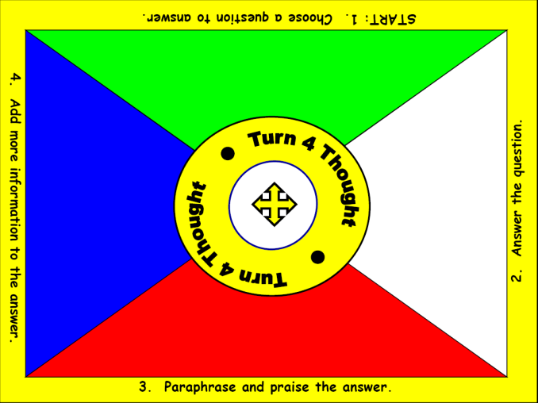
Kinds of Evidence – Continuum of Evidence
Informal Check for Understanding

Slide 39


Name a noun. | Form a sentence.
Name a verb. | Name an adjective
1
4
Team
Turn
2
3

Slide 40


Slide 41


Slide 42





Differentiation
Based on an
Unpacked
Standard

Slide 43

One Has to Go!
You must remove one choice.
Which one would you choose to go?
________________________
What makes you say that?
(explain your choice)

Slide 44
One Has to Go!
You must remove one choice.
Which one would you choose to go?
________________________
What makes you say that?
(explain your choice)

Slide 45
One Has to Go!
You must remove one choice.
Which one would you choose to go?
________________________
What makes you say that?
(explain your choice)

Slide 46
Advanced Organizers
Use Visuals
  Advanced organizers help students organize the information and retain 5 times more of the information.

Slide 47
VENN DIAGRAMS
Red
Thick
Small

Slide 48
VENN DIAGRAMS
Animals
Plants

Slide 49


Resources

Slide 50

Resources

Slide 51




The Power of Students Generating & Testing Hypotheses
(investigating, justifying, designing, synthesizing, appraising)
Growing
every child as a thinker, problem solver
and communicator to pursue their
future without limits!
Don’t Steal
Their
Thinking

Slide 52
Building Mental
Flexibility and Creativity

Slide 53


Determining
Depth of
Knowledge

Slide 54


Instructional Strategy:
Motor Mouth
Purpose: To build and ‘check for’ background knowledge
One partner draws a card
Read their partner the words in blue (at top of card)
The partner with the card has one minute to give clues that willhelp their partner say each DOK student action on the card.

Slide 55

Good Instruction
(Keep it Simple…Keep it Real)
“We can, whenever and wherever we choose, successfully teach all children whose schooling is of interest to us. We already know more than we need to do that. Whether or not we do it must finally depend on how we feel about the fact that we haven’t so far.”
~Ron Edmonds

Slide 56

ORGANIZATION
Helping Students Develop Understanding
Purposefully facilitate students collaborating to create interactive notes to archive essential understandings based on unpacked standards (and PLD).

Slide 57



Slide 58




Slide 59

Unit Glossary Template

Slide 60


Student-Generated
Glossary

Slide 61
KEY QUESTION: Why are common assessments so important?
WHY do we ASSESS:
1. INFORM INSTRUCTIONAL DECISIONS
2. ENCOURAGE STUDENTS TO TRY
“You can enhance or destroy students’ desire to succeed in school more quickly and permanently through your use of assessment than with any other tools you have at your disposal.” Rick Stiggins, Assessment Trainers Institute
Notes:
Grading: each side is worth 4 points:
Front elements:
“In God We Trust”
“Liberty”
Year
Lincoln head
Extra credit point - Mint letter
Back elements:
“United States of America”
“One Cent”
“E Pluribus Unum”
Lincoln Memorial
Extra credit point - Lincoln drawn in memorial
Identify scores by raising of hands. Use 6 or better for mastery. Questions:
Did they do better as an individual or a team?
How would the results be used if this was a “For” assessment?
How would the results be used if this was an “Of” assessment?

Slide 62
Communicating
Effectively
Listening and Speaking

Slide 64
Follow-up Debriefing
Each pair should share with your other team members the method you used to graph the figure.
Discuss with your team:
  Which method appeals to you?
  Is there another method that you would prefer?
Prepare for a “pairs choice of method” with a new graph.

Slide 66
Key Question
Did your performance on the second attempt to complete the grid exercise improve after having an opportunity to self-assess your initial strategy?

Slide 67
Formative Assessment
Formative assessment is the process used by teachers and students during instruction that provides feedback to adjust teaching and learning for the purpose of improving student learning.
Council of Chief State School Officers, October 2006
Notes:
Process rather than a particular test….
It is not the nature of the test itself that makes it formative or summative…it is the use to which those results will be put.

Slide 68

Gear 1
What do each of our students need to know and be able to do?
Essential
Knowledge
Essential
Vocabulary
Essential
Skills/Processes

Slide 69

Gear 2b: How will THEY know when they know it?

Slide 70
Differentiation
Based on an
Unpacked
Standard

Slide 71

Don’t
Steal
Their
Thinking!

Slide 72
The Power of Students Generating & Testing Hypotheses
(investigating, justifying, designing, synthesizing, appraising)
Growing
every child as a thinker, problem solver
and communicator to pursue their
future without limits!
Don’t Steal
Their
Thinking

Slide 73


Slide 74
Don’t
Steal Their
Thinking!

Slide 75
Classifying
Rectangle
Shape
Circle
Square Corner
Side
Attribute
Round
Triangle
Corner
Square

Slide 76
Clear Objective (Today I will…)/Vocabulary
referenced by teacher/students throughout learning
Lesson
Flowchart
Creating an Environment for Learning
Provides students with context
Allows teacher to build/check for background knowledge
Integration of:
Constant checks for understanding of each student.
Seize opportunities for student collaboration on second questions!
Helping Students Develop Understanding
This is the teaching/learning/discovering phase. Multiple checks for understanding along the way. Modeling, Guided Practice, Independent Practice
Helping Students Extend & Apply Knowledge
Student reflection & doing something with what they learned.

Slide 77


Clarifying the Target
Planning to differentiate support rather than expectations

Slide 78
Determining
Depth of
Knowledge

Slide 79
Instructional Strategy:
Motor Mouth
Purpose: To build and ‘check for’ background knowledge
One partner draws a card
Read their partner the words in blue (at top of card)
The partner with the card has one minute to give clues that willhelp their partner say each DOK student action on the card.

Slide 80






Slide 81






Slide 82
What is our mission?
Working together as a team, we will end the predictive value of race, class, gender, and special capacities for our children’s success through high quality teaching and learning for all. We seek to build relationships with families and communities to ensure that every student succeeds. We will know every student.

Slide 83


Interesting Fact:
Unpacking standards and/or administering a DFA or CFA is meaningless unless it results in a a purposeful response from the teacher and each student
Seizing
Opportunities

Slide 84


4 – second
partner
Find a friend in the room from a different school/grade-level/ or central office.
Find 2 comfortable seats and relax.
*Please bring a pen(cil)!

Slide 85
Content Neutral Structure:
BLIND SEQUENCING
Directions:
Deal the cards facedown to each team member.
You may look at your card(s) but do not allow anyone else to see your card(s).
The team member seated clockwise next to the dealer should describe the phase of the plant life cycle on one of their cards. Others may ask questions. Place card facedown on the table (no peak).
Then the next team member will describe the phase of the plant life cycle on their card. Place the card on the table.
The team must sequence the cards without looking until all cards are down.

Slide 86

What instructional strategy will produce our best results?

Slide 87

What instructional strategy will produce our best results?

Slide 88

Students Charting Progress with Success Criteria

Slide 89


Opportunities to Celebrate with each student

Slide 90

Clear Learning Intentions/ Success Criteria/ & Vocabulary
referenced by teacher/students throughout learning
Lesson
Flowchart
What instructional
strategies will produce
the best results for each
student?
Creating an Environment for Learning
Provides students with context
Allows teacher to build/check for background knowledge
Integration of:
Constant checks for understanding of each student.
Seize opportunities for student collaboration on second questions!
Helping Students Develop Understanding
This is the teaching/learning/discovering phase. Multiple checks for understanding along the way. Modeling, Guided Practice, Independent Practice
Helping Students Extend & Apply Knowledge
Student reflection & doing something with what they learned.

Slide 91
Anchor
Charts
Setting the Objective
(and checking along the way)

Slide 92

Thank you for your commitment to children!
"It's your attitude, not just your aptitude that determines your ultimate altitude."
--Zig Ziglar ☺
Dan

