Slide 1

G. E. A. R. S.
Growing Educators,
Achieving Results with Students
July 25, 2017

Slide 2

Mission
In Avondale, every student will grow as a thinker, problem solver and communicator to pursue a future without limits.

Slide 3
Affirming our Beliefs
We believe all children are capable of success – No exceptions.
We connect all children to caring adults to reveal and grow the possibilities.
We prepare students for their future by time traveling to allow children to see their potential in four destinations and to plan for it today. We are a district of Hope.

Slide 4

GEARS
Growing Educators, Achieving Results with Students

Slide 5
Resource
To
Share
flexiblecreativity.com

Slide 6

Teaching Every Student
Five Key Elements
Learning Environment
The Curriculum
Assessments
Instruction
Classroom Management

Slide 7
4 – second partner
Your Task:
Find a partner from another school and a different grade-level and/or content area.
Find 2 seats, introduce your self, and tell them one goal you have for this school year.
Smile…

Slide 8


HUNT 4
SOLUTIONS

Slide 9
Depth of Knowledge Edition
State and justify the DOK of each assessment
Classify plane and three-dimensional figures. (Math)
Describe cause-effect of particular events. (Social Studies)
Support ideas with details and examples. (ELA – Writing)
Develop generalizations of the results obtained and the strategies used and apply them to new problem situations. (Science)
Perform procedures with multiple steps and multiple decision points. (Math)
Use a dictionary to find the meanings of words. (ELA – Reading)
Perform a simple science process or a set procedure (like a recipe). (Science)
Analyze and explain multiple perspectives or issues within or across time periods, events, or cultures. (Social Studies)
DOK 2
DOK 2
DOK 3
DOK 4
DOK 3
DOK 1
DOK 1
DOK 4
Clue: 2 are DOK 1, 2 are DOK 2, 2 are DOK 3, 2 are DOK 4

Slide 11
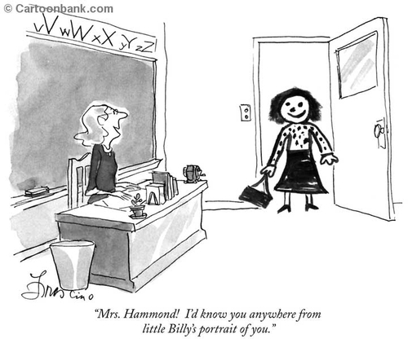
Brain Break

Slide 12
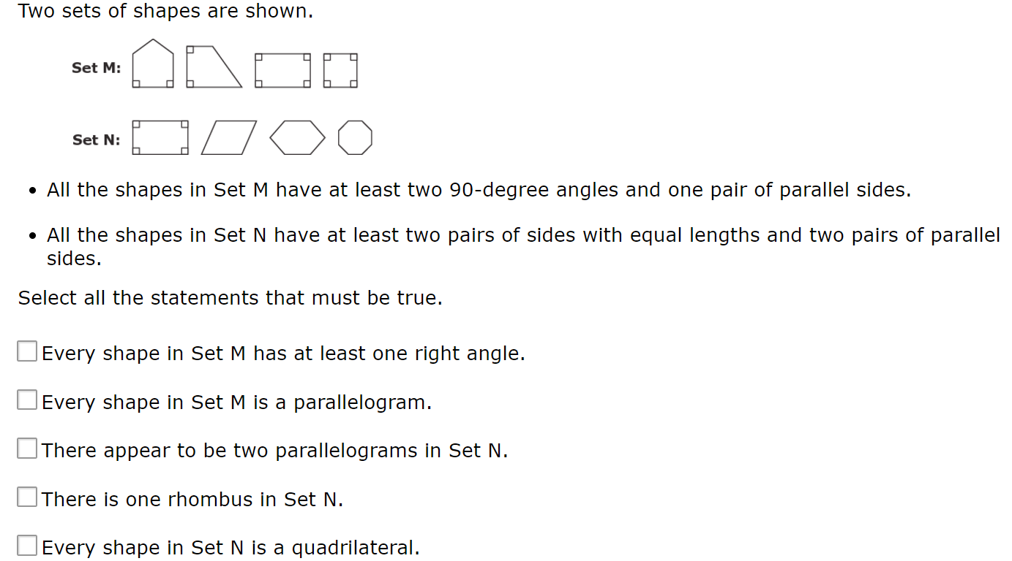
Deconstructing
the
AzMERIT
What we know:
Domain: MDG Cluster: 5.GB Standard: 5.GB.3 AzMerit: Item # 3
Our Task –
Solve the problem.
Justify the DOK level

Slide 13
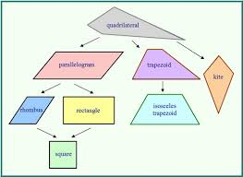
Deconstructing an AzMERIT Item

Slide 14
Deconstructing an AzMERIT Item

Slide 17
Justifying the DOK of the Item
DOK 3

Slide 18
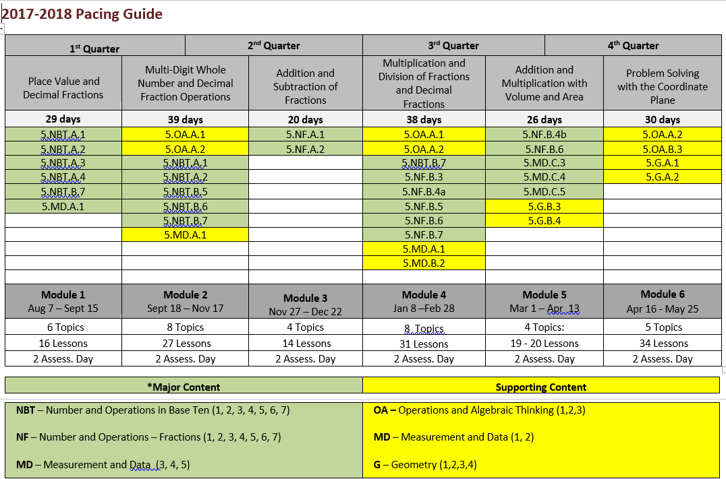
When is this standard taught/learned?

Slide 19

Mystery Envelope
Inside your envelope is an actual AzMerit item experienced by students.
Work with a partner to:
  Solve the problem.
  Justify your solution.
  Identify and defend the DOK of the item (Scaffolding – consider using the DOK chart)
  Prepare to defend your solution/DOK level and critique the reasoning of others.
  Enjoy!

Slide 20
Main Myth about Learning
Some part of the learner’s anatomy must be in contact with the chair in order for learning to take place!

Slide 21
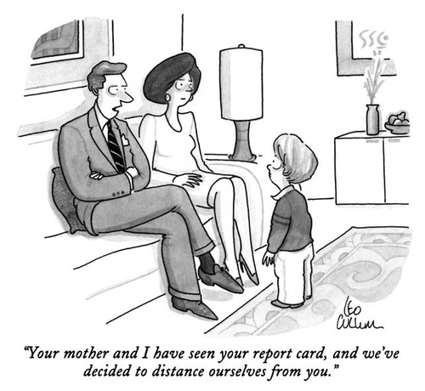
Brain Break

Slide 22

Why
Bother?

Slide 23

Wisdom from the CHESHIRE CAT
“Would you tell me, please, which way I ought to go from here?”, said Alice.
“That depends a good deal on where you want to get to,” said the Cat.
“I don’t much care where – “ said Alice.
“Then it doesn’t matter which way you go,” said the Cat.
~ Lewis Carroll, Alice’s Adventure in Wonderland

Slide 24
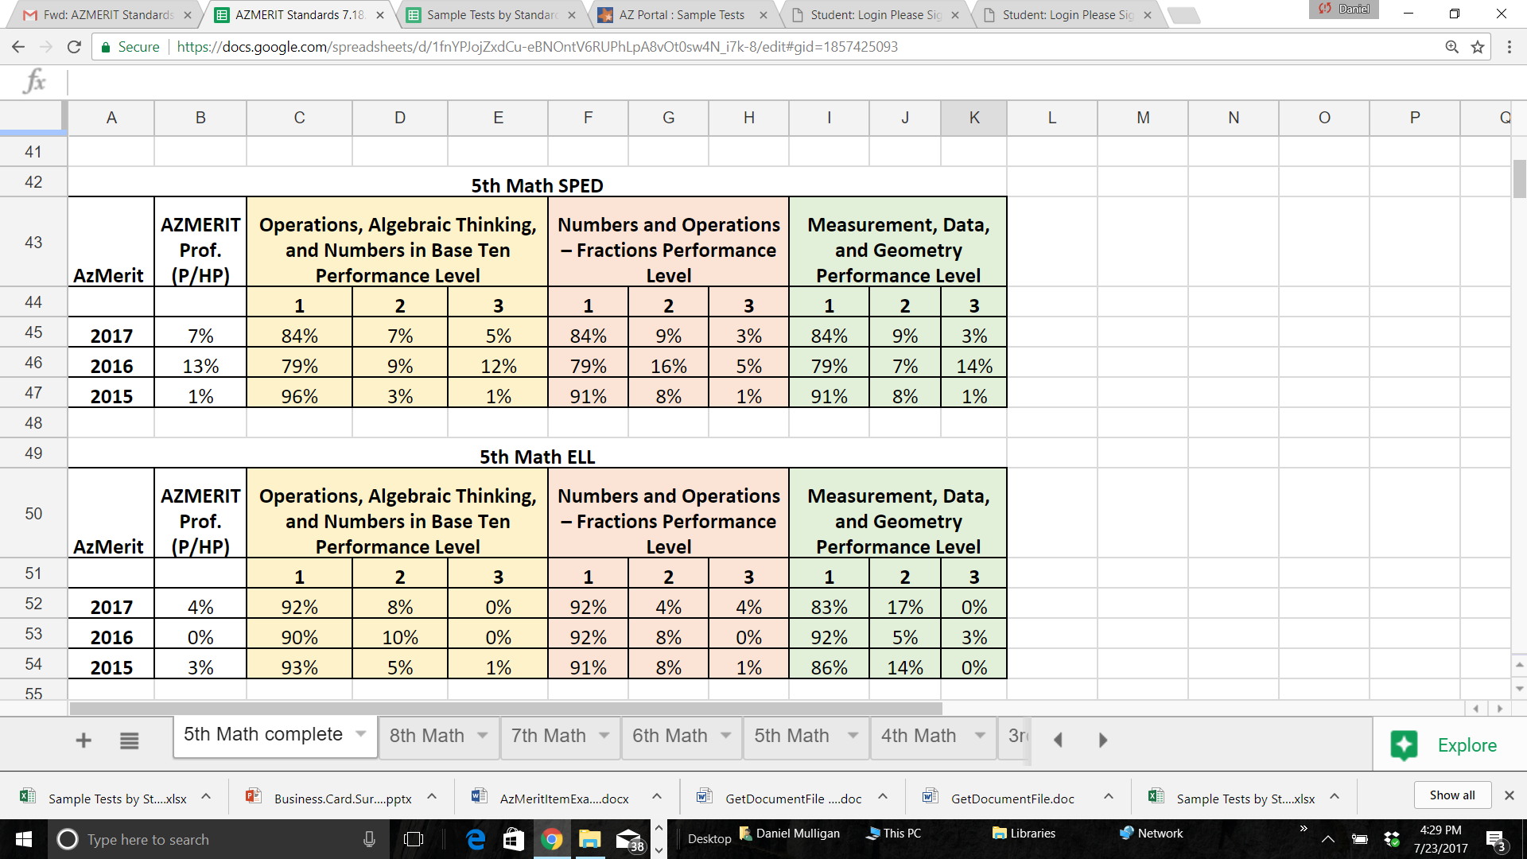
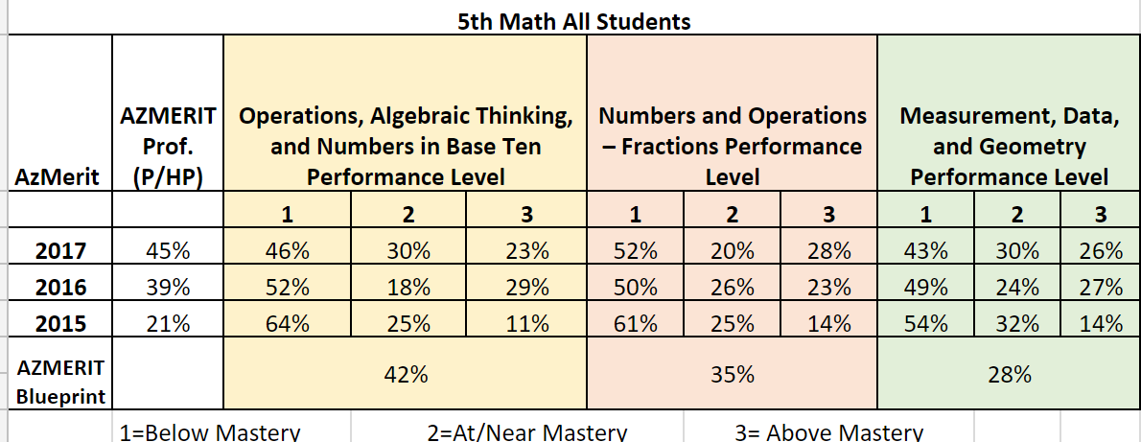
ALL
means
ALL

Slide 25
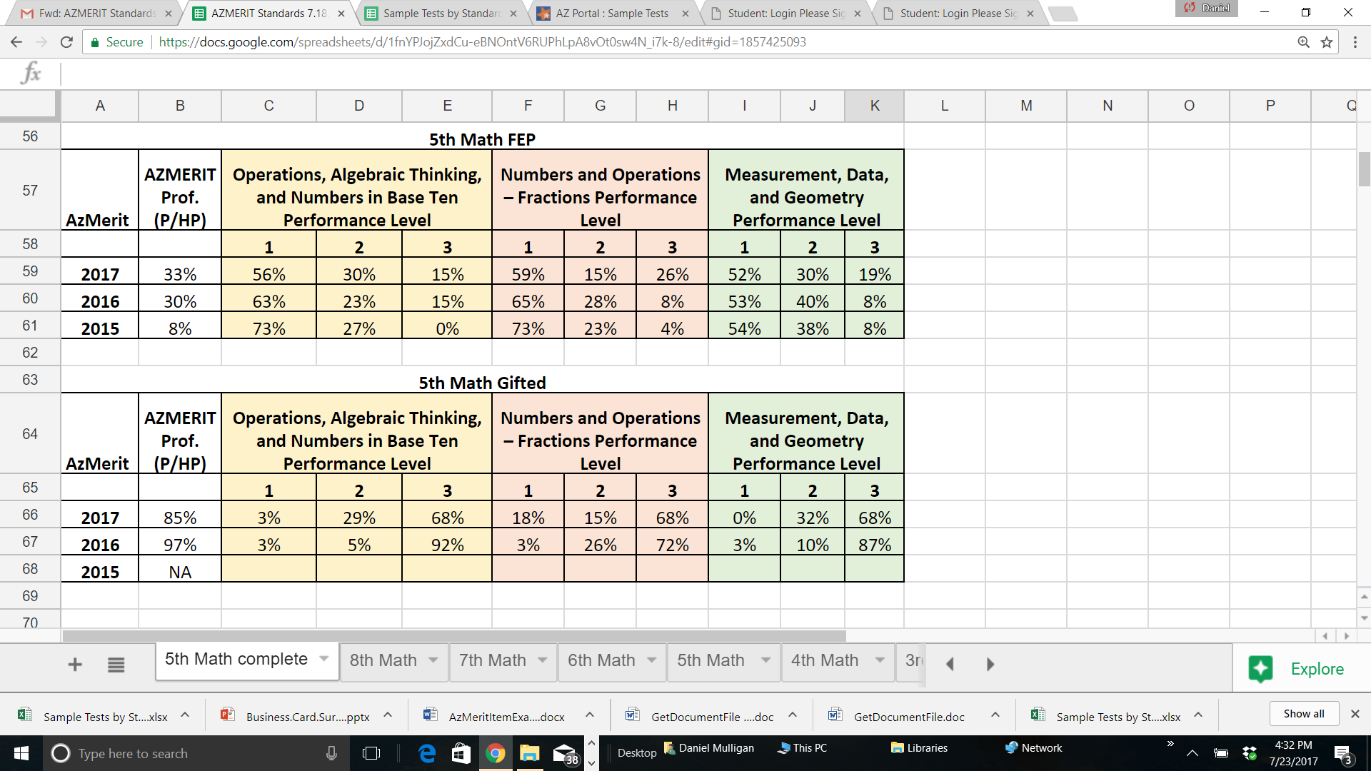
ALL
means
ALL

Slide 26
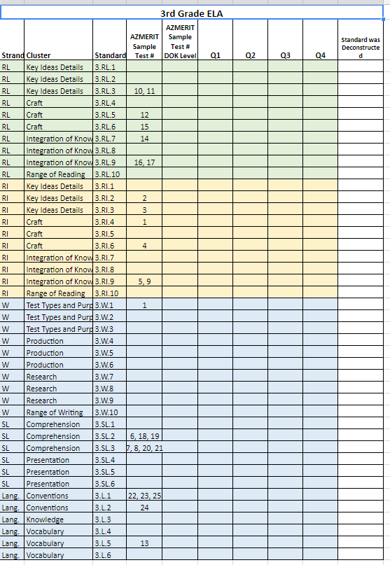
DART Team Task
Task:
Work in your DART team to deconstruct a sample AzMERIT assessment*.
Use the sample assessment items and the item analysis chart to:
  Analyze each assessment item
  Identify the DOK level of the item
  Establish when it is taught in the current suggested pacing guide
*NOTE: Grades K, 1, and 2 use the appropriate Grade 3 assessment.
Science use a Math assessment
Social Studies use an ELA assessment

Slide 27
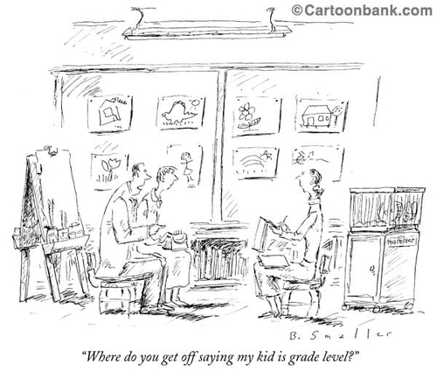
Brain Break

Slide 28

Good Instruction
(Keep it Simple…Keep it Real)
“We can, whenever and wherever we choose, successfully teach all children whose schooling is of interest to us. We already know more than we need to do that. Whether or not we do it must finally depend on how we feel about the fact that we haven’t so far.”
~Ron Edmonds

Slide 29


In Avondale, every student will grow as a thinker, problem solver, and communicator to pursue a future without limits.
Essential Knowledge
Essential Skills
LEARNING TARGET
Essential Vocabulary
Prepared for the GEARS Team Members of
AVONDALE Elementary School District #44
by Dan Mulligan, Ed. D., flexiblecreativity.com (Twitter: @drdanmulligan)
July 2017
“The difference between who you are and what you want to be is what you do.” ~Bill Phillips,2006

Slide 30
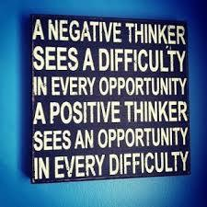
Today’s
GOAL: To Clarify Our Work:
Today I will: work with my peers to increase my understanding of the rigor embedded in the Arizona standards and related AzMERIT items.
So I can: unpack a standard and decompose assessment items.
I will know I have it: when I can identify/revise/create focused assessment and lessons.
Objective

Slide 31
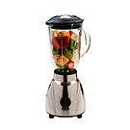
Mix it Up in the Box
Listen for the topic and the amount of time;
Silently mix around the room;
When directed, pair up with person closest to you;
In pairs, Partner A shares and Partner B listens;
Partner B responds to what he/she heard by paraphrasing: “LET ME TELL YOU WHAT I UNDERSTOOD YOU TO SAY”;
Record summary of partners response; then
Switch Roles

Slide 33
Thinking inside the Box
1 | 2
3
Describe the elements of unpacking a standard? What are some tools you and/or your DART team used during the process? Explain.
How will unpacking a standard impact assessment and lesson planning? Explain…
How would you justify to teachers at your school why it is important to unpack standards?

Slide 34
Share the Ideas you
Gathered
1 | 2
3
Describe the elements of unpacking a standard? What are some tools you and/or your DART team used during the process? Explain.
How will unpacking a standard impact assessment and lesson planning? Explain…
How would you justify to teachers at your school why it is important to unpack standards?

Slide 35

Effective Assessment and Instruction focuses on Unpacked Standards that identify the nonnegotiable knowledge, skills, processes, & vocabulary
Three types of curricula exist in any classroom:
    The Intended Curriculum: content/skill specified by the state, district, or school at a particular grade level.
    The Implemented Curriculum: content/skill actually delivered by the teacher.
    The Attained Curriculum: content/skill actually learned by the students.
The BIG Idea
Implemented Curriculum
Intended Curriculum
Attained Curriculum

Slide 36
Additional
DOK
Indicator
Resource

Slide 37
The Process of
Unpacking Standards

Slide 38
Arizona College & Career Ready Standards
Performance Level Descriptors

Slide 39
To make an assessment truly
diagnostic, we must include
Items at each proficiency
level.
Create items to provide feedback on student mastery of each indicator.

Slide 45
AzMERIT
Item Format Types
Resource:
AzMERITitemFORMATmaster

Slide 46
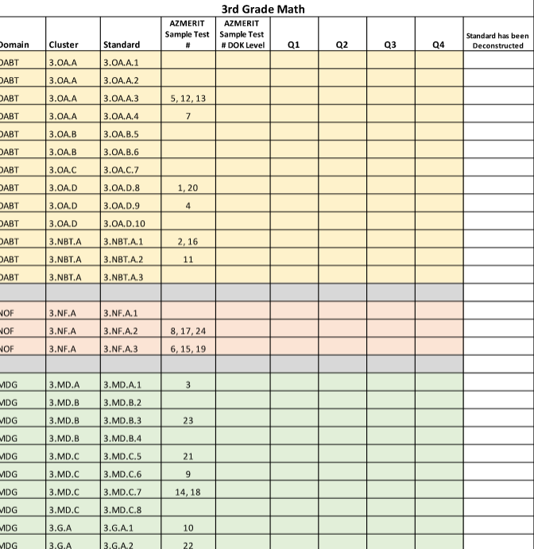
Step 6: Is there an AzMERIT question that aligns with this standard?

Slide 47
Identify all Galileo items that assess this standard.

Slide 48
AESD Math End of Module Assessment
Galileo 3.EMA.7

Slide 51
Opportunity to Learn

Slide 52
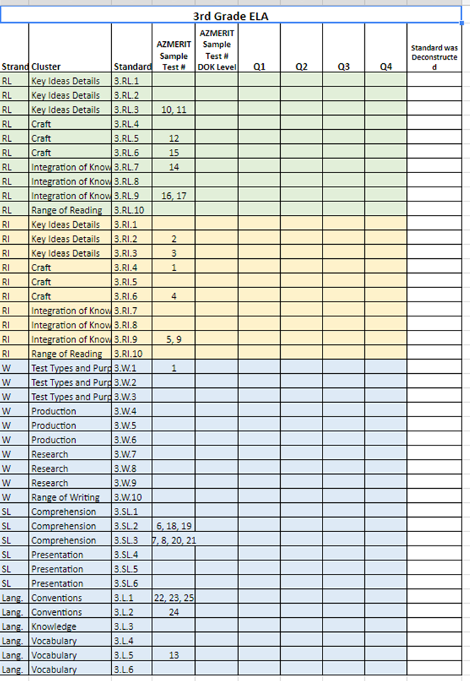
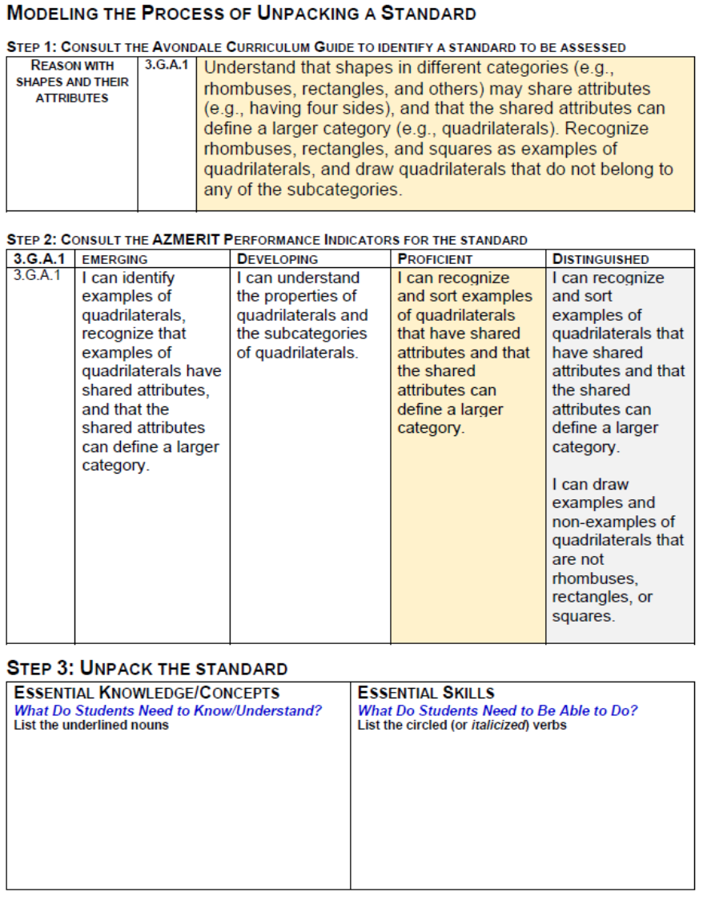
Today’s DART Task
Unpack a standard that will be taught during the first quarter.
Use the ‘Michelle’ Chart to identify any AzMERIT items that align to this standard.
Review the diagnostic Avondale Unit/Module assessment to approve/revise/create items based on the above steps.
Prepare for a peer review/submission of the new assessment.

Slide 53

Thank you for your commitment to children!
"It's your attitude, not just your aptitude that determines your ultimate altitude."
--Zig Ziglar ☺
Dan

