Slide 1



CELEBRATE THE STRUGGLE:
Empowering EACH Student to become an effective
Thinker, Problem Solver, & Communicator
Essential
Vocabulary
Essential
Skills
LEARNING TARGET
Essential
Knowledge
High Expectations
Prepared for the Collaborative Learning Team of
AVONDALE ELEMENTARY SCHOOL DISTRICT
by Dan Mulligan
June 2016

Slide 2
Opportunities – teaching for long-term memory
Consider evolving the ‘I do it’ section of a lesson into the “I do it…while checking for understanding’ section of the lesson;
Tell your neighbor, paraphrase what I said in your own words…
Communicators
Thinkers
Current Research from McREL reveals, on average, students can listen without’ doing something’ with the information for 2.5 to 3 minutes.
Tell your neighbor, why do you think we do that…
Will what we just did work in every case? Why or why not?
Problem
Solvers

Slide 3
Resources
to
Share
flexiblecreativity.com

Slide 4


Effective Instruction: focus on essential knowledge, skills, processes, & vocabulary
Three types of curricula exist in any classroom:
    The Intended Curriculum: content/skill specified by the state, division, or school at a particular grade level.
    The Implemented Curriculum: content/skill actually delivered by the teacher.
    The Attained Curriculum: content/skill actually learned by the students.
Implemented Curriculum
Intended Curriculum
Attained Curriculum

Slide 5
The
WHAT

Slide 6


4 – second
partner
Find a friend in the room from a different school/grade-level/ or central office.
Find 2 comfortable seats and relax.
*Please bring a pen(cil)!

Slide 8
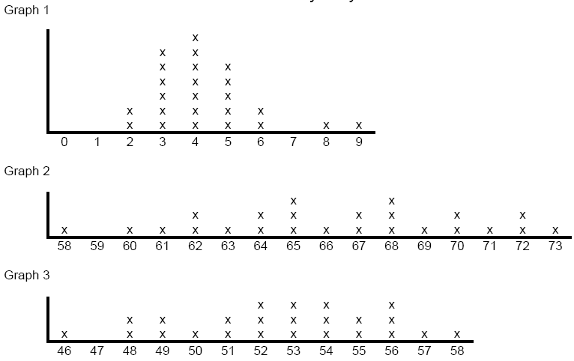
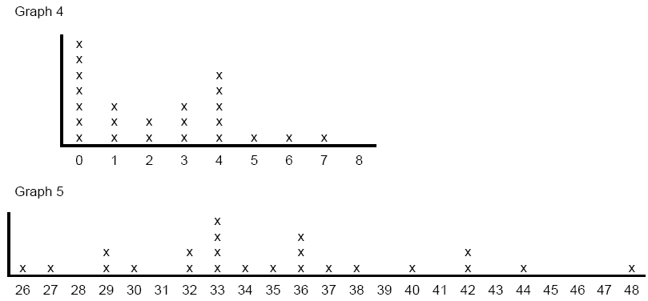
a. The number of cavities the sixth graders have?
b. The number of people in the sixth graders’ families?
c. The ages of the sixth graders’ mothers?
d. The heights of the sixth graders in inches?

Slide 9
Avondale Elementary School District
Mission
In Avondale, every student will grow as a thinker, problem solver and communicator to pursue a future without limits.
KEY QUESTIONS: Which of these processes did you practice during your analysis of the graph? Did the style of questioning deepen your understanding? Explain.

Slide 10
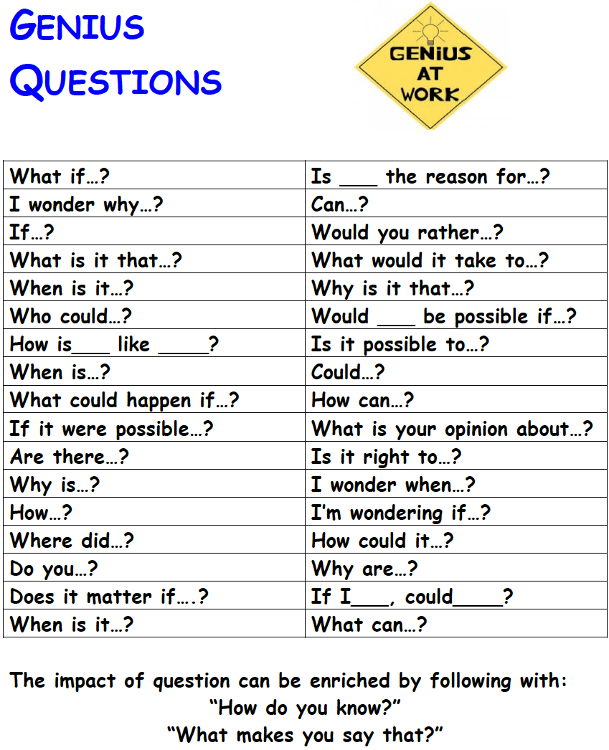


Slide 11
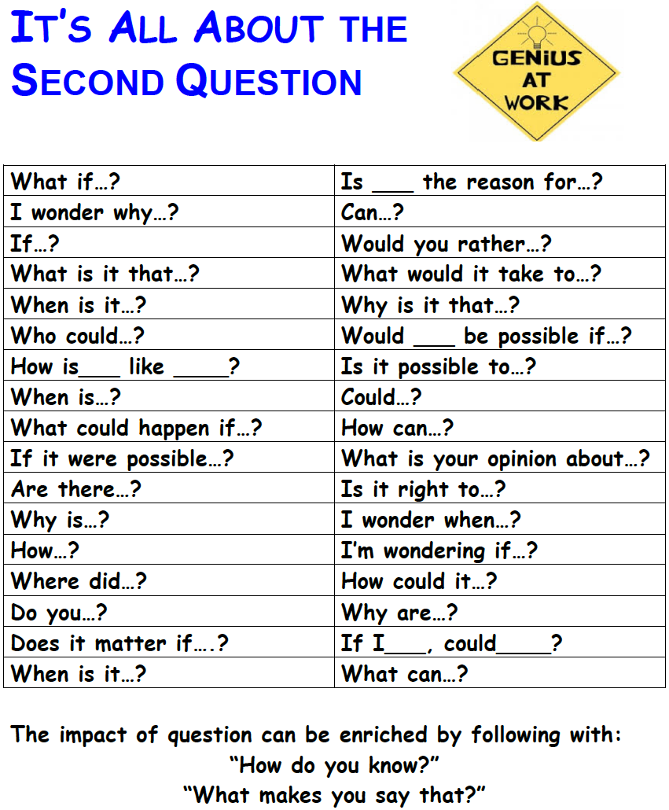
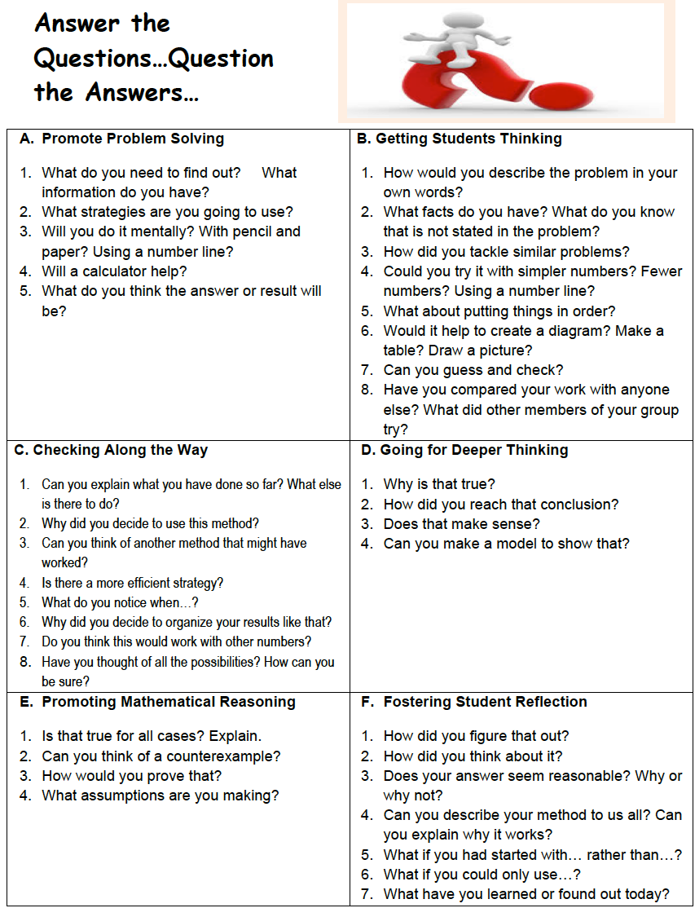
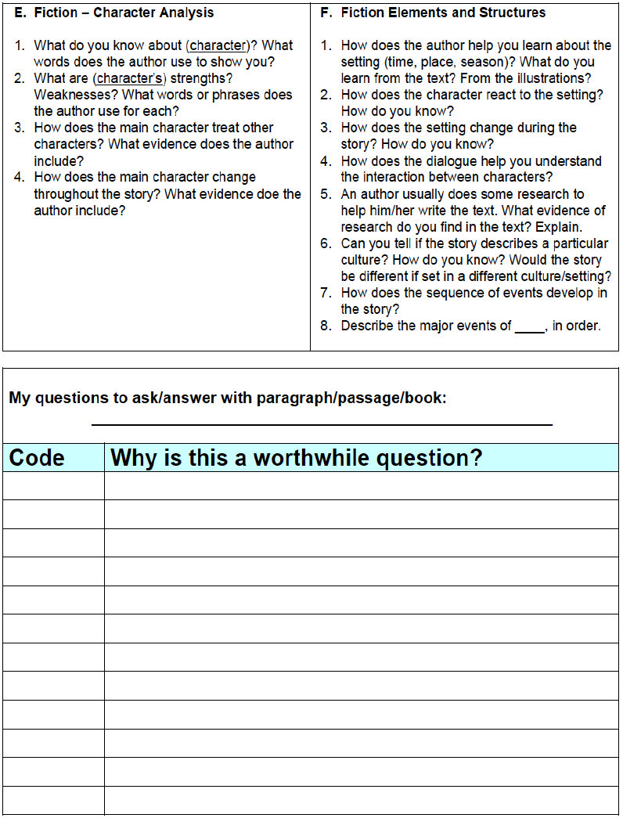
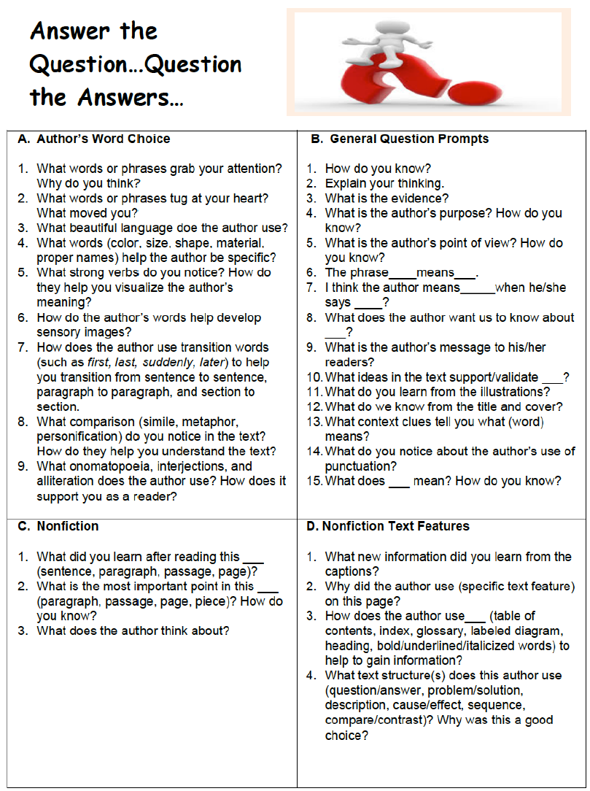
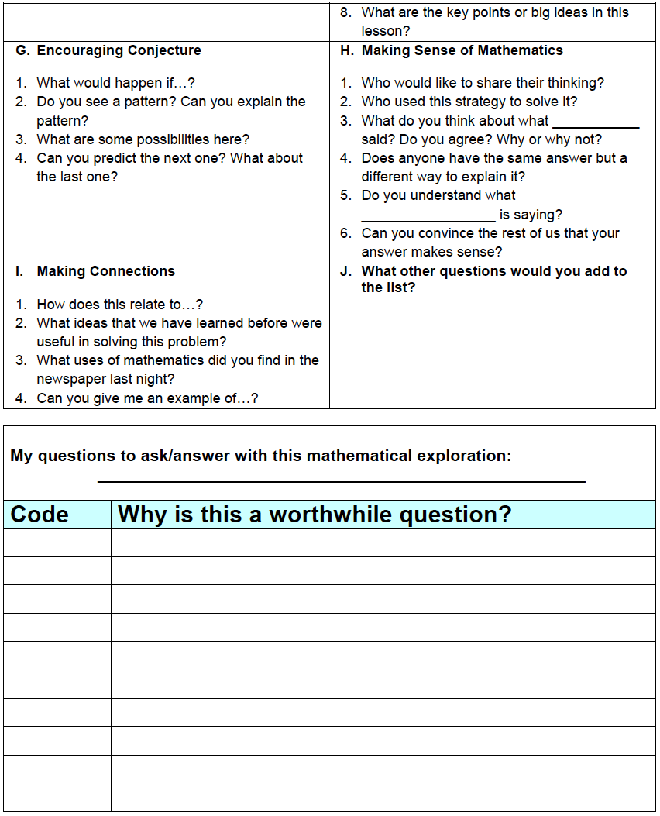
It’s All About:
The Second Question

Slide 12
Where
are
we?

Slide 13
Strategies to increase student achievement
Work collaboratively (e.g., construct viable arguments, critique, agree) to identify key words that capture the essential elements of strategies to increase student achievement used this past year with fidelity.
Enjoy working with your new best friend.

Slide 14

Good Instruction
(Keep it Simple…Keep it Real)
“We can, whenever and wherever we choose, successfully teach all children whose schooling is of interest to us. We already know more than we need to do that. Whether or not we do it must finally depend on how we feel about the fact that we haven’t so far.”
~Ron Edmonds

Slide 15
Lesson Planning

Slide 16
Process for Lesson Planning
page
8
Step 1: Know the Target (Minimally, what does each student have to know and be able to do?)

Slide 17
Process for Lesson Planning
page
9
Step 2: What is the DOK level of the standard(s)?

Slide 18
Process for Lesson Planning
page
9
Step 2: What is the DOK level of the standard(s)?

Slide 19
SPREAD the LOVE
Introduce your partner to the other people at your table.

Slide 20
VENN DIAGRAMS
Viewing a video of the text
Reading a story

Slide 21
Advanced Organizers
Use Visuals
  Advanced organizers help students organize the information and retain 5 times more of the information.

Slide 22
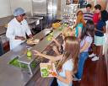


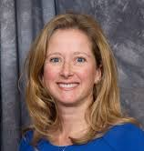

Organizing Theme:
Things someone would say…
EDUCATIONAL
STAKEHOLDER EDITION
Cafeteria Worker
Triangle
Trivia
200 POINTS
Parent
Student
100 POINTS 100 POINTS
Principal
Superintendent
Teacher
50 POINTS 50 POINTS 50 POINTS

Slide 23

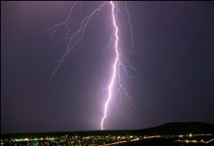


K – 5
Science
Kinetic Energy
200 POINTS
Hypothesis
Electron
100 POINTS 100 POINTS
Atmosphere
Experiment
Dissolve
50 POINTS 50 POINTS 50 POINTS

Slide 24

Grade 2 Math
Ruler
200 POINTS
Line of Symmetry
Pattern
100 POINTS 100 POINTS
Solid Shapes
Third from Right
Rotation
50 POINTS 50 POINTS 50 POINTS

Slide 25
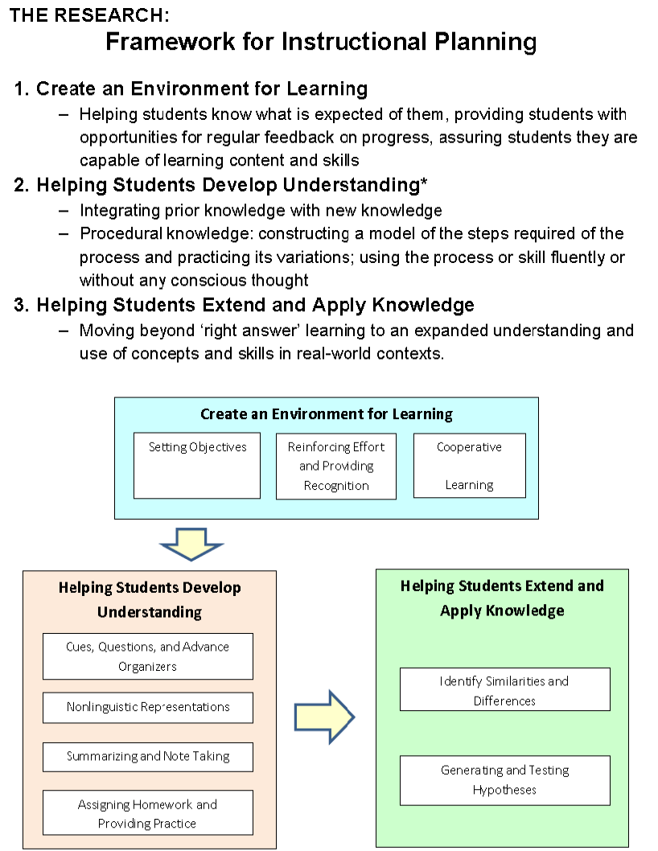

Framework for
Instructional Planning McREL, 2012
page
18
The
Opening
Create an Environment for Learning
  Helping students know what is expected of them, providing students with opportunities for regular feedback on progress, assuring students they are capable of learning content and skills
Helping Students Develop Understanding
  Integrating prior knowledge with new knowledge
  Procedural knowledge: constructing a model of the steps required of the process and practicing its variations; using the process or skill fluently or without any conscious thought
Helping Students Extend and Apply Knowledge
  Moving beyond ‘right answer’ learning to an expanded understanding and use of concepts and skills in real-world contexts.
The Work
Period
The
Closing

Slide 26
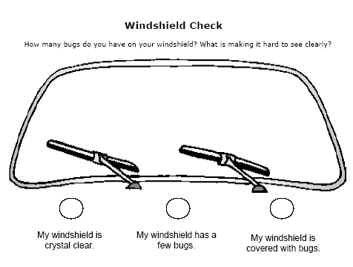

Slide 27
Category | Ave. Effect Size (ES) | Percentile Gain
Identify similarities & differences | 1.61 | 45
Summarizing & note taking | 1.00 | 34
Reinforcing effort & providing recognition | .80 | 29
Homework & practice | .77 | 28
Nonlinguistic representations | .75 | 27
Cooperative learning | .73 | 27
Setting objectives & providing feedback | .61 | 23
Generating & testing hypotheses | .61 | 23
Questions, cues, & advance organizers | .59 | 22

Slide 28
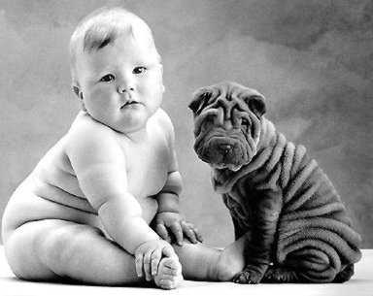
Identifying
Similarities and Differences

Slide 29
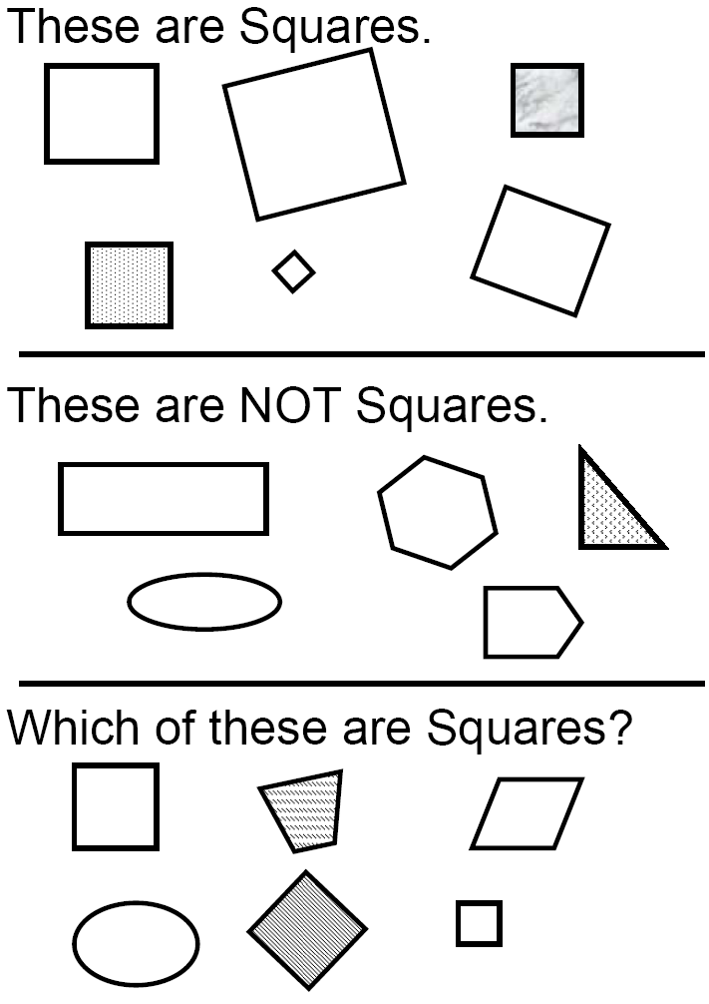
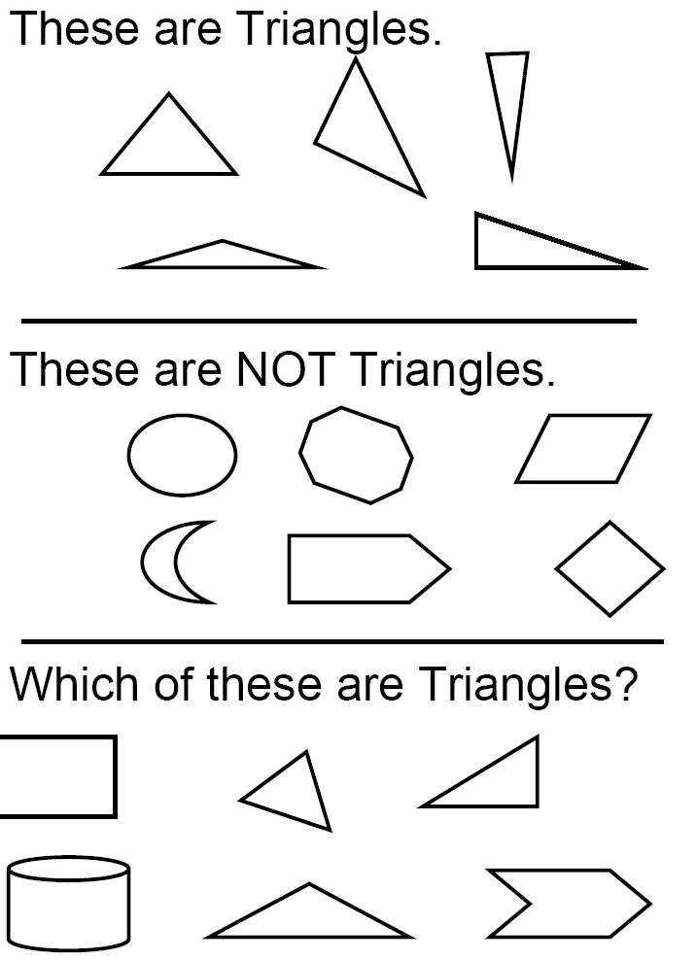

Slide 30
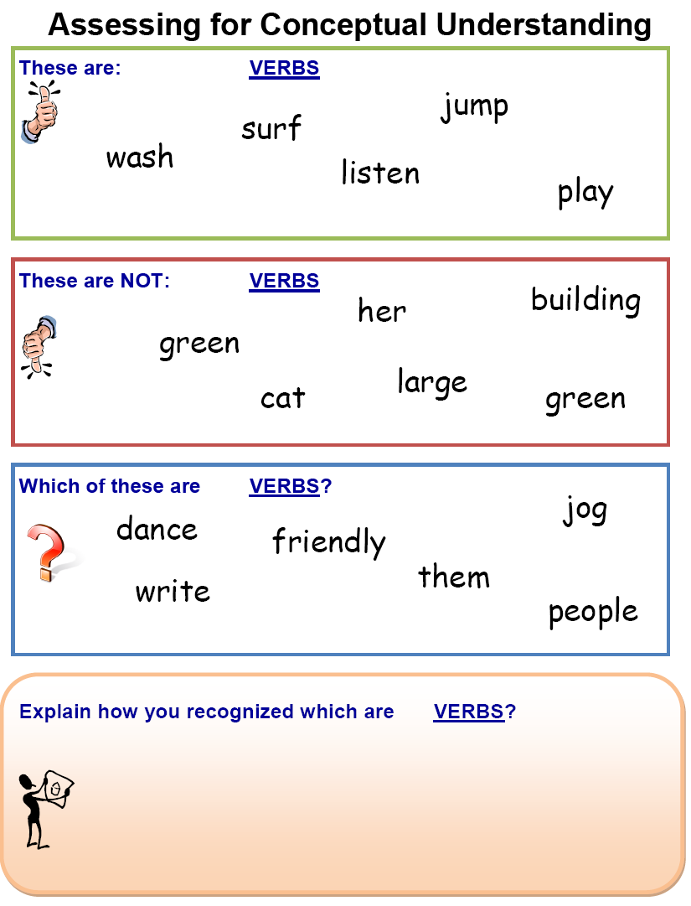

Slide 31
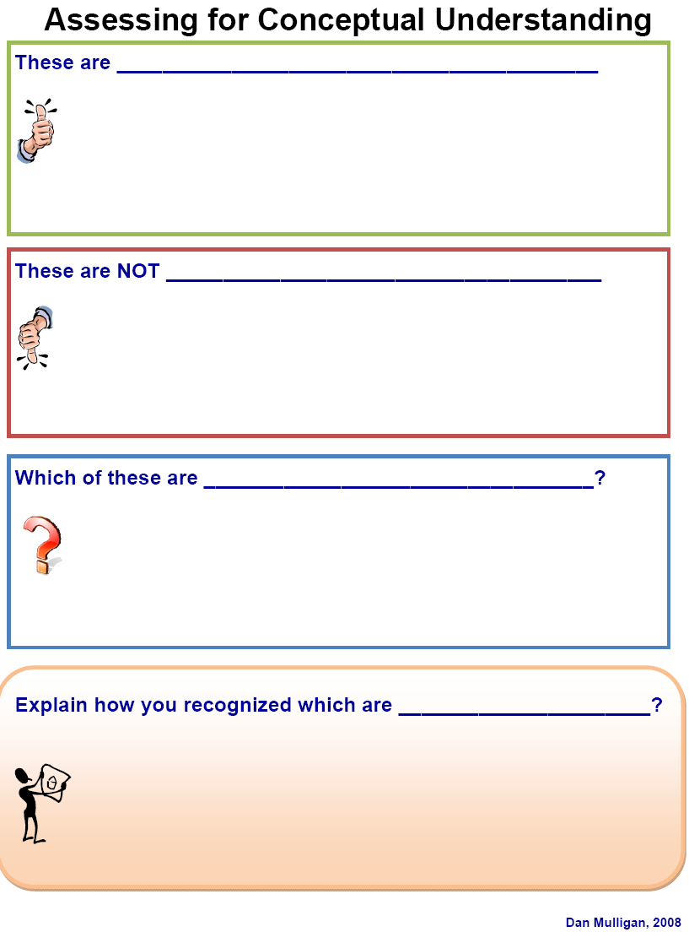
If you want a learner to truly understand and own essential knowledge, expand your exploration from ‘what it is’ to also ‘what it is NOT’.

Slide 32
page
46
Work with your partner to prepare a conceptual example that can be shared with your staff.

Slide 33
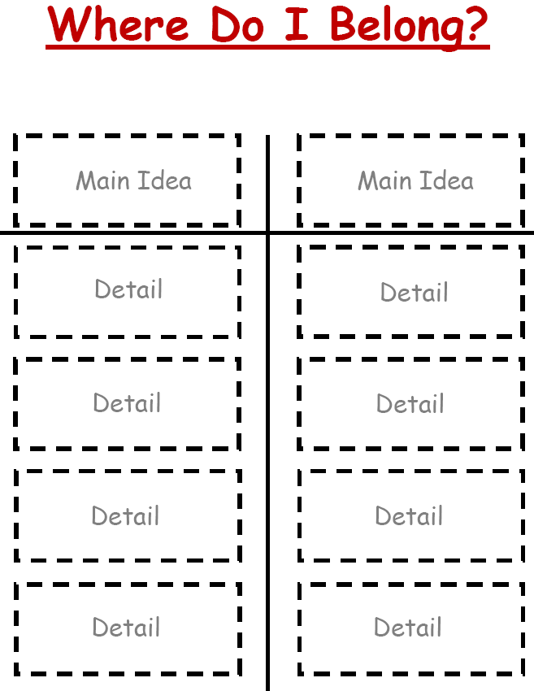

How can you use the Where do I belong? structure to support your role as teacher/administrator?
?
?
A = bh
4 right angles
Right Triangle
3 sides
1 right angle
4 sides
Opposite sides equal
One side is the longest
Rectangle
A = ½ bh

Slide 34
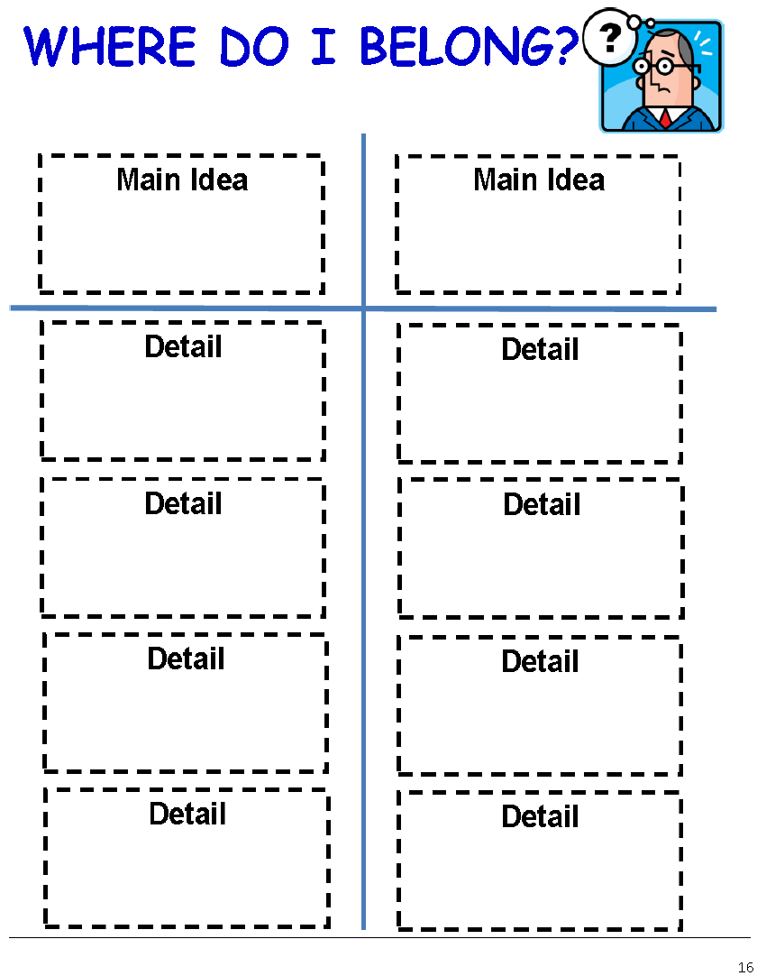
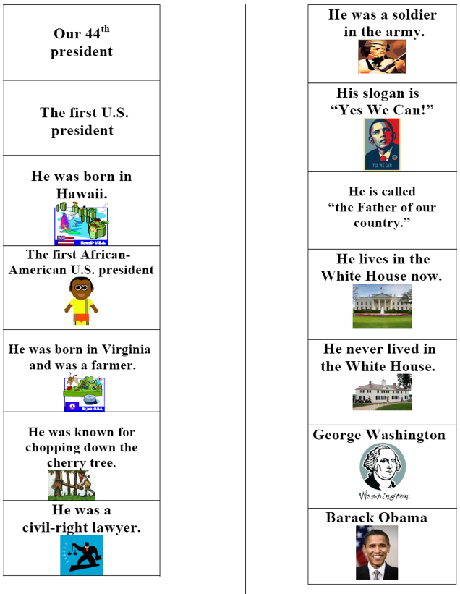
Open Task and Constructed Response
page
48

Slide 35
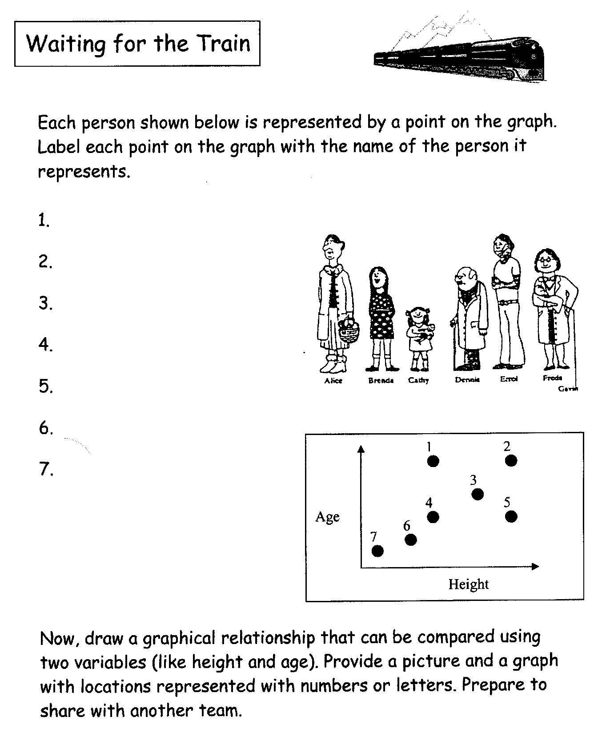
page
50
That was the sound of rigor in mathematics…
Driving Question:
How does learning math sound in your class, school, or division?

Slide 36
MOTOR
MOUTH
Things associated with school
Books
Report Cards
Teachers
School Bus
Cafeteria
Pencils
Erasers
Things associated with numbers
Decimal
Prime
Perfect Square
Numerator
Divisible
Integers
Even
Things associated with shapes
Quadrilateral
Vertex
Three-dimensional
Angle
Area
Right Triangle

Slide 37
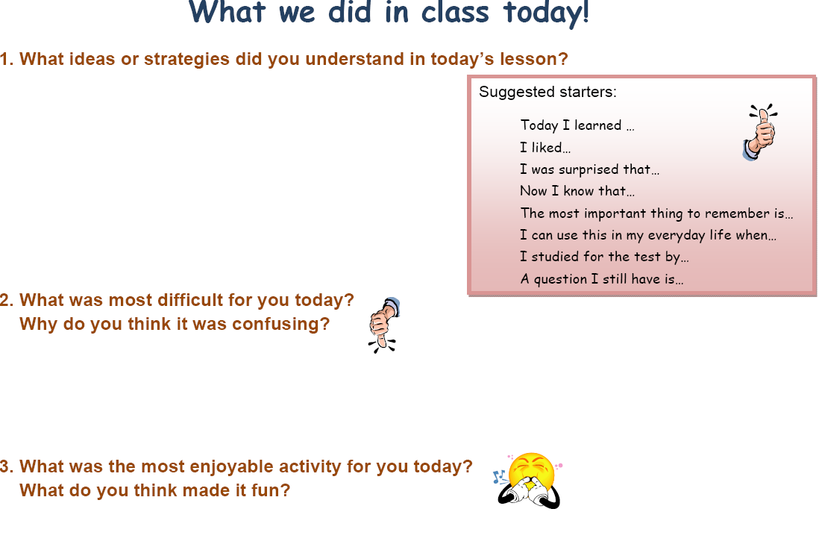

Slide 38

Thank you for your commitment to children!
"It's your attitude, not just your aptitude that determines your ultimate altitude."
--Zig Ziglar ☺
Dan

