Slide 1

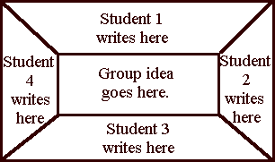

Celebrate the Struggle
A Vertical Approach to Meeting the Rigor of Arizona’s Standards
Prepared for the Collaborative Learning Team Members of
AVONDALE ELEMENTARY SCHOOL DISTRICT
by Dan Mulligan, Ed. D., flexiblecreativity.com, (twitter: @drdanmulligan)
June 2016

Slide 2
Avondale Elementary School District
Mission
In Avondale, every student will grow as a thinker, problem solver and communicator to pursue a future without limits.
KEY QUESTIONS: Which of these processes did you practice during your analysis of the graph? Did the style of questioning deepen your understanding? Explain.

Slide 3
Relationships
Message from a teacher at a high poverty middle school in Washington DC
HAD A GREAT DAY!
Last night I called 16 parents to tell them how "AWESOME" their child has been performing. Three parents cried on the phone because they never received a positive call before. This morning I had a parent bring me lunch to show her appreciation for the phone. In the afternoon, I had a parent write me a very lovely card with a 5.00 Starbucks gift card in it. The card was about how hard she is working on her son's behavior and that phone call made her feel that all the hard work is starting to pay off. Just made me feel that I'm making a difference. Also, several students came up and hugged me for the call!
Guided Groups

Slide 4
Lesson Planning

Slide 5
SPREAD the LOVE
Please form teams of 6 people with as great a mix of schools as possible.

Slide 6
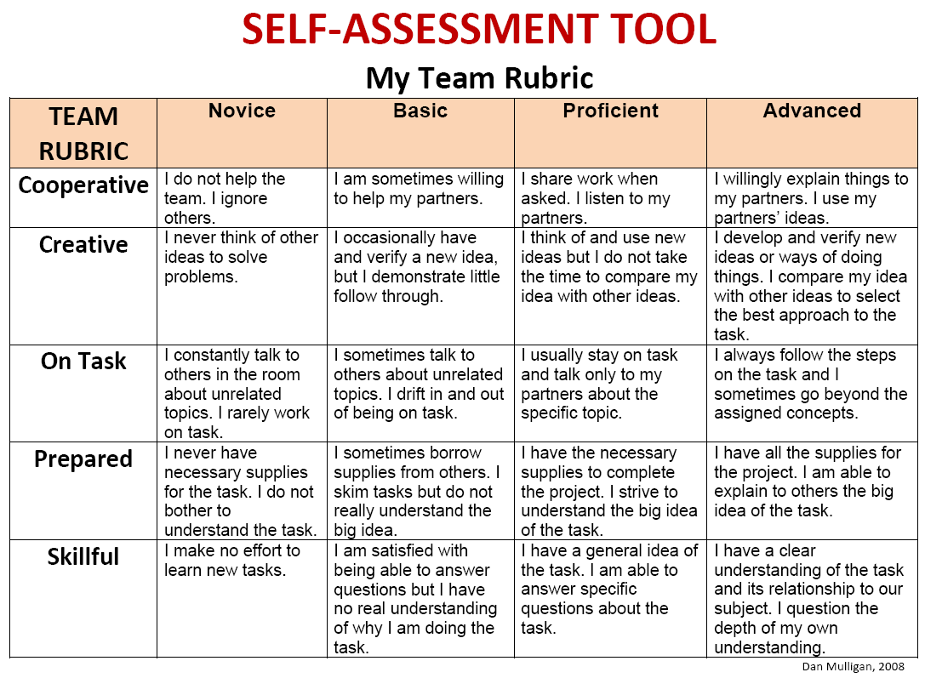
Self-Assessment Tool

Slide 7
Latoya &
Kirk

Slide 8
Self-Assessment Tool

Slide 9
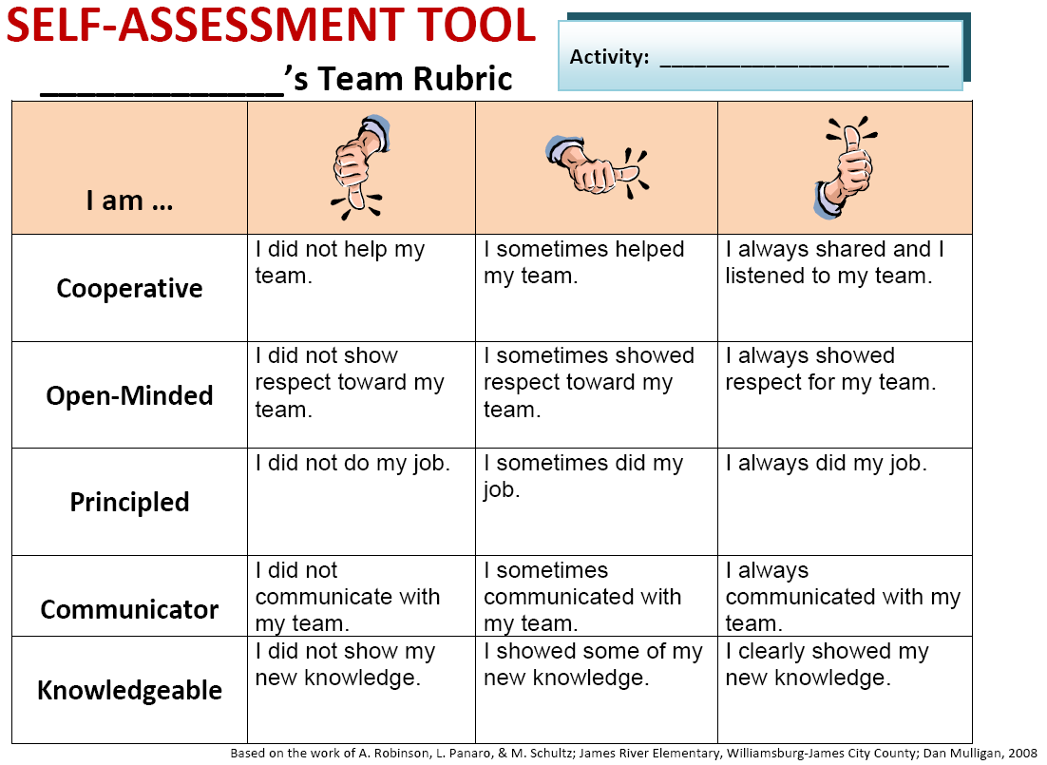

Slide 10
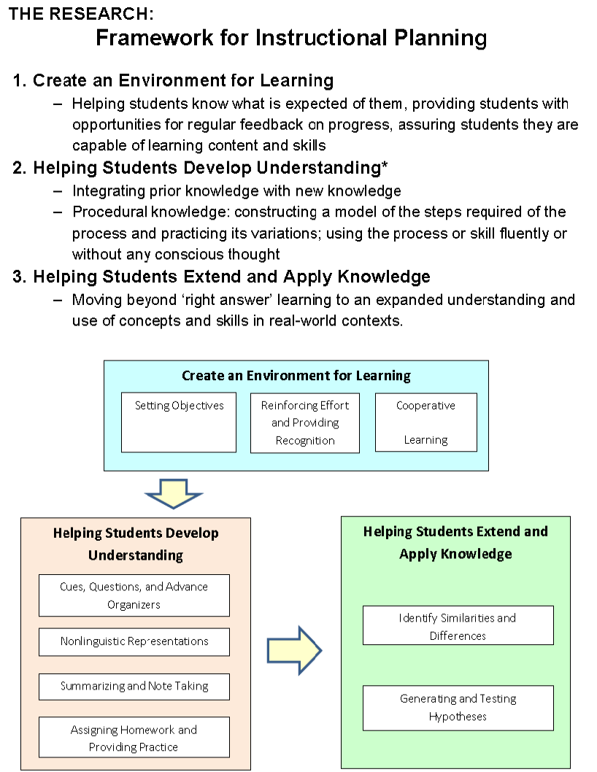

Framework for
Instructional Planning McREL, 2012
page
18
The
Opening
Create an Environment for Learning
  Helping students know what is expected of them, providing students with opportunities for regular feedback on progress, assuring students they are capable of learning content and skills
Helping Students Develop Understanding
  Integrating prior knowledge with new knowledge
  Procedural knowledge: constructing a model of the steps required of the process and practicing its variations; using the process or skill fluently or without any conscious thought
Helping Students Extend and Apply Knowledge
  Moving beyond ‘right answer’ learning to an expanded understanding and use of concepts and skills in real-world contexts.
The Work
Period
The
Closing

Slide 11
Create an Environment for Learning
When students know what they are learning, their performance, on average, has been shown to be
27 percentile points higher
than students who do not know what they are learning.

Slide 12
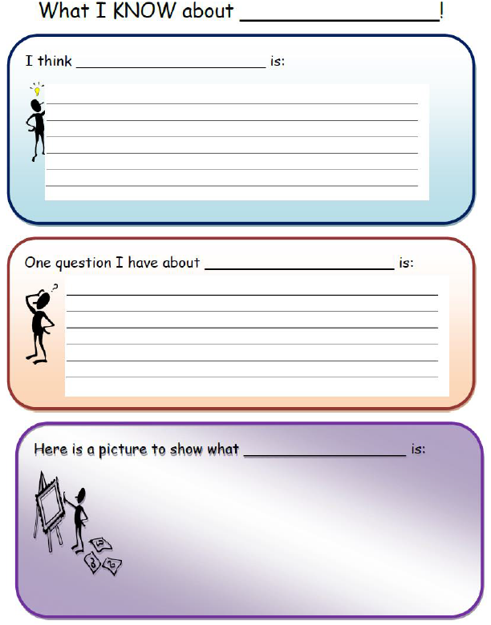

Slide 13
Anchor
Charts
Setting the Objective
(and checking along the way)

Slide 14
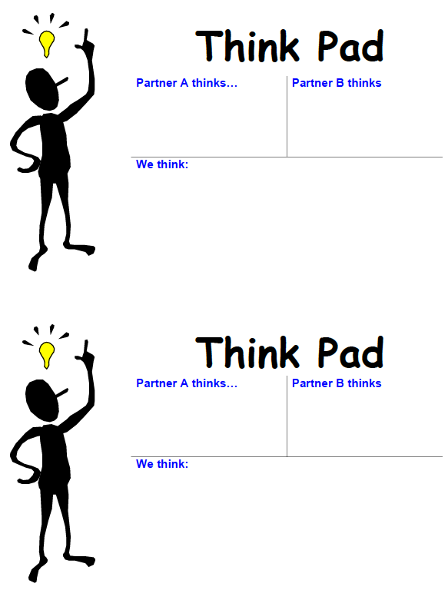
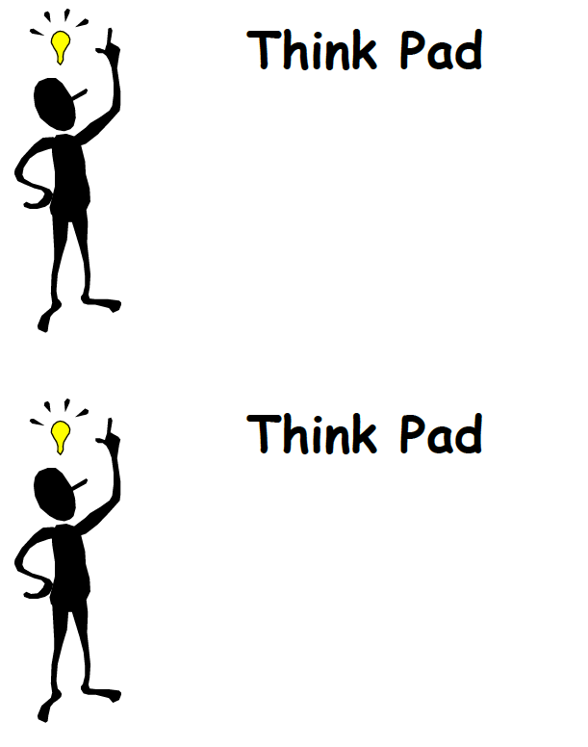
Think Pad is a resource designed to:
provide evidence of understanding and participation during student-to student dialogue
facilitate student reflection on their thinking

Slide 15
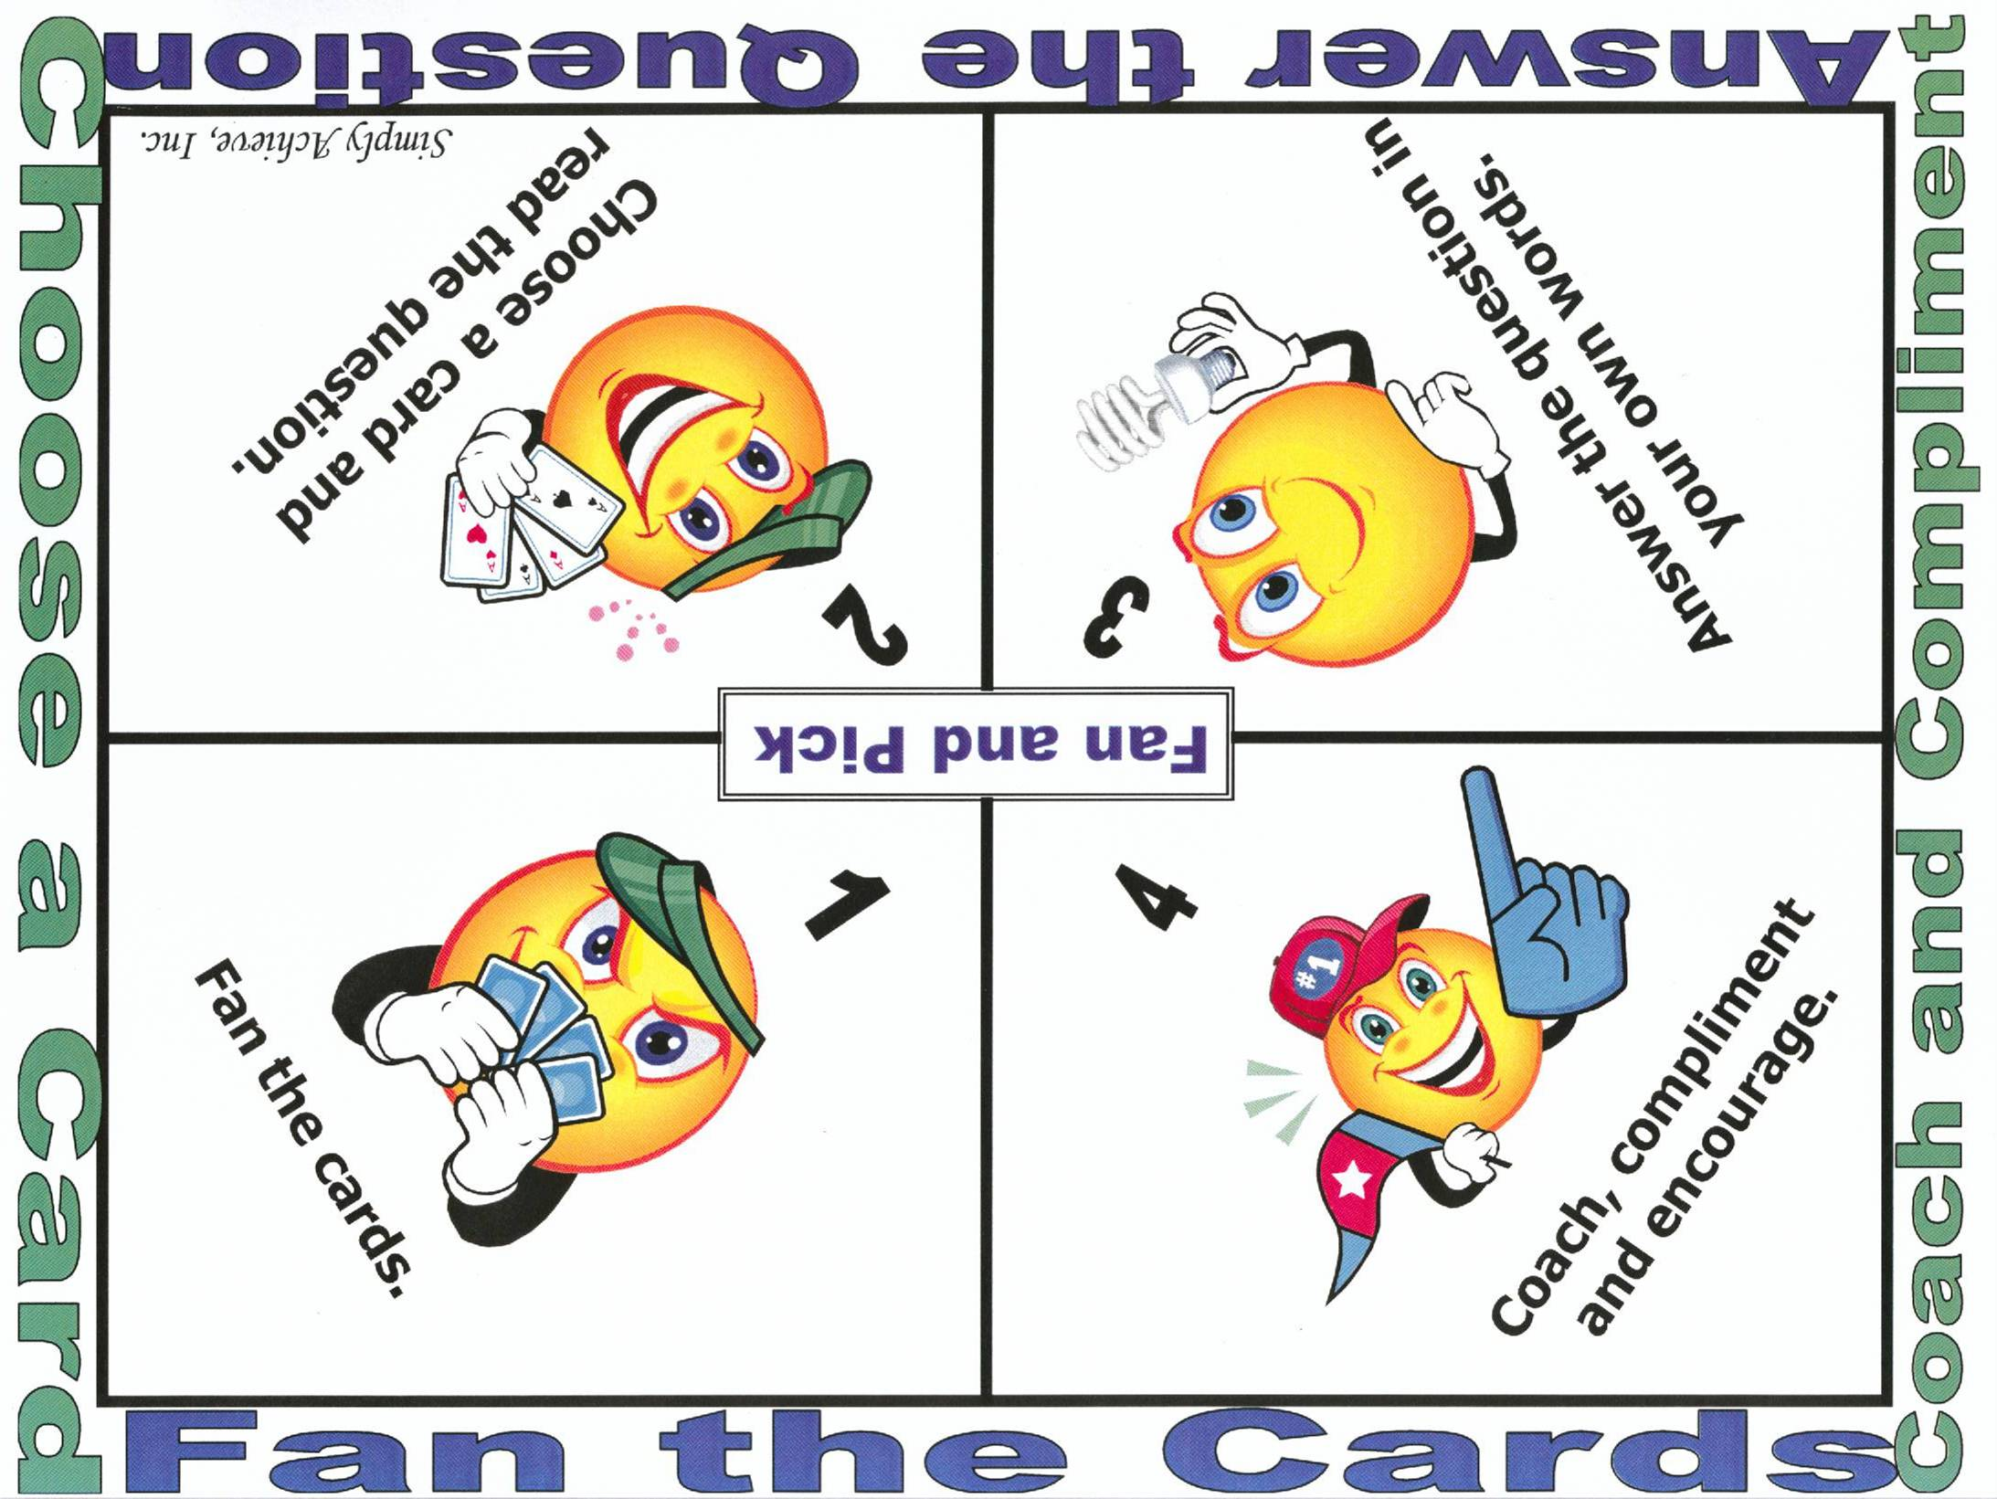

Slide 16


Slide 18

Self Reliance
There are three types of baseball players—those who make it happen, those who watch it happen, and those who wonder what happened.
Tommy Lasorda
teachers/administrators

Slide 19
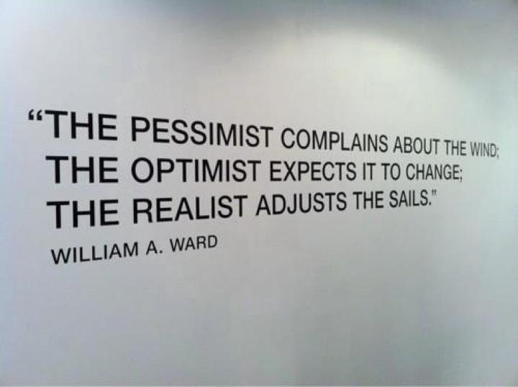

Today’s Essential Question: How do we best “adjust the sails?”

Slide 20
Category | Ave. Effect Size (ES) | Percentile Gain
Identify similarities & differences | 1.61 | 45
Summarizing & note taking | 1.00 | 34
Reinforcing effort & providing recognition | .80 | 29
Homework & practice | .77 | 28
Nonlinguistic representations | .75 | 27
Cooperative learning | .73 | 27
Setting objectives & providing feedback | .61 | 23
Generating & testing hypotheses | .61 | 23
Questions, cues, & advance organizers | .59 | 22

Slide 21
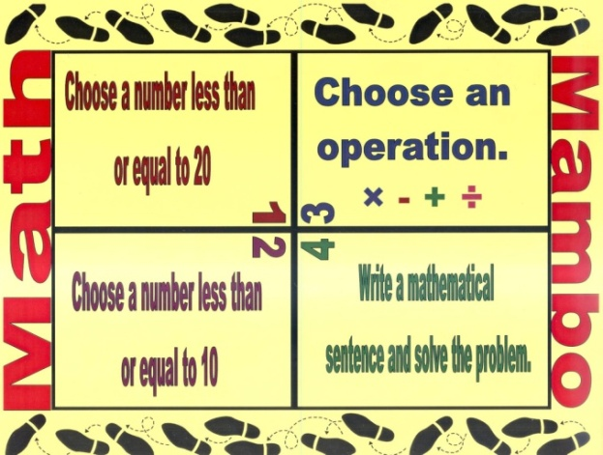
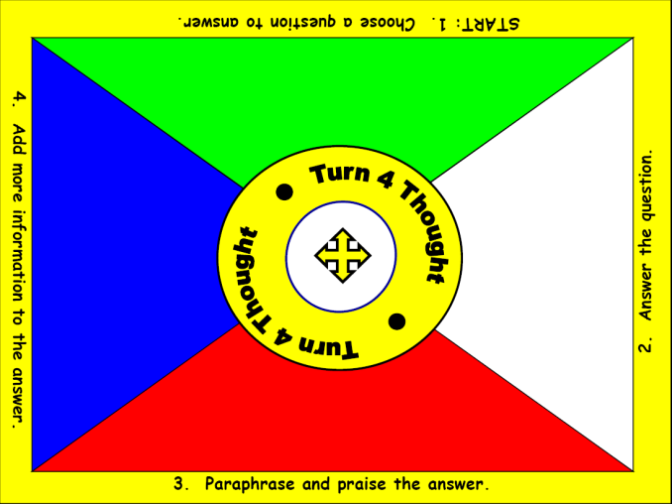
Kinds of Evidence – Continuum of Evidence
Informal Check for Understanding

Slide 22
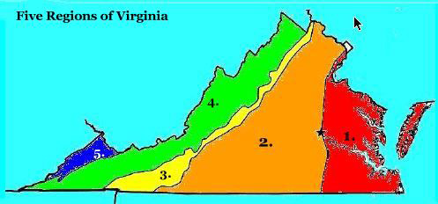
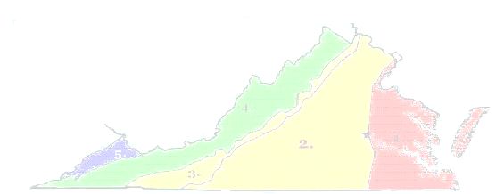
Name a noun. | Form a sentence.
Name a verb. | Name an adjective
1
4
Team
Turn
2
3

Slide 23
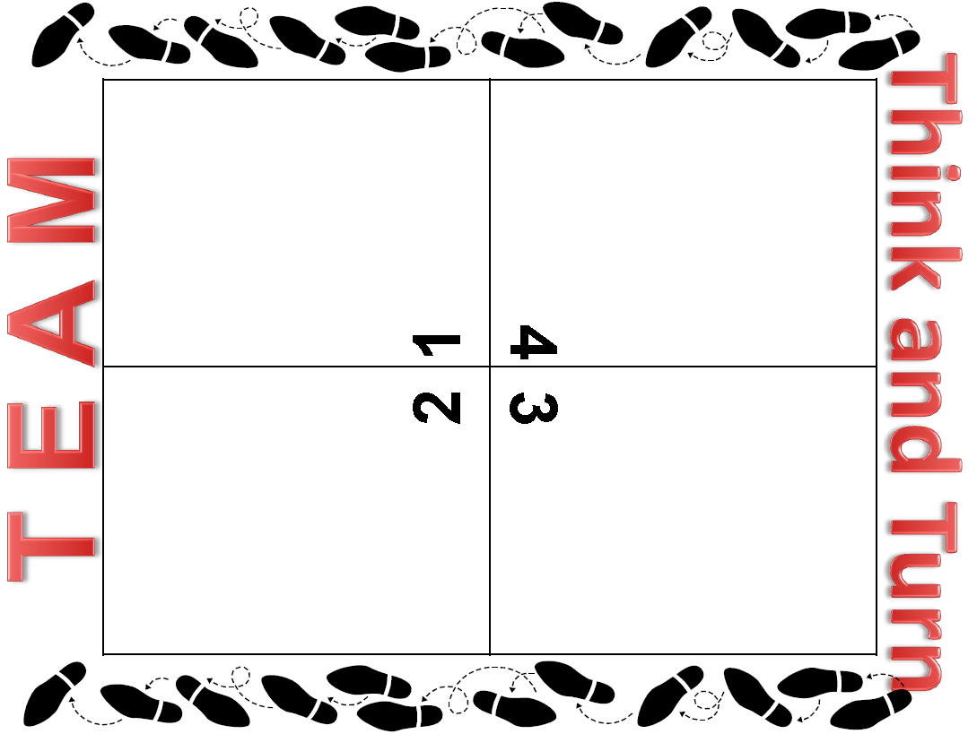
page
49

Slide 24
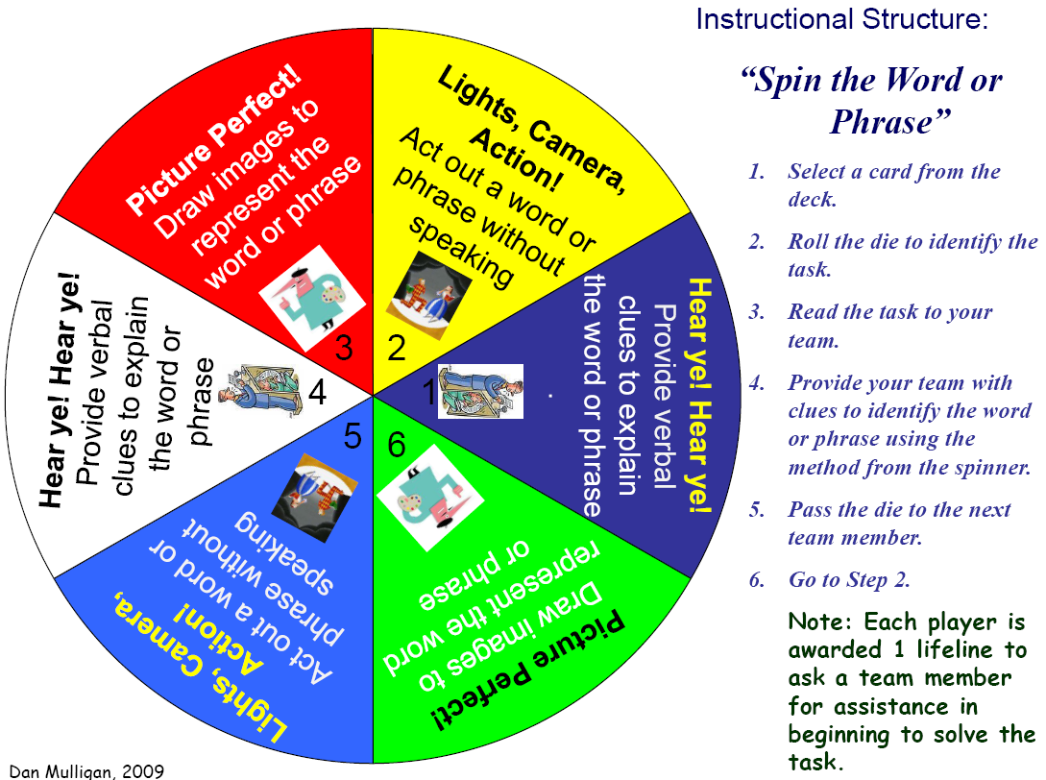
Spin the Word
modified
Remove the cards from the bag.
Place the deck of cards face down in the center of the table.
Determine the order of playing by each person rolling the die.
Each card contains:
  Math vocabulary word, and
  Method of giving clues
Remember:
  Each person has a turn,
  Each person has a lifeline!
Enjoy!

Slide 25

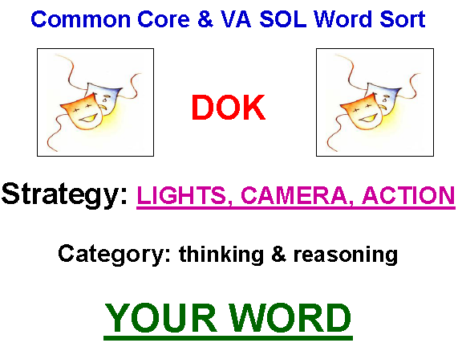

Slide 26

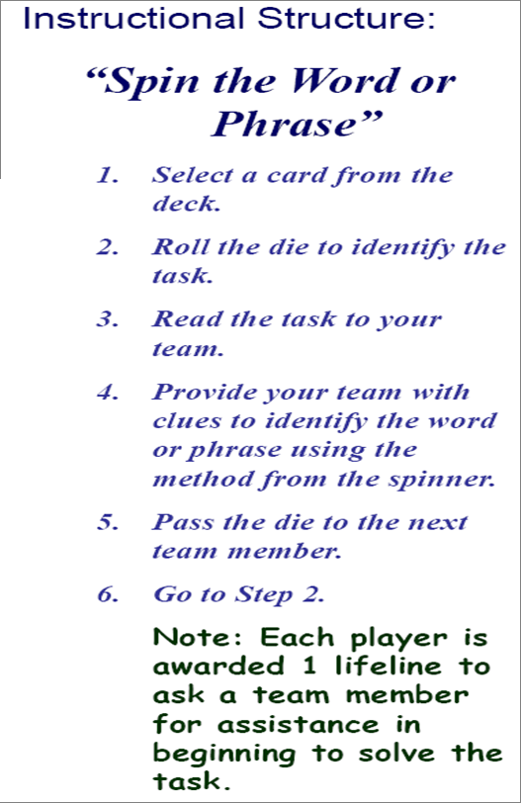
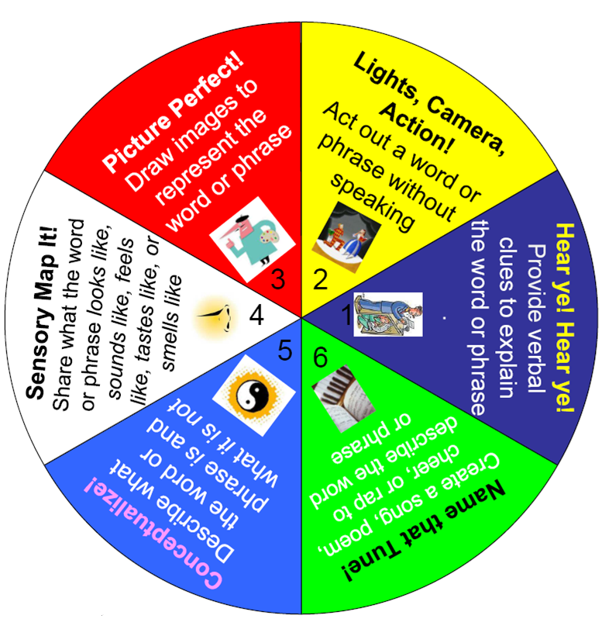
Click on the arrow to start and stop spinner.

Slide 27
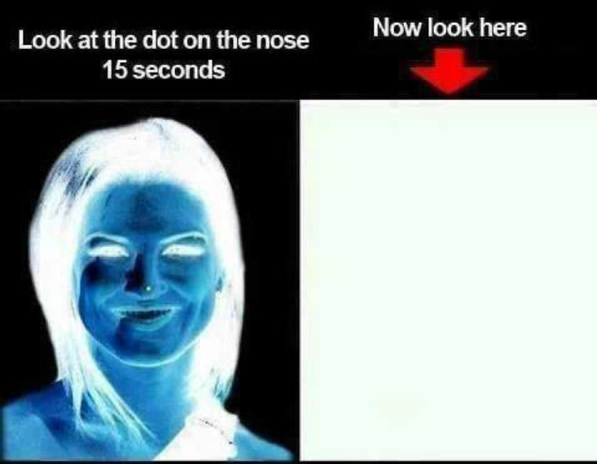

Slide 28
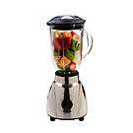
Mix it Up in the Box
Listen for the topic and the amount of time;
Silently mix around the room;
When directed, pair up with person closest to you;
In pairs, Partner A shares and Partner B listens;
Partner B responds to what he/she heard by paraphrasing: “LET ME TELL YOU WHAT I UNDERSTOOD YOU TO SAY”;
Record summary of partners response; then
Switch Roles

Slide 30

Thinking inside the Box
1 | 2
3 | 4
What is one learning structure/behavior shared yesterday that would assist our vision to assist each of our students to grow as a thinker? Explain.
What is one learning structure/behavior shared yesterday that would assist our vision to assist each of our students to grow as a communicator? Explain.
What is one learning structure/behavior shared yesterday that would assist our vision to assist each of our students to grow as a problem solver? Explain.
How does this picture relate to you as a learning leader? Complete this sentence: “This image is like mission in that _____”

Slide 31
1 | 2
3 | 4
What is one learning structure/behavior shared yesterday that would assist our vision to empower each of our students to be thinkers? Explain.
What is one learning structure/behavior shared yesterday that would assist our vision to empower each of our students to be communicators? Explain.
What is one learning structure/behavior shared yesterday that would assist our vision to empower each of our students to be problem solvers? Explain.
How does this picture relate to you as a learning leader? Complete this sentence: “This image is like mission in that _____”

Slide 32
Avondale Elementary School District
Mission
In Avondale, every student will grow as a thinker, problem solver and communicator to pursue a future without limits.
KEY QUESTIONS: Which of these processes did you practice during your analysis of the graph? Did the style of questioning deepen your understanding? Explain.

Slide 33

Talk to Me…
Directions
  Form a team of EIGHT (8) people…
  Determine the person with the most sisters and then send them to pick-up your team ziplock bag… PLEASE DO NOT OPEN!!!
  Determine the person with the least sisters and send them to pick-up a grid sheet for each person.
  Distribute a grid sheet to each team member.

Slide 35
Follow-up Debriefing
Each pair should share with your other team members the method you used to graph the figure.
Discuss with your team:
  Which method appeals to you?
  Is there another method that you would prefer?
Prepare for a “pairs choice of method” with a new graph.

Slide 37
Key Question
Did your performance on the second attempt to complete the grid exercise improve after having an opportunity to self-assess your initial strategy?

Slide 38
The Formative Assessment Process
Students | Teachers
Understand the target. (Focus on learning goals.) | Select and clearly communicate the learning target.
Produce work. | Make at least one assignment.
Compare the work with the target. | Compare student performance with the target or goal.
Evaluate strengths and weaknesses. | Evaluate students’ strengths and weaknesses.
Prescribe action for improvement. | Give clear oral or written feedback.
Take action for improvement: study, practice, review, rewrite, etc. | Support or assign action to close the gap.

Slide 39
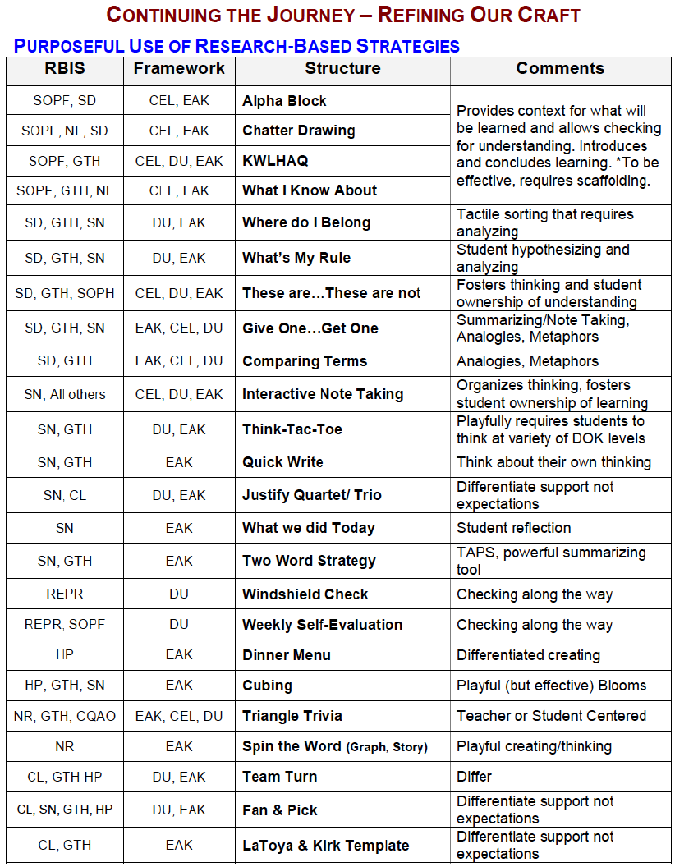
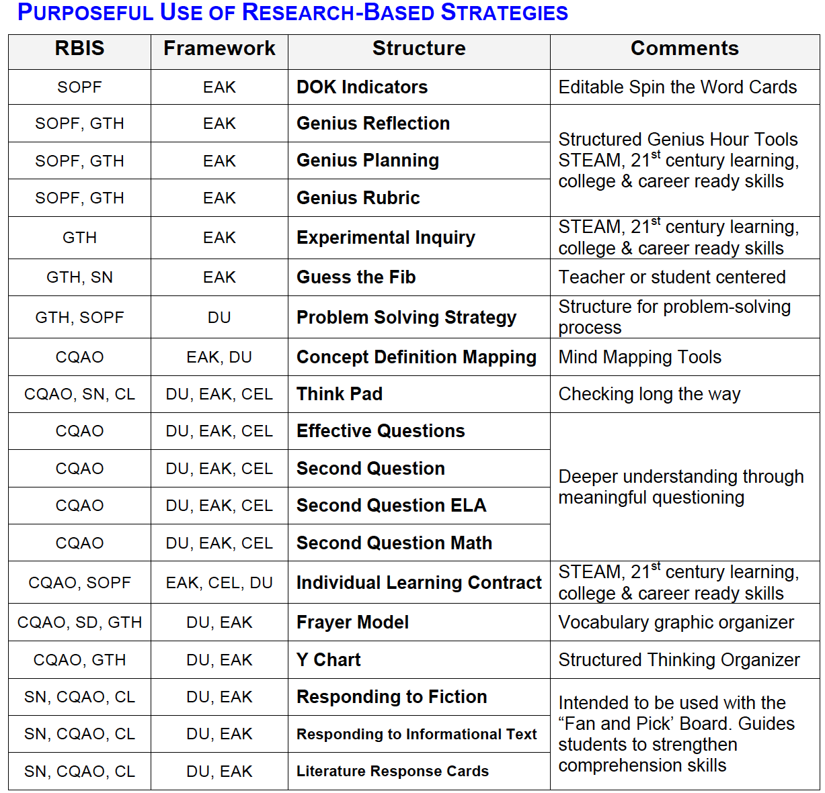
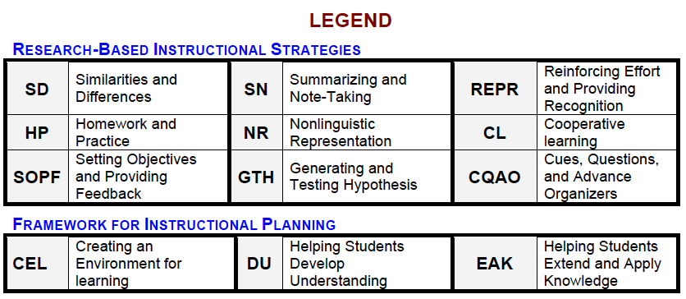

Slide 40

Thank you for your commitment to children!
"It's your attitude, not just your aptitude that determines your ultimate altitude."
--Zig Ziglar ☺
Dan

