Slide 1
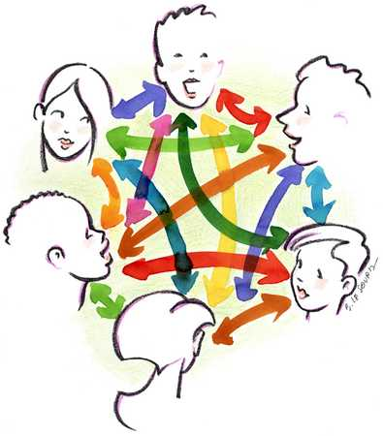
My preferred way to be assessed is...
My response:
I know that I have really learned something when...
My response:
Colleague: __________ School: ______
Colleague: __________ School: ______
THINK PAD
Sharing and Learning Together
Name
My response:
Colleague: _________ School: _______
I typically assess students by...
When I think about assessing students, I have learned that...

