Slide 1
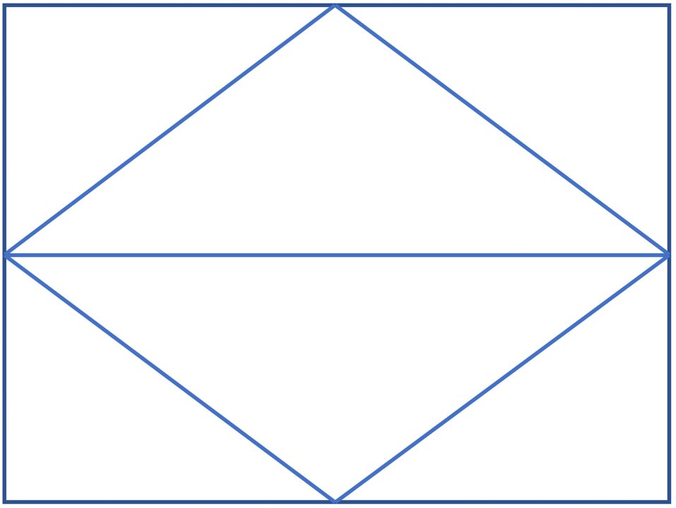





I will explain my solutions to practical problems involving volume of a cylinder.
I will justify my solutions to practical problems involving volume of a sphere and cylinder.
Driving Question: How do changes in the radius, diameter, and height of cylinders, cones, and spheres affect the volume of each shape?
Geometric Solid, Square Root, Volume, Cylinder, Radius, Diameter, Height of Solid, Literal Equation, Sphere, Cube Root, Perfect Cubes, Cone
Thinking Routine: Diamond Board
I will explore how changes in one dimension affect the volume of a cone, sphere, or cylinder.
I will justify my solutions to practical problems involving volume of a cone, sphere, and cylinder.

