Slide 1
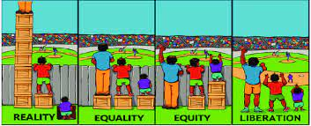

Forward and Upward @ The Speed of Change
Mathematics Research-Based Strategies
http://www.flexiblecreativity.com/ Search: Essex
Prepared for the Instructional Leadership Team of
Essex High School
by Dan Mulligan, drdanmulligan@gmail.com
October 2021
‘The difference between who you are and who you want to be is what you do.’
~Bill Phillips

Slide 2

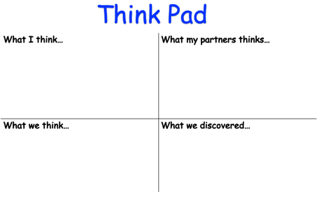

Think, Pair, Share Thinking Routine
This routine encourages students to think about something, such as a problem, question or topic, and then articulate their thoughts. The Think, Pair, Share routine promotes understanding through active reasoning and explanation. Because students are listening to and sharing ideas, Think, Pair, Share encourages students to understand multiple perspectives.

Slide 3
Effective strategies to engage students
Creating an Environment for Learning
Celebrating You!
Work collaboratively (e.g., construct viable arguments, critique, agree) to describe effective strategies to engage students.
Why are they effective?

Slide 4
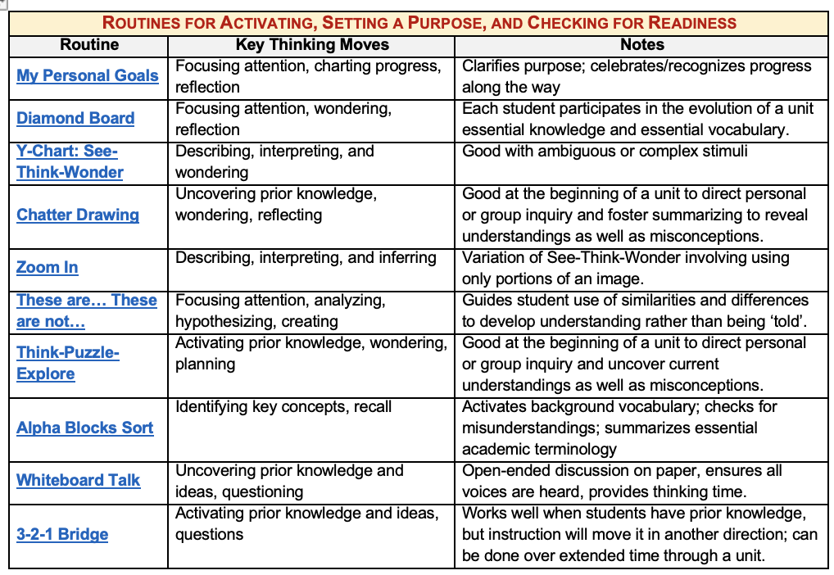
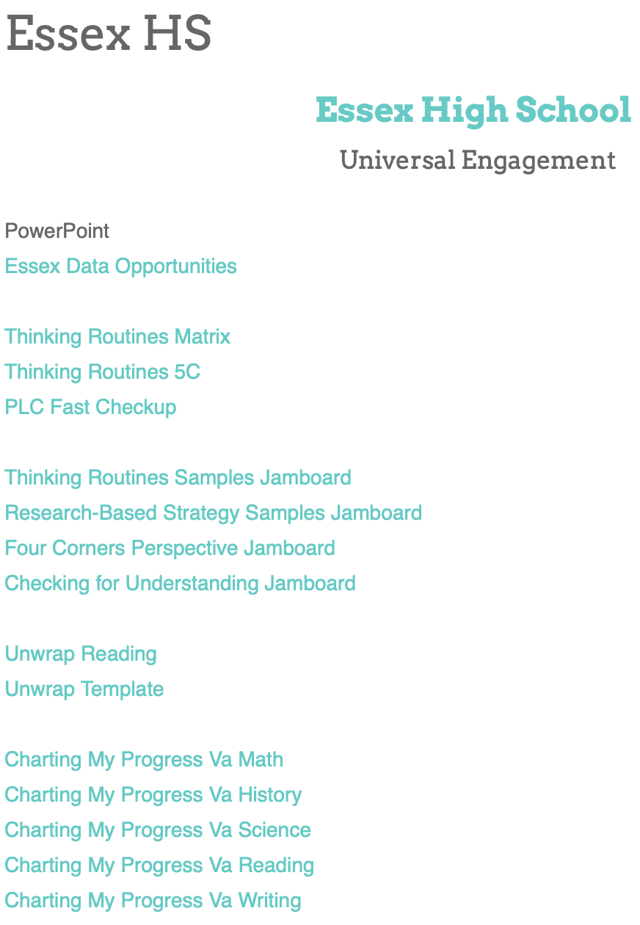
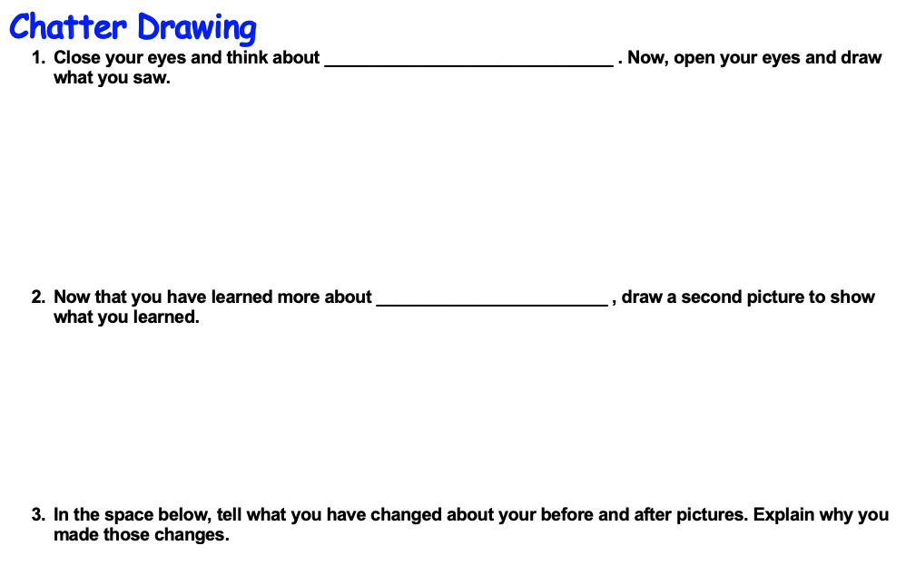
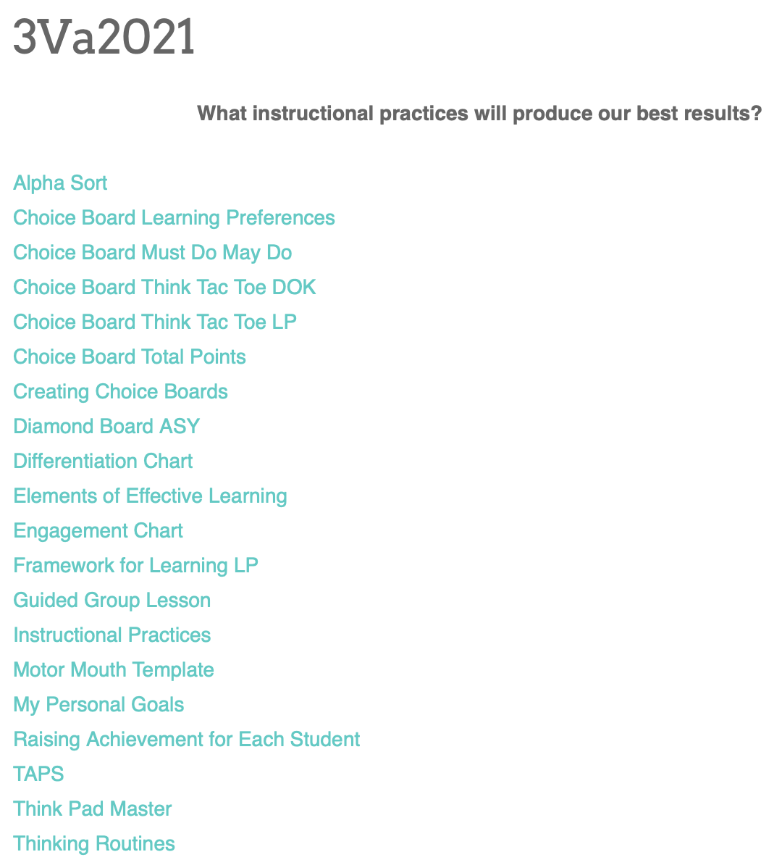
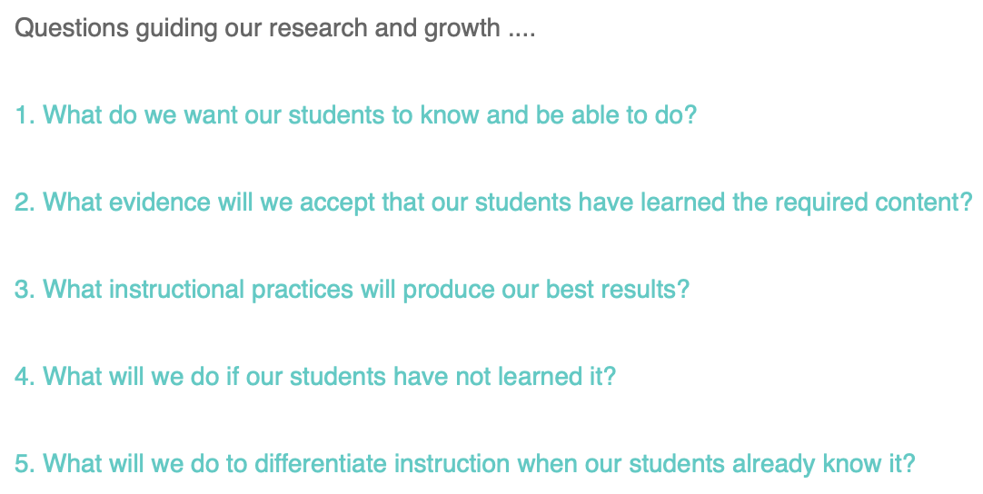
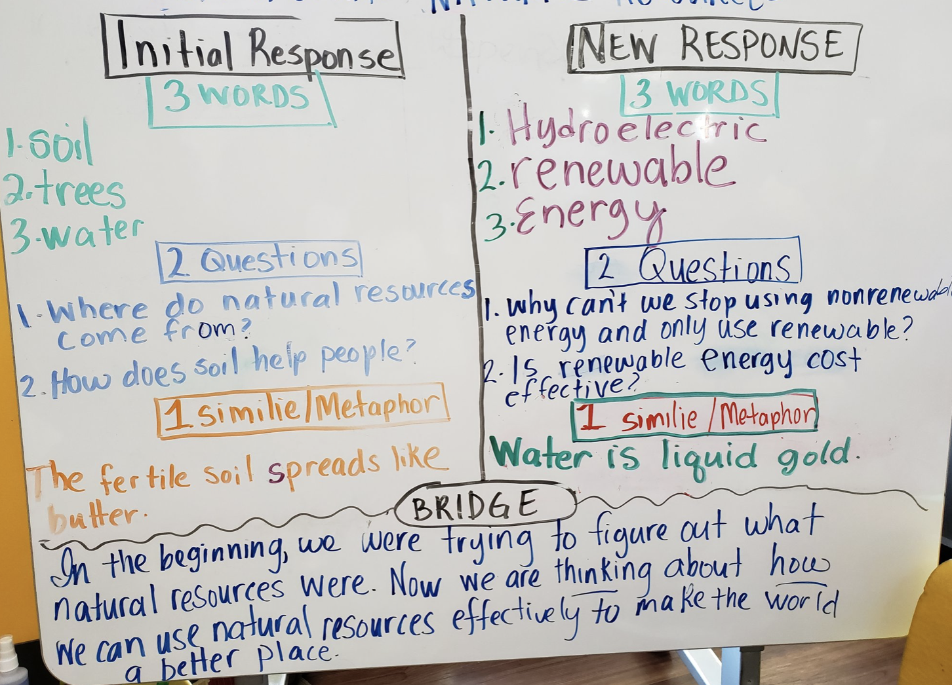
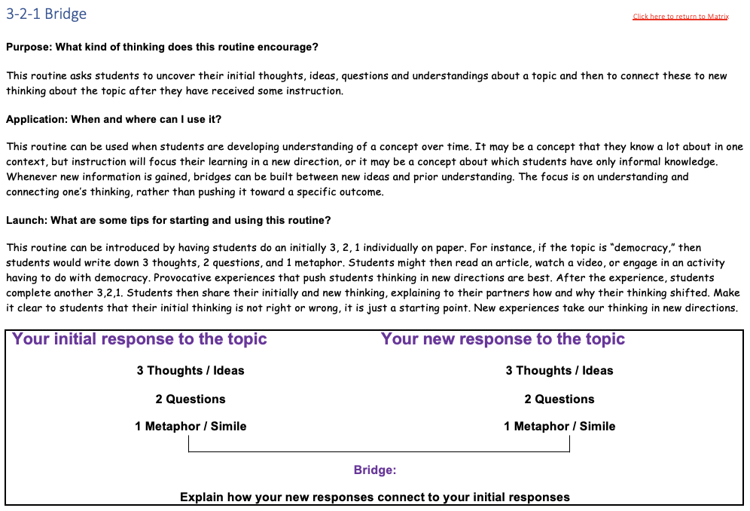
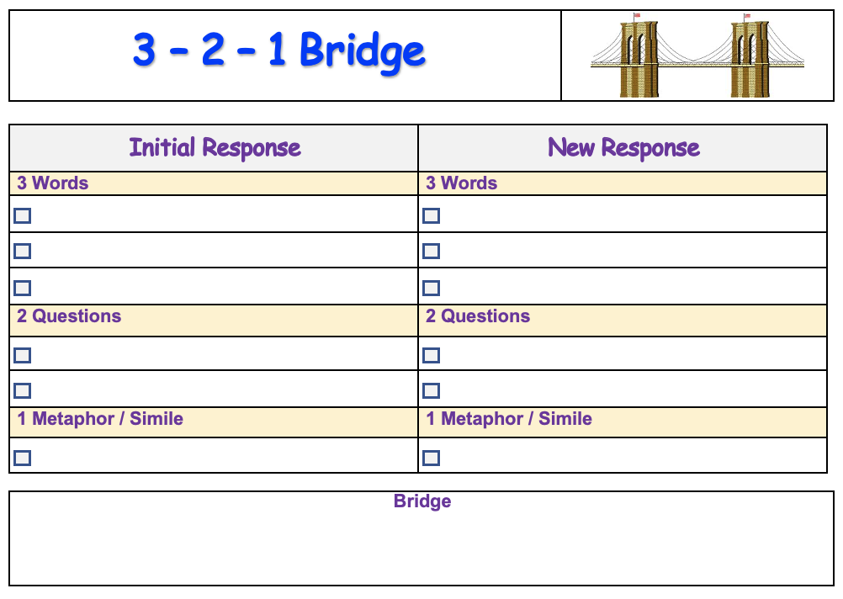
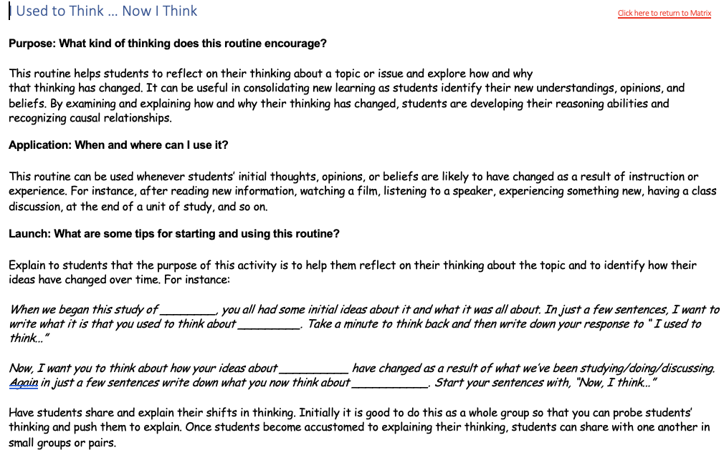
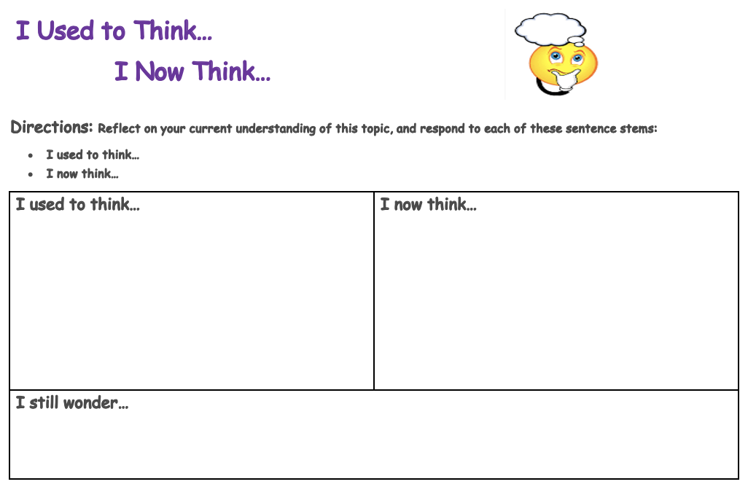
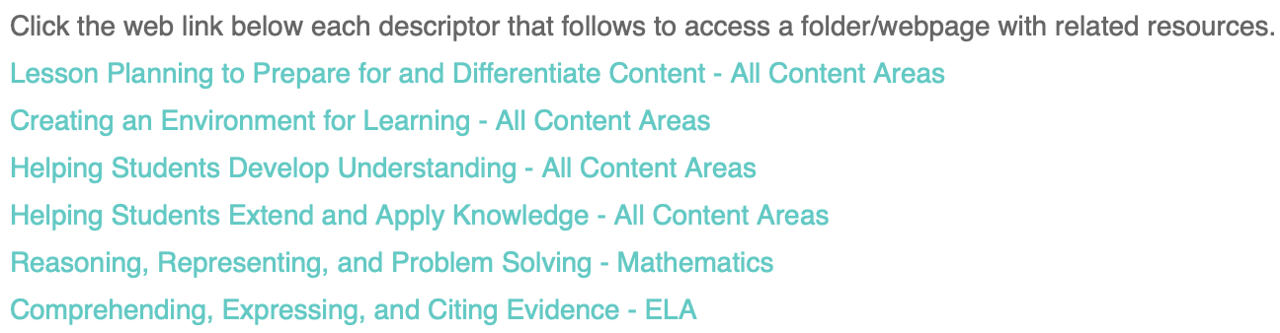
Resources
Screen Shot 2021-10-21 at 6.06.43 PM

Slide 5

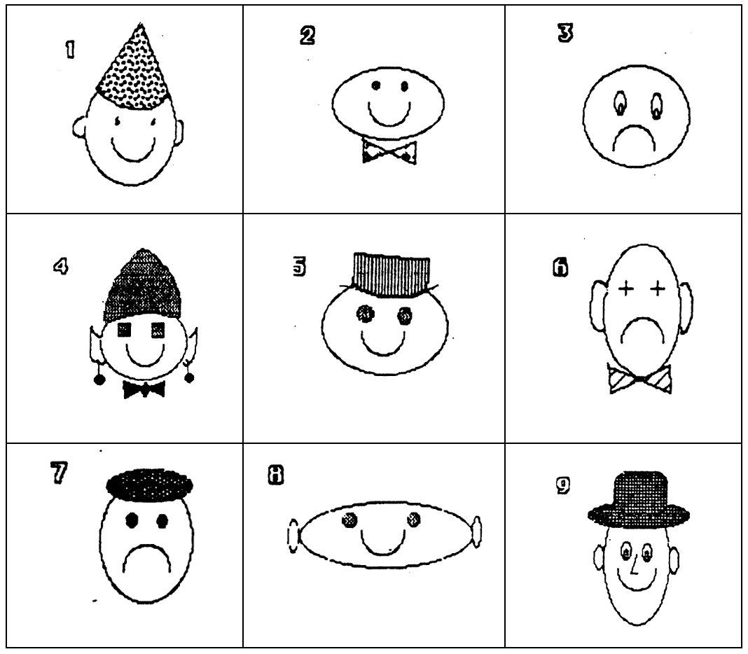
ENITS and ENOTS
Creatures on a distant planet ‘Nelle’ have been studied at length by anthropologists and determined to fall into two categories – ENITS and ENOTS. Pictures of space creatures have been provided by scientists from NASA. Your task is to classify each creature as an ENIT and an ENOT based on the following rules:
Any creature with a smile, a hat, and no ears is an ENIT.
Any creature with no smile, no hat, but two ears is also an ENIT.
Any creature with a smile or a hat, but not both, is an ENIT if it has a bowtie.
Any creature not identified as an ENIT is an ENOT.
ENOT
ENIT
ENOT
ENOT
ENIT
ENIT
ENOT
ENOT
ENOT

Slide 6
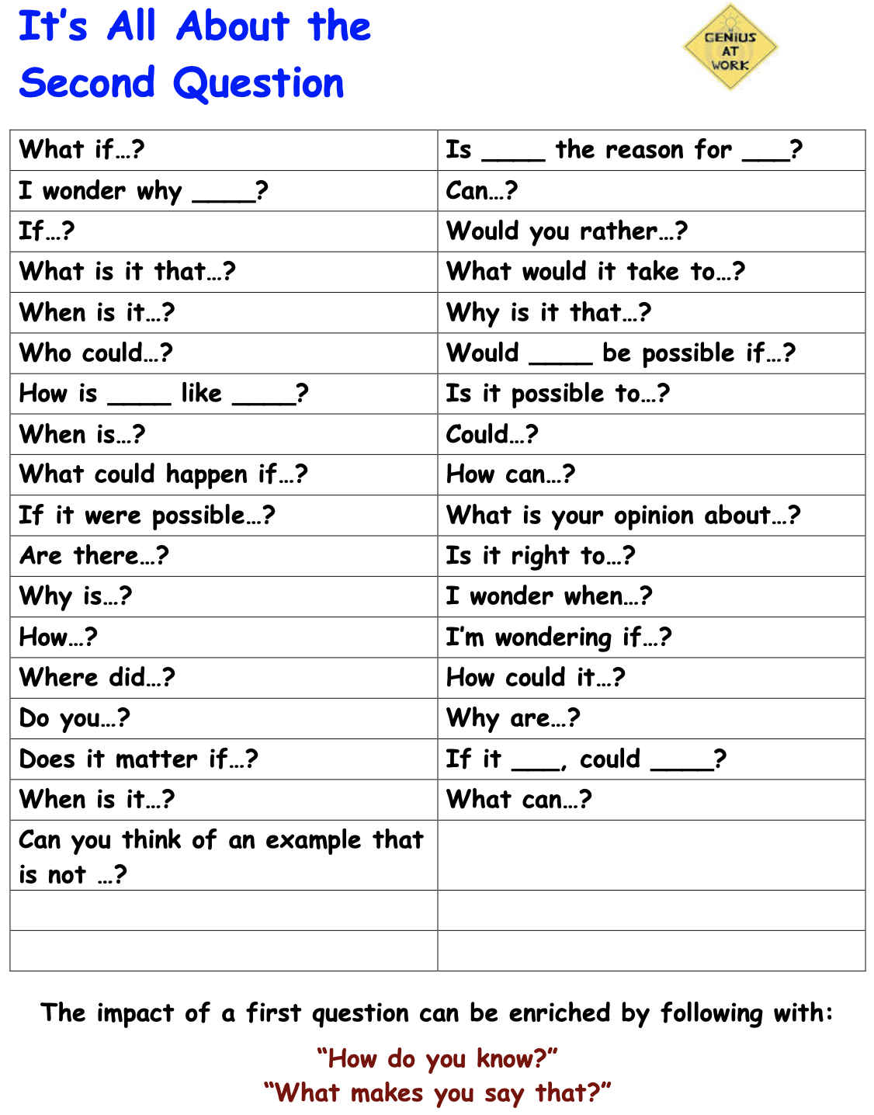

Did you know?
Asking a second question conveys interest in the student’s response to the first question and will help you really uncover what you are seeking to learn. Be curious, and you will be amazed what you uncover.

Slide 7
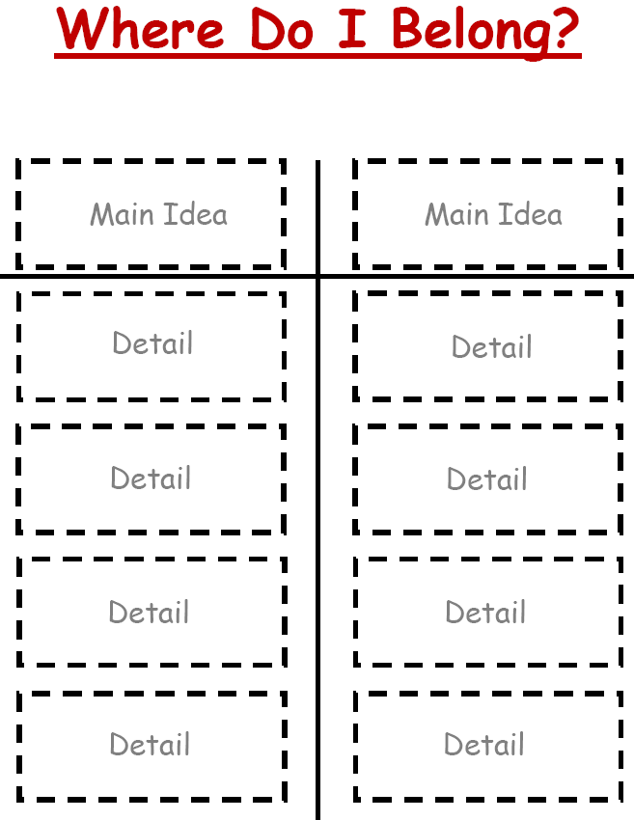

Classifying
Rectangle
Shape
Circle
Square Corner
Side
Attribute
Round
Triangle
Corner
Square

Slide 8

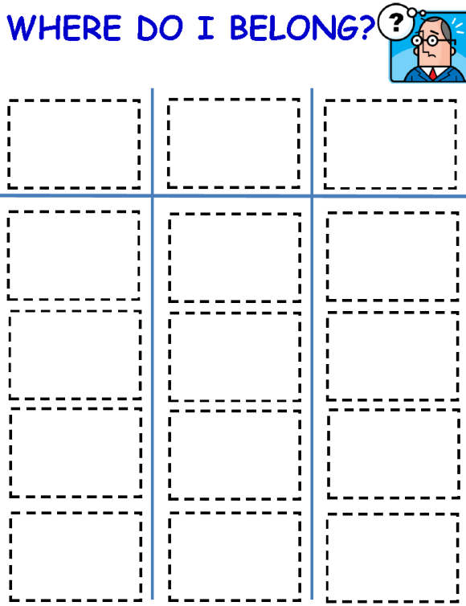
Parts of Speech
Tree
Fluffy
Sharp
Lion
Noun
Adjective
Talk
Run
Verb
Sing
House
Climb
Ashanti
Long
Sweet

Slide 9
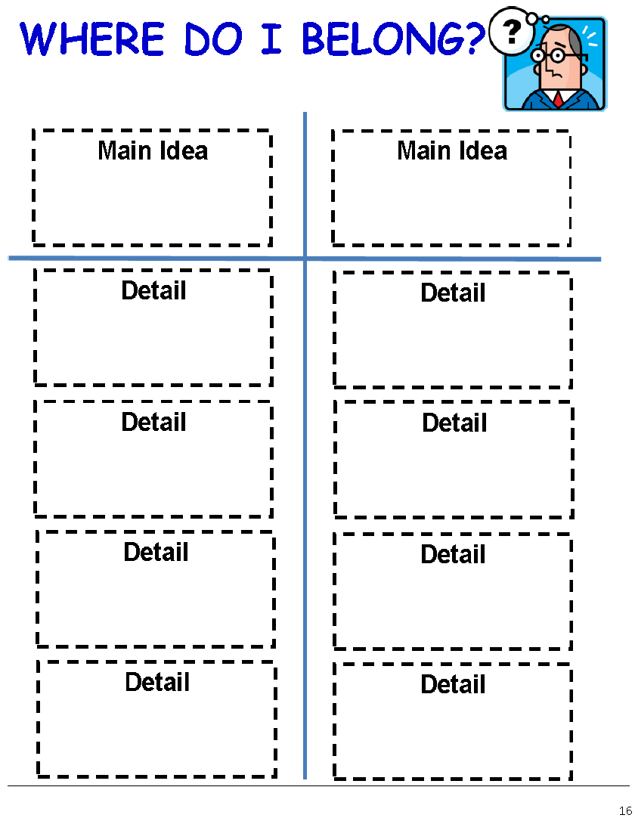
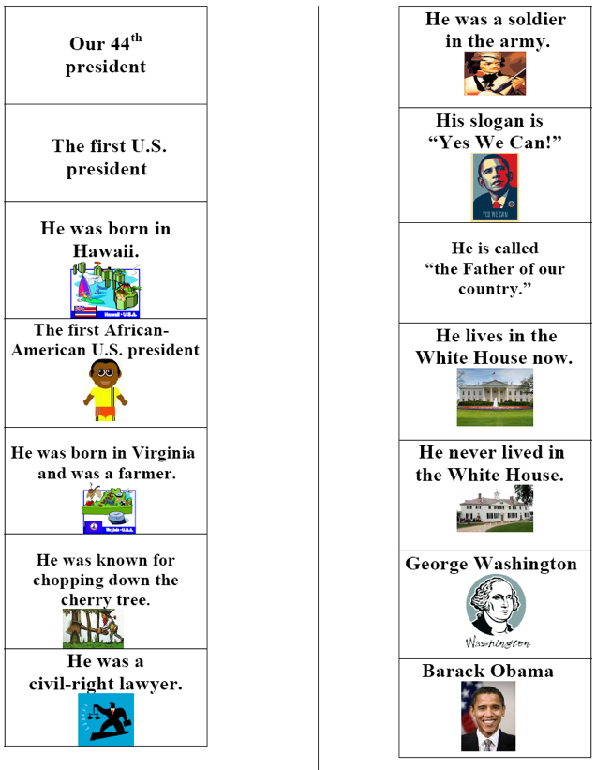
Open Task and Constructed Response
page
48

Slide 10
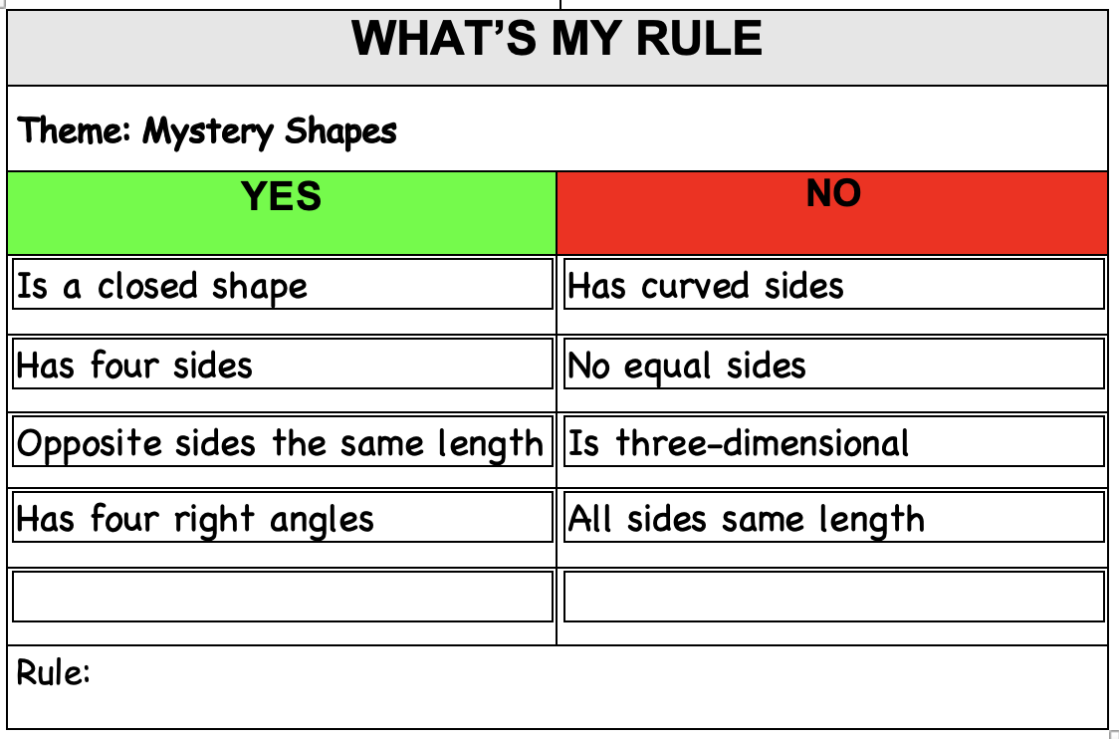

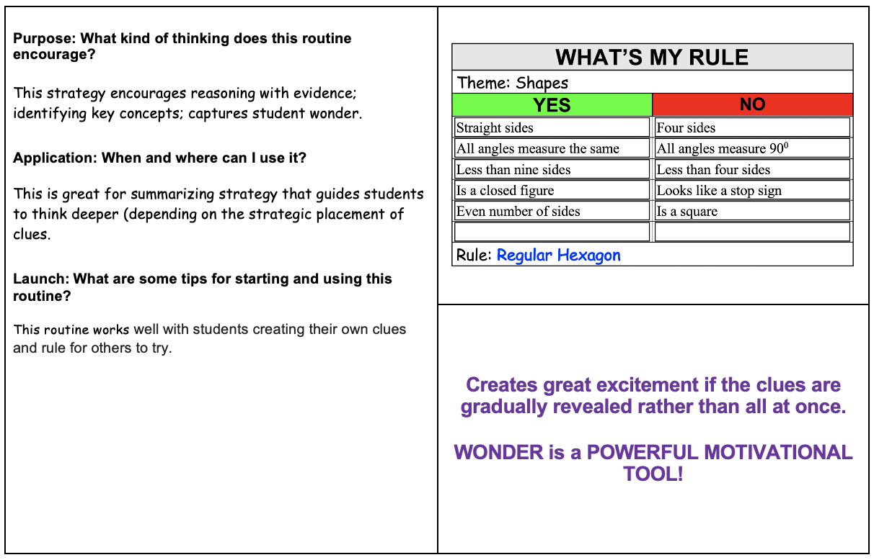
Don’t
Steal Their
Thinking!
Similarities AND Differences: Breaking a concept into its similar and dissimilar characteristics allows students to understand complex problems by analyzing them in a simpler way.

Slide 11
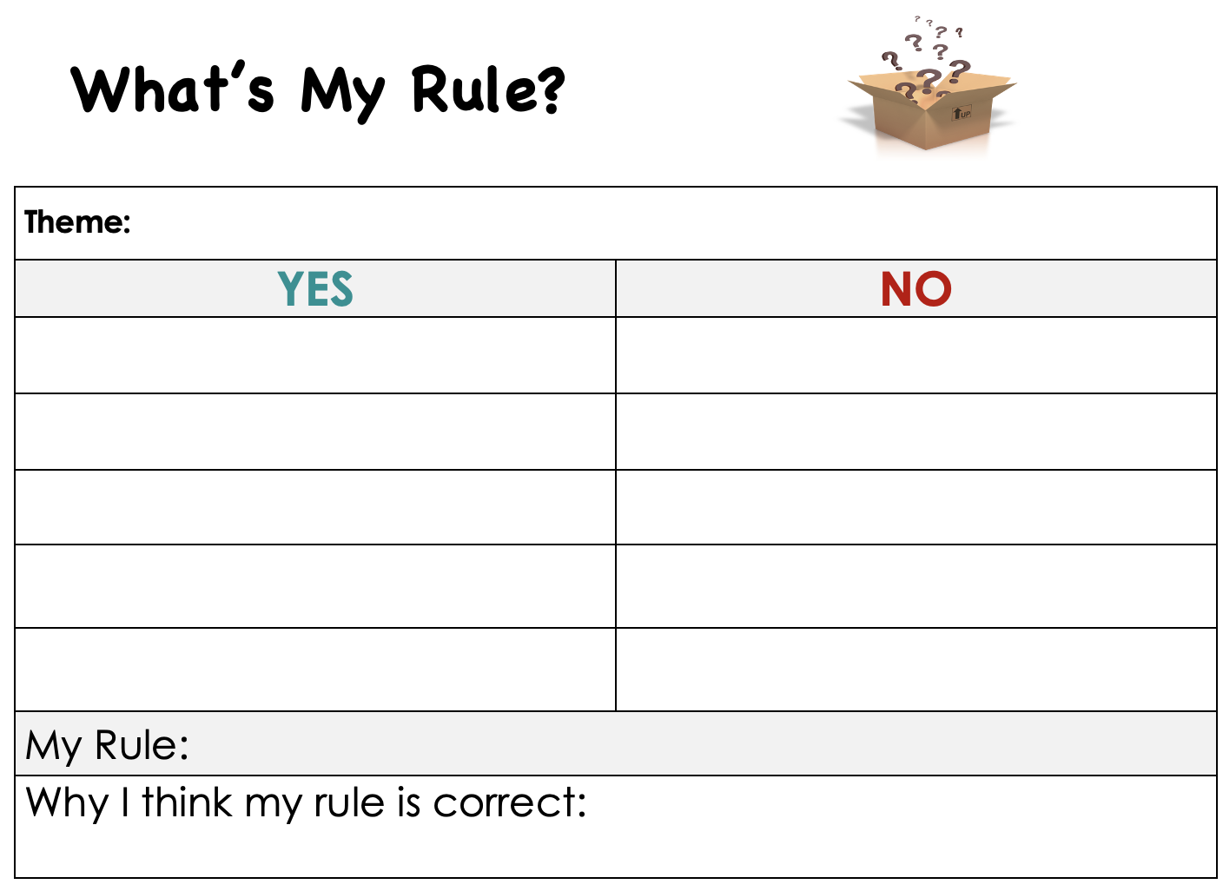
Interactive Reveal Version
Mystery Shape
Is a closed shape
Has curved sides
Has four sides
No equal sides
Opposite sides same length
Is three-dimensional
Has four right angles
All sides same length

Slide 12
Vocabulary
cylinder
circle
cube
Brazil
Portugal
Mexico
?
?
?

Slide 13

Who are we?
Essex County Public Schools exists to serve the individual educational needs of our students.
Essex County Public Schools exists to serve the individual educational needs of our students.
In partnership with our students, faculty, staff, parents, and the community, Essex County Public Schools is committed to creating Pathways to Excellence by promoting a positive, student-focused culture striving for continuous improvement that meets the academic, athletic, artistic, and career occupational needs of all our students by guiding, inspiring, celebrating, and teaching our students as we equip them to meet the challenges of a global society.

Slide 14
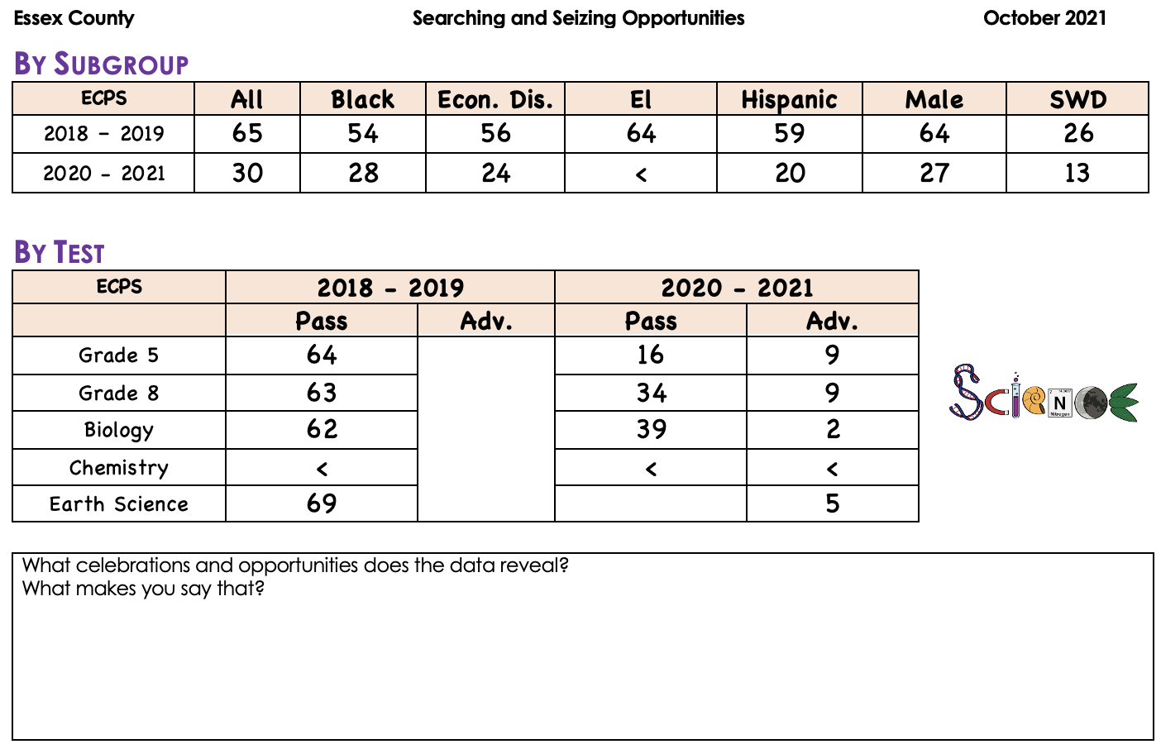
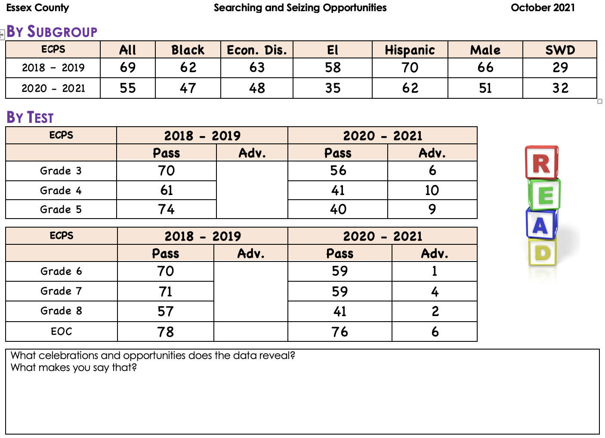
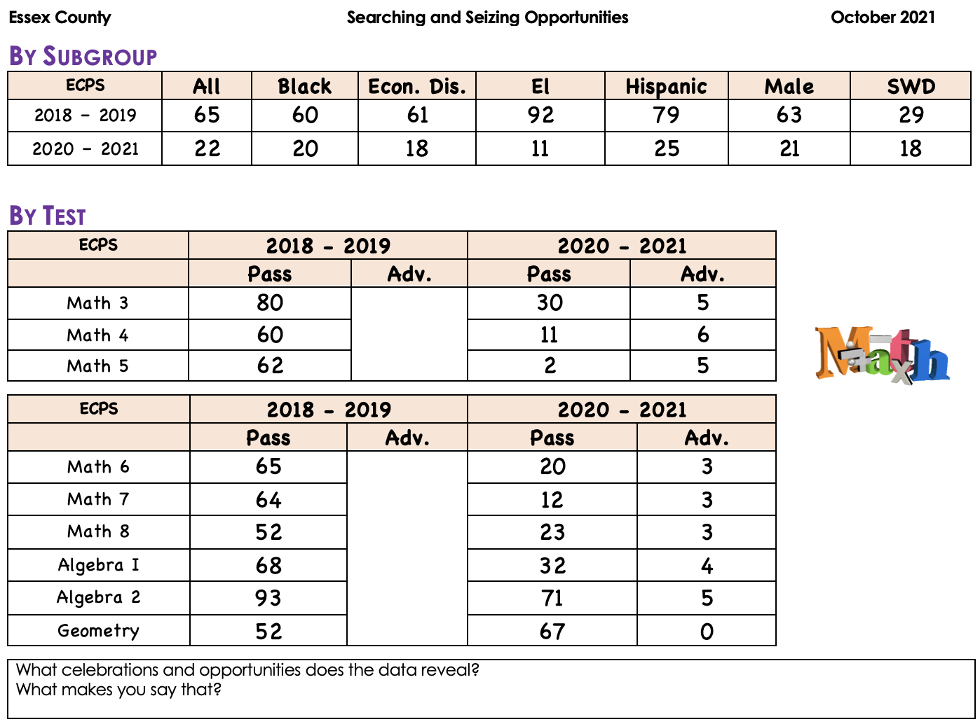
Searching for Opportunities

Slide 15
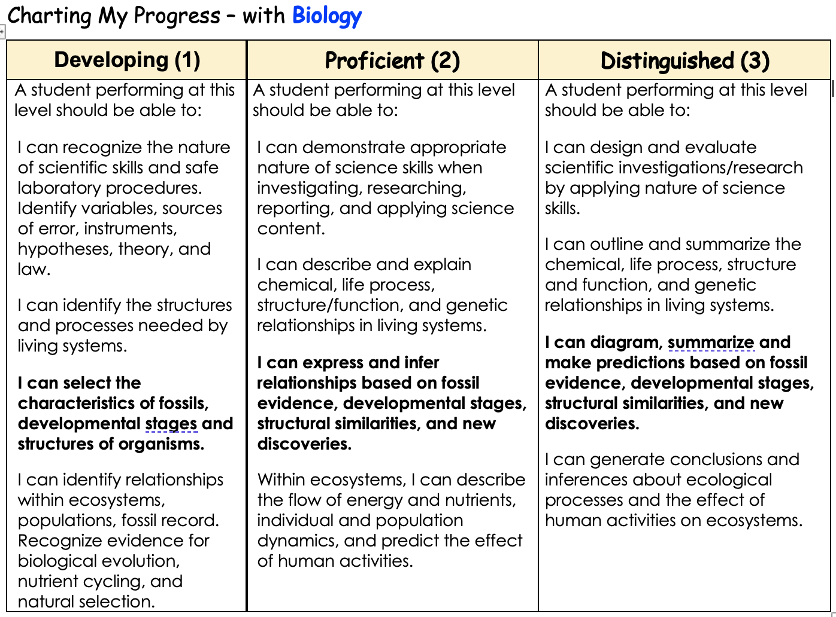
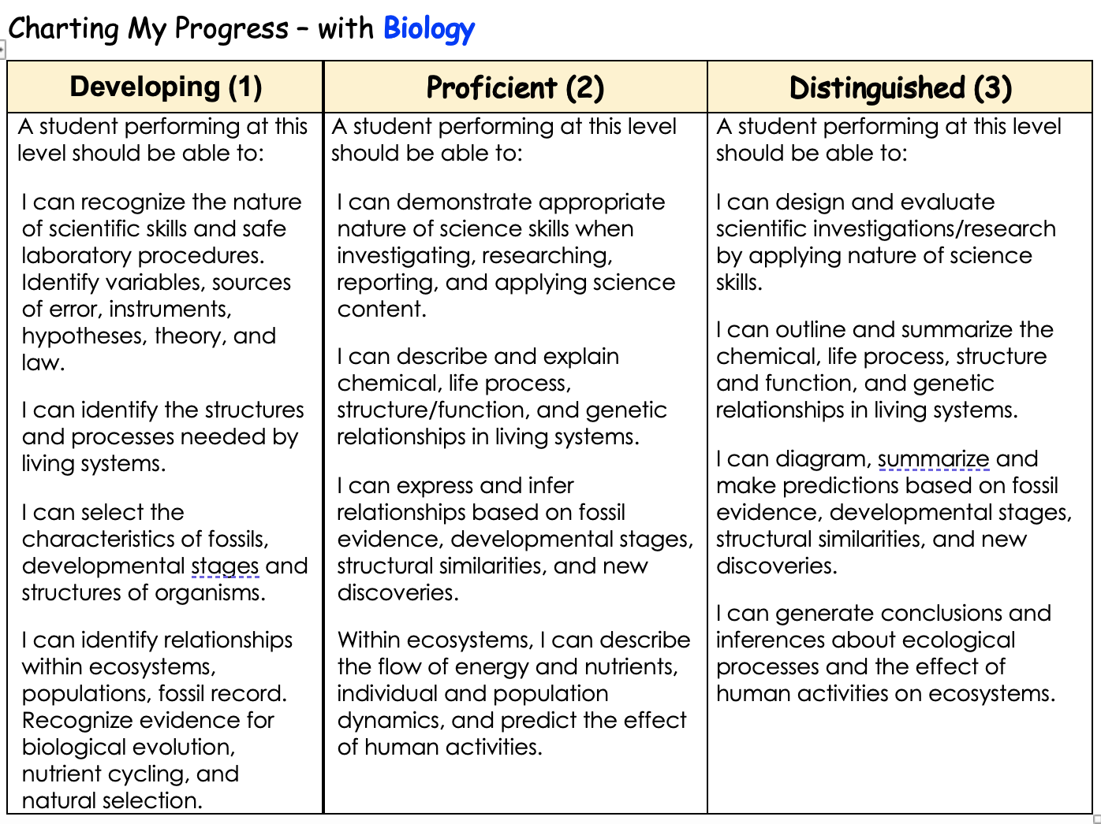
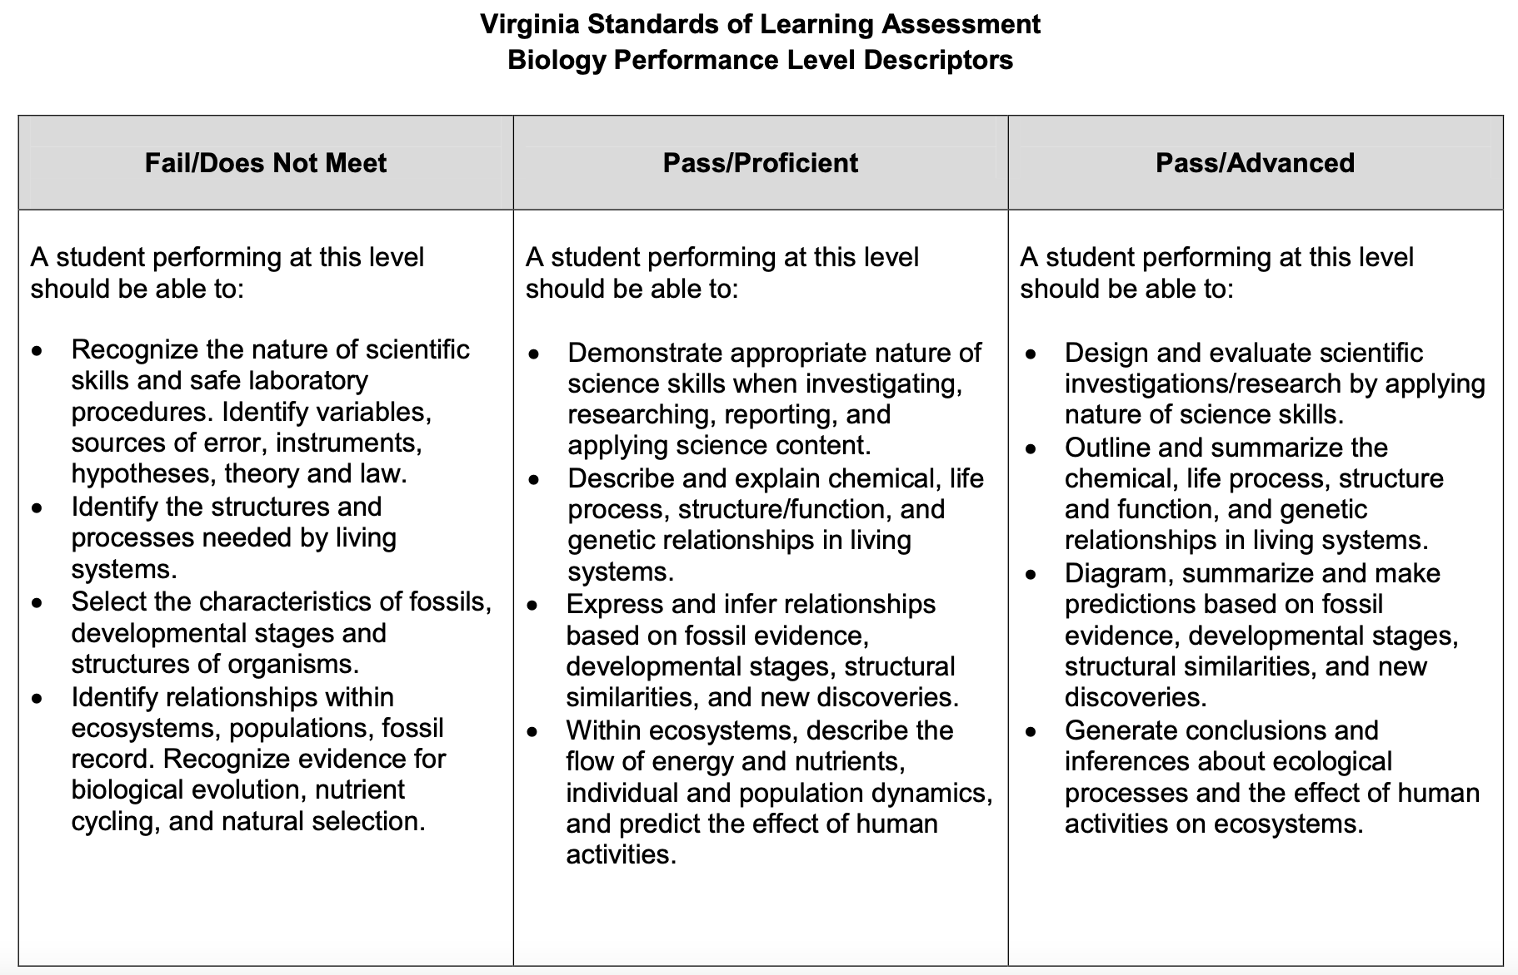
Performance Level Descriptors

Slide 16
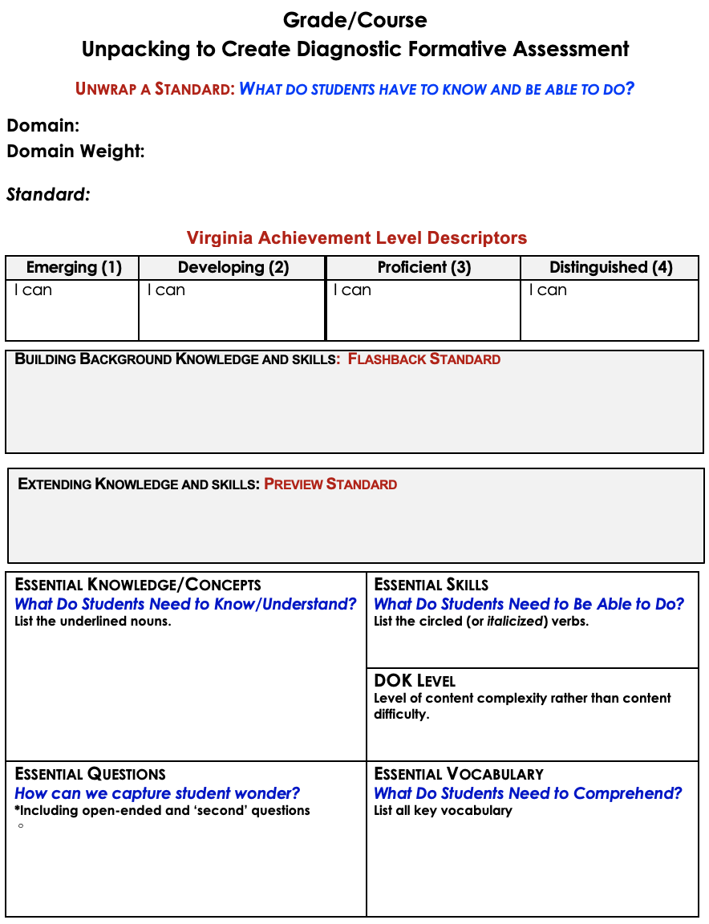
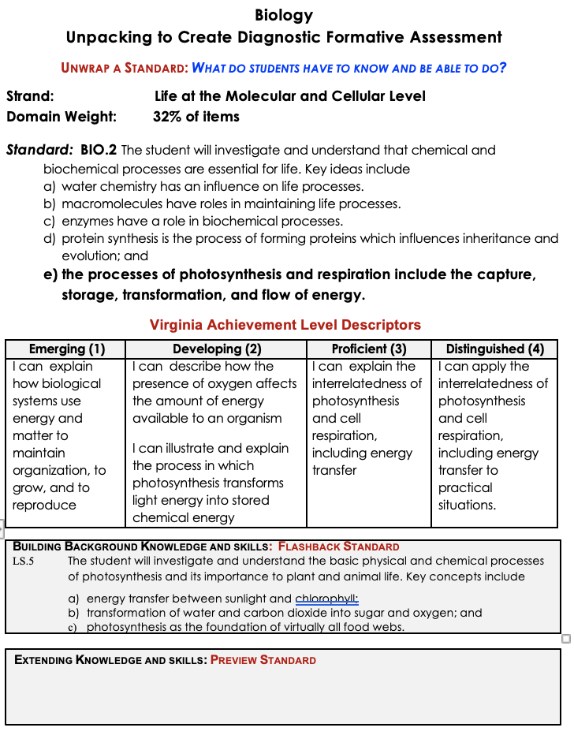
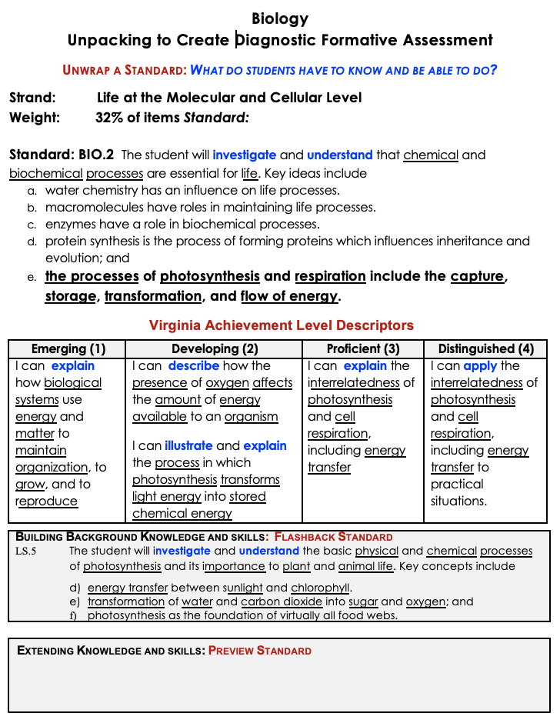
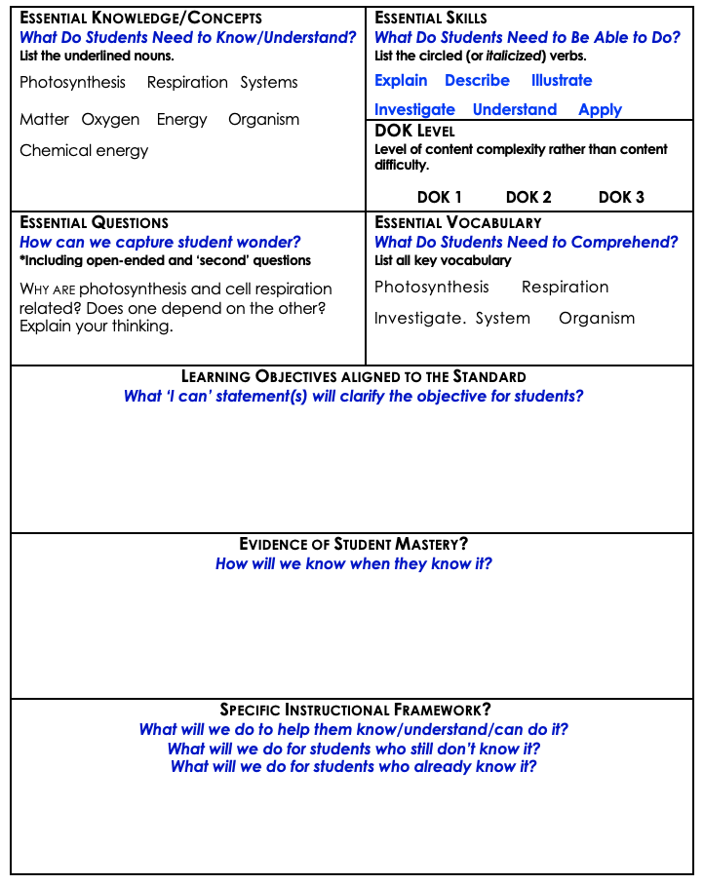
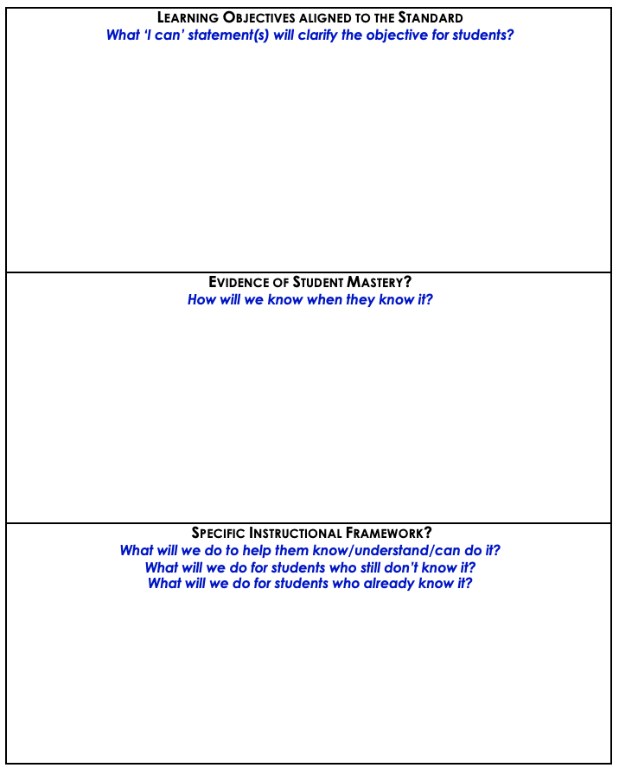
Unpacking to Create Diagnostic Formative Assessment and Targeted Small Group Learning

Slide 17
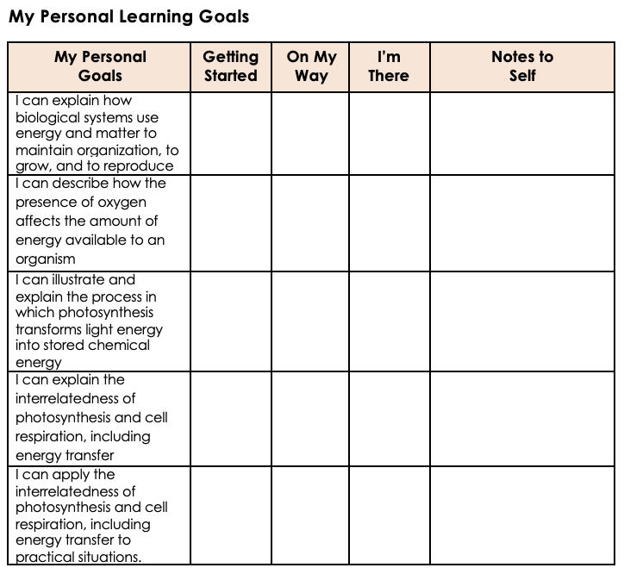
Each Student Charting Their Own Progress Compared to the Standard

Slide 18
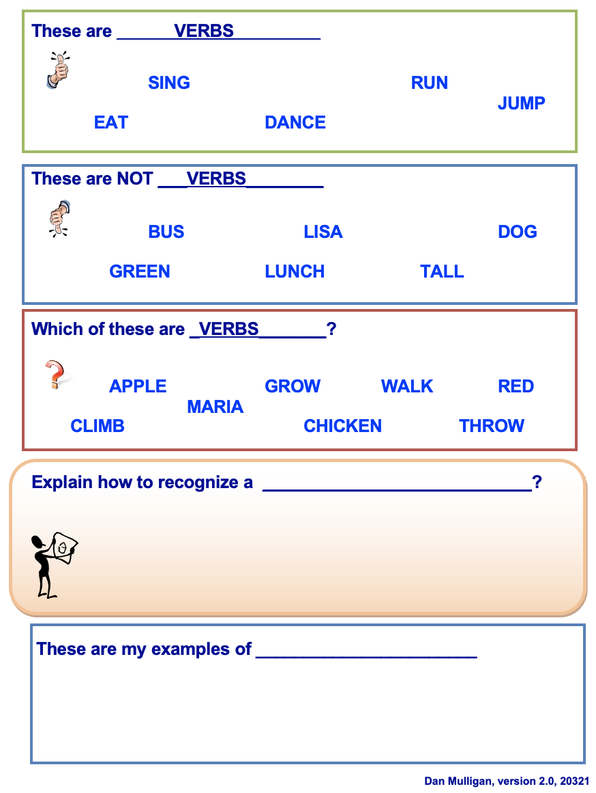
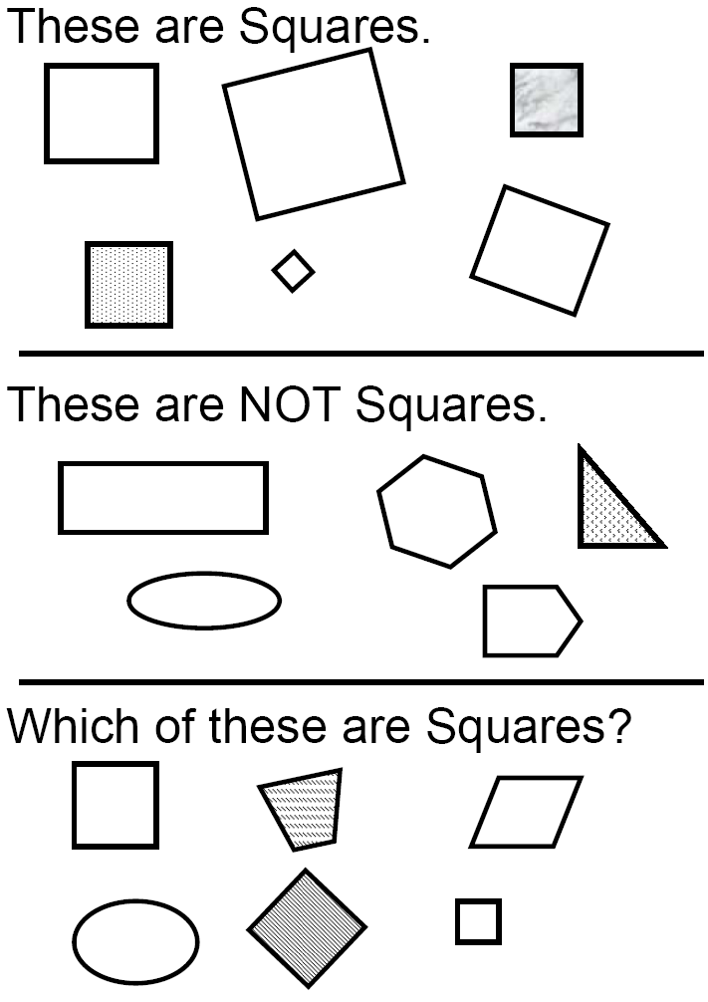
Don’t
Steal Their
Thinking!
Similarities AND Differences: Breaking a concept into its similar and dissimilar characteristics allows students to understand complex problems by analyzing them in a simpler way.

Slide 19
4 - second
partner

Slide 20
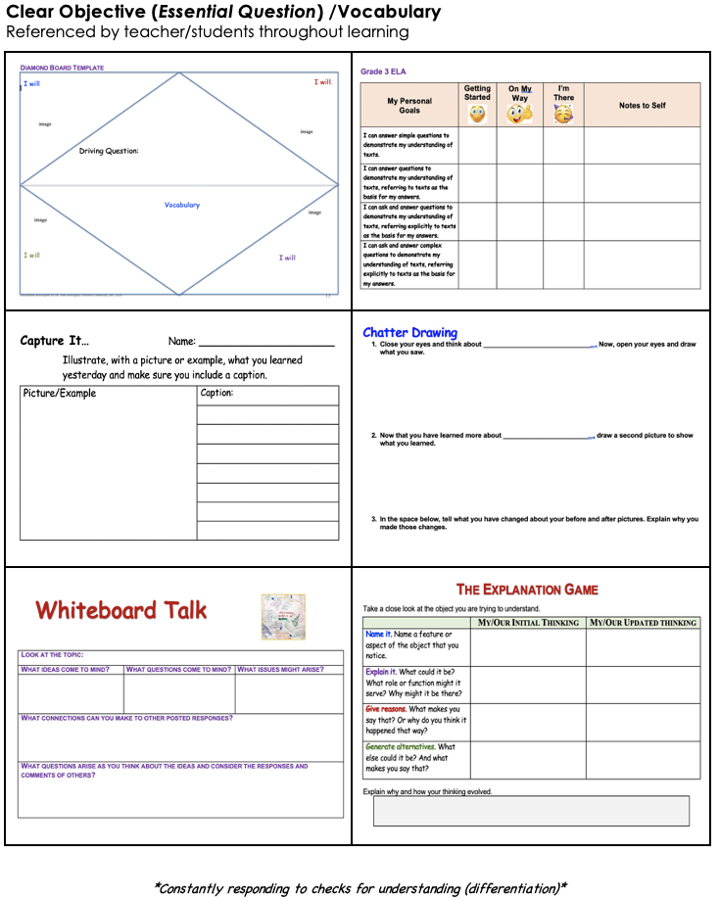
Clear Objective (Today I will…)/Vocabulary
referenced by teacher/students throughout learning
Lesson
Flowchart
Creating an Environment for Learning
Provides students with context
Allows teacher to build/check for background knowledge
Integration of:
Constant checks for understanding of each student.
Seize opportunities for student collaboration on second questions!
Helping Students Develop Understanding
This is the teaching/learning/discovering phase. Multiple checks for understanding along the way. Modeling, Guided Practice, Independent Practice
Helping Students Extend & Apply Knowledge
Student reflection & doing something with what they learned.

Slide 21
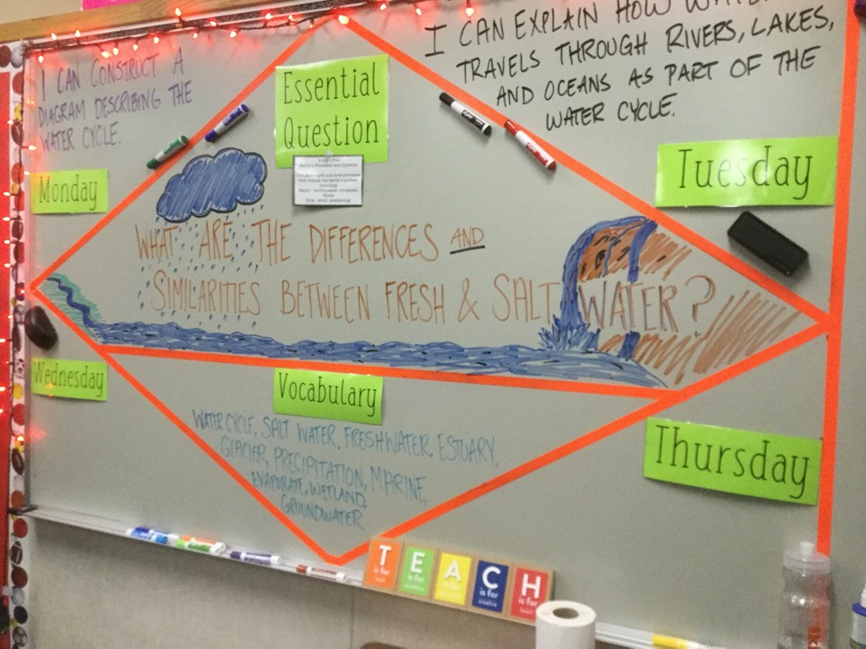
Setting the Objective
and
Providing Feedback

Slide 22

I can identify and describe two-dimensional and three-dimensional shapes.
I use identify properties of squares.
Driving Questions:
How do we know when a shape is a quadrilateral?
How can we sort and explain types of quadrilaterals?
Shape Side Angle Square
Quadrilateral Rhombus Rectangle
Three-dimensional Two-dimensional
Example Nonexample
Sort
I can sort and draw examples and nonexamples of types of quadrilaterals.
I recognize types of quadrilaterals.

Slide 23
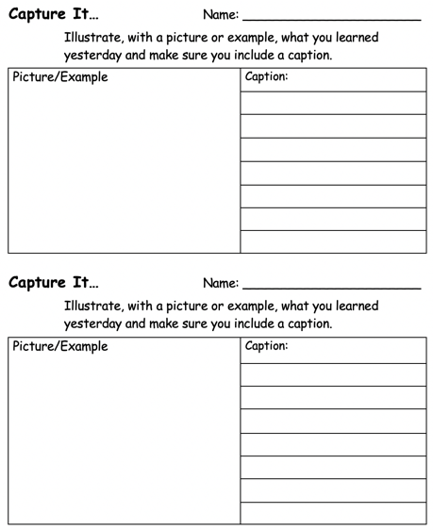
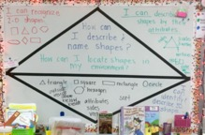
Setting Objectives & Providing Feedback
Misconception:
Posting an objective raises student achievement.
Truth:
Students and the teacher USING the objective is what raises student understanding and achievement.
Spiraling to Previous Day’s Essential Understandings

Slide 24
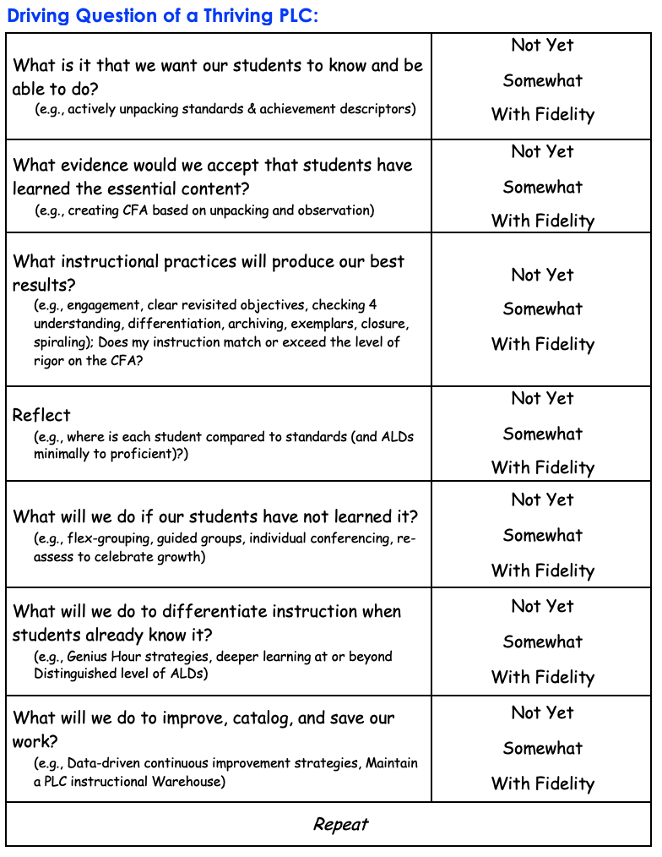
Today’s
Objective
I can describe, classify, and justify research-based engagement strategies that can be easily implemented to increase the achievement of each of my students.
I can describe, classify, and justify research-based engagement strategies that can be easily implemented to increase the achievement of each of my students.

Slide 25
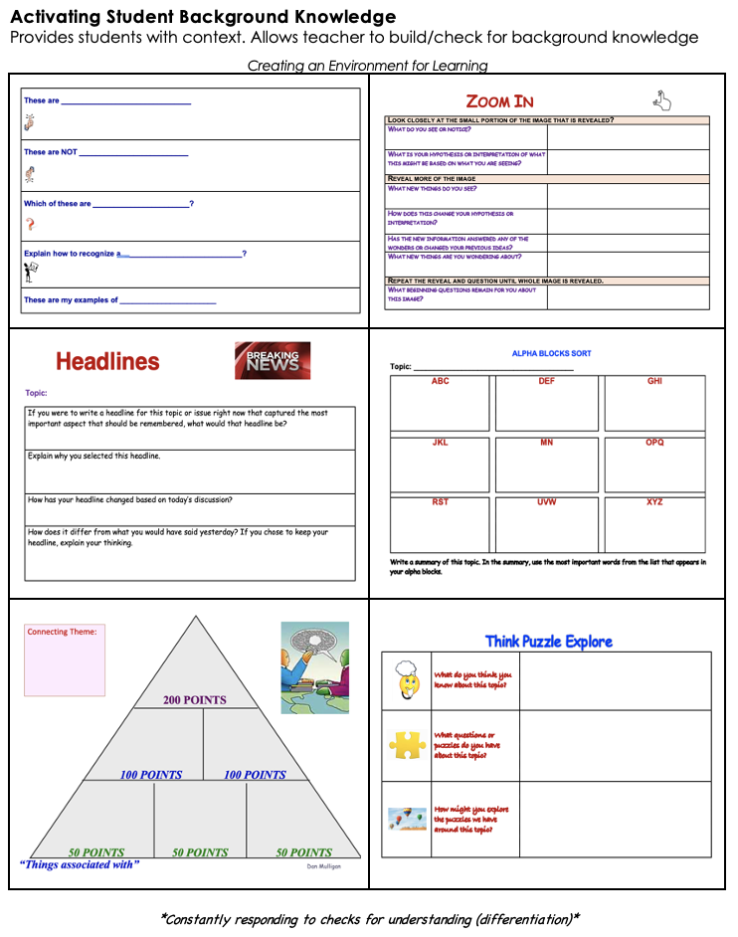
Lesson
Flowchart
Clear Objective (Today I will…)/Vocabulary
referenced by teacher/students throughout learning
Creating an Environment for Learning
Provides students with context
Allows teacher to build/check for background knowledge
Integration of:
Constant checks for understanding of each student.
Seize opportunities for student collaboration on second questions!
Helping Students Develop Understanding
This is the teaching/learning/discovering phase. Multiple checks for understanding along the way. Modeling, Guided Practice, Independent Practice
Helping Students Extend & Apply Knowledge
Student reflection & doing something with what they learned.

Slide 26

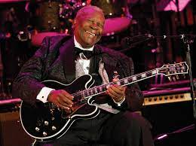
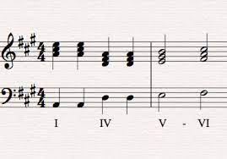
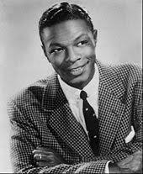
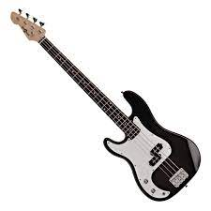

Music/ Dance
Flamenco
200 POINTS
Blues
Chord
100 POINTS 100 POINTS
Baritone
Bass Guitar
Beat
50 POINTS 50 POINTS 50 POINTS

Slide 27
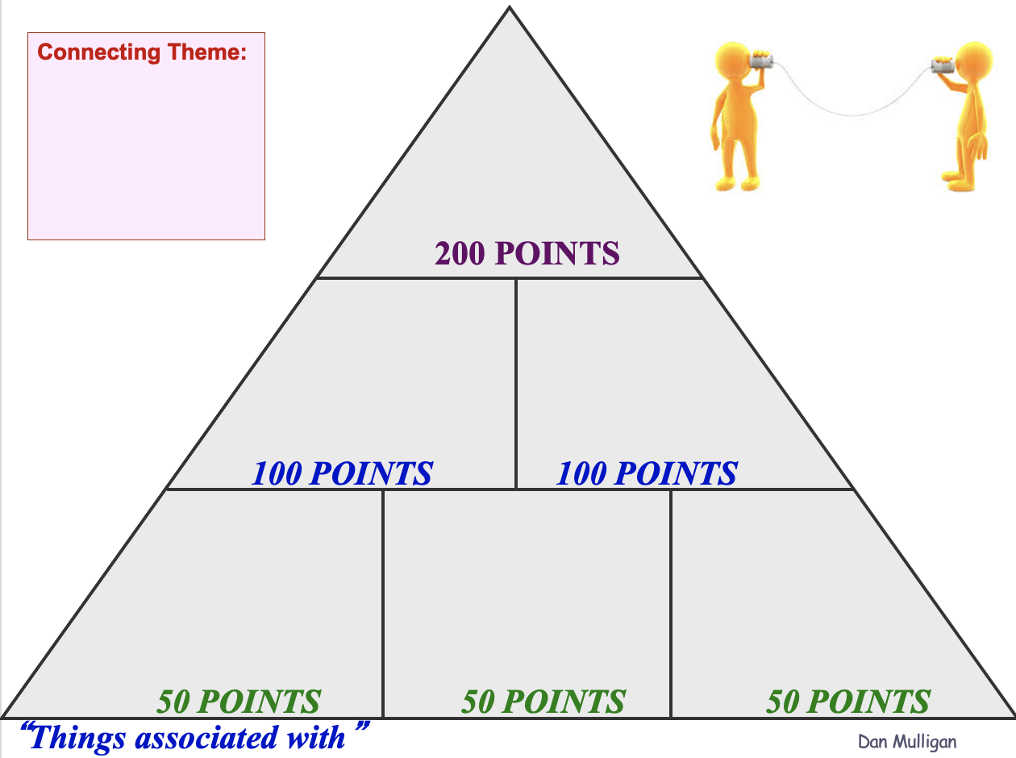

Slide 28

Checking for Understanding
Share with your partner one of the most effective strategies to engage students that you have used this year. Then actively listen to your partner as they share their strategy.
One more thing…
When you share your idea…none of your words can begin with the letters…
P S or T

Slide 29
Today’s
Objective
in
Context

Slide 30

Poor Students, Rich Teaching: Mindsets of Change
1. The Relational Mindset
Students who feel connected will stay in school.
2. The Achievement Mindset
Effort, motivation, and attitudes to succeed are teachable skills
3. The Rich Classroom Climate Mindset
A positive classroom/climate results in improved student achievement
4. The Engagement Mindset
Engage with purpose every student, every day, every nine minutes or less guaranteed
5. The Positivity Mindset
Highlight the ‘good’ rather than the ‘bad’
6. The Enrichment Mindset
Consider accelerating struggling students rather than remediating*
7. The Graduation Mindset
All means All…every student, every day!
Your behavior reflects that everyone matters…

Slide 31
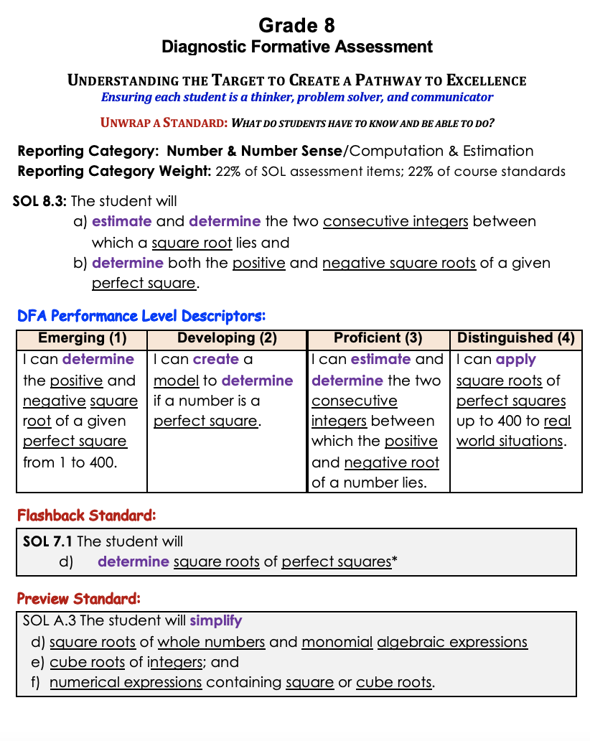
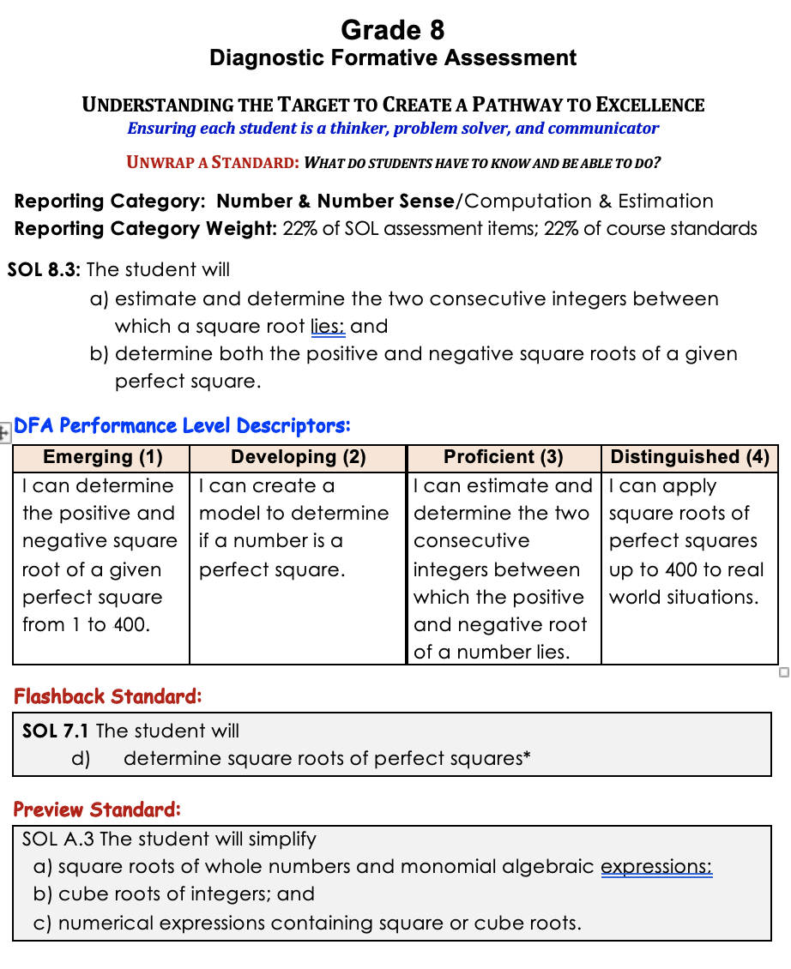
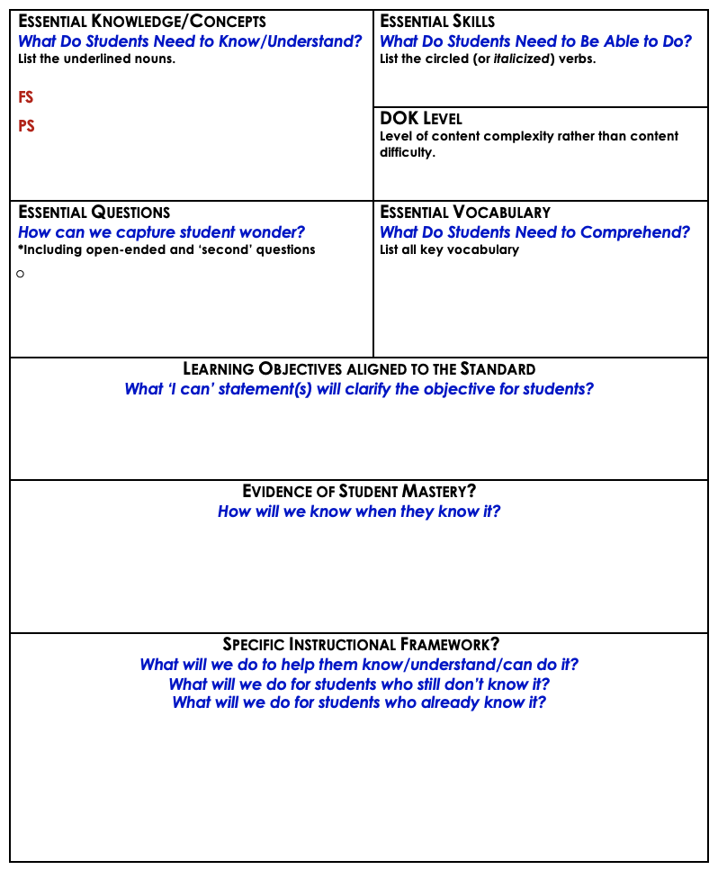


Slide 32









Slide 33


Interesting Fact:
Unpacking standards and/or administering a DFA or CFA is meaningless unless it results in a a purposeful response from the teacher and each student
Seizing
Opportunities

Slide 34


Slide 35


Effective Instruction: focus on essential knowledge, skills, processes, & vocabulary
What is that we want students to know and be able to do?
Three types of curricula exist in any classroom:
The Intended Curriculum: content/skill specified by the state, division, or school at a particular grade level.
The Implemented Curriculum: content/skill actually delivered by the teacher.
The Attained Curriculum: content/skill actually learned by the students.
Implemented Curriculum
Intended Curriculum
Attained Curriculum

Slide 36


Slide 37

Don’t
Steal Their
Thinking!

Slide 38




Thinking Routines

Slide 39

Lesson
Flowchart
Clear Objective (Today I will…)/Vocabulary
referenced by teacher/students throughout learning
Creating an Environment for Learning
Provides students with context
Allows teacher to build/check for background knowledge
Integration of:
Constant checks for understanding of each student.
Seize opportunities for student collaboration on second questions!
Helping Students Develop Understanding
This is the teaching/learning/discovering phase. Multiple checks for understanding along the way. Modeling, Guided Practice, Independent Practice
Helping Students Extend & Apply Knowledge
Student reflection & doing something with what they learned.

Slide 40

ORGANIZATION
Helping Students Develop Understanding
Purposefully facilitate students collaborating to create interactive notes to archive essential understandings based on unpacked standards (and PLD).

Slide 41




Slide 42

Unit Glossary Template

Slide 43


Student-Generated
Glossary

Slide 44


Determining
Depth of
Knowledge

Slide 45


Instructional Strategy: Motor Mouth
Purpose: To build and ‘check for’ background knowledge
One partner draws a card
Read their partner the words in blue (at top of card)
The partner with the card has one minute to give clues that willhelp their partner say each DOK student action on the card.

Slide 46


Choice
and
Voice
Must do… May do
Total Points

Slide 47


Content Neutral Structure: BLIND SEQUENCING
Phases of Moon
Please leave the cards in the Ziplock with this side (cover) face-up.
Directions:
Shuffle cards.
Deal all cards with same side (cover) face-up.
Clockwise one person describes a

Slide 48

Content Neutral Structure: BLIND SEQUENCING
Directions:
Deal the cards facedown to each team member.
You may look at your card(s) but do not allow anyone else to see your card(s).
The team member seated clockwise next to the dealer should describe the phase of the plant life cycle on one of their cards. Others may ask questions. Place card facedown on the table (no peak).
Then the next team member will describe the phase of the plant life cycle on their card. Place the card on the table.
The team must sequence the cards without looking until all cards are down.

Slide 49



DOK Question Poster

Slide 50



Anchor
Charts
Setting the Objective
(and checking along the way)

Slide 51
4 – second partner
Please bring your Alpha Sort, Think Pad, and a pen(cil)

Slide 52

One Has to Go!
You must remove one choice.
Which one would you choose to go?
________________________
What makes you say that?
(explain your choice)

Slide 53
One Has to Go!
You must remove one choice.
Which one would you choose to go?
________________________
What makes you say that?
(explain your choice)

Slide 54
One Has to Go!
You must remove one choice.
Which one would you choose to go?
________________________
What makes you say that?
(explain your choice)

Slide 55




Rigor Thinking Routines Research-Based Strategies

Slide 56
Choice
and
Voice
Must do… May do
Total Points

Slide 57
DOK Question Poster

Slide 58

There are two reasons why we assess:
To inform instructional decisions (targeted learning stations)
To encourage each student to try

Slide 59
Musical/Rhythmic Sing it Create a beat Rap it Make a cheer Create a jingle Hum it Identify sounds React to sounds Listen to sounds Connect to music Write a poem | Verbal/Linguistic Read it Spell it Write it Listen to it Tell it Recall it Use “you” words Apply it Chunk information Say it Use mnemonics | Logical/Mathematical Make a pattern Chart it Sequence it Create a mnemonic Analyze it Think abstractly Think critically Use numbers Prove it Interpret the data Use the statistics | Visual/Spatial Mind maps Graphic organizers Video Color code Highlight Shape a word Interpret a graphic Read a chart Study illustrations Visualize it Make a chart Create a poster
Body/Kinesthetic Role play Walkabout Dance Lip sync Skits/charades/mimes Construction Math manipulatives Sign language Sports Activity centers Body language | Intrapersonal Metacognition Use self-talk Work independently Solve in your own way Understand self Journal it Rehearse it Use prior knowledge Connect it Have ownership | Interpersonal Think-Pair-Share Jigsaw Cooperative grouping Drama Debates Class meetings Role play Meeting of minds Peer counseling Tutors/buddies Giving feedback Shared Journals | Naturalist Label it Categorize it Identify it Form a hypothesis Do an experiment Adapt it Construct it Classify it Investigate it Discern patterns

Slide 60

Spin the Word
modified
Remove the cards from the bag.
Place the deck of cards face down in the center of the table.
Determine the order of playing by each person rolling the die.
Each card contains:
Math vocabulary word, and
Method of giving clues
Remember:
Each person has a turn,
Each person has a lifeline!
Enjoy!

Slide 61



Click on the arrow to start and stop spinner.

Slide 62


Kinds of Evidence – Continuum of Evidence Informal Check for Understanding

Slide 63

Name a noun. | Form a sentence.
Name a verb. | Name an adjective
1
4
Team
Turn
2
3

Slide 64
Name a number for the slope of a line. | Form a sentence.
Name a number for the y-intercept of a line. | Write the equation of the line in standard form.
1
4
Team
Turn
2
3

Slide 65


Slide 66


Slide 67


Slide 68

Clear Objective (Today I will…)/Vocabulary
referenced by teacher/students throughout learning
Lesson
Flowchart
Creating an Environment for Learning
Provides students with context
Allows teacher to build/check for background knowledge
Creating an Environment for Learning
Provides students with context
Allows teacher to build/check for background knowledge
Integration of:
Constant checks for understanding of each student.
Seize opportunities for student collaboration on second questions!
Helping Students Develop Understanding
This is the teaching/learning/discovering phase. Multiple checks for understanding along the way. Modeling, Guided Practice, Independent Practice
Helping Students Extend & Apply Knowledge
Student reflection & doing something with what they learned.

Slide 69


Slide 70

Thank you for your commitment to children!
"It's your attitude, not just your aptitude that determines your ultimate altitude." --Zig Ziglar ☺
Dan

