Slide 1



Pathways to Excellence
Shelf-Ready Research-Based Learning Strategies
What do we want all of our students to know and be able to do?
What will we do to make sure they know and are able to do it?
LEARNING TARGET
How will we know what they know it?
wordle.net
tagxedo.com
Prepared for the Collaborative Learning Team Members of
Essex County High School
by Dan Mulligan, Ed. D., flexiblecreativity.com (Twitter: @drdanmulligan)
August 2017
“The difference between who you are and what you want to be is what you do.” ~Bill Phillips,2006

Slide 2

Teaching Every Student
Five Key Elements
Learning Environment
The Curriculum
Assessments
Instruction
Classroom Management

Slide 3
4 – second partner
Find a friend not at your table that you rarely collaborate.
Find 2 seats and introduce yourself (smile).
Share with your partner one positive experience from this summer. It can be family, professional, etc. Why do you consider it positive?

Slide 4

The HOW
What will we do to help students understand the essential content?
What will we do to help students acquire the necessary skills?

Slide 5
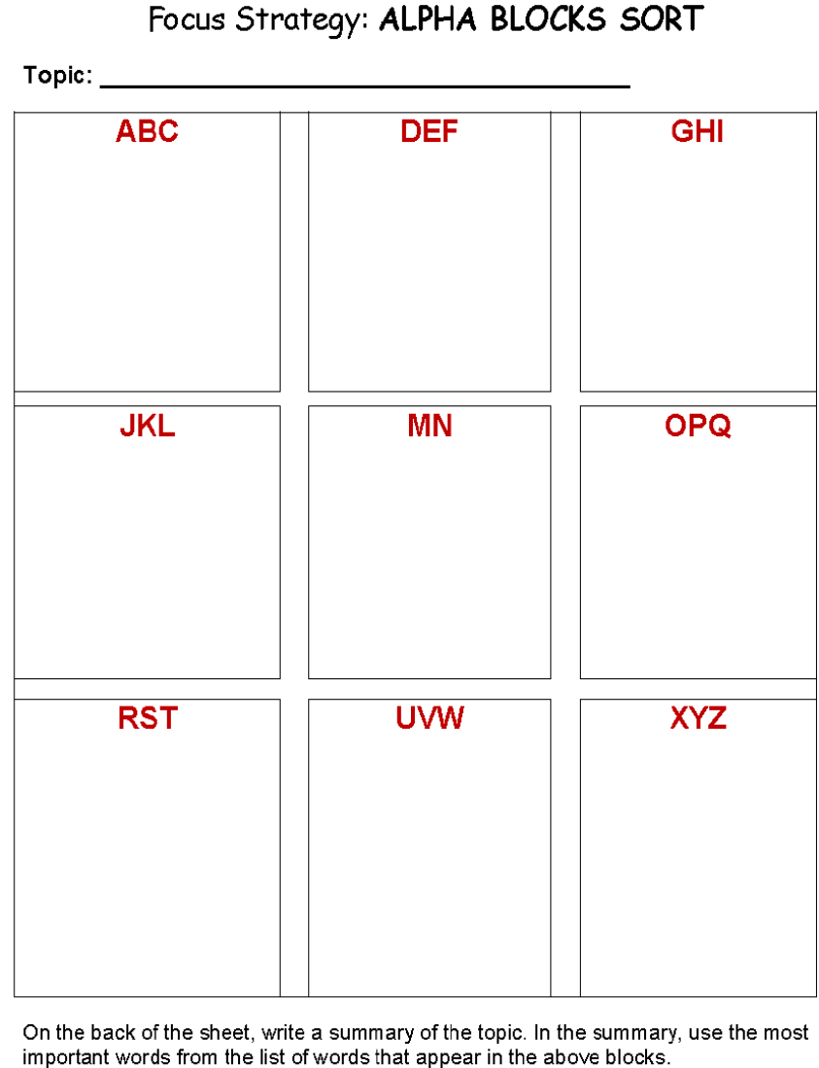
Essential Question:
What will we do
to make sure they
know and
can do it?
strategies to engage each student
Work collaboratively (e.g., construct viable arguments, critique, agree) to identify strategies to engage each student.
Enjoy working with your new best friend.

Slide 6
Lesson
Flowchart
Clear Objective (Today I will…)/Vocabulary
referenced by teacher/students throughout learning
Creating an Environment for Learning
Provides students with context
Allows teacher to build/check for background knowledge
Integration of:
Constant checks for understanding of each student..
Seize opportunities for student collaboration on second questions!
Helping Students Develop Understanding
This is the teaching/learning/discovering phase. Multiple checks for understanding along the way. Modeling, Guided Practice, Independent Practice
Helping Students Extend & Apply Knowledge
Student reflection & doing something with what they learned.

Slide 7
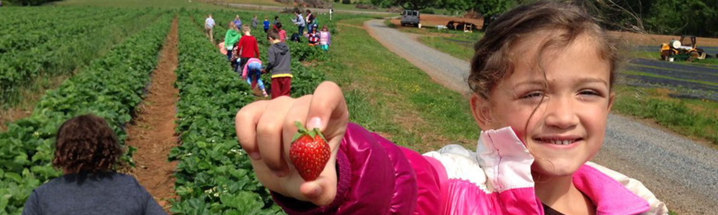
Create an Environment for Learning
When students know what they are learning, their performance, on average, has been shown to be
27 percentile points higher
than students who do not know what they are learning.

Slide 8
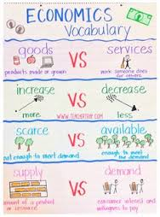
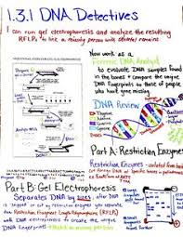
Anchor
Charts
Canva.com
Setting the Objective
(and checking along the way)

Slide 9
4 – second partner

Slide 10
Research on Imagery as Elaboration
Students who used imagery to learn vocabulary, on average, performed
# of studies
6 | 37 percentile pts. higher than… | …students who kept repeating definitions.
4 | 21 percentile pts. higher than… | …students who were using the terms in a sentence.

Slide 11
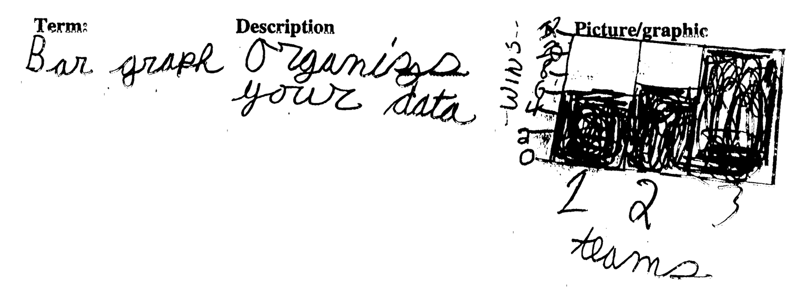

Slide 12
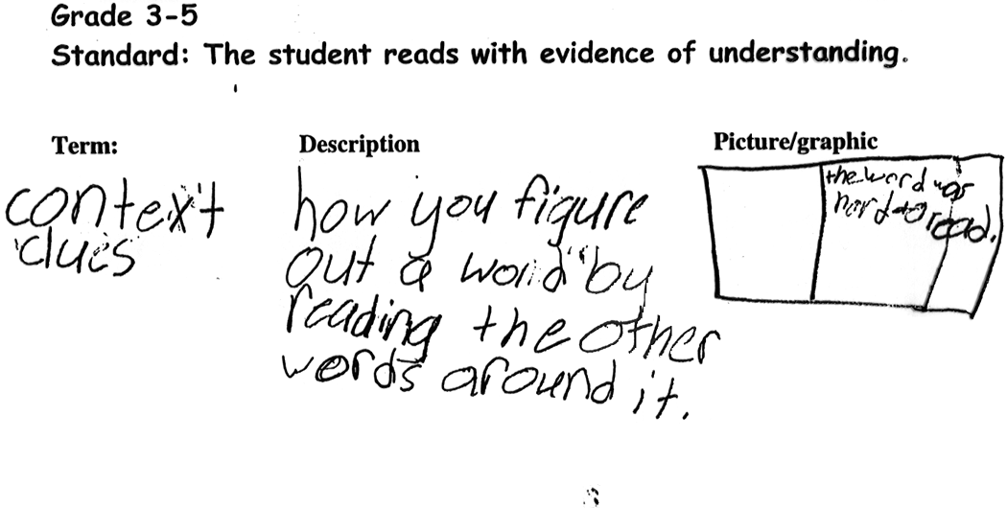

Slide 13



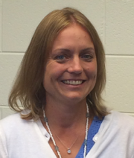
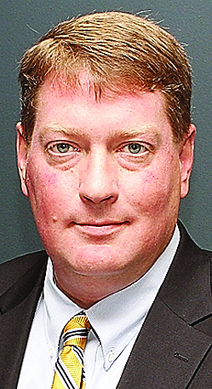

Organizing Theme:
Things someone would say…
EDUCATIONAL
STAKEHOLDER EDITION
Cafeteria Worker
Triangle
Trivia
200 POINTS
Parent
Student
100 POINTS 100 POINTS
Principal
Superintendent
Teacher
50 POINTS 50 POINTS 50 POINTS

Slide 14
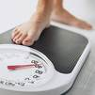

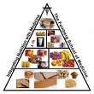

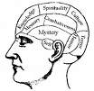

Health/PE
Body Mass
200 POINTS
Equipment
Nutrition
100 POINTS 100 POINTS
Movement
Wellness
Endurance
50 POINTS 50 POINTS 50 POINTS

Slide 15
Higher-Order
Student
Thinking
Predict
200 POINTS
Justify
Innovate
100 POINTS 100 POINTS
Compare
Sequence
Explain
50 POINTS 50 POINTS 50 POINTS

Slide 16

Good Instruction
(Keep it Simple…Keep it Real)
“We can, whenever and wherever we choose, successfully teach all children whose schooling is of interest to us. We already know more than we need to do that. Whether or not we do it must finally depend on how we feel about the fact that we haven’t so far.”
~Ron Edmonds

Slide 17
Helping
Students
Develop
Understanding

Slide 18
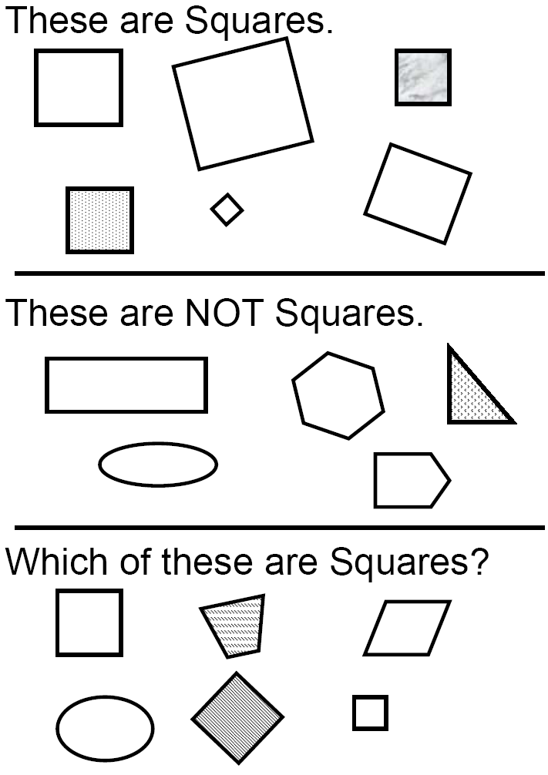

Slide 19
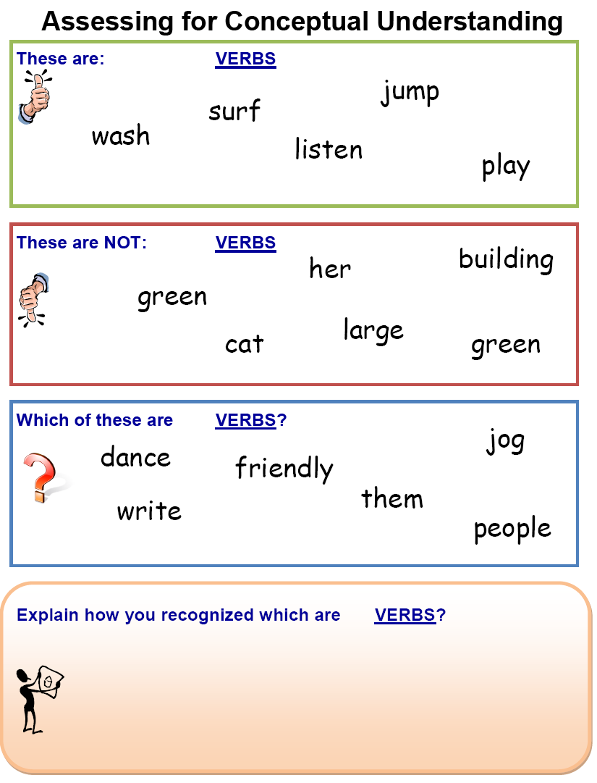

Slide 20
If you want a learner to truly understand and own essential knowledge, expand your exploration from ‘what it is’ to also ‘what it is NOT’.

Slide 21
Essex County Mission Statement
In partnership with our students, faculty, staff, parents, and the community, Essex County Public Schools is committed to creating Pathways to Excellence by promoting a positive, student-focused culture striving for continuous improvement that meets the academic, athletic, artistic, and career-occupational needs of all our students by guiding, inspiring, celebrating, and teaching our students as we equip them to meet the challenges of a global society.

Slide 22
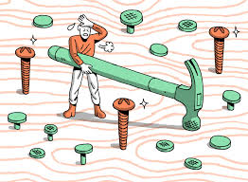
The WHAT
What do we want our students to know and be able to do?
How will we know when they know it?

Slide 23

Effective Assessment and Instruction focuses on Unpacked Standards that identify the nonnegotiable knowledge, skills, processes, & vocabulary
Three types of curricula exist in any classroom:
    The Intended Curriculum: content/skill specified by the state, district, or school at a particular grade level.
    The Implemented Curriculum: content/skill actually delivered by the teacher.
    The Attained Curriculum: content/skill actually learned by the students.
The BIG Idea
Implemented Curriculum
Intended Curriculum
Attained Curriculum

Slide 30
Good Instruction
(Keep it Simple…Keep it Real)
“We can, whenever and wherever we choose, successfully teach all children whose schooling is of interest to us. We already know more than we need to do that. Whether or not we do it must finally depend on how we feel about the fact that we haven’t so far.”
~Ron Edmonds

Slide 31
4 – second partner

Slide 32
Category | Ave. Effect Size (ES) | Percentile Gain
Identify similarities & differences | 1.61 | 45
Summarizing & note taking | 1.00 | 34
Reinforcing effort & providing recognition | .80 | 29
Homework & practice | .77 | 28
Nonlinguistic representations | .75 | 27
Cooperative learning | .73 | 27
Setting objectives & providing feedback | .61 | 23
Generating & testing hypotheses | .61 | 23
Questions, cues, & advance organizers | .59 | 22

Slide 33
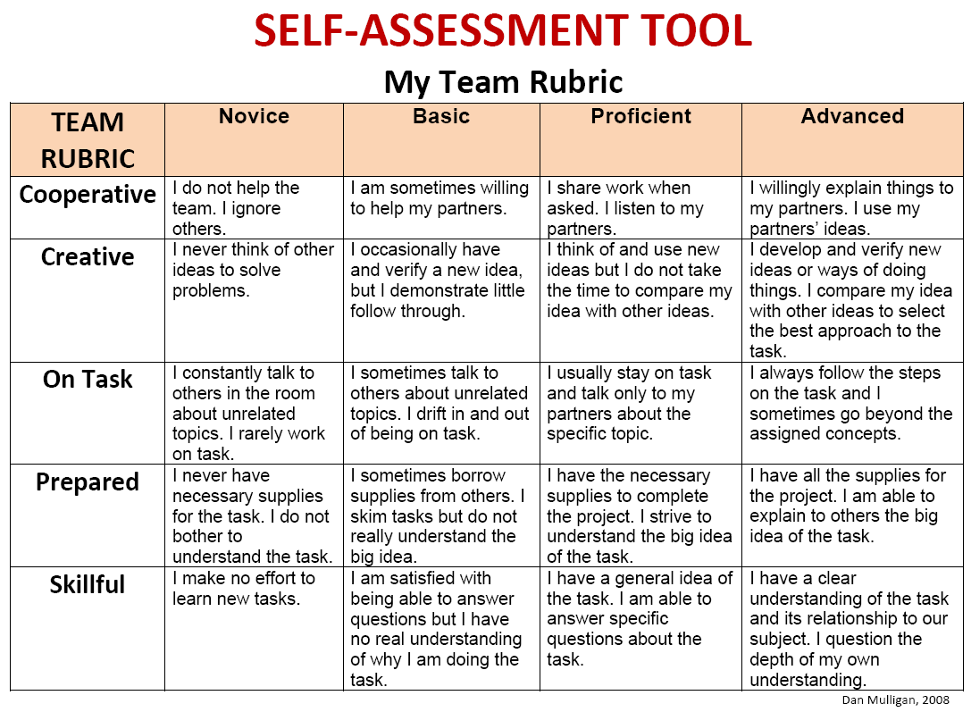

Slide 35
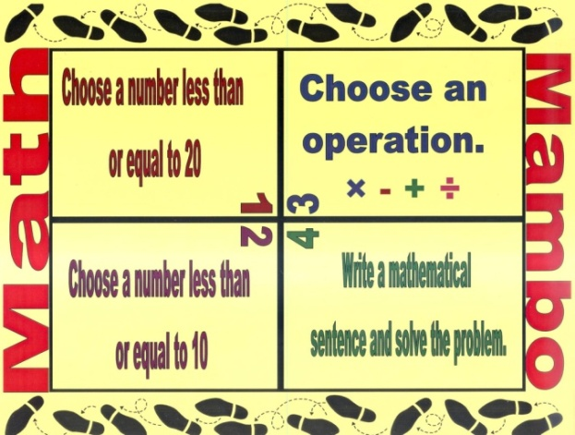
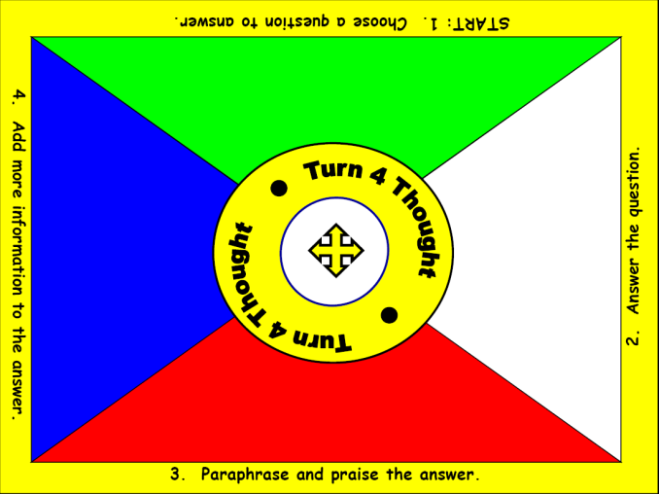
Kinds of Evidence – Continuum of Evidence
Informal Check for Understanding

Slide 36
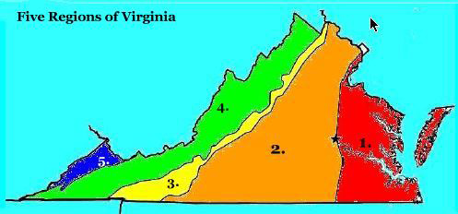
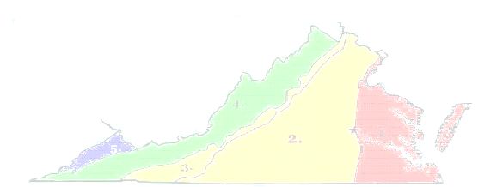
Name a noun. | Form a sentence.
Name a verb. | Name an adjective
1
4
Team
Turn
2
3

Slide 37
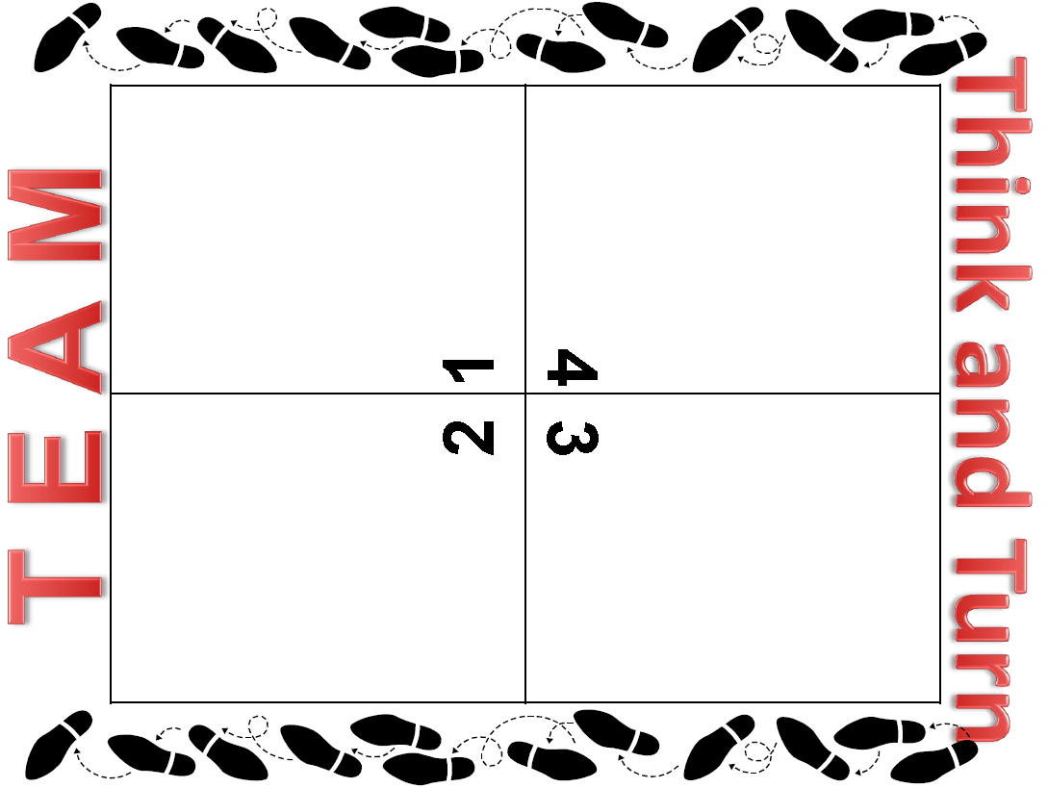

Slide 38

Fostering Student Engagement
Strategy: Blind Sequencing
Goal: To place the phases of the moon in their order.
Team member next to dealer describes their card.
Other team members can ask clarifying questions.
Team member places card FACE DOWN on the table.
Next person describe a card and places card face down.
Team tries to sequence cards.
Cards may NOT be turned over until team is finished.

Slide 39
What We Teach - Resources
page
6

Slide 40
Target WORD in Green

Slide 41

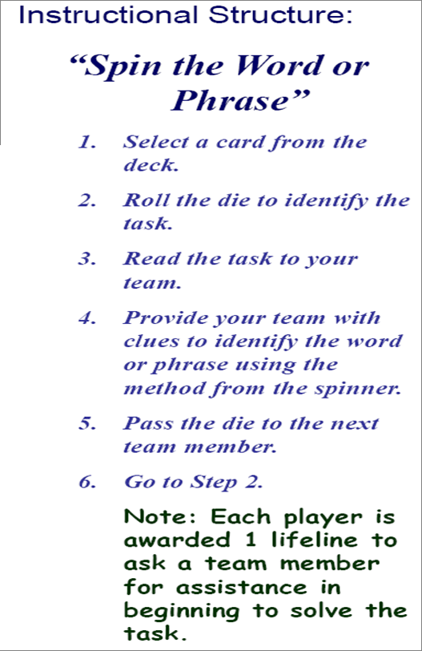
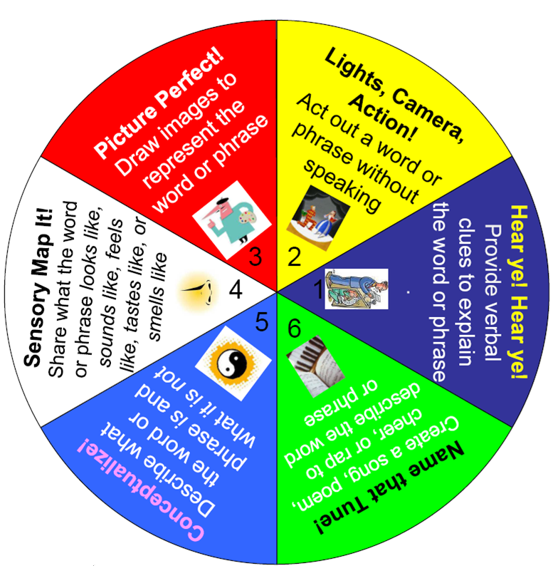
Click on the arrow to start and stop spinner.

Slide 42
Instructional Strategies that Facilitate
Successful Inclusion Must …
B. Helping Students Develop Understanding
Integrating prior knowledge with new knowledge
Procedural knowledge: constructing a model of the steps required of the process and practicing its variations; using the process or skill fluently or without any conscious thought
Supply students with STRUCTURE and ORGANIZATION
Encourage student COMMUNICATION and COLLABORATION
Provide students with VISUAL and HANDS-ON learning experiences

Slide 43
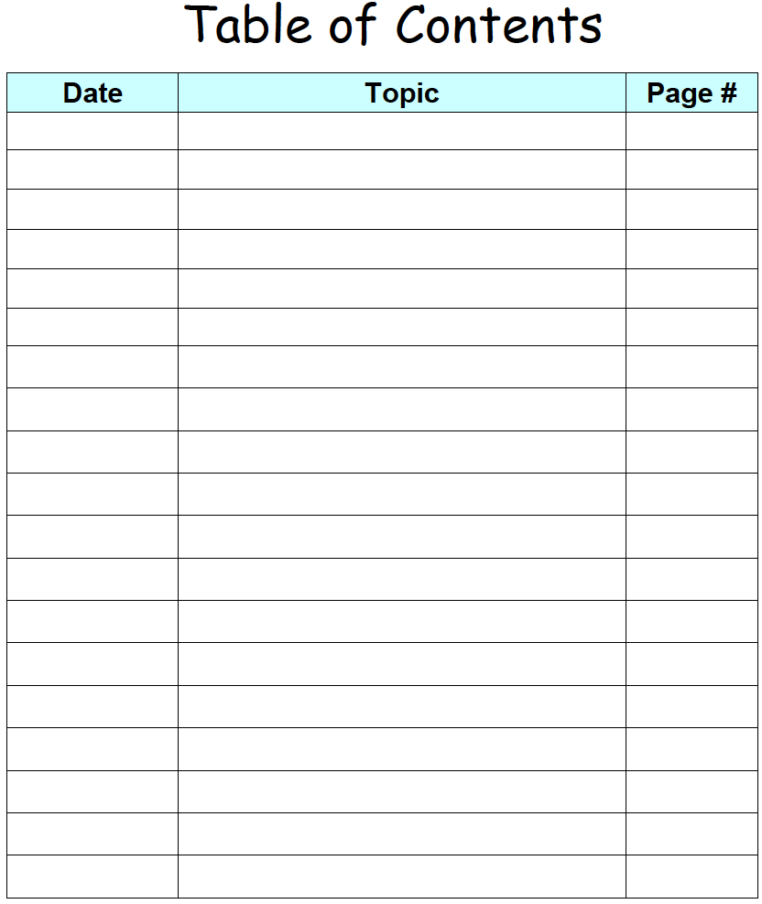
Research-based
Strategy:
Summarizing and
Note-taking
Instructional
Explicitness
pages
16 - 20

Slide 44
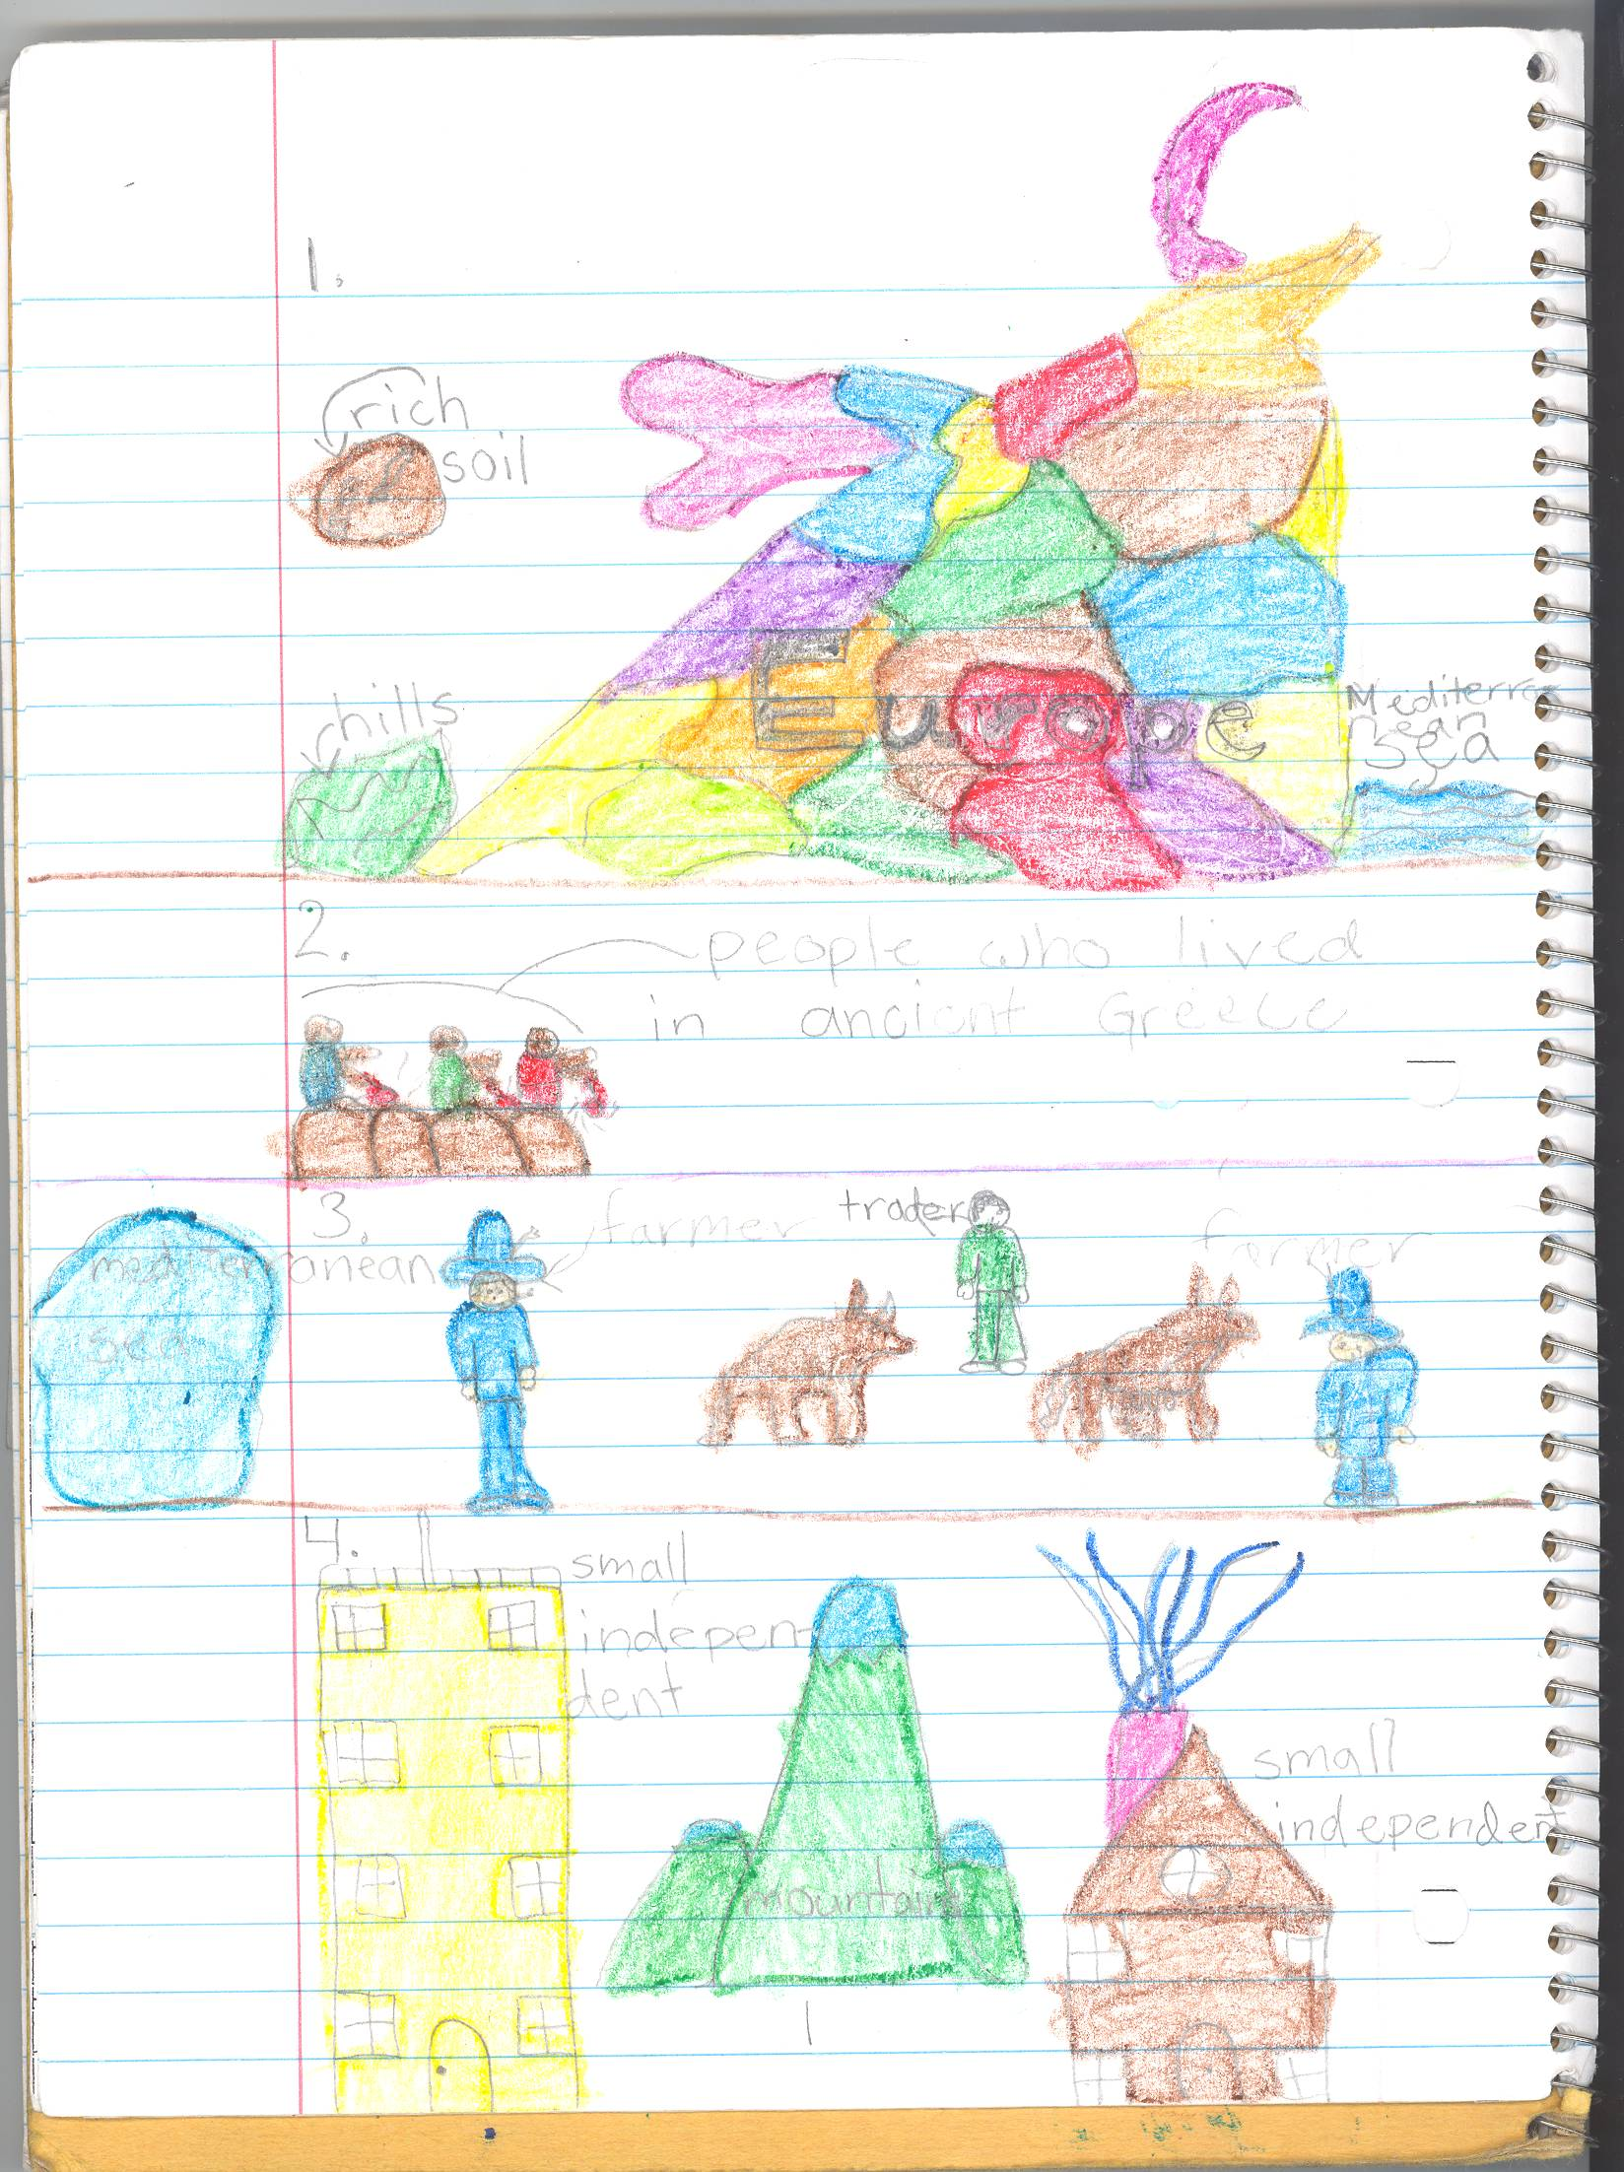
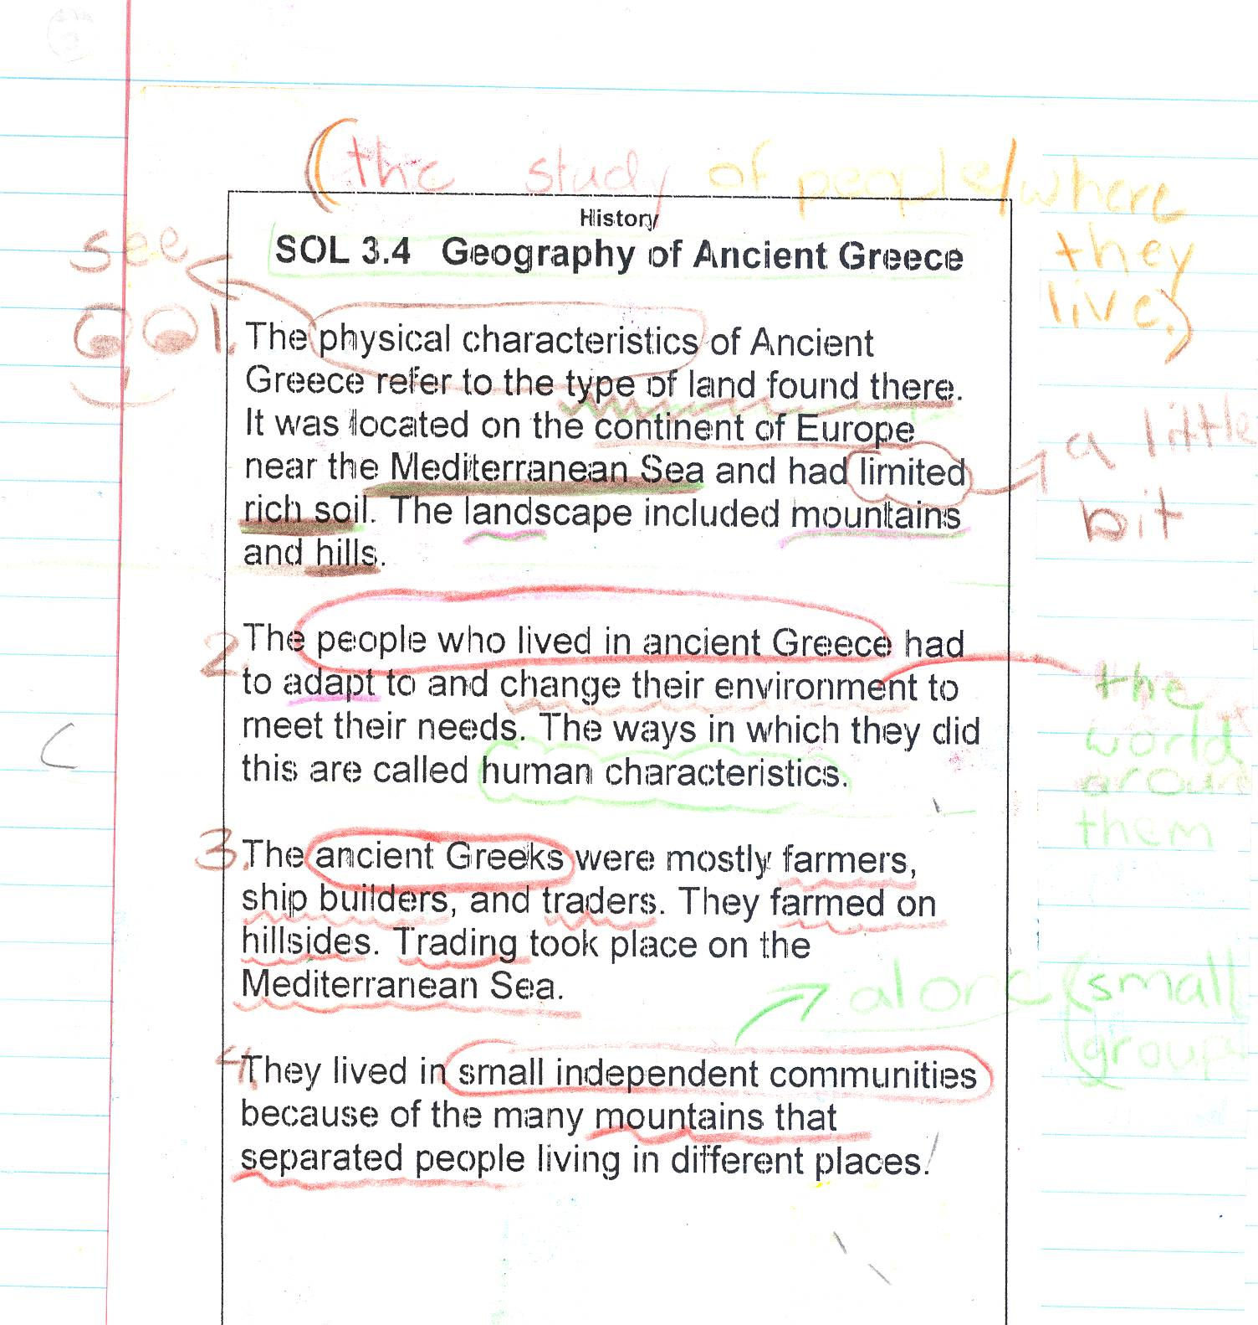
Highlighter

Slide 45
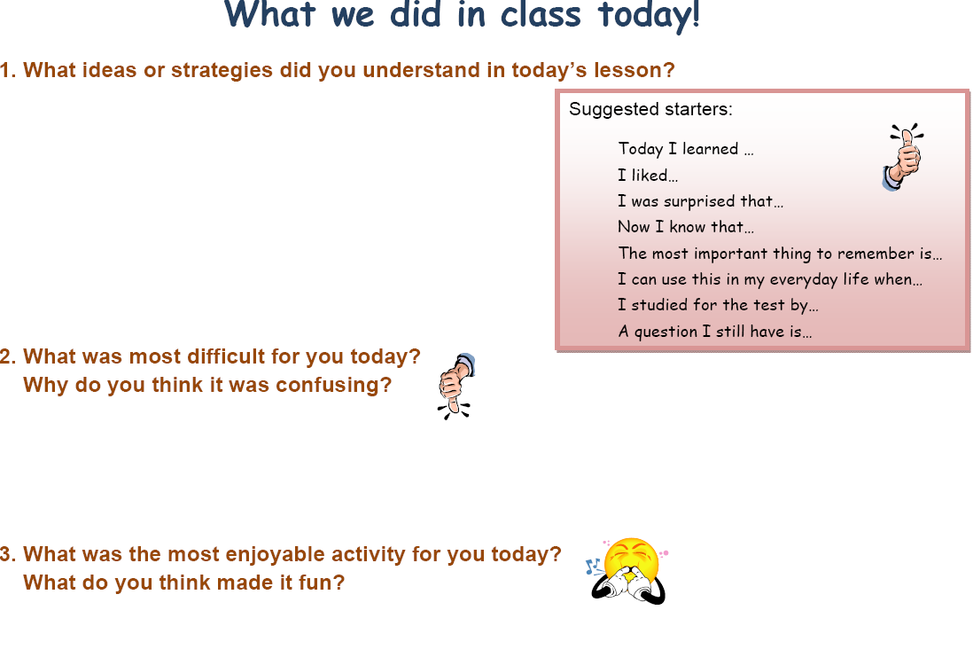

Slide 46
Assessment Guiding
Learning
There are two reasons why we assess:
to inform instructional decisions;
to encourage students to try.
~Grant Wiggins

Slide 47
KEY QUESTION: Why are common assessments so important?
WHY do we ASSESS:
1. INFORM INSTRUCTIONAL DECISIONS
2. ENCOURAGE STUDENTS TO TRY
“You can enhance or destroy students’ desire to succeed in school more quickly and permanently through your use of assessment than with any other tools you have at your disposal.” Rick Stiggins, Assessment Trainers Institute
Notes:
Grading: each side is worth 4 points:
Front elements:
“In God We Trust”
“Liberty”
Year
Lincoln head
Extra credit point - Mint letter
Back elements:
“United States of America”
“One Cent”
“E Pluribus Unum”
Lincoln Memorial
Extra credit point - Lincoln drawn in memorial
Identify scores by raising of hands. Use 6 or better for mastery. Questions:
Did they do better as an individual or a team?
How would the results be used if this was a “For” assessment?
How would the results be used if this was an “Of” assessment?

Slide 49
Follow-up Debriefing
Each pair should share with your other team members the method you used to graph the figure.
Discuss with your team:
  Which method appeals to you?
  Is there another method that you would prefer?
Prepare for a “pairs choice of method” with a new graph.

Slide 51
Key Question
Did your performance on the second attempt to complete the grid exercise improve after having an opportunity to self-assess your initial strategy?

Slide 52
Formative Assessment
Formative assessment is the process used by teachers and students during instruction that provides feedback to adjust teaching and learning for the purpose of improving student learning.
Council of Chief State School Officers, October 2006
Notes:
Process rather than a particular test….
It is not the nature of the test itself that makes it formative or summative…it is the use to which those results will be put.

Slide 53

Thank you for your commitment to children!
"It's your attitude, not just your aptitude that determines your ultimate altitude."
--Zig Ziglar ☺
Dan

