Slide 1
Focus Standard

Slide 2
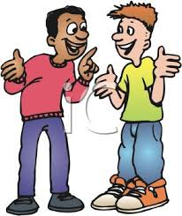
Motor Mouth
Things associated with
US History
Protest
Discrimination
Federal
Vote
Judicial
Boycott
Freedom
Things associated with
Lesson Planning
Closure
Clear Objective
Formative Assessment
Collaboration
Note-taking
Unpack Standard
Engagement
Things associated with
Virginia Studies
Products
Executive Branch
L. Douglas Wilder
Reconstruction
Tourism
Coastal Plain
General Assembly

