Slide 1
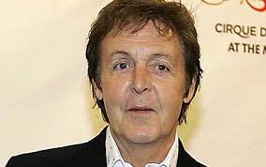
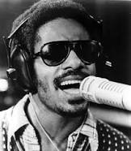
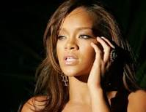
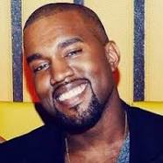
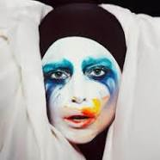
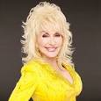
Organizing Theme:
Things someone would say…
FAMOUS
Living
SINGERS
Paul McCartney
Triangle
Trivia
200 POINTS
Stevie Wonder
Rihanna
100 POINTS 100 POINTS
Kanye West
Lady Gaga
Dolly Parton
50 POINTS 50 POINTS 50 POINTS

Slide 2
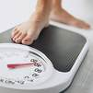

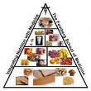

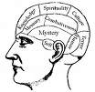

Health/PE
Body Mass
200 POINTS
Equipment
Nutrition
100 POINTS 100 POINTS
Movement
Wellness
Endurance
50 POINTS 50 POINTS 50 POINTS

Slide 3
Research-based Instructional Strategies
YOUR
TURN!!!
200 POINTS
100 POINTS 100 POINTS
50 POINTS 50 POINTS 50 POINTS

Slide 4




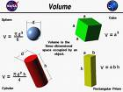
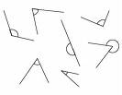


Grade 6 Math
Measurement & Geometry
ISOSCELES TRAPEZOID
200 POINTS
CONGRUENT
CYLINDER
100 POINTS 100 POINTS
PLANE FIGURE
VOLUME
TYPES of ANGLES
50 POINTS 50 POINTS 50 POINTS

Slide 5
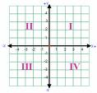
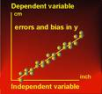


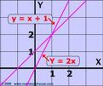
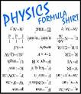
Grade 8 Math
Patterns, Functions, & Algebra
(32% of SOL test)
COORDINATE PLANE
200 POINTS
DEPENDENT VARIABLE
DOMAIN
100 POINTS 100 POINTS
FUNCTION
LINEAR EQUATION
FORMULA
50 POINTS 50 POINTS 50 POINTS

Slide 6

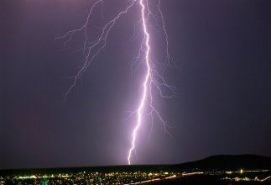


Science
Kinetic Energy
200 POINTS
Hypothesis
Electron
100 POINTS 100 POINTS
Atmosphere
Experiment
Dissolve
50 POINTS 50 POINTS 50 POINTS

Slide 7
Enter text here
200 POINTS
Enter text here
Enter text here
100 POINTS 100 POINTS
Enter text here
Enter text here
Enter text here
50 POINTS 50 POINTS 50 POINTS

