Slide 1
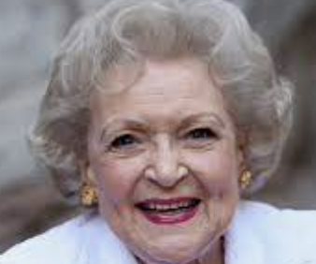
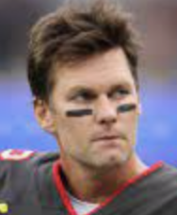
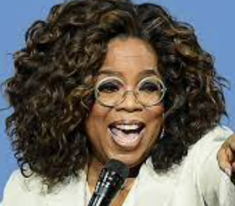
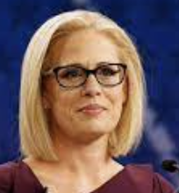
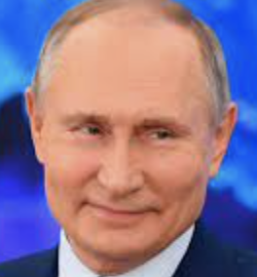
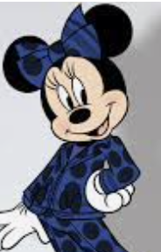
Famous People February 2022 Edition
Betty White
200 POINTS
Tom Brady
Oprah
100 POINTS 100 POINTS
Krysten Sinema
Vladimir Putin
Minnie Mouse
50 POINTS 50 POINTS 50 POINTS

Slide 2
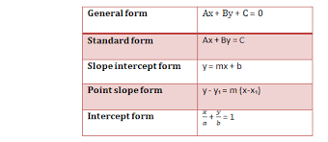
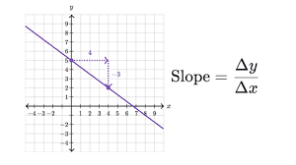
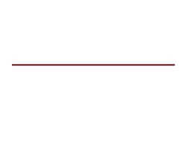
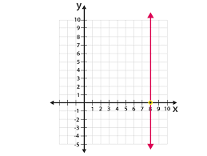
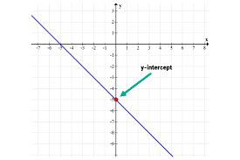
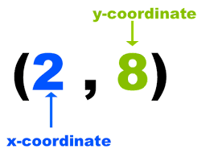
Three- Dimensional
Shapes
Equation of a Line
200 POINTS
Slope
Horizontal
100 POINTS 100 POINTS
Vertical
y-intercept
Ordered Pair
50 POINTS 50 POINTS 50 POINTS

