Slide 1
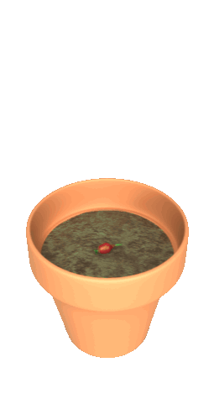

Engagement, Data-driven Small Group, and Lesson Planning to Create a Joyful Place!
“You can’t go back and change the beginning, but you can start where you are and change the ending.”
~C.S. Lewis
https://www.flexiblecreativity.com/tucson-usd-january-2024
Prepared for the Professional Learning Network Members of
TUSCON UNIFIED SCHOOL DISTRICT
by Dan Mulligan, Project Momentum Arizona
JANUARY 2024

Slide 2
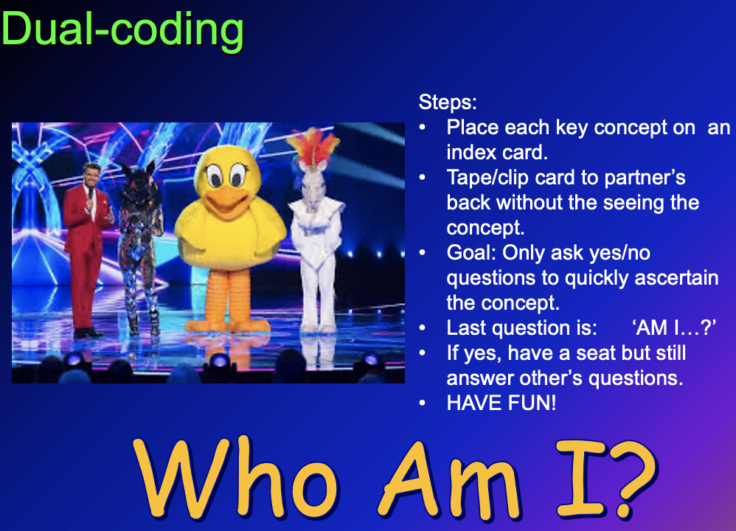

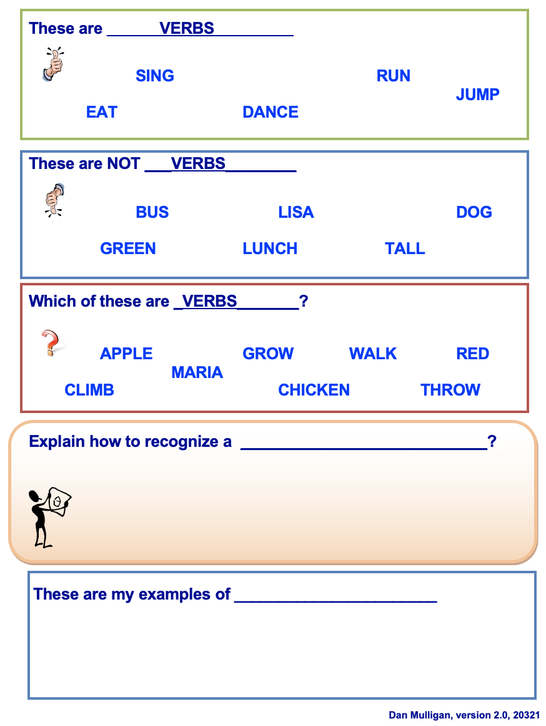
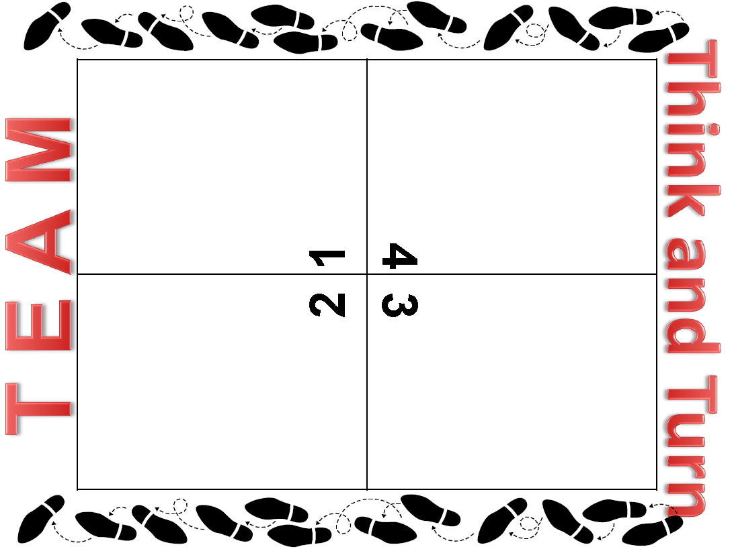
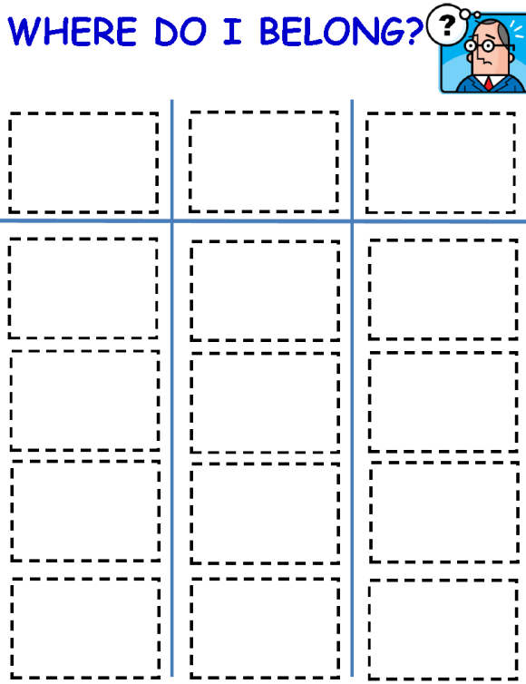
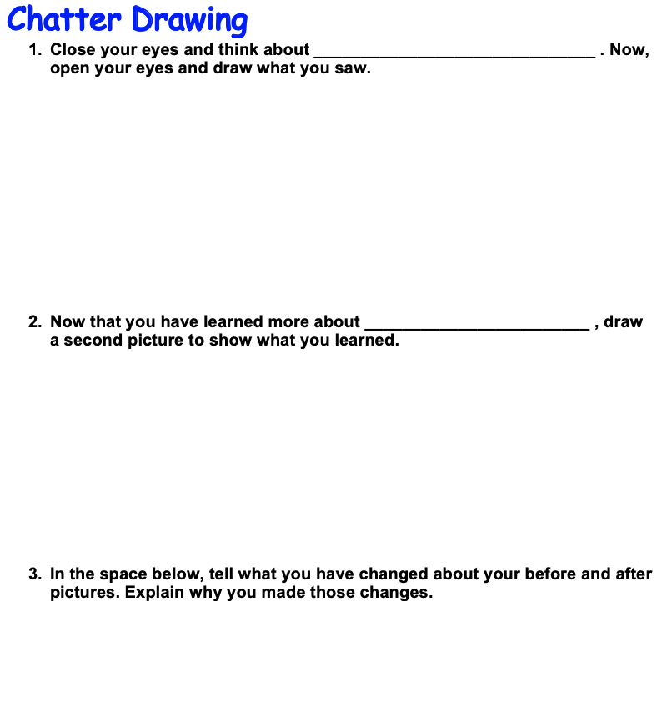
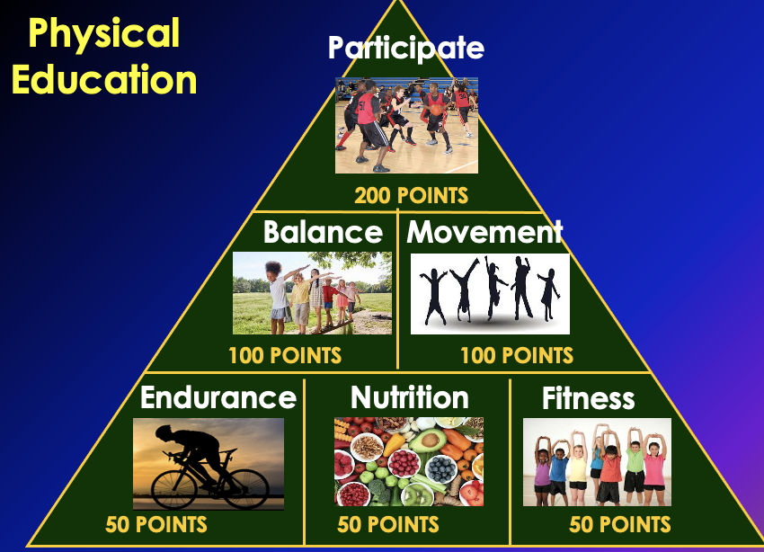
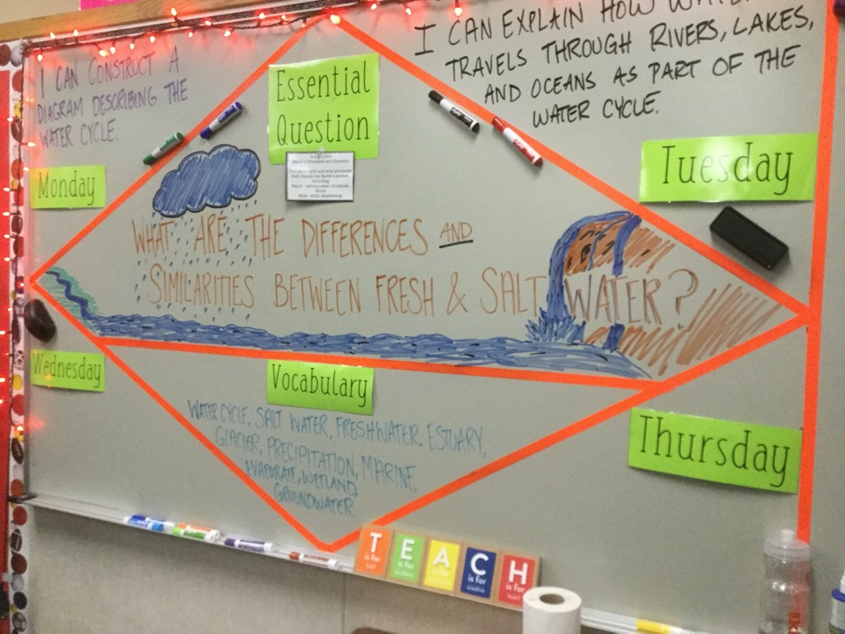
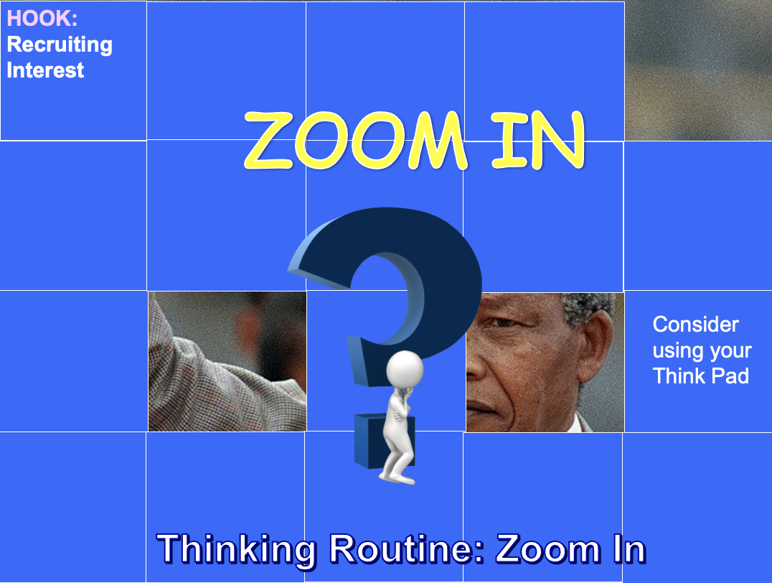
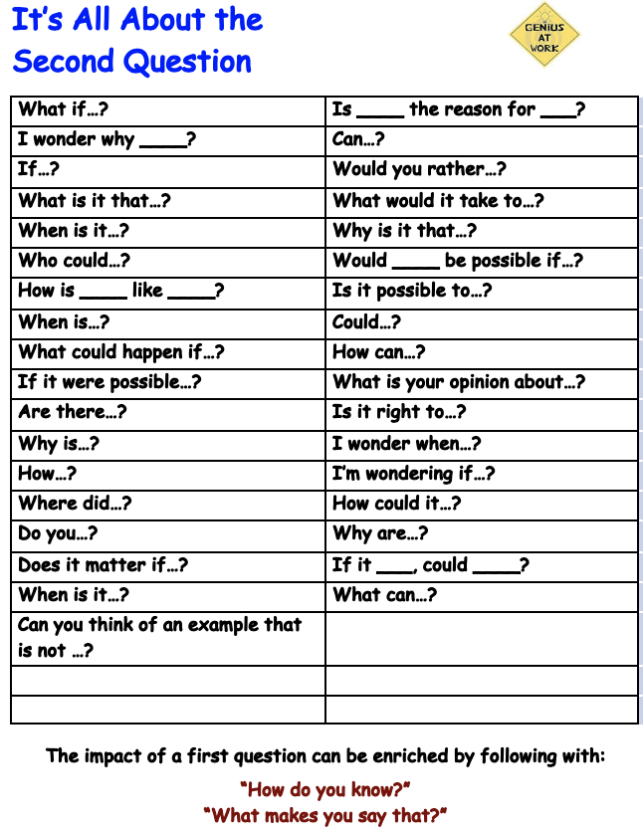
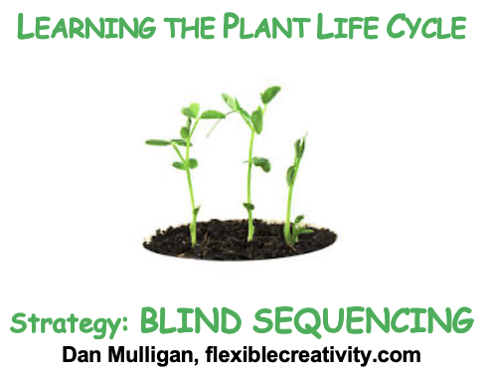

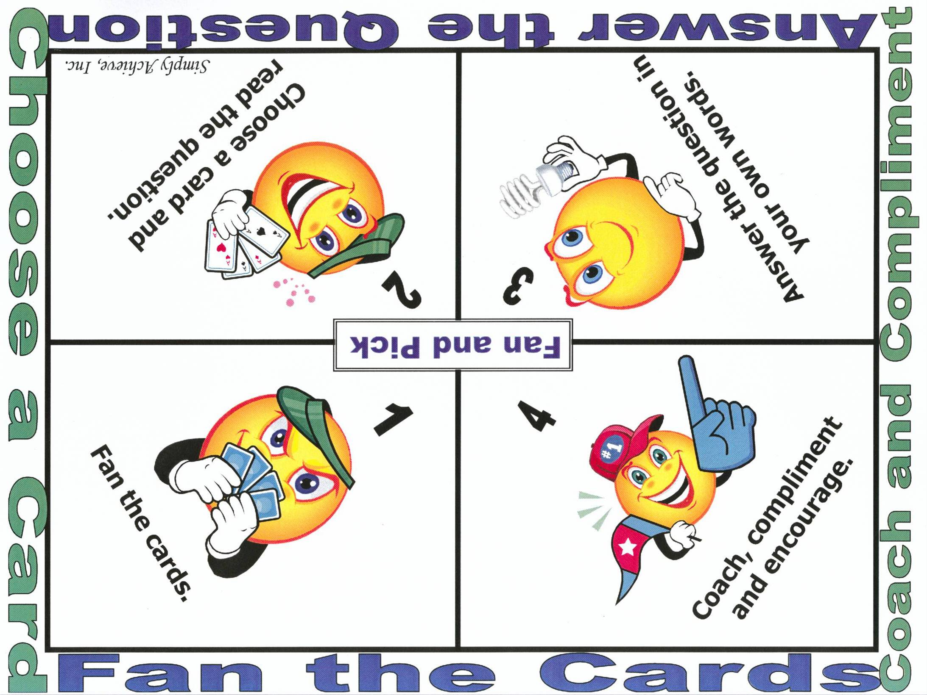
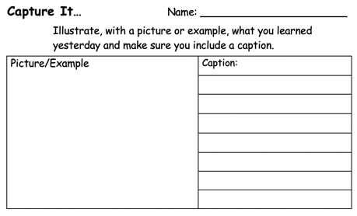
Flashback Friday

Slide 3
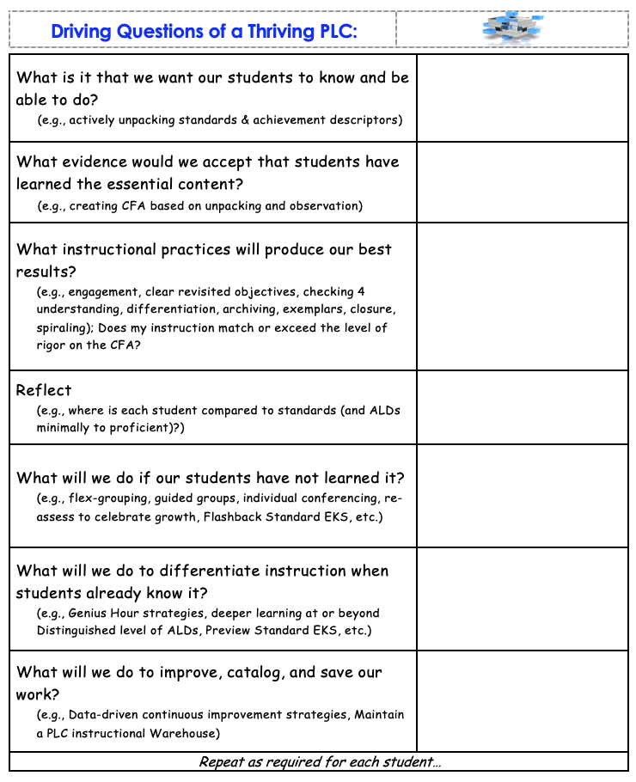
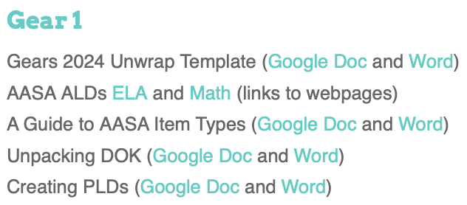

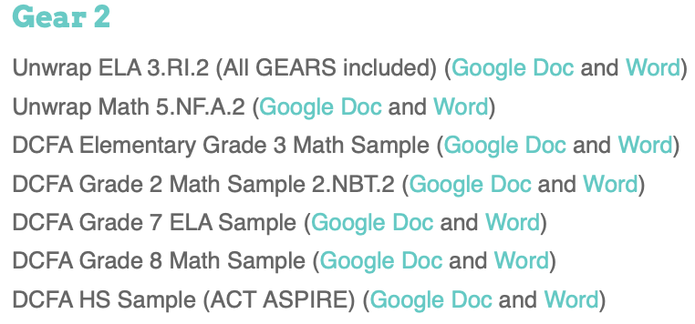

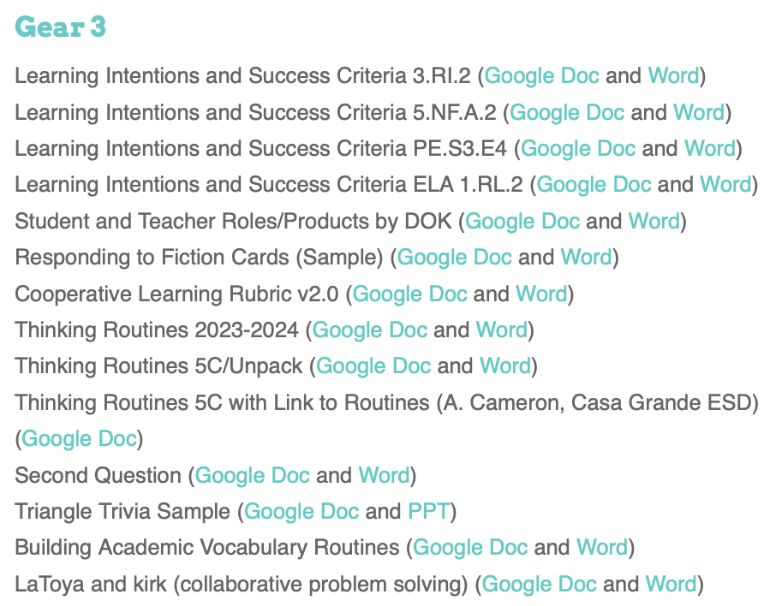
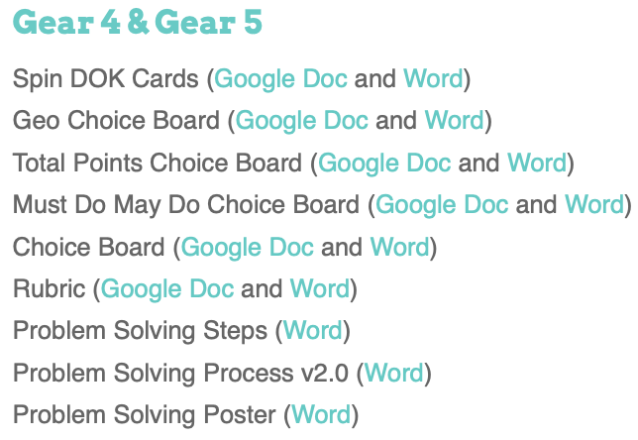
Resources to Share
Learning Intention: I am learning practical strategies to increase student achievement, engage my students, and facilitate data-driven differentiated support.
Don’t Steal
Their Thinking!

Slide 4
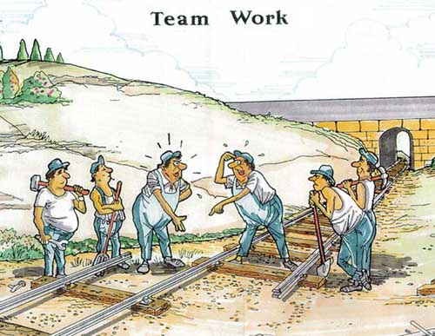

Teamwork??
Requires each team member actively listen and clearly express their thoughts and questions.

Slide 5
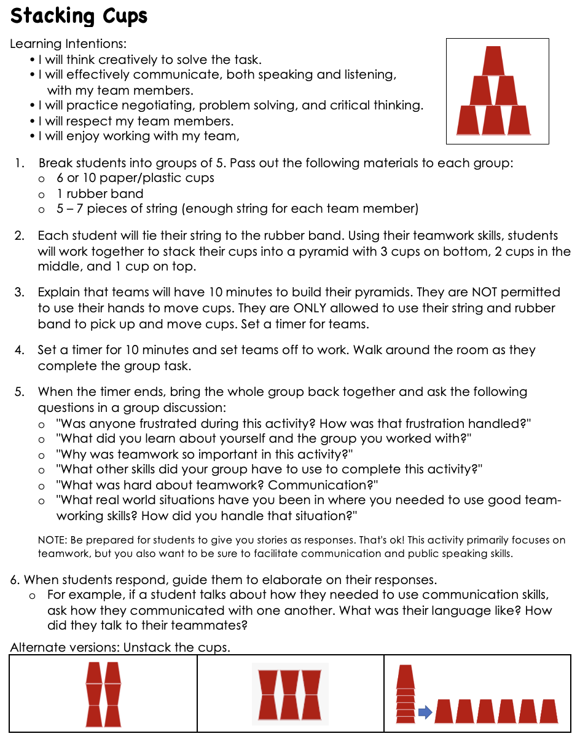

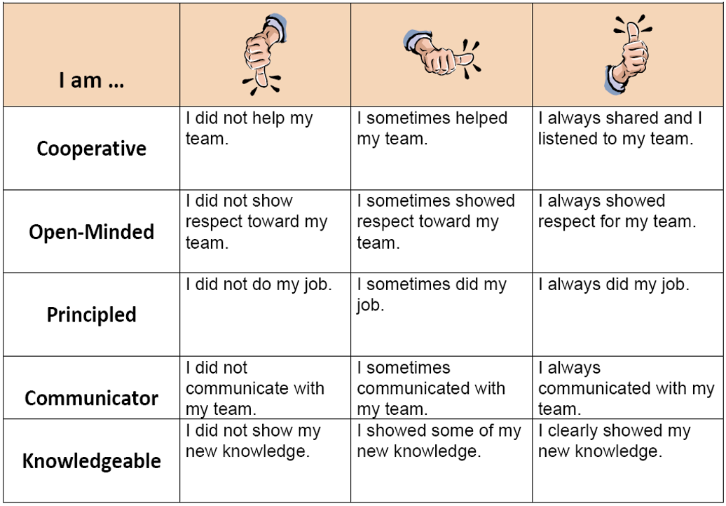



Select a question to discuss with a partner or partners:
Was anyone frustrated during this activity? How was that frustration handled?
"What did you learn about yourself and the group you worked with?"
"Why was teamwork so important in this activity?"
"What other skills did your group have to use to complete this activity?"
"What was hard about teamwork? Communication?"
"What real world situations have you been in where you needed to use good team-working skills? How did you handle that situation?"
Extensions

Slide 6

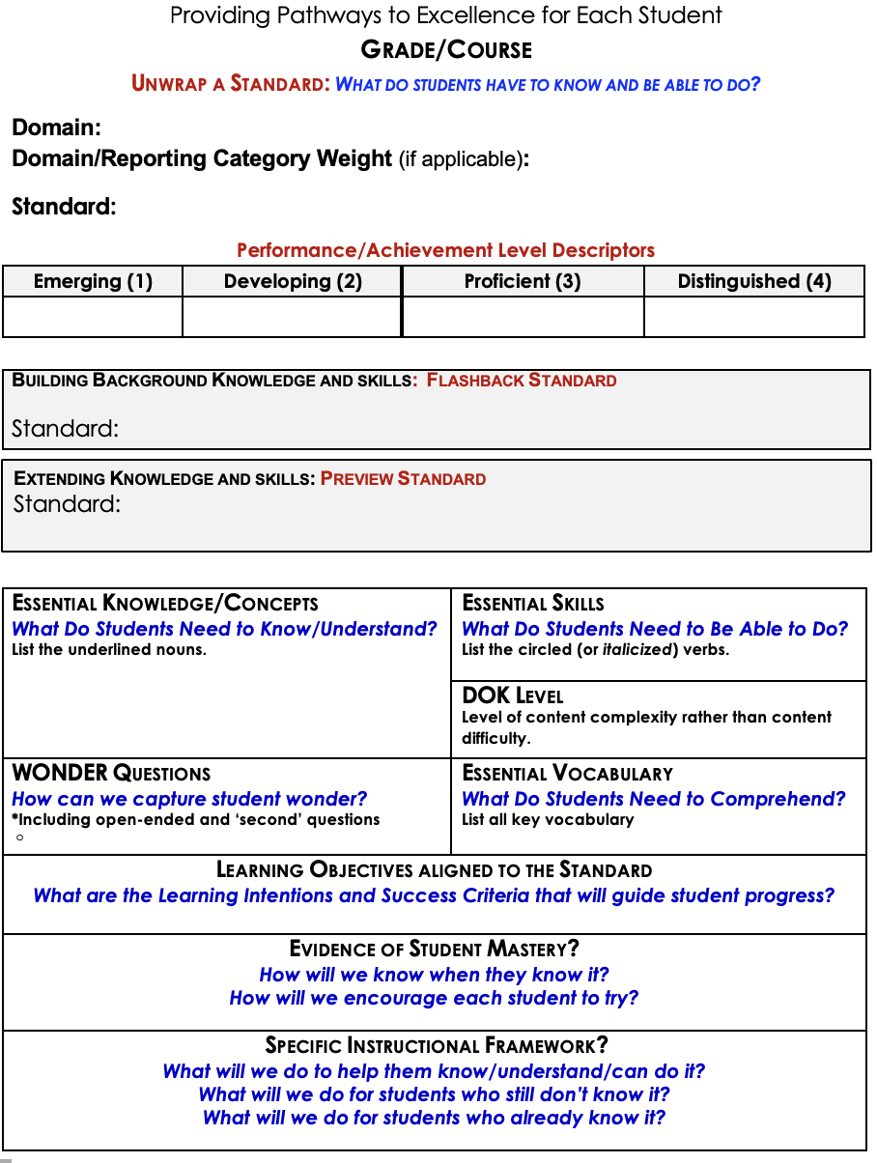


Slide 7
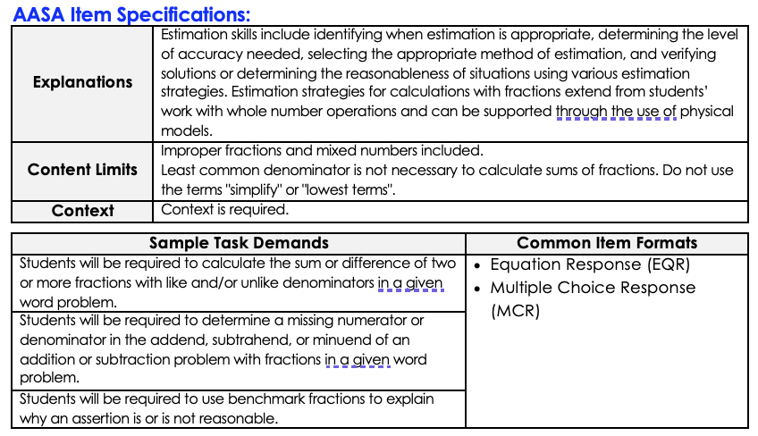
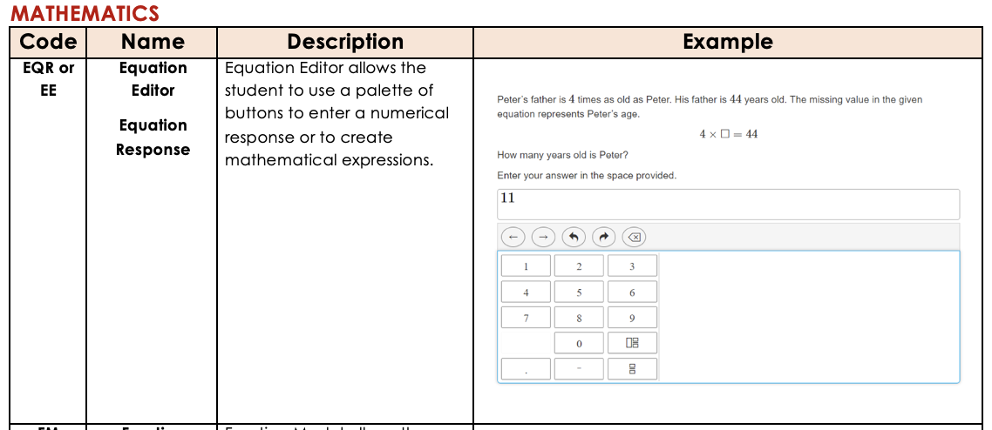
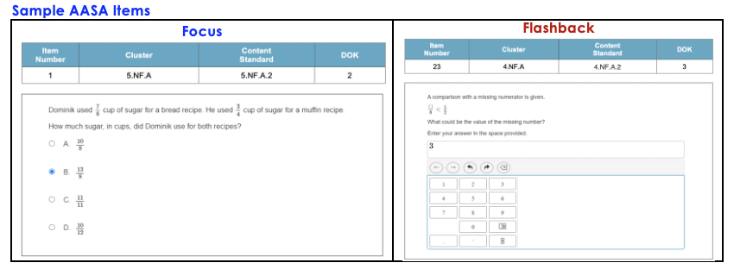
Sample Arizona resources:
Specify how each student may be required to demonstrate proficiency.

Slide 8
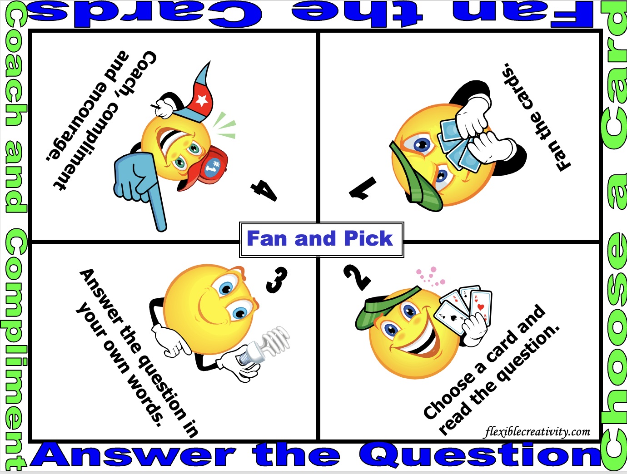

Slide 9
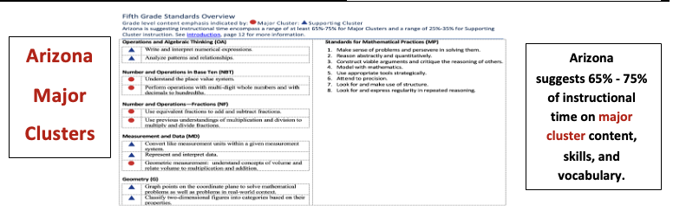
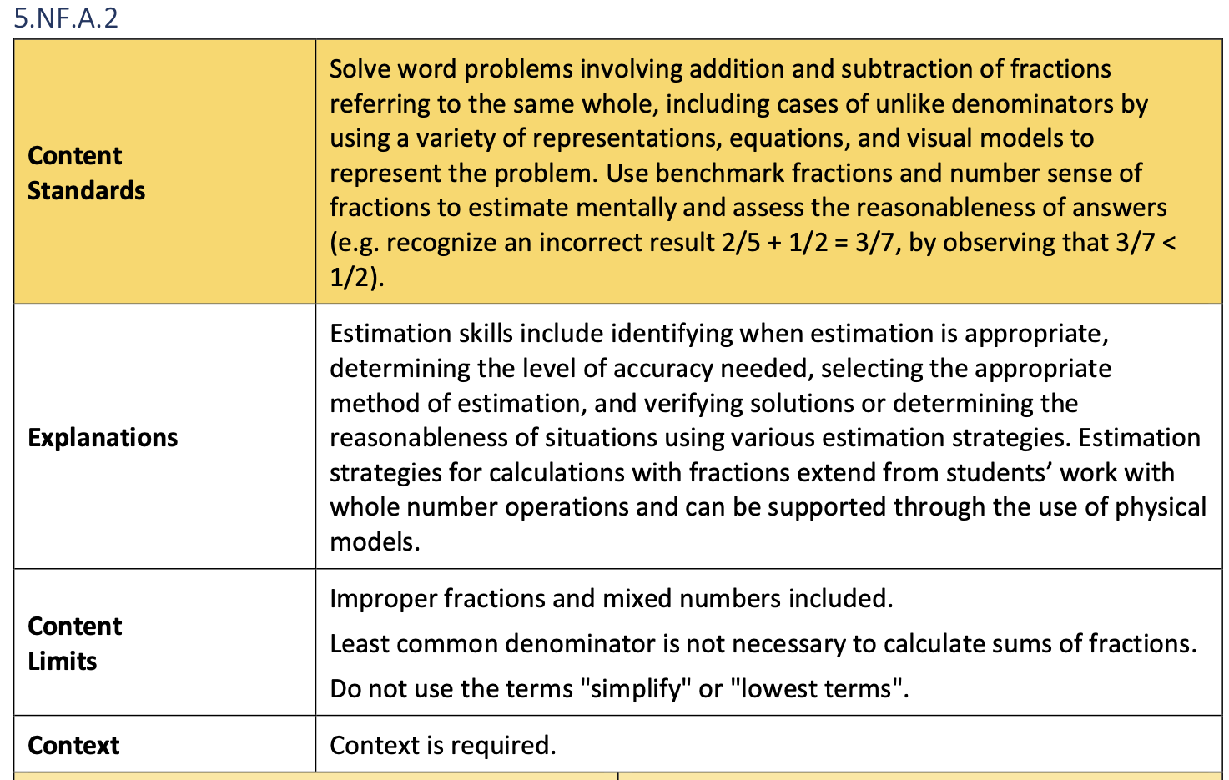
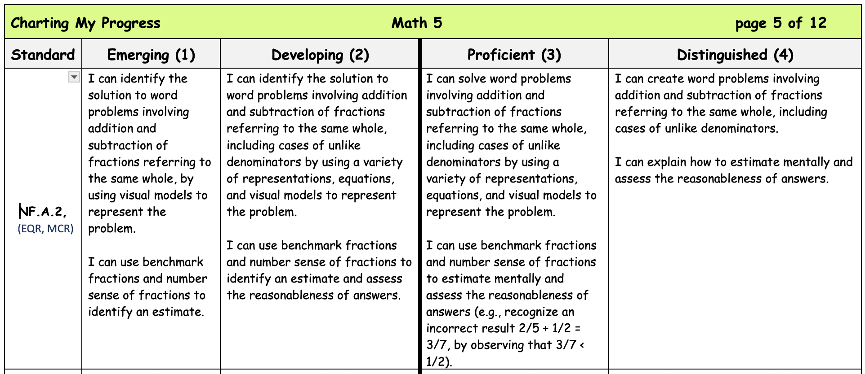
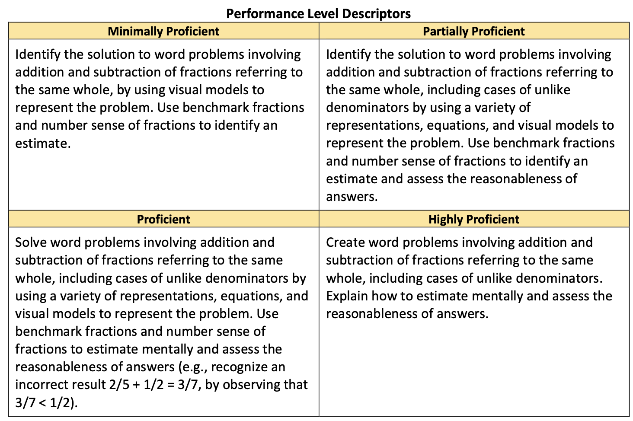
Sample Arizona AASA resources:
Specify how each student may be required to demonstrate proficiency.

Slide 10
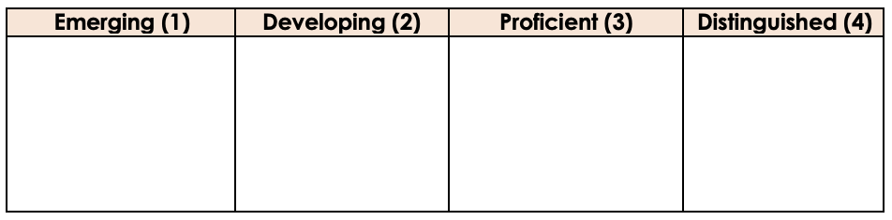
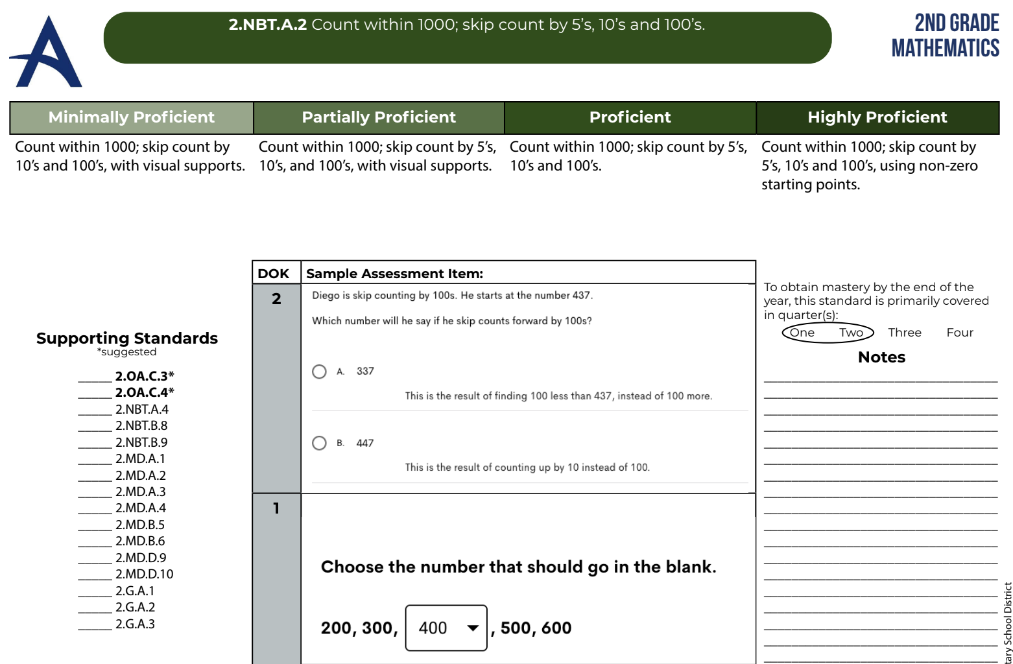
Planning to provide each student with an equal opportunity to learn…
Standard: 2.NBT.A.2 I will count within 1000; skip count by 5s, 10s and 100s.
I can count within 1000.
I can skip count by 10s, and 100s, with visual support (e.g., number line, hundreds boards, manipulatives).
I can count within 1000.
I can skip count by 5s, 10s, and 100s, with visual support (e.g., number line, hundreds boards, manipulatives).
I can count by 5s, 10s, and 100s, using non-zero starting points.
I can skip count by 5s, 10s, and 100s, using non-zero starting points.
I can explain my reasoning.
I can apply counting by 5s, 10s, and 100s, using any starting point.
I can explain my reasoning.
Beginning
Skill
(3rd Step)
Prior
Skill
(2nd Step)
Start
Here
(standard)
Extended
Skill
(Last Step)
https://www.alhambraesd.org/standards

Slide 11
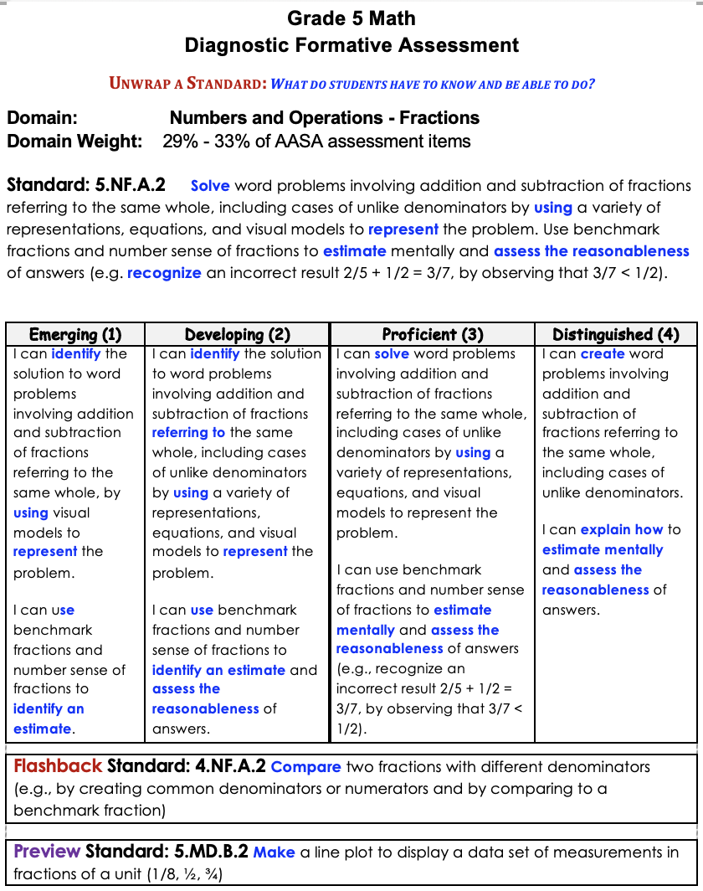
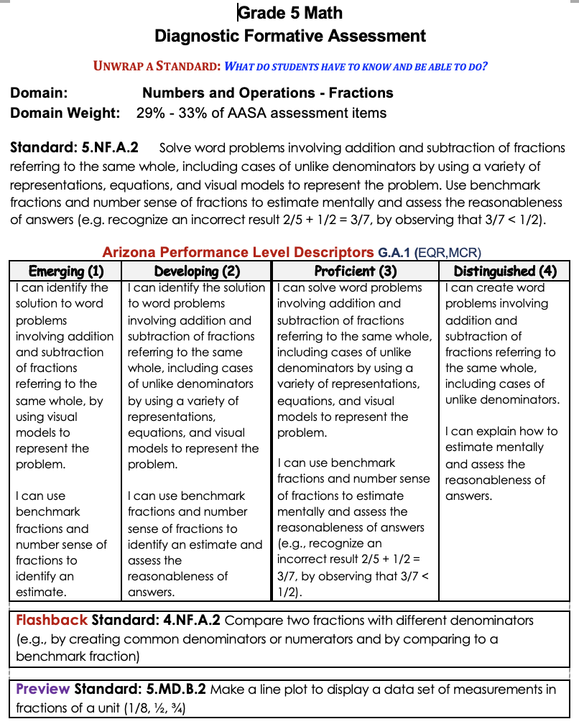
Unpacked standards clarify:
Gear 1:
What do students
have to know and
be able to do?
what each student needs to know and be able to do
degrees of essential knowledge, skills, and vocabulary to move each student from where they are to proficiency and beyond.

Slide 12
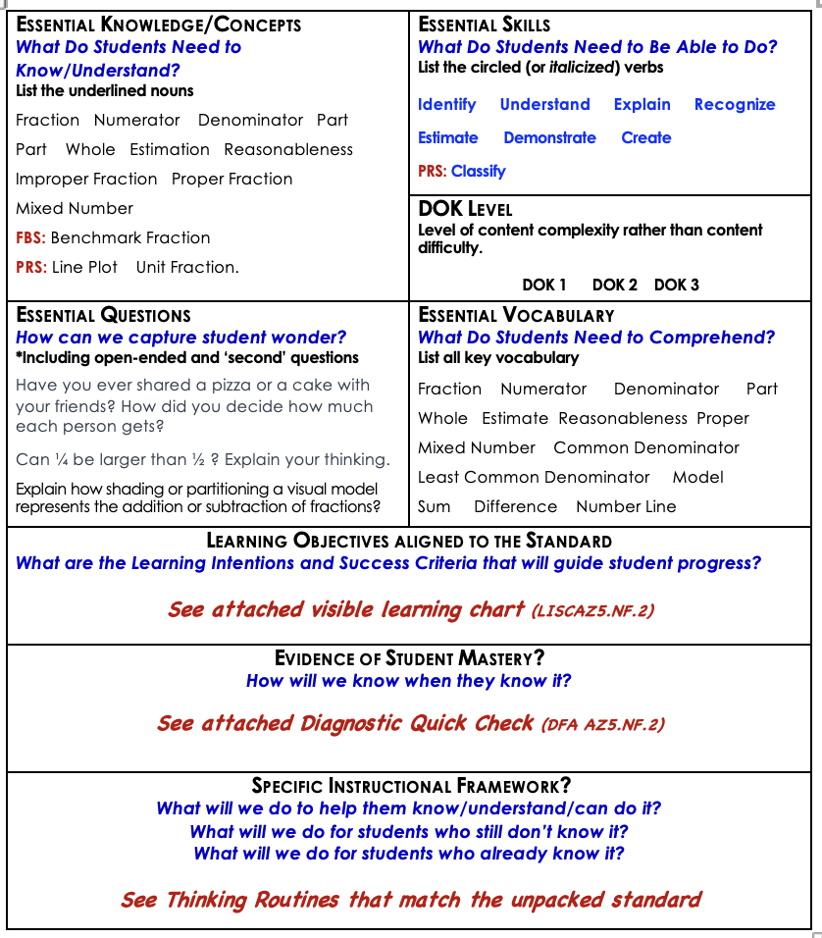
The Project Momentum Gears Driving Questions
to guide discussion, planning, and collaboration.

Slide 13

Motor Mouth
Things associated with
SCHOOL
Books
Report Cards
Teachers
School Bus
Cafeteria
Pencils
Erasers
Things associated with
PLANTS
Roots
Stems
Photosynthesis
Flowers
Leaves
Water
Seeds
Things associated with
MATTER
Solid
Liquid
Gas
Mixtures
Solutions
Atoms
Molecules

Slide 14
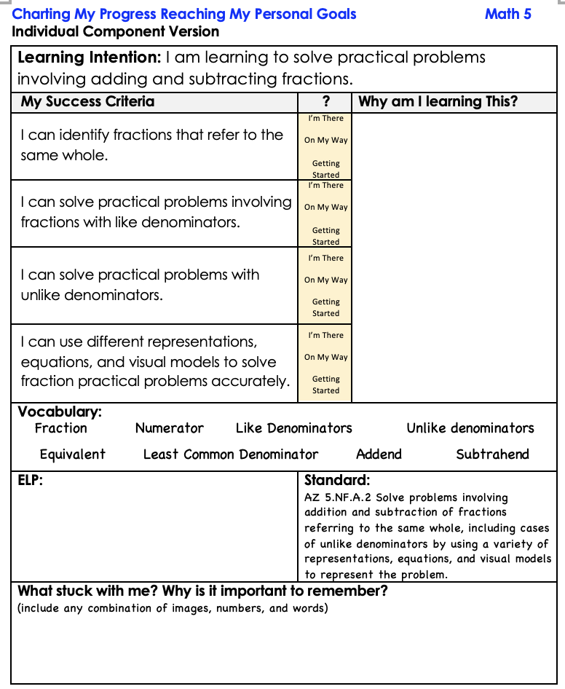
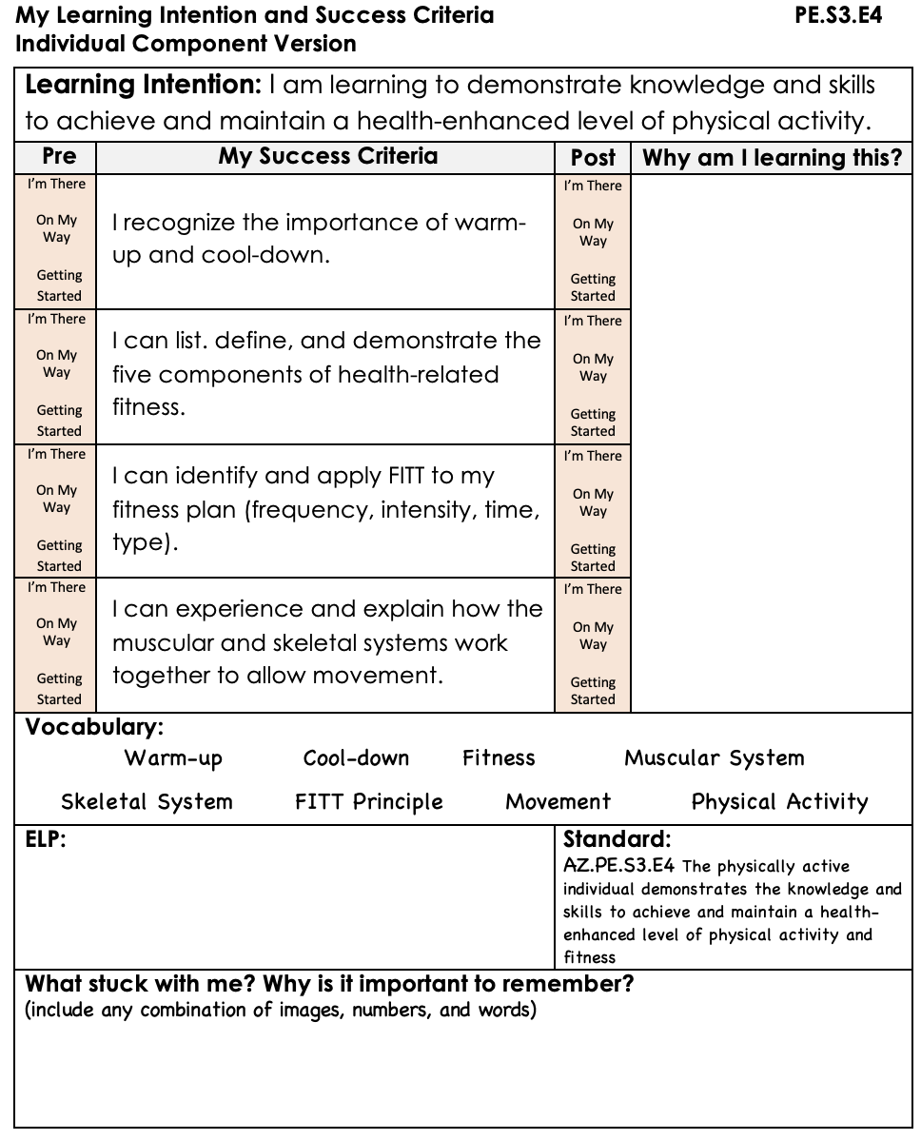
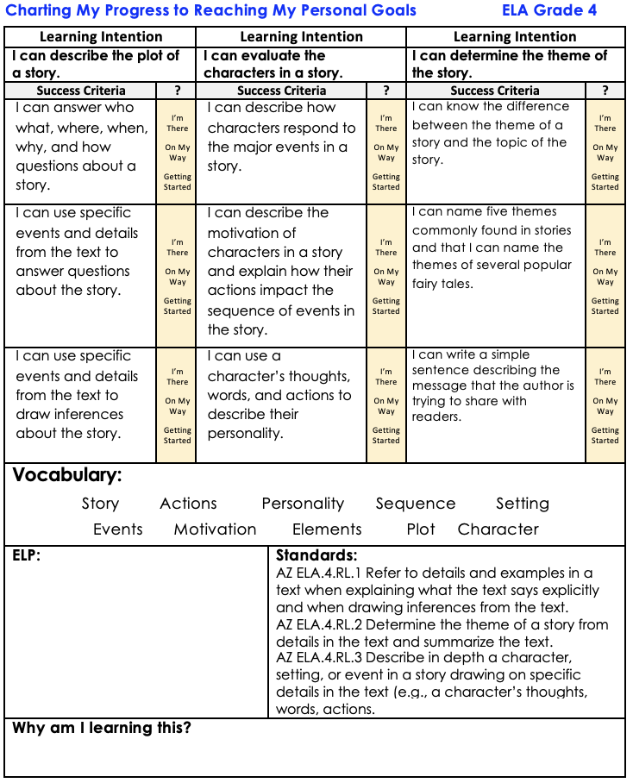

What are
learning intentions
and success criteria
To guide each
student’s progress?

Slide 15

Big Picture:
Clarifies what each student must know and be able to do to be successful.
Unwrapping
a
Standard
Standard
Describes how skills might be demonstrated both in early forms and in increasingly advanced forms.
Learning
Progression
Learning
Progression
Learning
Progression
Learning
Intentions
Learning
Intentions
Learning
Intentions
Expands each of the learning progressions into daily (smaller) statements of expectations for each student.
Describes what success looks like in meeting each learning intention.
Success
Criteria
Success
Criteria

Slide 16
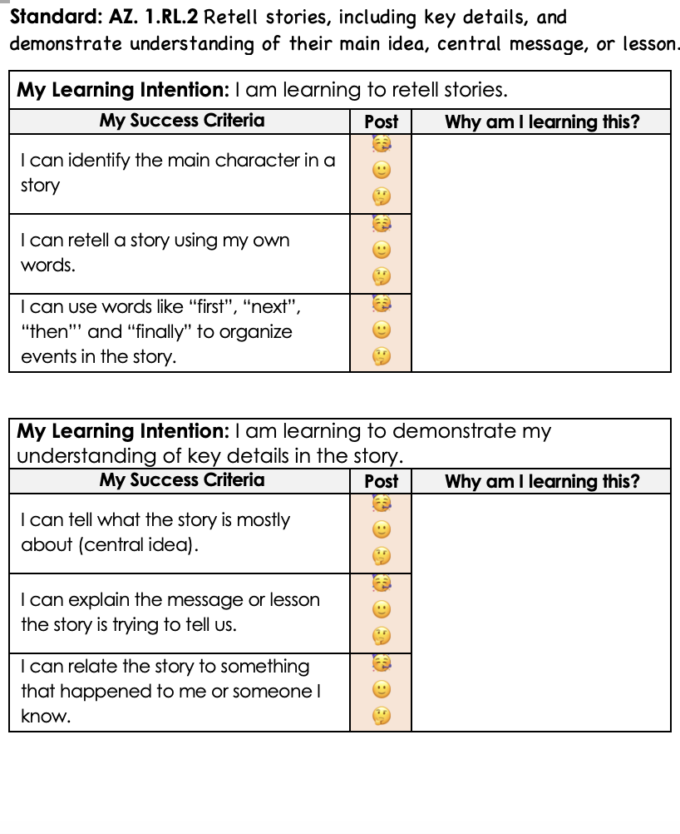
Learning intentions
and success criteria
clarify the purpose of our work, guide each
student’s progress, and facilitate celebrating with each student?
Standard: AZ. 1.RL.2 Retell stories, including key details, and demonstrate understanding of their main idea, central message, or lesson.

Slide 17
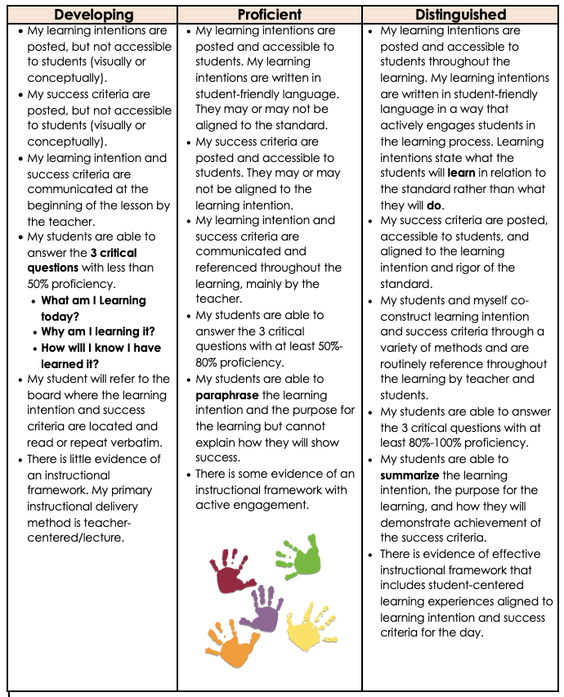
Searching for
Opportunities with
Learning
Intentions and
Success
Criteria

Slide 18
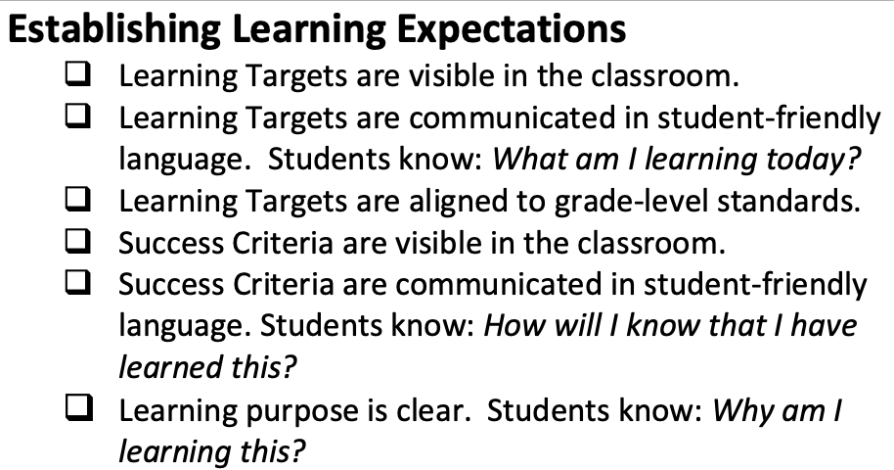
Visible Learning

Slide 19
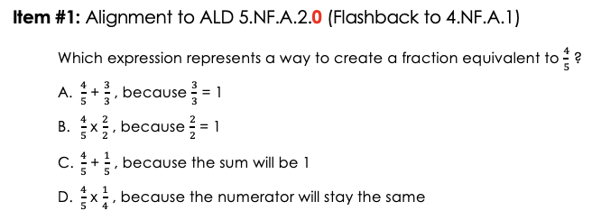
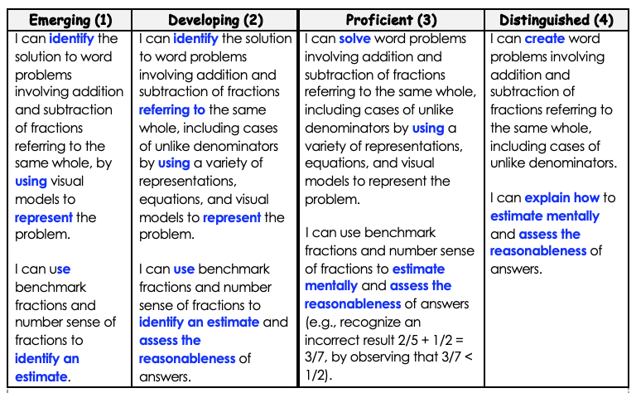
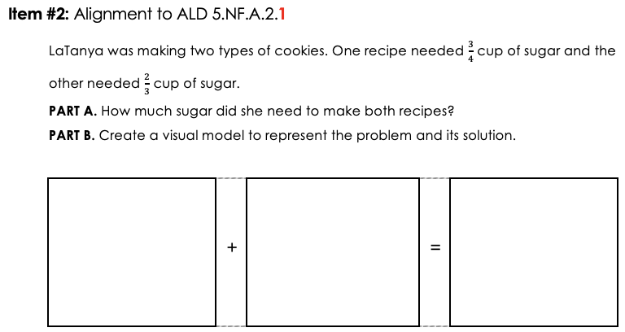
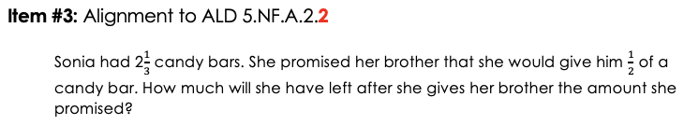
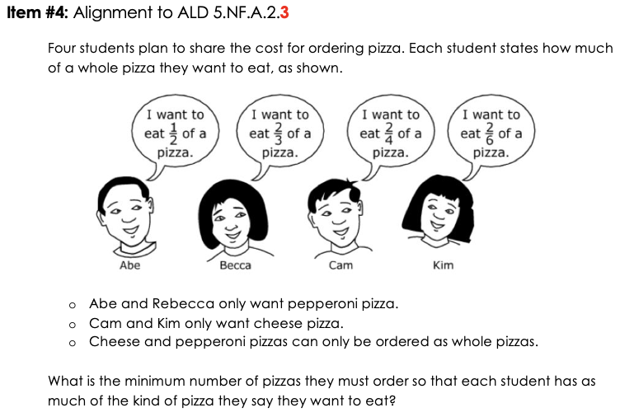
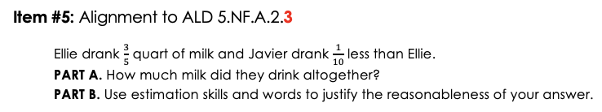
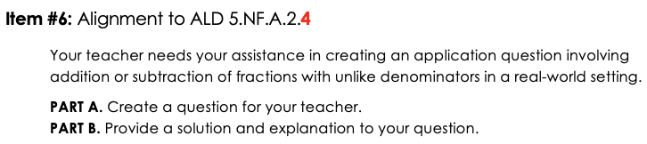

Gear 2:
How will we know
when they know
and can do it?

Slide 20
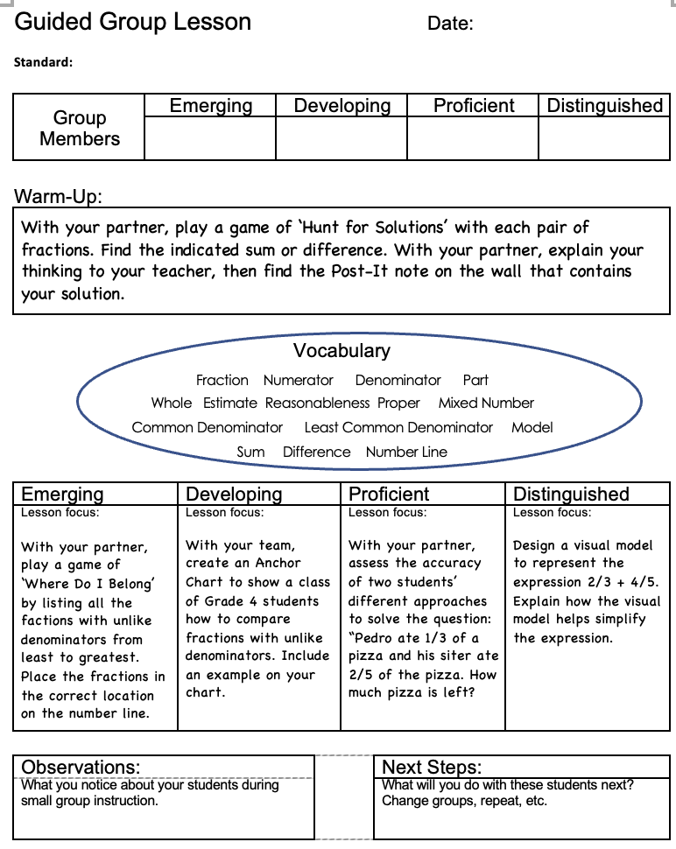
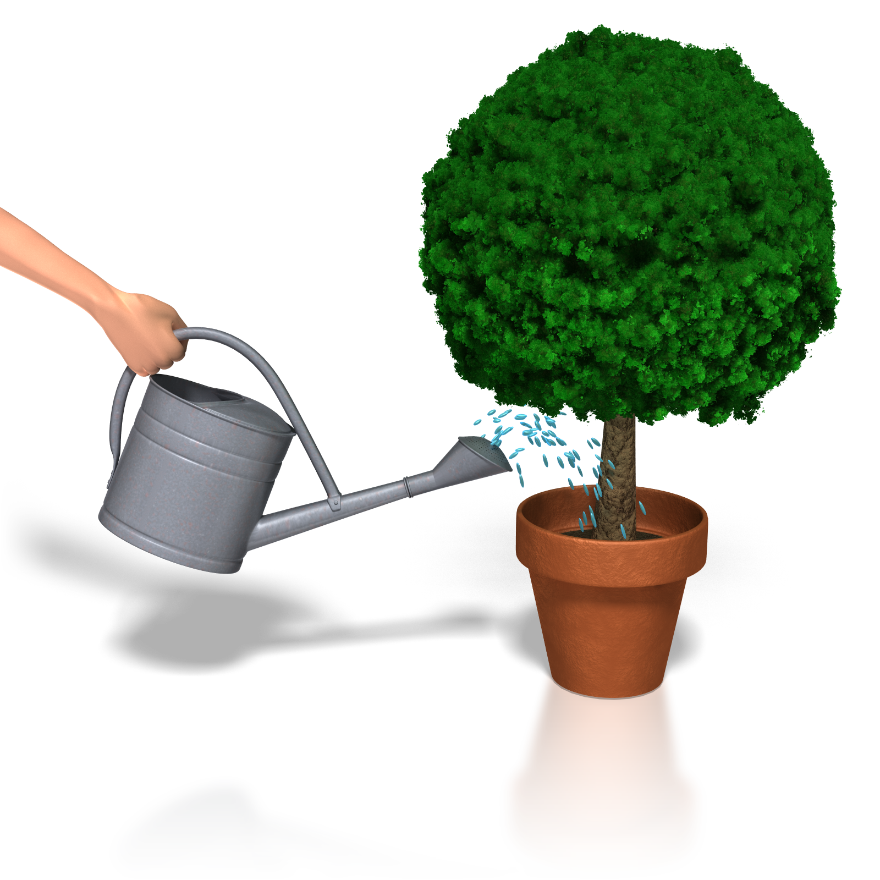
Gear 4/5:
What will we do for students who still don’t know it?
What will we do for students who already do know it?

Slide 21


Slide 22


Gear 3:
What instructional practices will produce our best results?
GOAL: Increase effectiveness and decrease workload

Slide 23



Click on the arrow to start and stop spinner.

Slide 24


This side of card face up
Directions:
Take cards out of Ziplock (please so NOT turn cards over).
Shuffle cards.
Place cards as a deck in the center of your team.
Please wait for directions.
Have fun.

Slide 25




Gear 3:
What instructional practices will produce our best results?

Slide 26
SPREAD the LOVE
Introduce your partner to the other people at your table. Form groups of four (4) or six (6).
Note: This may require recruitment from a neighboring table.

Slide 28

Give one…
Get one
Refining each of our skills by sharing our expertise

Slide 29


Sample
Arizona resources:
Specify how each student may be required to demonstrate proficiency.

Slide 30
Planning to provide each student with an equal opportunity to learn…
Standard: 2.NBT.A.2 I will count within 1000; skip count by 5s, 10s and 100s.
I can count within 1000.
I can skip count by 10s, and 100s, with visual support (e.g., number line, hundreds boards, manipulatives).
I can count within 1000.
I can skip count by 5s, 10s, and 100s, with visual support (e.g., number line, hundreds boards, manipulatives).
I can count by 5s, 10s, and 100s, using non-zero starting points.
I can skip count by 5s, 10s, and 100s, using non-zero starting points.
I can explain my reasoning.
I can apply counting by 5s, 10s, and 100s, using any starting point.
I can explain my reasoning.
Beginning
Skill
(3rd Step)
Prior
Skill
(2nd Step)
Start
Here
(standard)
Extended
Skill
(Last Step)
https://www.alhambraesd.org/standards

Slide 31

The Project Momentum Gears Driving Questions
to guide discussion, planning, and collaboration.

Slide 32

Sample Arizona AASA resources:
Specify how each student may be required to demonstrate proficiency.

Slide 33

What are
learning intentions
and success criteria
To guide each
student’s progress?

Slide 34








Gear 2:
How will we know
when they know
and can do it?

Slide 35

Gear 4/5:
What will we do if they don’t know it?
What will we do of they already know it?
Students and teachers can analyze results to determine next steps for each student.

Slide 36

Gear 4/5:
What will we do for students who still don’t know it?
What will we do for students who already do know it?

Slide 37


Effective feedback

Slide 38


Data-driven
Small Group
A note on generative artificial intelligence resources.
A teacher using AI to plan a lesson is like a world-class chef using google to plan a five course meal.
Requires unpacking a standard.
Is not error free.
Often misses the nuance of teaching students.
Can save time in lesson planning and assessment development but tend to be teacher-centered.
One of the better AI resources is:
https://www.magicschool.ai

Slide 39

Learning By Doing
When you realize that people learn naturally from the life they experience every day, it won’t surprise you that the brain is set up to learn better with active, hands-on endeavors. Many students request less bookwork and more hands-on activities. Students are more willing to do bookwork if there is a project or activity as part of the lesson. Building models and displays, fieldtrips and fieldwork, hands-on experiments, and craft activities are all strategies that help students learn.

Slide 41
Walk the ‘Steps’ to Problem Solve

Slide 42



Fan the Cards
This side of card face up

