Slide 1
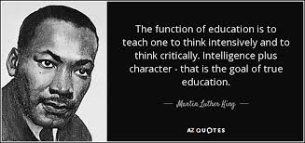
The Art and Science of Teaching
Shelf-Ready Strategies to Elevate Engagement and Deepen Understanding
CONTENT without PURPOSE is only TRIVIA.
Prepared Especially for the Collaborative Learning Team of
VETERANS MIDDLE SCHOOL
by Dan Mulligan, flexiblecreativity.com
Fall 2017

Slide 2

Good Instruction
(Keep it Simple…Keep it Real)
“We can, whenever and wherever we choose, successfully teach all children whose schooling is of interest to us. We already know more than we need to do that. Whether or not we do it must finally depend on how we feel about the fact that we haven’t so far.”
~Ron Edmonds

Slide 3
Shelf-Ready Editable Resources Available for YOUR Use
Today’s Goal:
I can apply strategies to increase student engagement and passion for Learning.
I can explain how to use each strategy effectively.
Today’s Essential Vocabulary:
Understanding Check
Environment Create
Extend Apply
Scaffold Equity
Archive Rigor

Slide 4
Assessment
There are two reasons why we assess:
~to inform instructional decisions
~to encourage students to try
In the section ‘What I think’ of your Think Pad:
Record one or your most effective strategies
Why do you think it is effective?
Enjoy thinking…

Slide 5


4 – second partner
(Networking)
Please bring a completed copy of the Think Pad and a writing tool.
Find a friend in the room.
Share strategies with your partner and record their idea on your Think Pad.
PLEASE STAY with YOUR BEST FRIEND.

Slide 6

Teaching Every Student
Five Key Elements
Learning Environment
The Curriculum
Assessments
Instruction
Classroom Management

Slide 7
Lesson
Flowchart
Clear Objective I can/ Vocabulary
referenced by teacher/students throughout learning
Integration of:
Constant checks for understanding of each student..
Seize opportunities for student collaboration on second questions!
Capitalize on student engagement and reflection
Creating an Environment for Learning
Provides students with context
Allows teacher/students to build/check for background knowledge
Helping Students Develop Understanding
This is the teaching/learning/discovering phase. Multiple checks for understanding along the way. Modeling, Guided Practice, Independent Practice…Active student engagement…
Helping Students Extend & Apply Knowledge
Student reflection & doing something with what they learned.

Slide 8
Creating an
Environment
for Learning

Slide 9
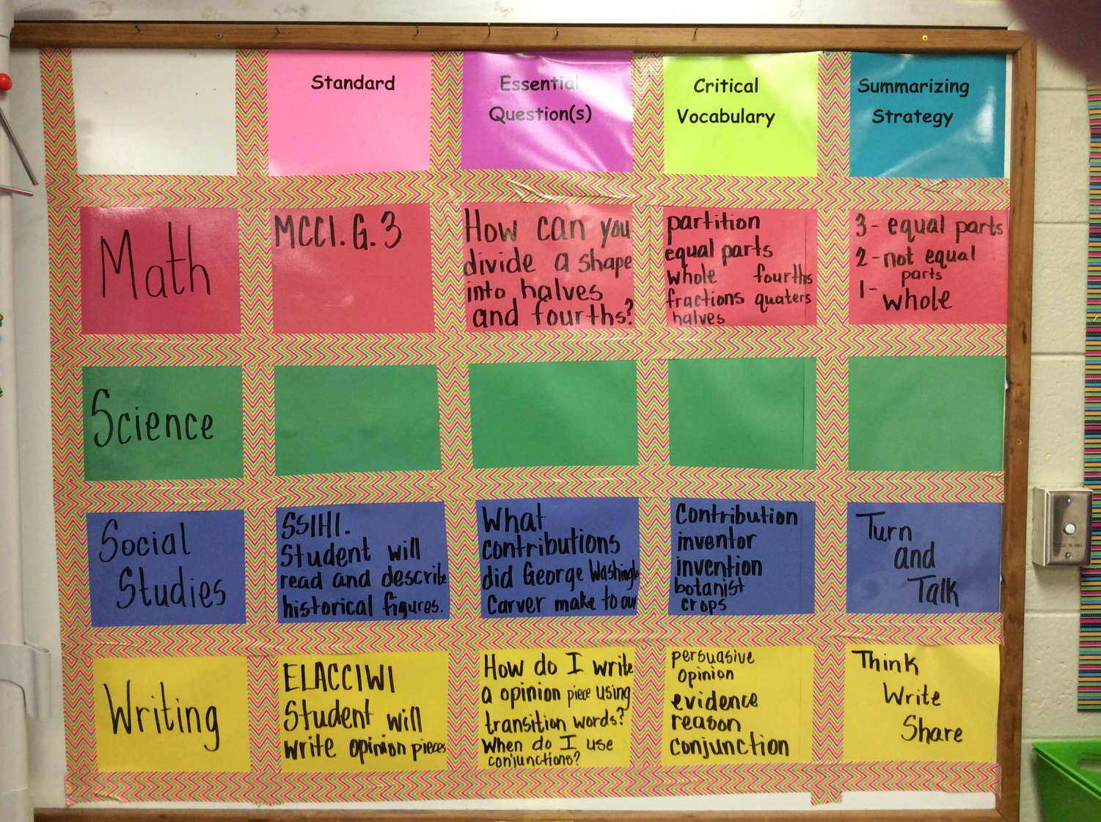
Setting the Objective

Slide 10
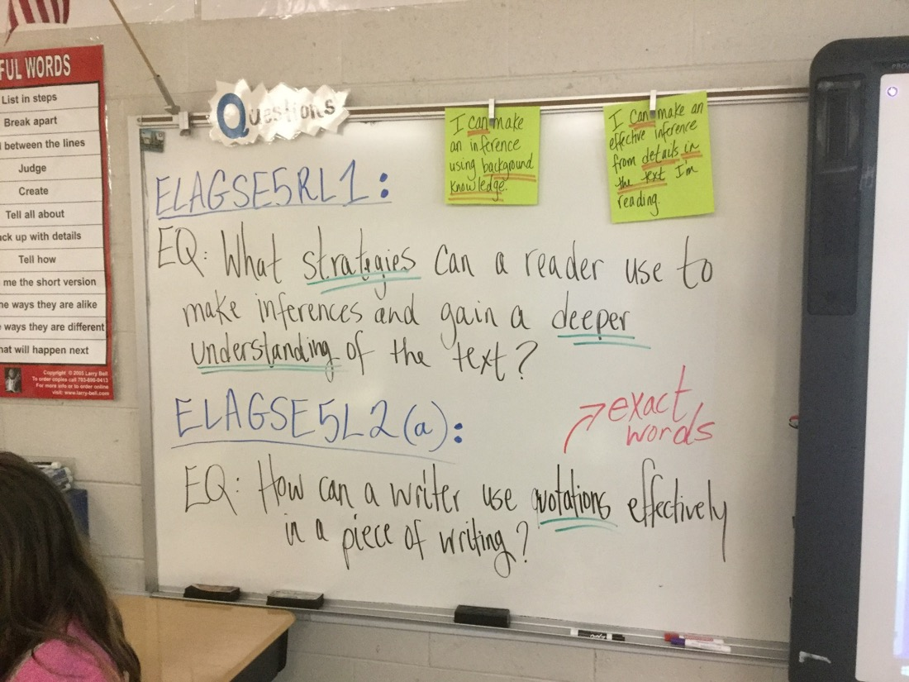
Unpack, with students, the
objective embedded in the ‘I can’

Slide 11
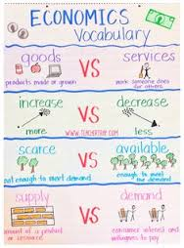
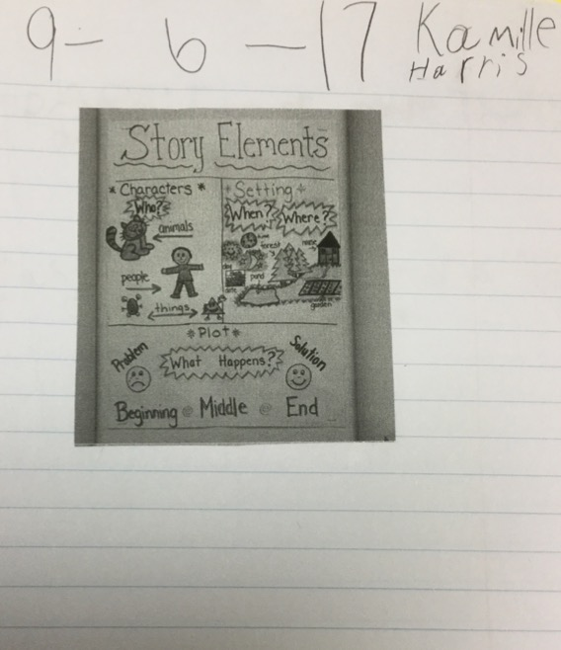
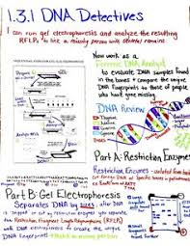
Anchor
Charts
Canva.com
canva.com
Setting the Objective
(and checking along the way)

Slide 12






What do I want
my students
to do?
(student actions)
Cite Evidence
200 POINTS
Collaborate
Think Critically
100 POINTS 100 POINTS
Understand Objective
Summarize
Participate
50 POINTS 50 POINTS 50 POINTS

Slide 13
Helping Students Develop Understanding
(aka…STOP TELLING THEM!!!)
(Let THEM figure it out…with scaffolding)

Slide 14
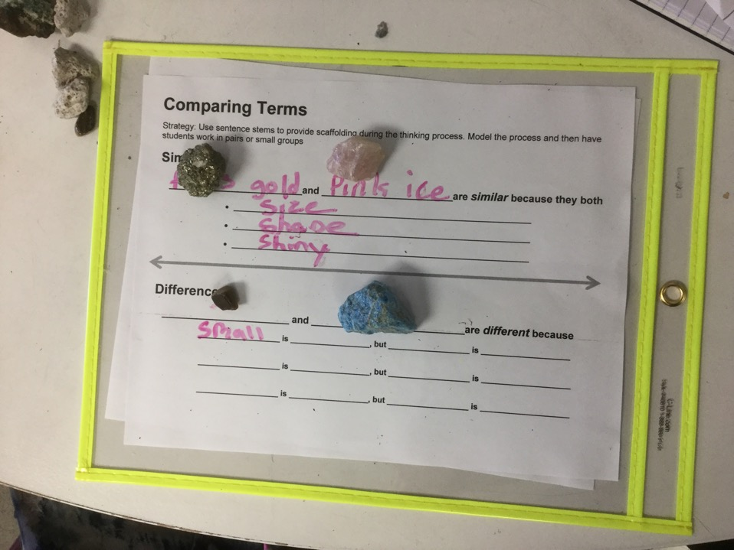

Slide 15
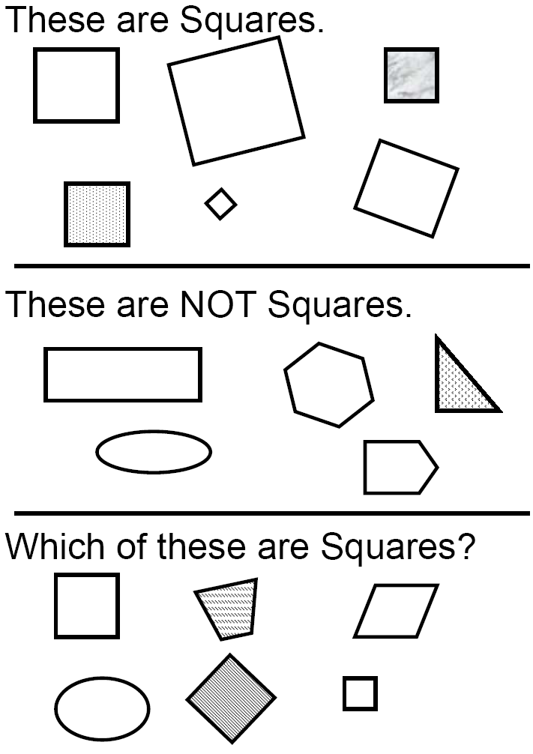

Slide 16
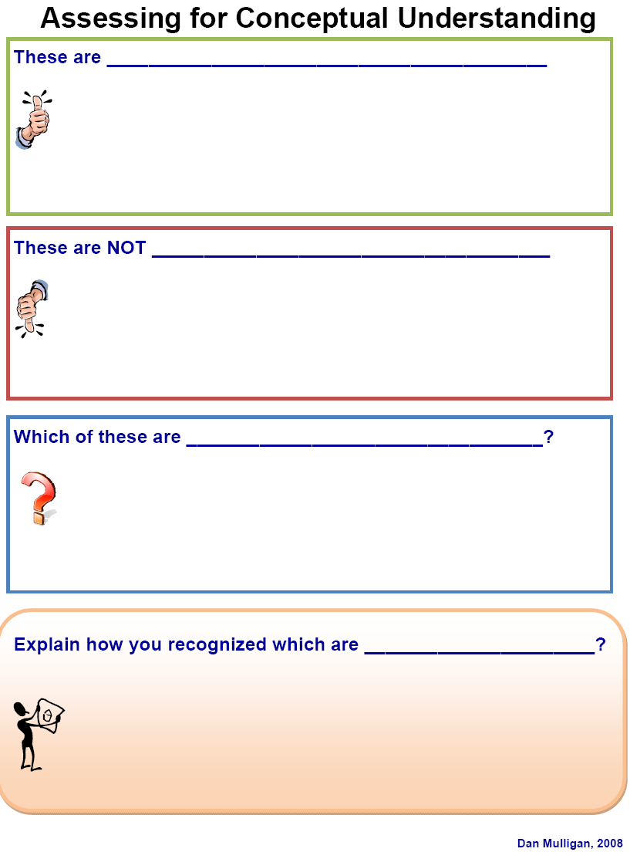

Slide 17
Vocabulary

Slide 18
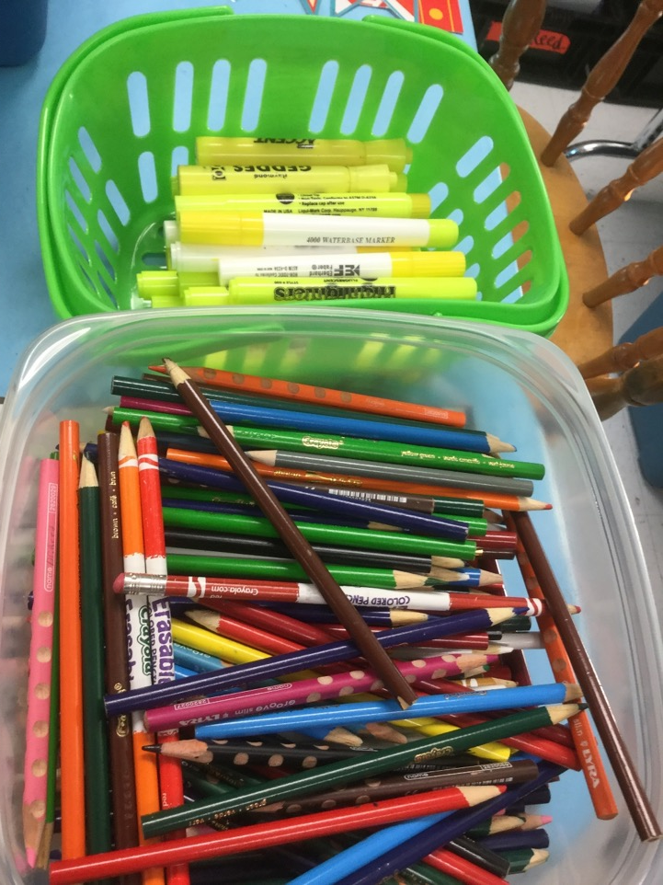
What is the message in this image?

Slide 19
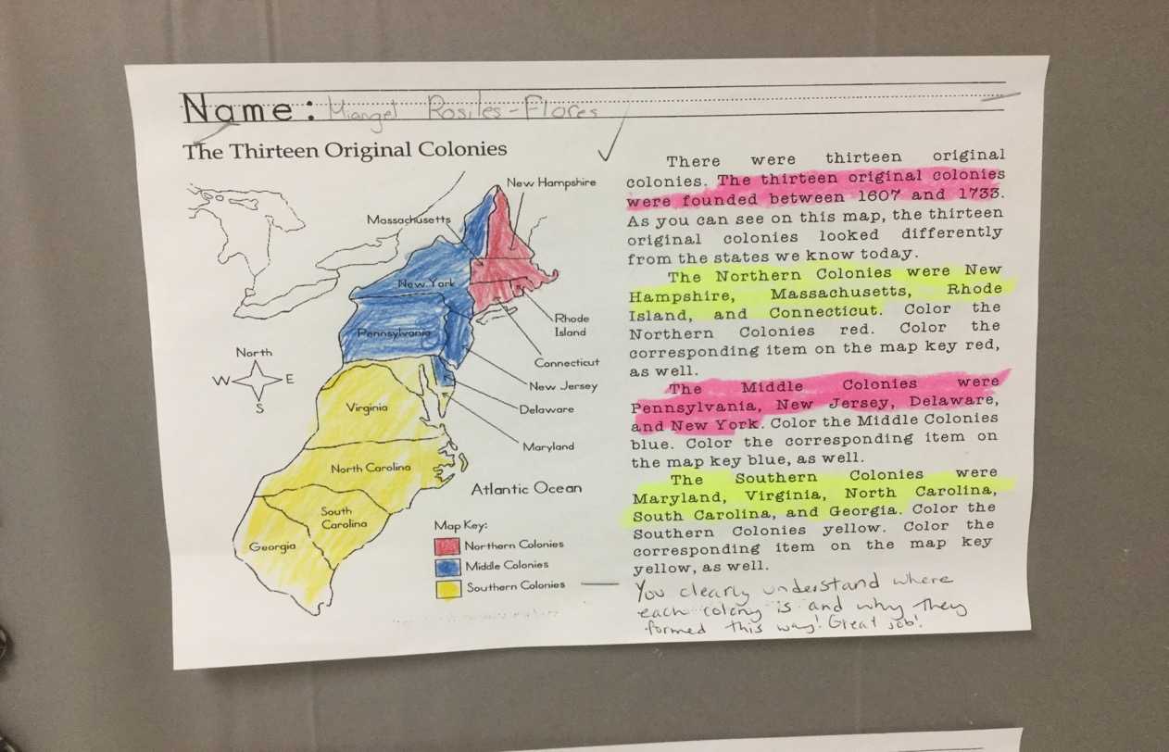
Highlight the Main Idea

Slide 20
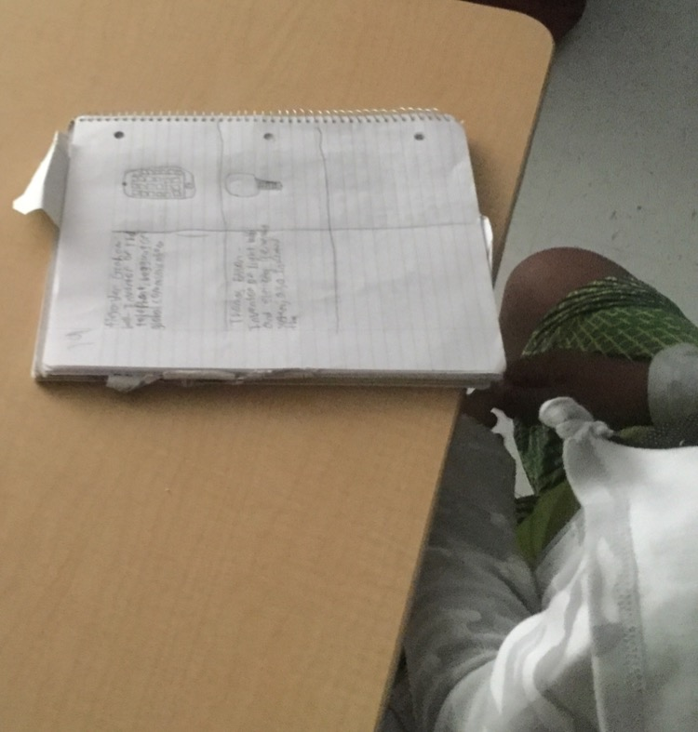
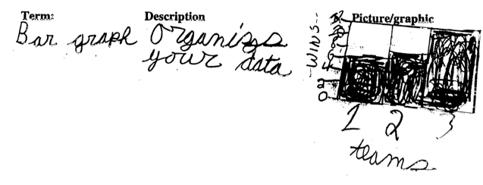
Table of Contents and a
Glossary at the end of each Unit

Slide 21
Opportunity to learn (OTL) has the strongest relationship with student achievement of all school-level factors. It may seem like common sense, but data shows that success in mastery learning is directly related to “whether or not students have had an opportunity to study a particular topic or learn how to solve a particular type of problem presented by the test.” (Husen)

Slide 22
Essential Skills – What do Students need to be able ‘to do’?

Slide 24
Essential Skills – What do Students need to be able ‘to do’?
Directions:
When you give a clue, begin with “This is when you guide your students to …”

Slide 25
Unpacking the 2016 Math SOL
page 17 - 18

Slide 27
DOK
Question Stems

Slide 28

Thank you for all you do,
for all the children!
~Dan

